Slide 1
REST API – Definition and Key Principles
REST (Representational State Transfer) is an architectural style for designing networked applications, emphasizing a stateless client-server communication model, uniform interface, and scalability.
A REST API, or Representational State Transfer Application Programming Interface, is a type of web service that follows the principles of REST architecture.
Key Characteristics
Statelessness: Each request from a client to the server must contain all the information necessary to understand and process the request. The server does not store any client state between requests, which improves scalability and reliability.
Client-Server Architecture: The client and server are independent components that can evolve separately.
Uniform Interface: REST APIs use a uniform interface for communication, typically based on standard HTTP methods such as GET, POST, PUT, DELETE, and PATCH. Resources are identified by URIs (Uniform Resource Identifiers), and representations of resources (e.g., JSON or XML) are exchanged between the client and server.
Cacheability: Responses from the server can be cached to improve performance and reduce the need for redundant requests. Cache control directives can be used to specify caching behavior.
Layered System: REST APIs are often designed as layered systems, where different components (e.g., proxies, gateways) can be added between the client and server to improve scalability, security, or performance.

Slide 2
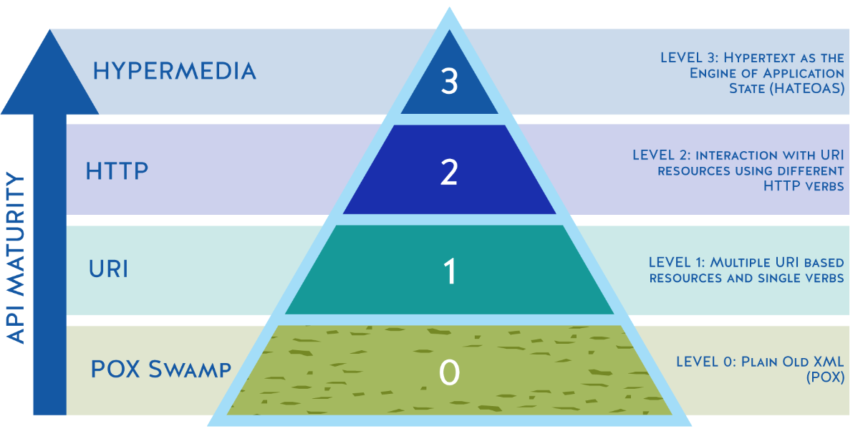
Richardson Maturity Model – Web APIs
The Richardson Maturity Model is a framework for assessing the maturity of a web API based on its design and architecture. It consists of four levels, each representing a progressively more sophisticated and RESTful approach to API design.
Responses from the server contain hypermedia links (e.g., URLs) that allow clients to navigate the API dynamically. Clients can discover and interact with resources dynamically by following links provided in the responses.
HTTP methods or verbs (GET, POST, PUT, DELETE, etc.) are used to indicate the desired action on a resource. Resources are represented in a stateless manner, and the API starts to exhibit more RESTful characteristics.
VERBS
Each resource is identified by a URI, and different URIs represent different resources. Relies primarily on HTTP POST
API relies on HTTP POST requests to perform operations, usually with XML payloads. Zero adherence to REST.
While reaching Level 3 (HATEOAS) is the ultimate goal for many RESTful APIs, it can be challenging to implement and may not be necessary for all use cases.

Slide 3
REST API – Resource URI Design
In RESTful APIs, resource URLs are used to uniquely identify and access resources (e.g., data entities such as users, products, orders) exposed by the API. Designing resource URLs is a crucial aspect of API design as it directly impacts the usability, maintainability, and scalability of the API.
HTTP Method | Resource URI | Description
GET | /library/books | This gets list of books
GET | /library/books/12345678 | This gets a book identified by book id "12345678"
POST | /library/books | This creates a new book order
DELETE | /library/books/12345678 | This deletes a book identified by book id "12345678"
PUT | /library/books/12345678 | This updates a specific book identified by book id "12345678’”
PATCH | /library/books/12345678 | This can be used to do a partial update for a book identified by book id "12345678"
Best Practices
Use Nouns to Represent Resources
Use Plural Nouns for Collections
Use Hierarchical URLs for Nested Resources
Use HTTP Methods for Operations
Use Query Parameters for Filtering, Sorting, and Pagination
Keep URLs Descriptive and Predictable

Slide 4
REST API – Commonly Used Status or Response Codes
HTTP Code | HTTP Short Description | Description
2XX - Successful Response Codes
200 | OK | The request was successful, and the server returns the requested data.
201 | Created | The request has been fulfilled, and a new resource has been created as a result.
202 | Accepted | The request has been accepted for processing, but the processing has not been completed.
204 | No Content | The request was successful, but there is no content to return.
4XX- Client Error Response Codes
400 | Bad Request | The server cannot process the request due to a client error, such as invalid syntax or parameters.
401 | Unauthorized | The request requires authentication, and the client needs to provide valid credentials.
403 | Forbidden | The client does not have permission to access the requested resource.
404 | Not Found | Requested resource cannot be found
5XX – Server Error Response Codes
500 | Internal Server Error | The server encountered an unexpected condition that prevented it from fulfilling the request.
503 | Service Unavailable | The server is currently unable to handle the request due to temporary overloading or maintenance.

Slide 5
REST API – Authentication and Authorization
Authentication and authorization are essential aspects of securing RESTful APIs, ensuring that only authorized users or clients can access protected resources.
Authentication
Authentication is the process of verifying the identity of a client or user attempting to access an API. It involves presenting credentials (e.g., username/password, API key, token) to the server to prove identity.
Common authentication mechanisms in RESTful APIs include:
Basic Authentication: Clients include a username and password in the HTTP request headers. While simple, it's less secure as credentials are transmitted in plaintext.
API Keys: Clients include an API key (a unique identifier) in the request headers for authentication. API keys are typically used for identifying applications rather than users.
Token-Based Authentication: Clients exchange credentials for a token (e.g., JWT - JSON Web Token) upon successful login. Subsequent requests include this token in the Authorization header for authentication.
OAuth 2.0: An authorization framework that delegates authentication to third-party identity providers. Clients obtain access tokens that grant access to protected resources on behalf of the user.

Slide 6
REST API – Authentication and Authorization
Authorization
Authorization determines what actions a user or client can perform on a resource after authentication. It involves evaluating permissions and privileges associated with the authenticated identity.
Common authorization mechanisms in RESTful APIs include:
Role-Based Access Control (RBAC): Users are assigned roles (e.g., admin, user) with specific permissions. Access to resources is granted based on roles.
Attribute-Based Access Control (ABAC): Access decisions are based on attributes of the user, resource, and environment. Policies are defined using attributes and rules.
OAuth 2.0 Scopes: OAuth 2.0 scopes limit the permissions granted to access tokens. Clients request specific scopes when obtaining access tokens.
Fine-Grained Access Control Lists (ACLs): Access to individual resources is controlled based on explicit permissions assigned to users or groups.
Best Practices for Authentication and Authorization
Always use HTTPS
Implement token expiration
Protect or store tokens securely
Follow least privilege principle
Centralized Authentication and Authorization
Monitor and log authentication and authorization events for auditing and security purposes.
Conduct regular security audits and assessments to identify vulnerabilities and address them promptly.
By implementing robust authentication and authorization mechanisms and following best practices, you can ensure that your RESTful APIs remain secure and protected against unauthorized access and misuse.

Slide 7
REST API – Versioning
Implementing versioning in REST APIs involves providing a strategy for managing changes to the API over time while maintaining backward compatibility with existing clients.
Versioning Strategy | Description | Example
URI Versioning | Includes version number in the URI path | /api/v1/books, /api/v2/books
Query Parameter Versioning | Specifies the version number as a query parameter | /api/books?version=1, /api/books?version=2
Header Versioning | Specifies the version number in a custom header | ‘X-API-Version:v1’, ‘X-API-Version:v2’
Content Negotiation | Use content negotiation to determine the API version based on the requested media type. | Accept: application/vnd.company.resource.v1+json
Best Practices for Versioning
Choose a consistent approach
Version major releases that introduce breaking changes
Document versions
Support deprecated versions
By providing versioning options, you can ensure that clients have control over when and how they transition to newer versions of the API, while still supporting existing clients with backward compatibility.

Slide 8
REST API – Exception Handling
Exception handling in REST APIs is crucial for providing informative and meaningful responses to clients when errors occur. Based on response, client should be able to understand what exactly went wrong and fix issues quickly with the information provided
Best Practices for Exception Handling
Define Standard Error Responses or Status Codes: Establish a set of standard error responses with corresponding HTTP status codes. For example:
400 – Bad Request – Invalid or malformed input
401 – Unauthorized – Authentication is required or invalid credentials
404 – Not Found – Requested Resource not found
500 – Internal Server Error – Unexpected server error while processing the request
Provide Detail Error Messages: Include descriptive error messages in the response body to help clients understand the cause of the error. Ensure error messages are consistent and follow a standardized format.
Handle Exceptions gracefully: Catch exceptions and errors within the API codebase. Convert exceptions into appropriate HTTP responses with the corresponding status codes and log detailed error information for troubleshooting and debugging purposes.
Handle Unexpected Errors: Implement a global exception handler to catch unexpected errors and provide a generic error response. Ensure that sensitive information is not exposed in error responses to prevent security vulnerabilities.
By implementing robust exception handling mechanisms, you can improve the reliability, usability, and security of your REST APIs, leading to a better developer and user experience.

