Slide 1
GitHub Copilot – Your AI Pair Programmer
GitHub Copilot helps you to generate code snippets, boilerplate and repetitive code patterns based on the provided the natural language comments. It helps you to write code faster and smarter. GitHub Copilot accelerates the coding process, offering solutions and insights to optimize your development workflow.
Why GitHub Copilot?
Supported IDEs
Trained billions lines of code.
Turns natural language comments into coding suggestions.
Works on multiple IDEs.
Jet Brains – IntelliJ IDEA, PyCharm
Visual Studio Code
Visual Studio
Neovim/Vim
Azure Data Studio
How to work with Copilot?
Autocomplete suggestions: As you type code, Copilot analyzes your file and related files and offers context-aware suggestions directly within your text editor.
Generate code based on the natural language comments: When you describe your requirement as a comment, it generates the code automatically as a suggestion.
How to interact with your class?
You can converse with your class with Q&A approach
Benefits
Less time writing boilerplate, repetitive code
Less time recalling the syntax
Autogenerate the streamlined testcases
Focus on the logic rather than syntax

Slide 2
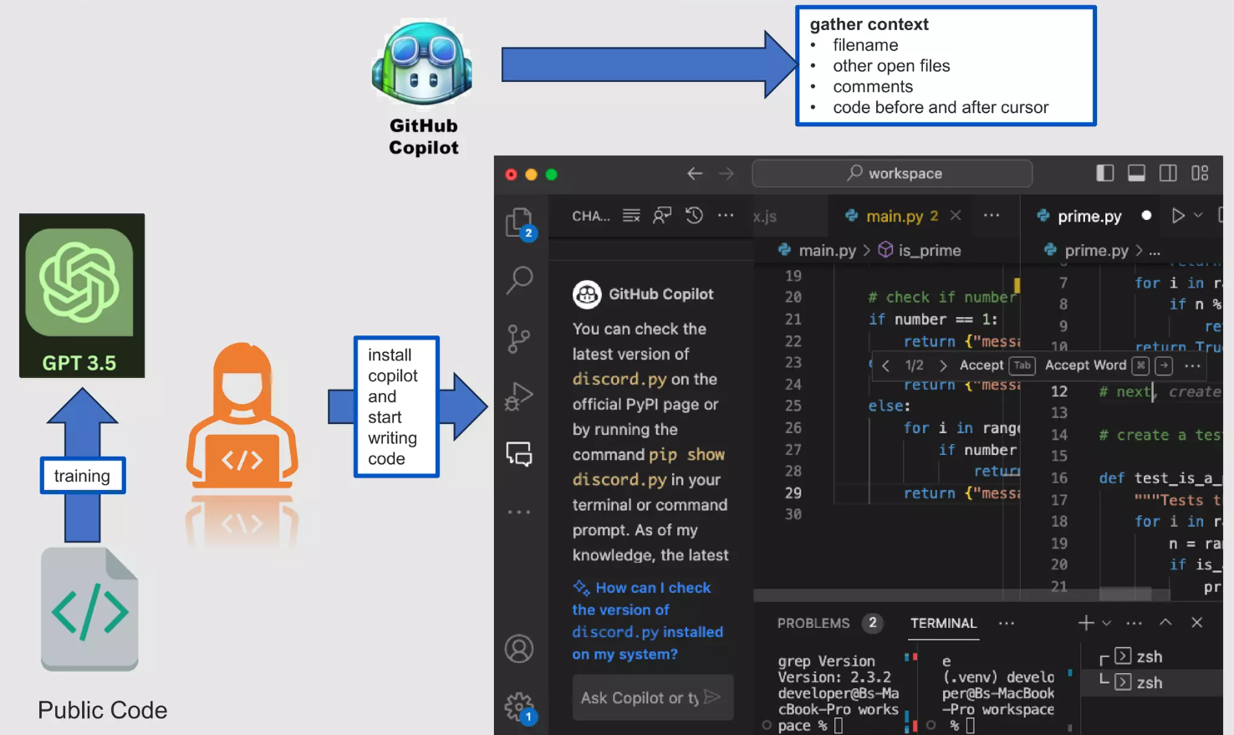
GitHub Copilot – How it Works?

Slide 3
GitHub Copilot Shortcuts
Keyboard Shortcuts for Windows
Keyboard Shortcuts for MAC
Action | Shortcut key
Accept an inline suggestion | Tab
Reject an inline suggestion | Esc
Show next inline suggestion | Alt + ]
Show previous inline suggestion | Alt + [
Trigger inline suggestion | Alt + \
Open Copilot | Alt + Enter
Action | Shortcut key
Accept an inline suggestion | Tab
Reject an inline suggestion | Esc
Show next inline suggestion | Alt + ]
Show previous inline suggestion | Alt + [
Trigger inline suggestion | Alt + \
Open Copilot | Alt + Return

Slide 4
GitHub Copilot vs Chat GPT
Feature | GitHub Copilot | Chat GPT
Primary purpose | Code generation and assistance | Natural language understanding and text generation
Use cases | Software Development, code suggestions | Natural language conversations
Integrations | Integrated into code editors | Used in Chatbots and applications
Training Data | Trained on code repositories, documentation | Trained on diversified data set. Typically text.
AI Model | GPT-4 (our plugin version is GPT-3) | GPT-4
Learning Approach | Supervised learning with code examples | Unsupervised learning from internet text.
Customization | Can be fine-tuned on your code bases | Can be fine-tuned for specific tasks.
Assistance level | Provide code suggestions and auto-completions | Conversational responses and text-generation
User Interaction | Works with code editors, responds to code | Text input and output via APIs or platform
Pricing Model | Subscription based pricing | Usage based pricing (API calls)
Developed by | GitHub collaboration with Open AI | Open AI
Community Support | GitHub community, Documentation | Open AI community, developer resources

Slide 5
GitHub Copilot Chat
Copilot Chat provides assistance to help you make informed decisions and write better code. With tight integration in IDEs, Copilot Chat understands what you're working on and can help you with development tasks like:
Code explanations: get in-depth analysis of how a code block works
Code refinement: get context-specific code suggestions and recommendations.
Unit testing: generates unit test cases.
Profiling: optimizes code performances.
Debugging: find issues and get proposed fixes to bugs and exceptions.
Code help: get answers to programming related questions in natural language.

Slide 6
GitHub Copilot Chat – Slash Commands
Command | Description and usage examples
/doc | Add comments for specified or selected code. Examples: - /doc deleteBasketAsync method in BasketService.java - select desired code and enter /doc
/explain | Get code explanations. Examples: - /explain the addItemToBasket method in BasketService.java - select desired code and enter /explain
/fix | Propose a fix for problems in the selected code. Examples: - /fix the setQuantities method in BasketService.java - select desired code and enter /fix
/generate | Generate code to answer specified question. Example: /generate code to add two numbers in Calculator.java
/help | Get help on using Copilot Chat. Example: /help
/optimize | Analyze and improve running time of the selected code. Examples: - /optimize the addItemToBasket method in BasketService.java - select desired code and enter /optimize
/tests | Create unit tests for the selected code. Example: select desired code and enter /tests

Slide 7
GitHub Copilot – Code Security, Privacy and Quality
GitHub won’t retain prompts, suggestions, code snippets, store or share your code
Filters to help detect and supress code suggestions that contain code that matches public code (150 chars excluding whitespaces) on GitHub
AI-based vulnerability prevention system can block insecure coding patterns in real-time.
Reference: https://resources.github.com/copilot-trust-center

Slide 8
Best Practices
Provide the context simple and specific. Aim to receive short output.
Articulate the logic and steps it needs to follow for achieving that goal. Let GitHub Copilot generate the code after each step.
Experiment with your prompts
Do not open multiple files that are not relevant to current working class.
Do not keep sensitive information in your application (server details, credentials etc.). Always use environment variables.
Do not open sensitive files in your IDE.
Reference: https://resources.github.com/copilot-trust-center

Slide 9
Best Practices
Provide the context simple and specific. Aim to receive short output.
Articulate the logic and steps it needs to follow for achieving that goal. Let GitHub Copilot generate the code after each step.
Experiment with your prompts
Do not open multiple files that are not relevant to current working class.
Do not keep sensitive information in your application (server details, credentials etc.). Always use environment variables.
Do not open sensitive files in your IDE.
Reference: https://resources.github.com/copilot-trust-center

Slide 10
Limitations
GitHub Copilot may suggest code that is unrelated to the code you’re editing, requiring your assistance. Suggested code may not compile correctly or may rely on outdated or deprecated libraries.
Ensure to thoroughly test your code as Copilot’s suggestions may include unoptimized, inefficient, or potentially insecure code.
Auto-complete suggestions in GitHub Copilot are currently limited to the current files and opened tabs.
Always use GitHub Copilot with good testing and code review practices.

