Slide 1
Using deep learning to map retrogressive thaw slumps in the Beiluhe region (Tibetan Plateau) from CubeSat images
A Summary

Slide 2
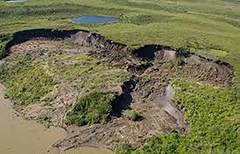
The Problem
Inability to accurately map RTSs from satellite images
What is RTS?
Melting of Permafrost resulting in Retrogressive Thaw Slumps (RTSs), a kind of thermokarst

Slide 3
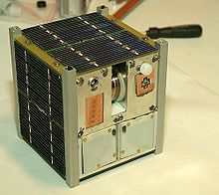
Proposed Solution
Using a DNN (DeepLabv3+) on CubeSat Images to map RTSs
What is DeepLabv3+?
DL algorithm using encoders and decoders for semantic image segmentation.
What is a CubeSat?
A mini-satellite made of multiple cubic modules

Slide 4
Methodology

Slide 5
Data Collection
Used orthorectified CubeSat Planet images having 4 bands (B, G, R, IR)
3 Approaches used -
Extracting RGB bands
Combining NDVI, NDWI and Blue band
Using PCA to extract 3 bands from the total 4 bands
For ground truth data -
Manual delineation of images in QGIS
Fieldwork for validation
[ For more training data, data augmentation was used ]

Slide 6
Training and Prediction
Network architecture: Xception65, Learning rate: 0.007, Batch size: 8, Iteration number: 30000
Divided an image into small patches and predicted pixel categories in each patch
Binary patches then converted to mapped polygons

Slide 7
Validation
[ IOU(A, B) = area (A ∩ B) / area (A ∪ B) ] was used
Precision, Recall, F1 scores used
[ True Positives (TP), False Positives (FP), False Negatives (FN)
P = (TP) / (TP + FP),
R = (TP) / (TP + FN),
F1 = (2*P*R) / (P + R) ]

Slide 8
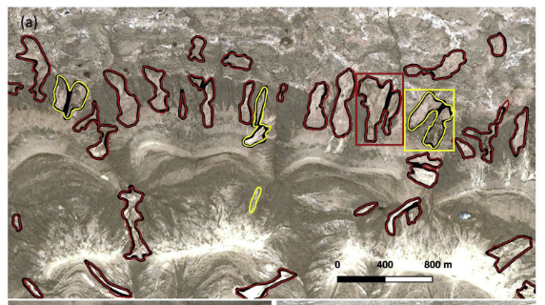
Model generalization

Slide 9
Merits and Demerits of CubeSat images
Merits
High temporal resolution
Demerits
Low spatial resolution

Slide 10
Current Challenges
Permafrost areas are challenging to reach and
Manually mapping on high-resolution images is labor-intensive.

