Slide 1
Home Appliances Application System
Software Project – BSHC-IoT
X13101161-Anjit Baral
18-12-2018

Slide 2
Project Idea
This System is about Smart Home System.
Internet will play major role for this system where things are connected.
System will control over home appliances via mobile application.
Users can simply control their home by downloading its app on their phone.
Application will be available on Google Store.
Where Sensors will be interact with Raspberry Pi.
It will control switches and door.
It will show the result of Home temperature and humidity.
It is a Long Term Project to follow.

Slide 3
Background Of Smart Home System
System for the new generation.
Who willing their home smart in affordable cost.
This home appliances automation system will be more customize, effective and secure.
At the moment, There are Numbers of System available that cost a lot with one or two functionality.
That High-end Home can be afford by those who willing to spend more.

Slide 4
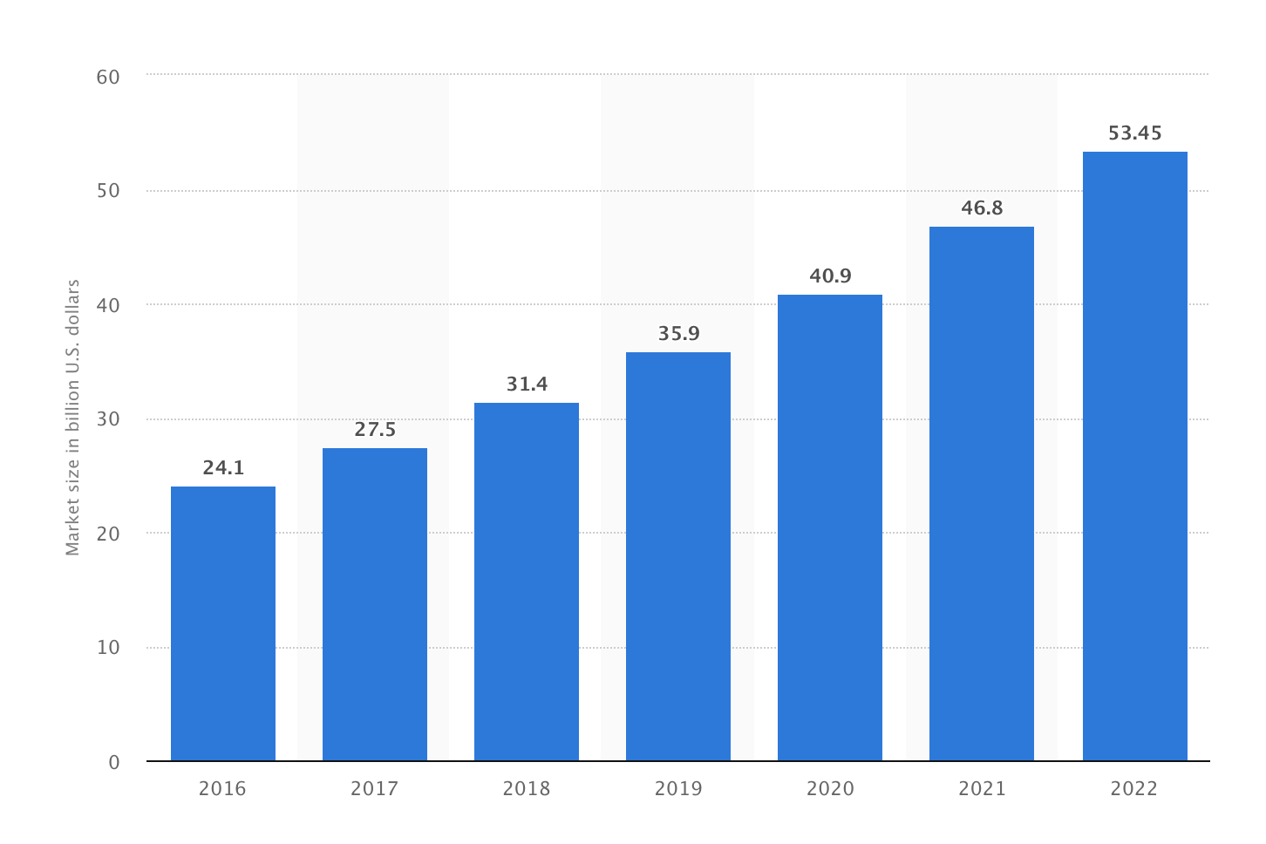
Background Of Smart Home System
Forecast market size of the global smart home market from 2016 to 2022 (in billion U.S. dollars)*
Cited by : (https://www.statista.com/statistics/682204/global-smart-home-market-size/)

Slide 5
Technical Approaches and Details
Android application has authentication mechanism by Firebase that allows users to login and logout.
Data will be stored into the Firebase Database.
Raspberry Pi will work on Raspbian OS.
Scripting code will be on Python.
Sensors will be evaluate data and send that to cloud storage.
Data will fetched on JSON format into the application
Android Studio IDE will be used to create an application.

Slide 6
Functionality and Goals of Project.
Enable to check the current status of temperature and Humidity
Enable to off the different light over the home
Enable to control other home appliances like cooler / heater.
Customization user account and update password to make it more secure.
Access to control door to lock and unlock.
Moreover, provide enhance experience to the Customers.

Slide 7
Disadvantages
Advantages
Help to reduce electricity cost.
Help to well organized home.
Low cost system for customer
Help to Manage time
Costly to install in home
Customer must learn about system to use it.
Currently working with the few things/appliances
If system crashed, only engineer can maintain.

Slide 8
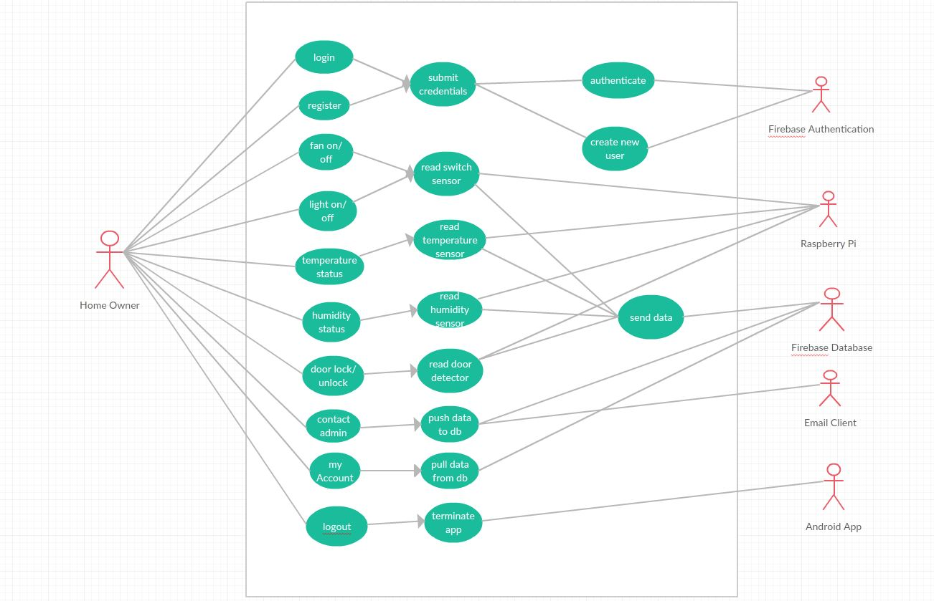
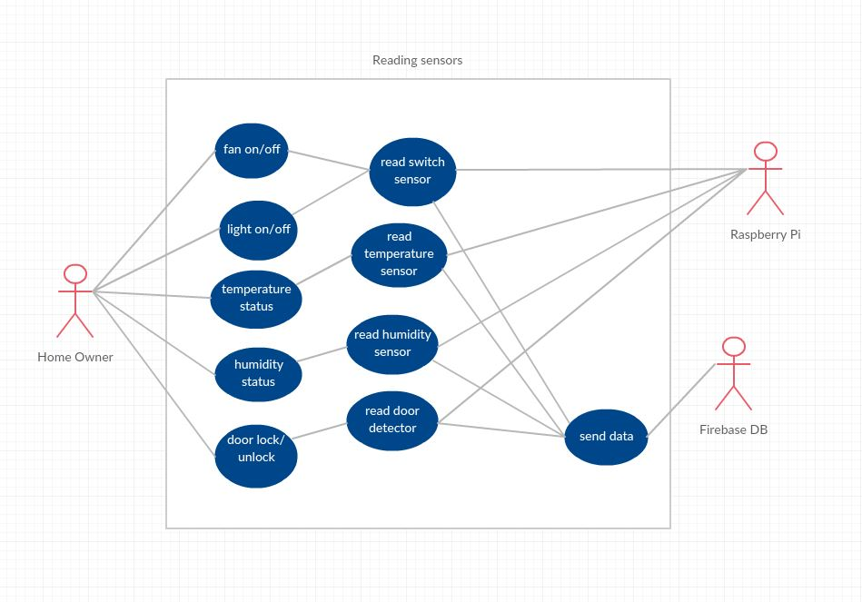
Use Case Of System

Slide 9
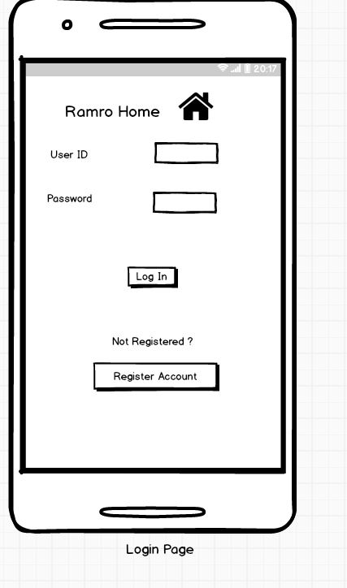
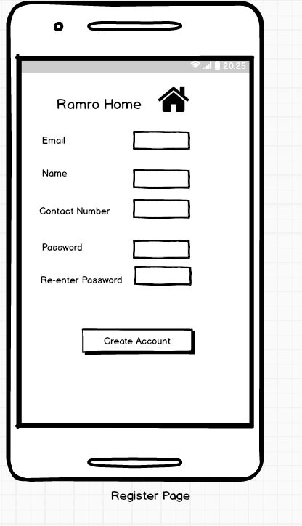
GUI and Design

Slide 10
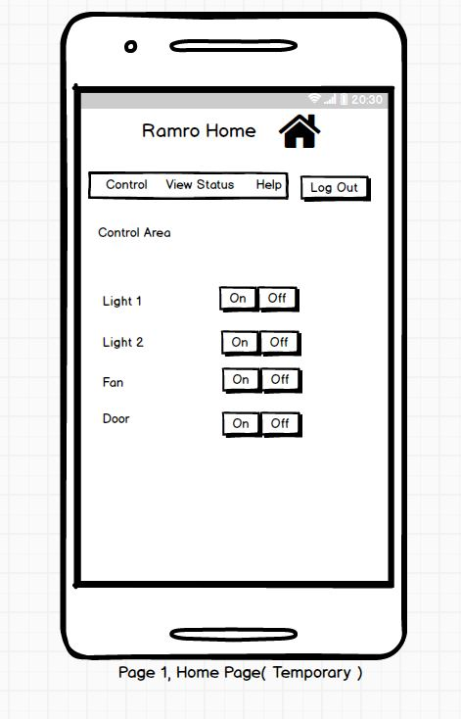
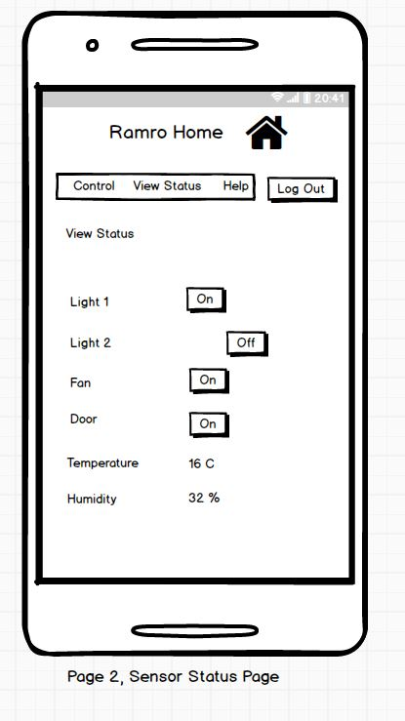
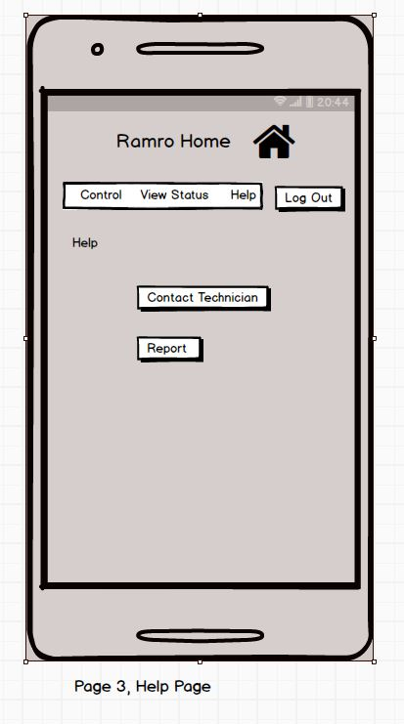
GUI and Design

Slide 11
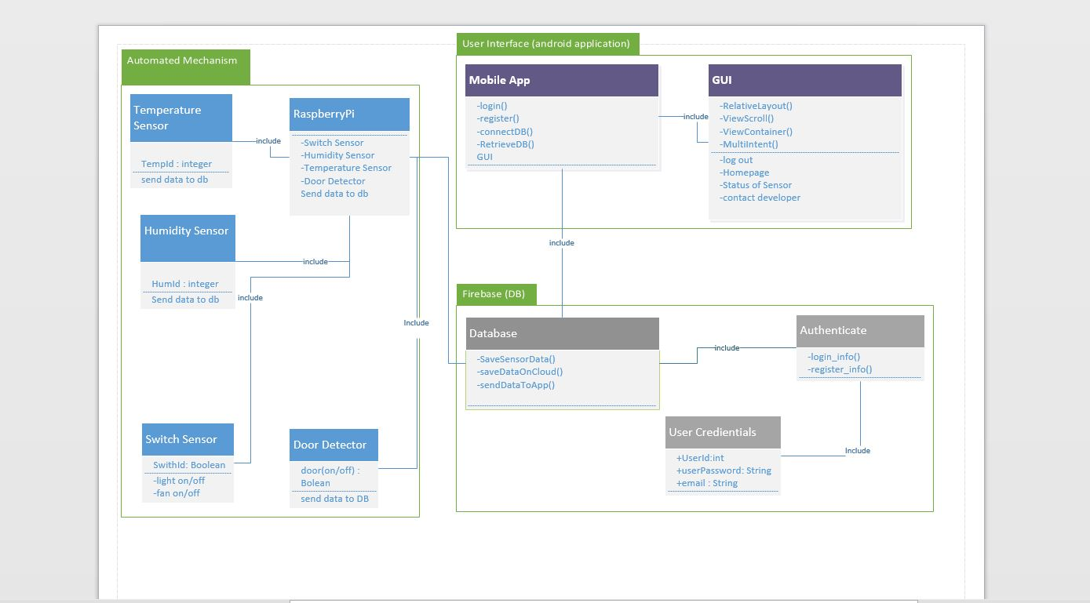
Architectural Design

Slide 12
Architectural Design
Presentation Tier:
Presentation Tier has User Interface, or we can say front-end as well, which contain Android mobile application which has linked with the firebase database. It will retrieve the sensors information and user information from the database.
Application Tier:
Application Tier, which called Business logic tier as well, it contains mechanism component like sensor (Switch, Fan, Door, Raspberry Pi). Another important thing for Application Tier is APIs Which helps to store the data into cloud and send JSON ( Javascript Object Notation format) format to the application.
Data Tier:
It will be mapping relational database into Firebase which is retrieve data from the sensors and user command and push the data to the cloud store. It will also send the data to the android mobile application whenever needed by users.

Slide 13
Technical Challenge
Dynamic Useful android application.
Well setup with Firebase.
Python Script and language.
External APIs
Implementing process of Relays, Circuit and wire.
Performance in Seamless manner.
App should be error free.
Knowledge about wire, board and networking.

Slide 14
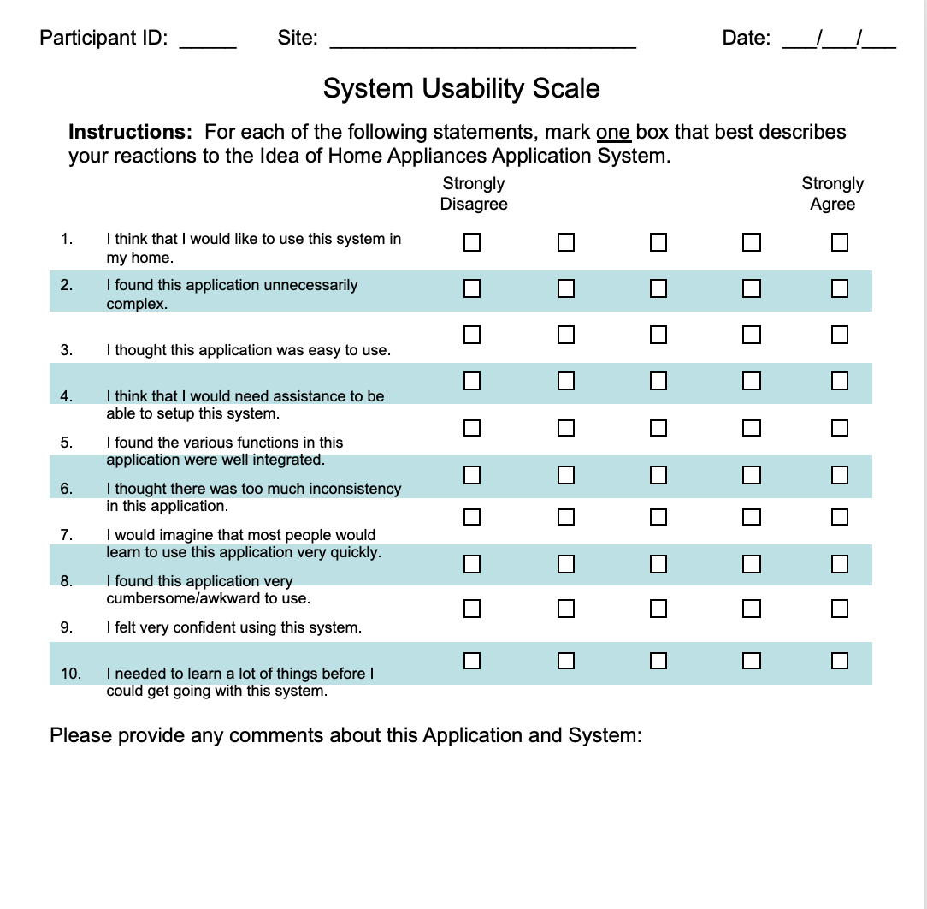
System Usability Scale

Slide 15
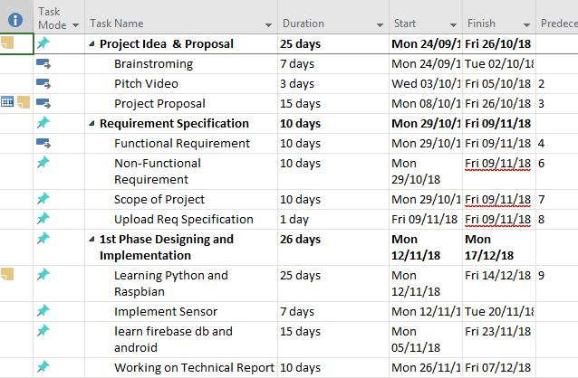
Project Plan

Slide 16
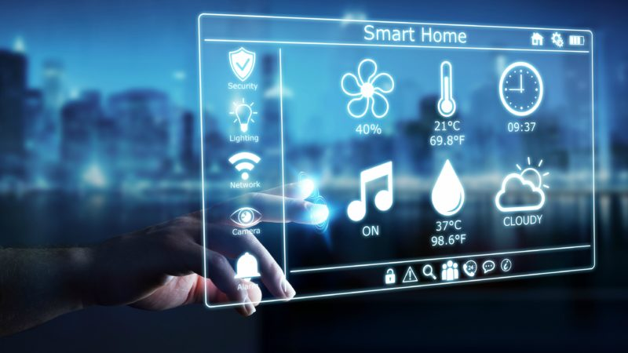
Future of Smart Home
Cited : (https://www.euractiv.com/section/energy/opinion/are-we-there-yet-current-state-of-the-smart-home-market/)

Slide 17
Demo
https://github.com/

Slide 18
Thank you

