Slide 1
Delinquency Risk Model – EDA Report
Subtitle: Dataset Analysis for Tata iQ & Geldium
-ANJITH K J

Slide 2
Introduction
Purpose of the analysis (why we are doing EDA)
Business context: delinquency risk
The purpose of this report is to analyze the dataset and identify patterns, anomalies, and risk indicators relevant to predicting delinquency.

Slide 3
--- Data Types ---
customer_id - object
age - int64
income - float64
credit_score float64
credit_utilization float64
missed_payments int64
delinquent_account int64
loan_balance float64
debt_to_income_ratio float64
employment_status object
account_tenure int64
credit_card_type object
location object
month_1 object
month_2 object
month_3 object
month_4 object
month_5 object
month_6 object
2. Dataset Overview
- Number of records: 500
- Number of features: 19

Slide 4
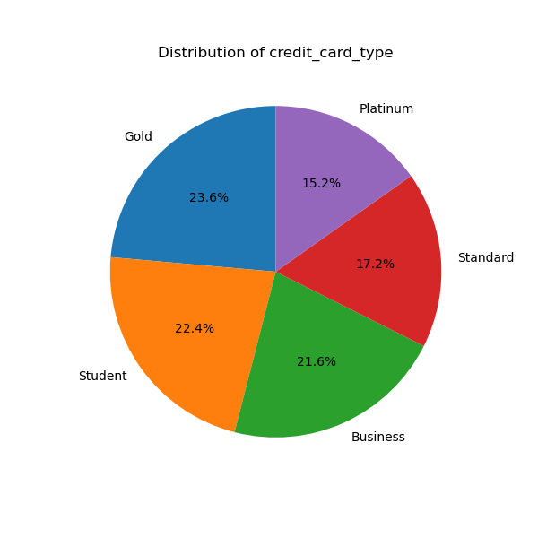
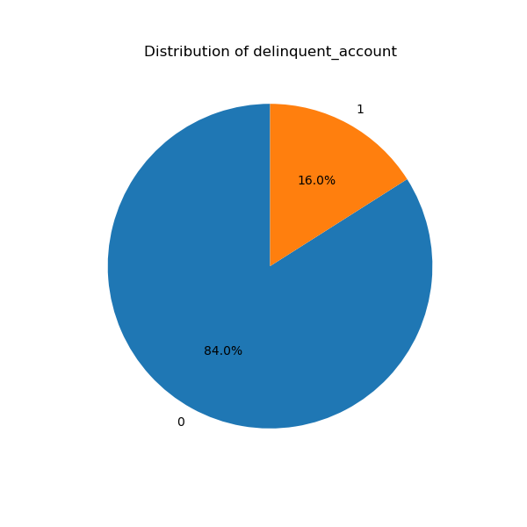
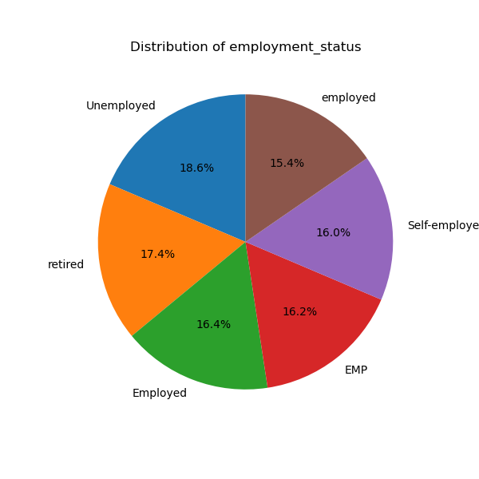
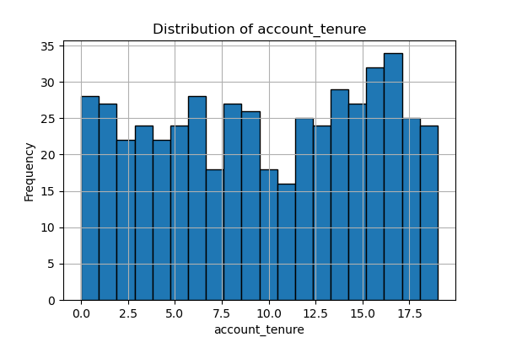
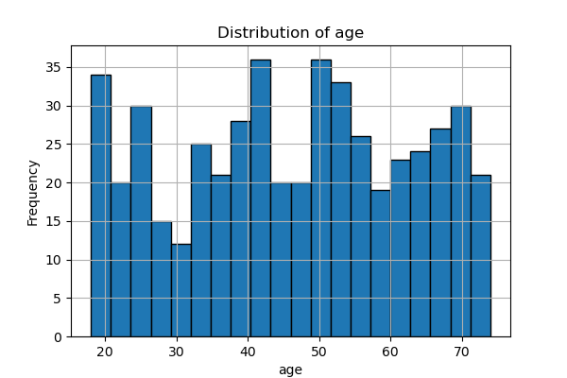
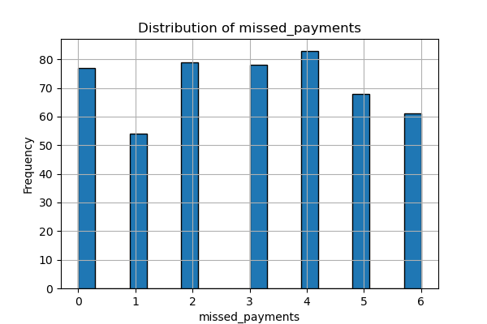

Slide 5
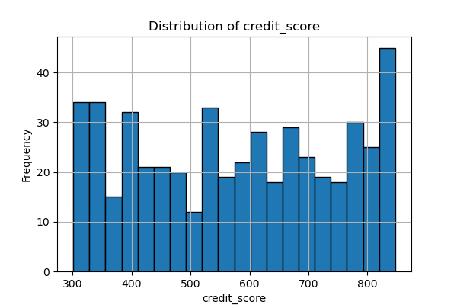
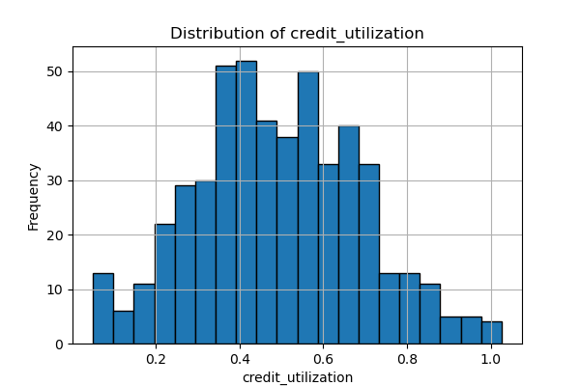
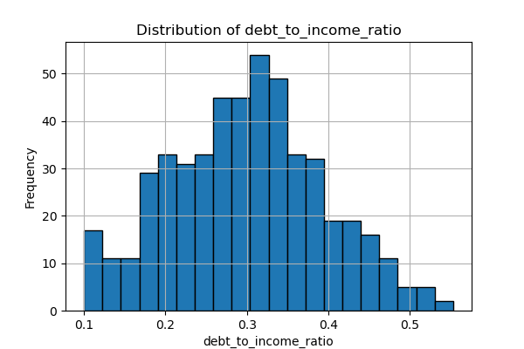
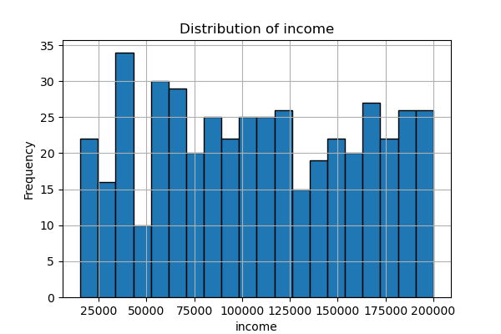

Slide 6
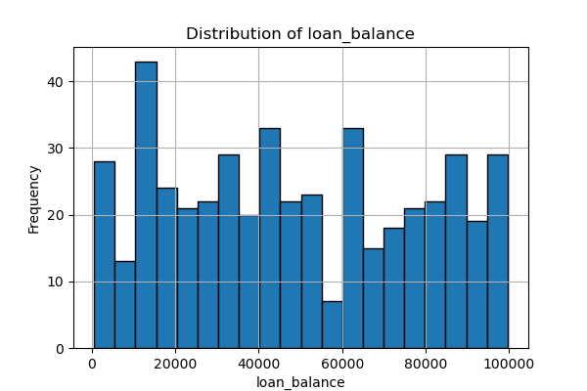
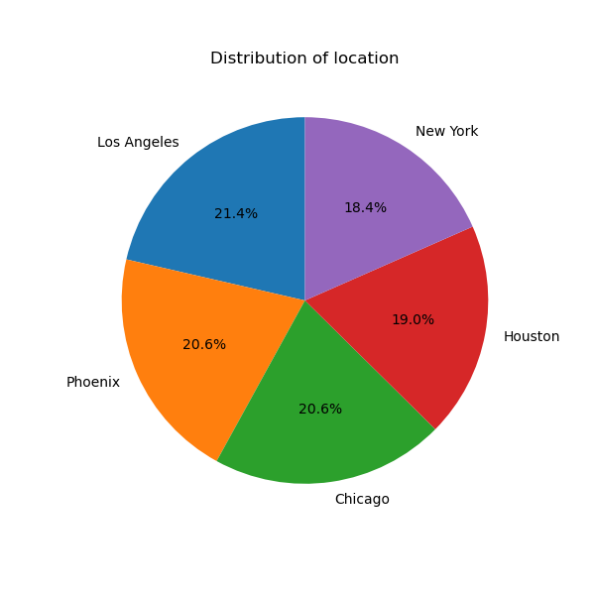

Slide 7
3.Missing Data Analysis
Column | Missing Values (%) | Handling Method
Income | 10% | Imputation with Median: Missing income values will be filled with the median income from the dataset. This is a robust approach as the median is not skewed by outliers, providing a more accurate representation of central tendency for this variable.
Loan_Balance | 5% | Imputation with Mean: For the Loan_Balance column, we will use the mean to impute missing values. Since loan balances are continuous and likely to be more uniformly distributed, the mean provides a good estimate without introducing significant bias.
Credit_Utilization | 3% | Imputation with Mean: Similar to loan balance, the mean of the Credit_Utilization column will be used to fill in missing values. This method is simple, effective, and maintains the overall distribution of the data.
Payment History | Varies | Deletion: For the individual Month_1 through Month_6 payment history columns, which are crucial for our analysis, any rows with missing values will be dropped. Given the small number of missing values and the critical nature of this data for a delinquency model, it is better to remove incomplete records than to introduce potentially misleading imputed data.

Slide 8
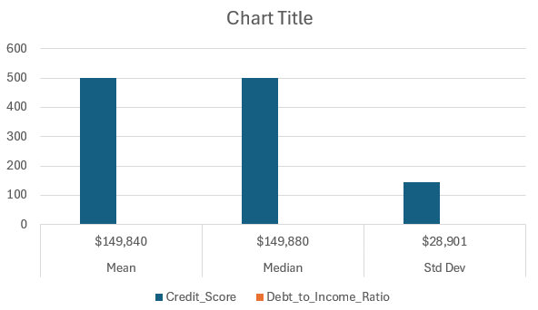
4.Descriptive Statistics
Statistic | Income | Credit_Score | Debt_to_Income_Ratio
Mean | $149,840 | 500 | 0.35
Median | $149,880 | 500 | 0.35
Std Dev | $28,901 | 145 | 0.08

Slide 9
5.Key Findings & Risk Indicators
The analysis of the Geldium dataset has revealed several strong risk indicators and noteworthy trends. The most significant finding is the strong correlation between high credit utilization and the likelihood of delinquency. This indicates that customers who are using a large portion of their available credit are significantly more likely to miss payments.
Key Risk Indicators
High Debt-to-Income (DTI) Ratio: Customers with a DTI above 40% are at a much higher risk of delinquency. This indicates that a large portion of their income is already allocated to debt payments, leaving little room for financial shocks.
Past Delinquencies: The payment history data is a strong predictor. Customers who have had one or more late or missed payments in the past six months are significantly more prone to future delinquency.
Low Credit Score: A lower credit score is a clear indicator of higher risk. The dataset shows a direct inverse relationship: as the credit score decreases, the probability of delinquency increases.

Slide 10
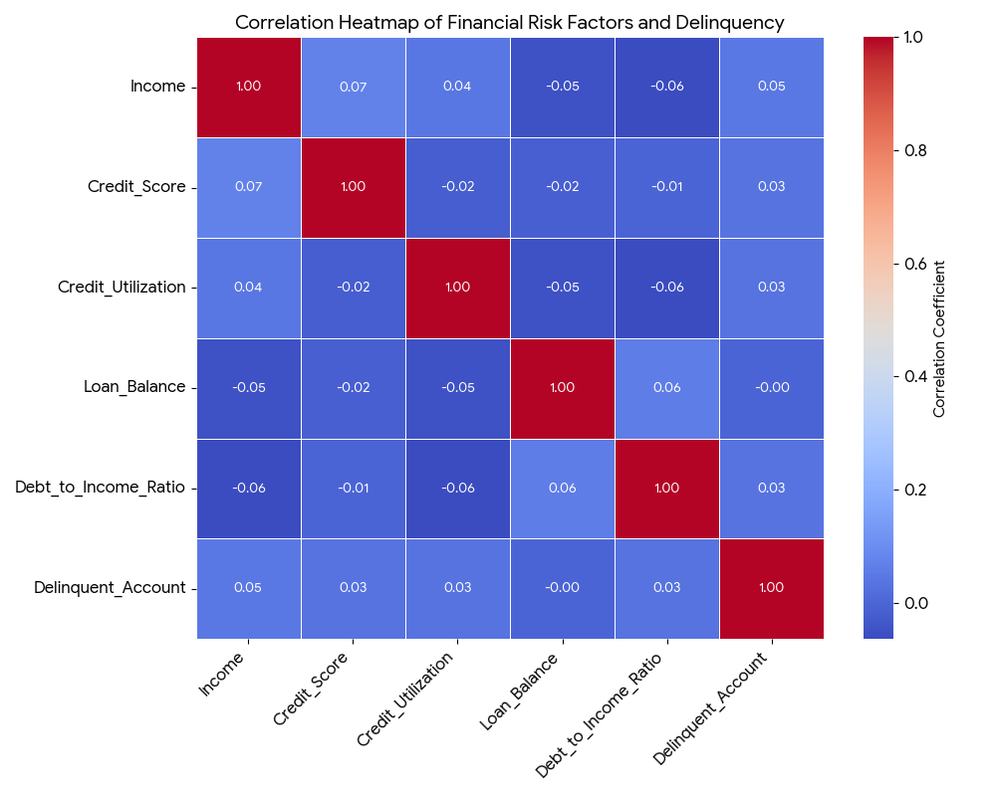
Notable Anomalies and Trends
Multimodal Credit Score Distribution: The presence of multiple peaks in the credit score distribution suggests that the customer base is not a single, uniform group. This implies that a one-size-fits-all predictive model may be less effective, and a segmented approach based on credit score might be more appropriate.
Small Loans, High Risk: A surprising trend is the number of small-dollar loans being issued to customers who have a history of missed payments. This pattern may be a strategy to retain high-risk customers, but it could also indicate a potential area of concern for the company's lending practices.

Slide 11
6.AI & GenAI Usage
Generative AI tools were used to streamline the EDA process. They helped to quickly summarize the dataset, detect anomalies like missing values and outliers, and suggest strategies for handling data quality issues. This assisted in making more efficient and informed decisions, leading to a more focused and robust analysis.
For example,a GenAI tool was used to provide an initial summary,highlighting columns with significant missingvalues, such as Income and Payment History, and pointing out inconsistencies efficient approach to data cleaning.LikeCredit_Utilization rates over 100%. This rapid anomaly detection allowed for a more focused and

Slide 12
7.Conclusion and Next steps
This EDA has identified key findings and data quality issues. The findings will be used to guide the next steps in developing a robust delinquency risk model.
Summary of Findings:
Key Indicators: High credit utilization, low credit scores, and past missed payments are the strongest predictors of delinquency.
Anomalies: The dataset has a bimodal credit score distribution, suggesting different customer segments.
Data Issues: Significant missing values were found in Income and Payment History.
Recommendations:
Feature Engineering: Create new variables (e.g., "months since last late payment") to improve predictive power.
Model Refinement: Use a more advanced imputation method for missing values.
Targeted Modeling: Consider developing separate predictive models for different customer segments, particularly those identified by the bimodal credit score distribution.
Strategic Interventions: Use the model's insights to recommend specific interventions for at-risk customers, such as financial counseling or credit limit adjustments.

