Slide 1
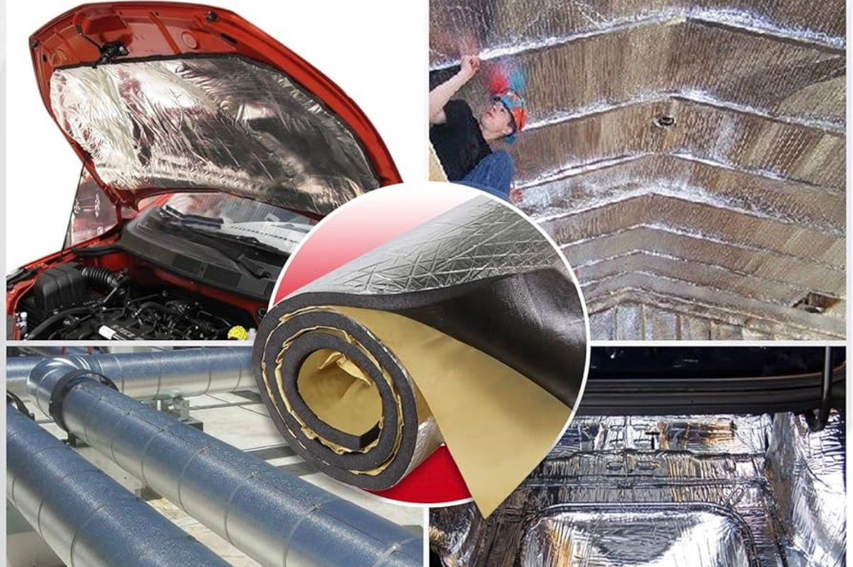

.
Sound Deadening Pad Treatment

Slide 2
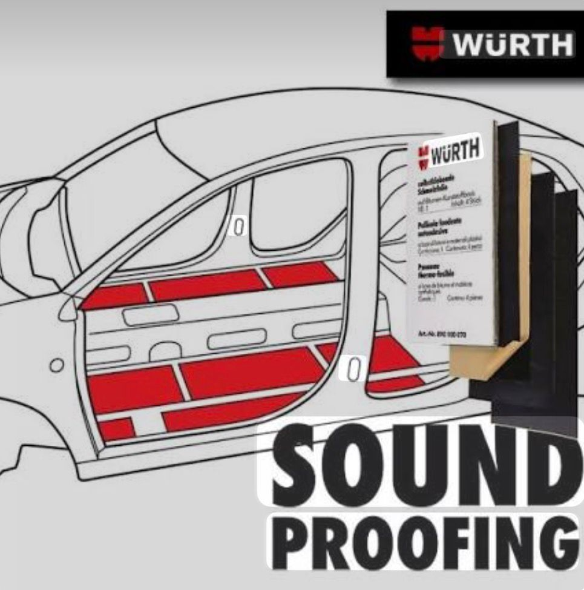
Introduction
Sound deadening pad treatment is used to reduce noise and vibration in vehicles.
Commonly applied on car floor, doors, roof, boot, and engine firewall.

Slide 3
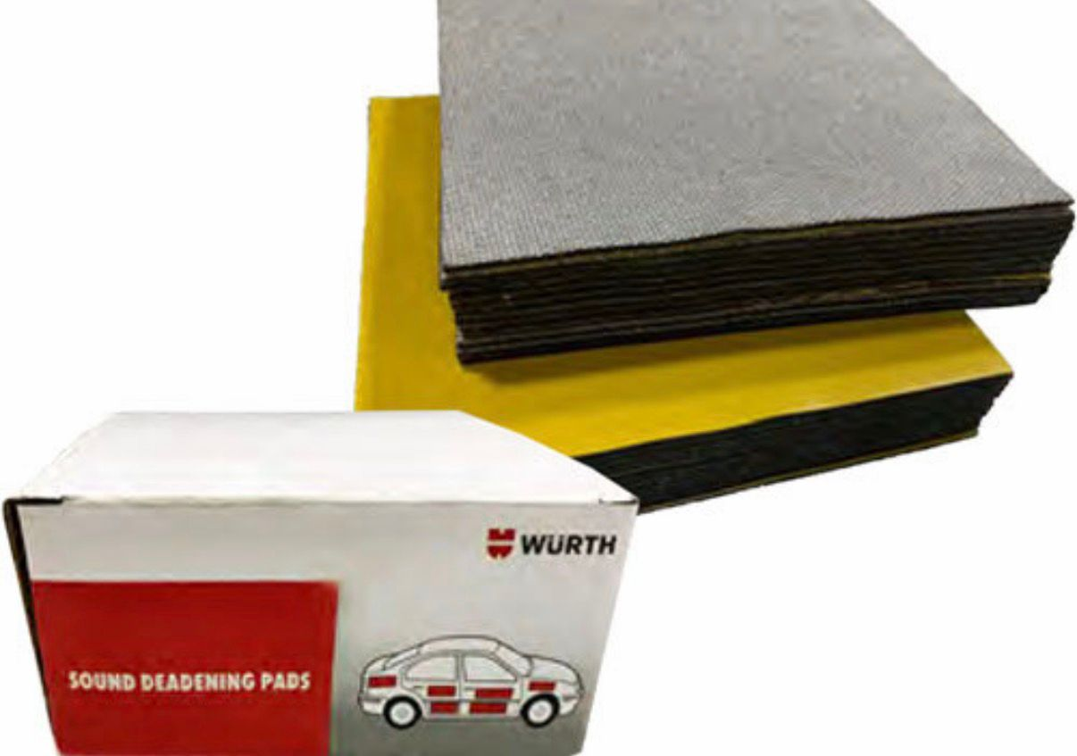
Materials Used
Aluminum foil layer for heat resistance.

Slide 4
Treatment Process – Surface Preparation
Clean the surface to remove dust, oil, and moisture.
Ensure the surface is dry and rust-free.
Proper cleaning ensures strong adhesion of the pad.

Slide 5
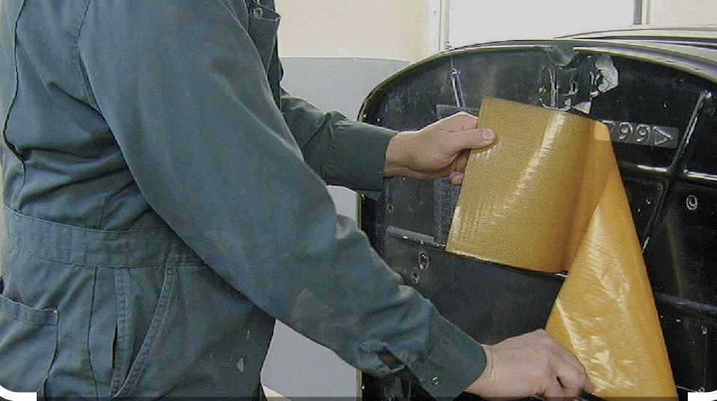
Treatment Process – Pad Application
Cut the sound deadening pad according to required shape and size.
place the pad on the surface.
Press firmly using a roller to avoid air bubbles.

Slide 6
Benefits of Sound Deadening Pad Treatment
Reduces road noise, engine noise, and vibrations.
Improves driving comfort and cabin quietness.
Enhances audio system sound quality.
Provides additional heat insulation.

Slide 7
THANK YOU

