Slide 1
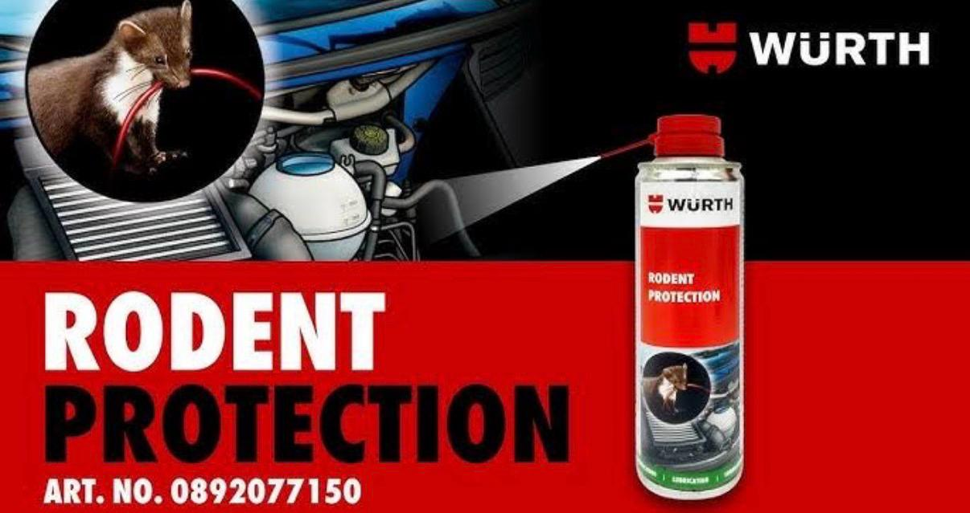

Slide 2

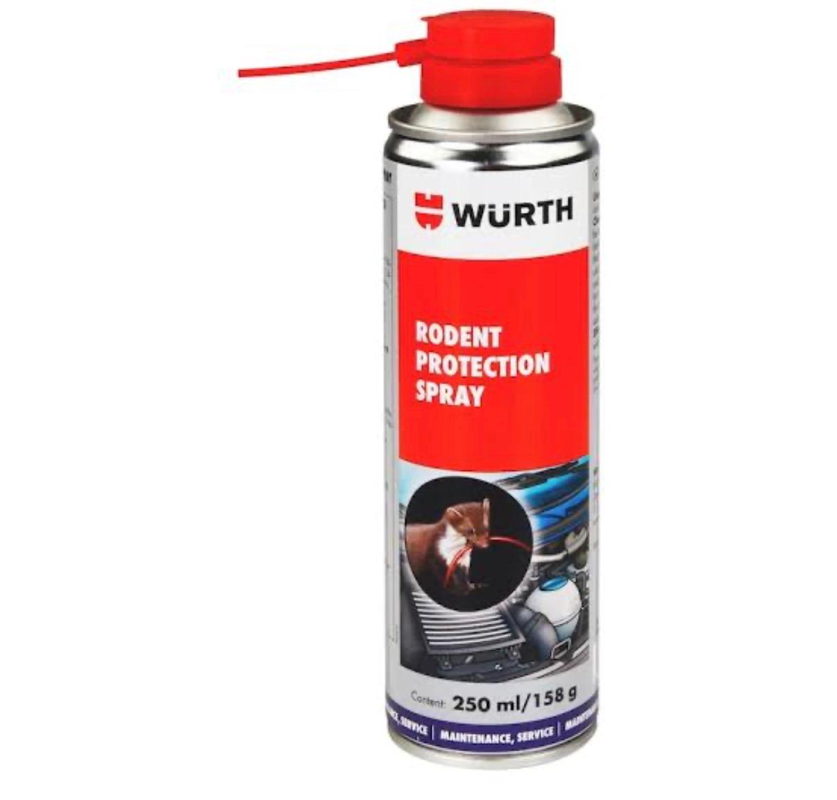
What is Rodent Treatment
•Process of controlling rats and mice
•Prevents damage and health risks

Slide 3
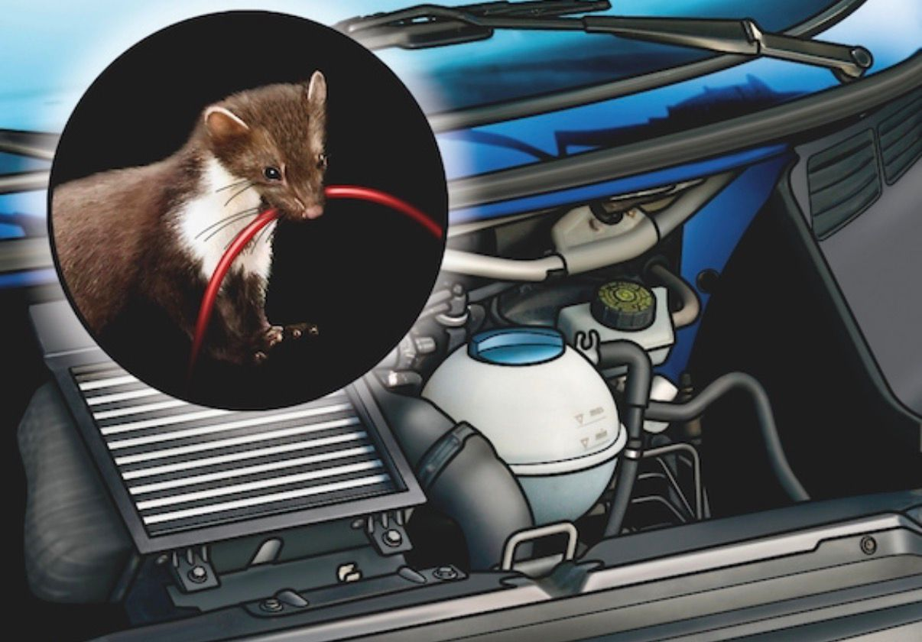
Why Rodent Control is Important
•Avoid wiring & interior damage
•Prevent diseases
•Protect property

Slide 4
Rodent Treatment Process
Inspection
Cleaning
Chemical treatment using rodent
Blocking entry points

Slide 5
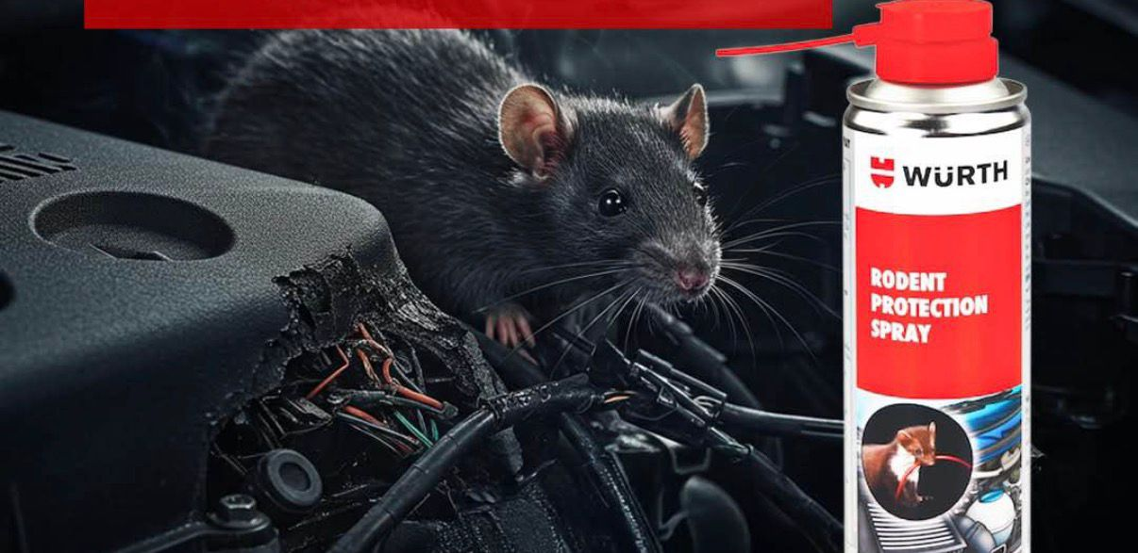
Benefits of Rodent Treatment
•Long-term protection
•Safe & hygienic
•Cost saving
•Peace of mind

Slide 6
Safety Measures Used
•Eco-friendly chemicals
•Pet & human safe methods
•Professional handling

Slide 7
THANK YOU

