Slide 1
Introduction to OS

Slide 2
What is OS?
Operating System is a software, which makes a computer to actually work.
It is the software the enables all the programs we use.
The OS organizes and controls the hardware.
OS acts as an interface between the application programs and the machine hardware.
Examples: Windows, Linux, Unix and Mac OS, etc.

Slide 3
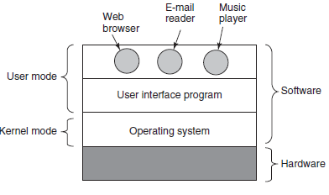
Fitting OS

Slide 4
Fitting OS
The hardware consists of chips, disks, a keyboard, a monitor, and similar physical objects.
On top of the hardware is the software.
Most computers have two modes of operation:
kernel mode
user mode
The operating system runs in kernel mode (also called supervisor mode.

Slide 5
Fitting OS
It has Complete access to all the hardware and can execute any instruction the machine is capable of executing.
It runs on the bare hardware and provides the base for all the other software
The rest of the software runs in user mode, where subset of machine instructions are available.
The user interface program, shell or GUI, is the lowest level of user-mode software, which allows user to start other programs.

Slide 6
Functions of OS
Operating systems perform two essentially unrelated functions:
The Operating System as an Extended Machine:
providing application programmers (and application programs) a clean
abstract set of resources instead of the messy hardware ones
The Operating System as a Resource Manager:
Managing the available hardware resources and their allocation as per requirement

Slide 7
The Operating System as an Extended Machine
The architecture of most computers at the machine-language level is primitive and difficult to program, especially for I/O.
So Operating systems contain many drivers for controlling I/O devices.
Eg: Disk drive, providing an interface to read and write data from hard disk.
It provides good abstractions, hiding the unpleasant, low-level details of bare H/W machine

Slide 8
The Operating System as an Extended Machine
It encompasses the following functions:
Execution environment (Process management – creation, control, and termination, file manipulation, interrupt handling, support for I/O operations. Language support).
Error detection and handling
Protection and security
Fault tolerance and failure recovery.
Notes:
responsible for using all the information and resources available on the machine in the most protected way. The Operating System is responsible for detection of any types of error or bugs that can occur while any task. The well secured OS sometimes also acts as countermeasure for preventing any sort of breach. Security:operating system uses password protection to protect user data and similar other techniques.

Slide 9
The Operating System as a Resource Manager
Operating system as primarily providing abstractions to application programs is a top-down view.
In the alternate bottom-up view, operating system provides an orderly and controlled allocation of the processors, memories, and I/O devices among the various programs wanting them.

Slide 10
The Operating System as a Resource Manager
Manages the resources and allocates them to users in an efficient and fair manner. It encompasses the following functions.
Time management (CPU and disk scheduling).
Space management (main and secondary storages).
Process Synchronization and deadlock handling.
Accounting and status information.
Notes:
Operating system Keeps track of time and resources used by various tasks and users, this information can be used to track resource usage for a particular user or group of user.

Slide 11
Operating System Designs
There are mainly 6 different designs that have been adopted for OS:
monolithic systems
layered systems
microkernels
client-server systems
virtual machines
exokernels

Slide 12
1. Monolithic systems
Most common organization where entire operating system runs as a single program in kernel mode.
Operating system is written as a collection of procedures, linked together into a single large executable binary program.
Each procedure in the system is free to call any other one.
There is no information hiding: Every procedure visible to every other

Slide 13
Monolithic systems
The object program for OS is created as follows:
Compile all the individual procedures (or the files containing
the procedures)
Binds all together into a single executable file using the system linker

Slide 14
Monolithic systems
Basic structure for the operating system:
1. A main program that invokes the requested service procedure.
2. A set of service procedures that carry out the system calls.
3. A set of utility procedures that help the service procedures

Slide 15
Monolithic systems

Slide 16
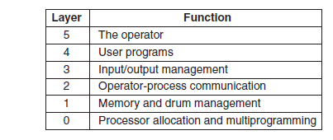
2. Layered systems
Organize the operating system as a hierarchy of layers, each one constructed upon the one below it.
The first system constructed in this way in 1968 had 6 layers,
Notes:
System operator process at Level 5

Slide 17
3. Micro Kernels
Designed to reduce bugs in Kernel by limiting the contents put in kernel, there by limiting the chances of crash
The basic idea behind the microkernel design is to achieve high reliability by splitting the operating system up into small, well-defined modules.
Only one of which—the microkernel—runs in kernel mode and the rest run as relatively powerless ordinary user processes

Slide 18
Micro Kernels: MINIX kernel
Microkernel performs functions such as catching interrupts and switching processes.
Offers a set of about 40 kernel calls to allow the rest of the operating system to do its work.
Outside the kernel, the system is structured as three layers of processes all running in user mode

Slide 19
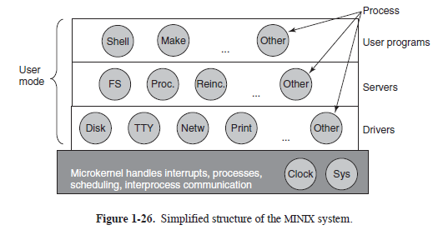
Micro Kernels: MINIX kernel
The idea of minimal kernel is to put the mechanism for doing something in the kernel, but not the policy.
The policy handling is managed by user processes.

Slide 20
Client Server Model
Two classes of processes are there: the servers, which provides some service, and the clients, which use these services.
Communication between clients and servers is often by message passing.
To obtain a service client constructs a message specifying its need and sends it to the server.
The server then provides the required service and sends back the response

Slide 21
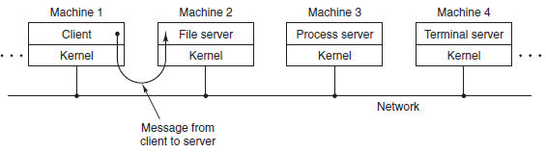
Client Server Model
General assumption is that clients and servers run on different computers, connected by a local or wide-area network.

Slide 22
5. Virtual Machines
IBM was the first to introduce the concept through a system called VM/370 in 1979.
The heart of the system, known as the virtual machine monitor, runs on the bare hardware and does the multiprogramming, by providing several virtual machines to the next layer.
The VMs are exact copies of the bare hardware, including kernel/user mode, I/O, interrupts everything else the real machine has and so supports any OS that bare h/w supports.

Slide 23
5. Virtual Machines
But the idea of Virtualization became popular only after 4 decades.
It was suggested as a way to run Web servers, FTP servers, and other servers implemented on separate computers into the same machine.
Another important use of virtualization is in Web hosting where it can provide the customers with the same feel of dedicated hosting (server).
Another use of virtualization is for end users who want to be able to run two or more operating systems at the same time

Slide 24
6.Exokernels
An alternative strategy to VM is to divide the resources of the actual machine among the differ users.
Each user will get a subset of resources.
In these type of systems, at bottom layer, running in kernel mode, is a program called the exokernel
Its job is to allocate resources to virtual machines and then check attempts to use them to make sure no machine is trying to use somebody else’s resources.

Slide 25
6.Exokernels
Each user-level virtual machine can run its own operating system, but restricted to using only the resources it has been allocated .
The advantage of the exokernel scheme is that it saves a layer of mapping.
In other designs, for each VM, VM Monitor must maintain tables to remap disk addresses, which can be avoided with exokernel.

Slide 26
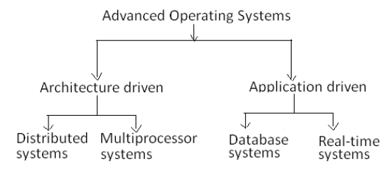
Types of Advanced OSs
Notes:
Architecture Driven: Hardware Specification
Application driven: Based on specific applications

Slide 27
Distributed Operating Systems
Controls and manages resources for a network of autonomous computers.
manage both hardware and software resources
behaves as a single monolithic system.
User not aware of program or resource location
Design issues same as traditional systems
Practical issues:
lack of shared memory
lack of global clock
unpredictable communication delays

Slide 28
Distributed Operating Systems
Four Major Advantages are:
resource sharing,
computation speedup,
reliability, and
Communication

Slide 29
Multiprocessor Operating Systems
Consists of a set of processors that
share a set of physical memory blocks
share a common clock
"share" over an interconnection network.
Control and manage resources
hardware and software resources
viewed as a uniprocessor system.
Practical issues:
increased complexity of synchronization, scheduling, memory management, protection and security

Slide 30
Real Time OS
Requires not only that the computing results be "correct" but also that the results be produced within a specified deadline period.
Many real-time systems are embedded in "specialized devices," such as ordinary home appliances .
They are also present in larger entities, such as automobiles and airplanes.
There are two types of real time computing:
Hard
Soft

Slide 31
Real-time Operating Systems
A hard real-time system has the most stringent requirements, guaranteeing that critical real-time tasks be completed within their deadlines.
Safety-critical systems are typically hard real-time systems.
A soft real-time system is less restrictive, simply providing that a critical real-time task will receive priority over other tasks and that it will retain that priority until it complete

Slide 32
Database Operating System
Databases place special requirements on OS
It must support
The concept of transaction
Operations to store, retrieve and manipulate data efficiently
Primitives for concurrency control
And system failure recovery
Should also have buffer management schemes for data retrieval and storage from secondary storage
Concurrency control is one of the most challenging problems in the design of database operating systems

