Slide 1
SECURITY
Potential Security Violations – Design Principles
for Secure Systems –The Access Matrix Model and
Implementation- The Access Control list Method.

Slide 2
Potential Security Violations
Protection and security deals with the control of unauthorized access and use of software and hardware resources of a computer.
Potential security violations are classified into three categories:
Unauthorized Information release :Unauthorized person is able to read and take advantage of the information stored in a computer system.
Unauthorized Information Modification: An unauthorized person is able to alter the information stored in a computer
Unauthorized denial of service: Unauthorized person prevents an authorized user from accessing the information stored in a computer

Slide 3
Design Principles for secure Systems
Following are the principles for designing a secure computer system:
Economy
Complete Mediation
Open Design
Separation of privileges
Least Privilege
Least common Mechanism
Acceptability
Fail-safe Defaults

Slide 4
Design Principles for secure systems
Economy: Protection mechanism should be economical to develop and use and should not cause overhead to the system.
Complete Meditation: design of a good secure system requires that every request to access an object be checked.
Open Design: A protection mechanism should not be dependent on the ignorance of the attackers regarding the protection mechanism. The protection mechanism should work even if its principles are known to attacker.
Separation of privileges: A mechanism that requires two keys to unlock a key is more robust than one key approach.(2 keys-2 conditions satisfied)

Slide 5
Design Principles for secure systems
Least Privilege: A subject/user should be given bare minimum access rights that are sufficient to complete the task.
Least common Mechanism: Mechanism that is common to more than one user should be minimized as shared mechanism represent potential information path b/w users and thus a threat to security.
Acceptability: A protection mechanism should be simple to use or else it will deter users from using it.
Fail-safe Default: Default case should be lack of access. If a design or implementation mistake is responsible for denial of access it will eventually be discovered and fixed.

Slide 6
Access Matrix Model
A protection system consists of mechanisms to control user access to system resources or to control information flow in the system.
A model of protection abstracts the essential features of a protection system.
Access matrix model is the most fundamental model of protection which was first proposed by Lampson.

Slide 7
Access Matrix Model
The model consists of following 3 components:
Current Objects: Finite set of entities to which access is to be controlled. The set is denoted by O. (For example file)
Current Subjects: Finite set of entities that access current objects, denoted by ‘S’. (Example: a process.) Usually S is a subset of O
Generic Rights: A finite set of Generic rights R={r1,r2,r3,….rm},gives various access rights that subjects can have to objects

Slide 8
The Protection State of a System
Protection state of a system is represented by a triplet (S,O,P)
S is a set of current subjects,
O is the set of current objects and
P is a matrix called access matrix, with a row for every current subject and a column for every current object
Each entry P[s,o] in access matrix is a subset of R, the generic rights.
It denotes the access rights which subject s has to object o.

Slide 9
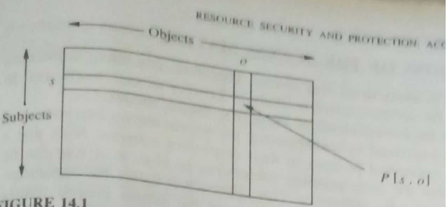
Access matrix: Example
Access matrix model of a protection system is very popular because of its simplicity elegant structure and amenability to various implementations.

Slide 10
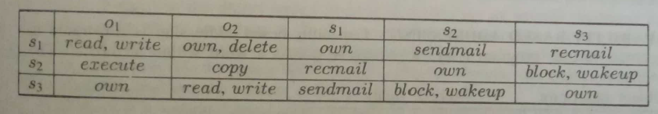
The Protection State of a System

Slide 11
Enforcing a security policy
A security policy is enforced by validating every user access for appropriate access rights.
Every Object has a monitor that validates all accesses to that object in the following manner.
A subject s requests an access α to object o
The protection system presents triplet(s, α ,o) to the monitor of o.
The monitor looks into the access rights of s to o. If α Є P[s,o] then the access is permitted. Else it is denied

Slide 12
Implementation of Access Matrix
There are 3 main implementation techniques of the access matrix :
Capabilities
The Access Control List Method
The Lock-key Method

Slide 13
Implementation of Access Matrix: Capabilities
This method corresponds to the row-wise decomposition of the access matrix.
Each subject s is assigned a list of tuples (o, P[s,o]) for all objects o that it is allowed to access.
The tuples are referred to as capabilities.
The list of capabilities assigned to a subject corresponds to the access rights contained in the row for subject s in access matrix.
At any time a subject is authorized to access only those objects for which it has capabilities.

Slide 14
Capabilities
Capability has 2 fields:
Object descriptor- An identifier for an object
Access rights-indicates allowed access rights to an object.
The object descriptor, in most cases will be address of the object, making this technique useful as an addressing mechanism ,aside from protection.
The main advantage of using capabilities as addressing mechanism is that it provides absolute addresses

Slide 15
Capability Based Addressing
A user program issues a request to access a word within the object, which contains the capability ID of the object and an offset (location of word within object).
The capability id is used to search the capability list of user to locate the capability which contains the allowed access rights and object descriptor.
System checks whether the requested access is permitted by checking the capability.
The base address of object is obtained from object table by using the object descriptor.
Base address is added to offset in request to access exact memory location of the word.

Slide 16
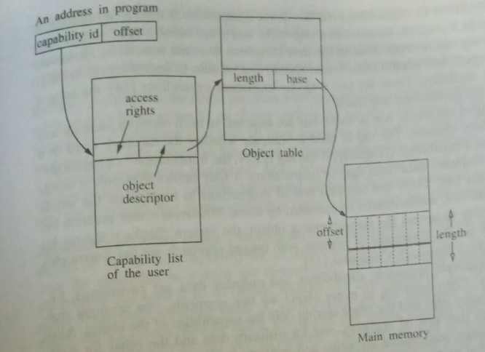
Capability Based Addressing

Slide 17
Capability Based Addressing
There are 2 features of capability based addressing
Relocatability
Sharing
An object can be relocated anywhere in the memory without making any change to the capabilities that refer to it.
Sharing is made easy as several programs can share the same object with different names(object descriptors) for the object.

Slide 18
Capability :Implementation
There are two ways to implement capabilities:
Tagged Approach
Partitioned Approach
In tagged approach one ore more bits are attached to each memory location and to every processor register.
If the tag bit is 1(ON), it indicates the presence of capability in the memory word or register.

Slide 19
Capability :Implementation
In partitioned approach capabilities and ordinary data are partitioned ,ie, stored separately.
There are two segments for every object: One segment storing only the ordinary data and other storing only capabilities of the object.
Processor also has 2 sets of registers: one for ordinary data and other for capabilities.
Users cannot manipulate segments and registers storing capabilities.

Slide 20
Capability : Advantages
Capability based protection system has 3 main advantages:
Efficiency
Simplicity
flexibility
It is efficient because the validity of an access can be easily tested.
It is simple due to the natural correspondence b/w the structural properties of capabilities and semantic properties of addressing variables.
It is flexible as the capability system allows users to decide which of his addresses contain capabilities.

Slide 21
Capability :Drawbacks
Control of propagation: The copy of capability for an object is propagated to many subjects ,without knowledge of the first subject which shared the capability
Review: The determination of all subjects who have access to an object is difficult
Revocation of access rights: As the copy of capability for an object is being passed on from one object to other, revocation of access rights for the object is a difficult task.
Garbage collection: When the capabilities for an object disappear from the system, the object is left inaccessible to users and becomes garbage.

Slide 22
Access Control List Method
This method corresponds to column wise decomposition of access matrix.
Each object o is assigned a list of pairs (s, P[s,o]) for all subjects s that are allowed to access the object.
The access list assigned to the object o corresponds to all access rights contained in the column for object o in the access matrix.

Slide 23
Access Control List Method
When a subject s requests access α to object o it is executed in the following manner:
The system searches access control list of o to find out if any entry (s,Φ) exists for the subject s.
If an entry (s,Φ) exists for subject s, then the system checks to see if the requested access is permitted.(ie, α Є Φ)
If requested access is permitted, then the request is executed. Otherwise appropriate exception is raised.

Slide 24
Access Control List Method: Implementation Considerations
The execution efficiency of access control list method is poor because an access control list has to searched for every access to a protected object.
Main features of access control list method are:
Easy Revocation: Revocation of access rights from a subject can be easily achieved by removing the subject’s entry from objects access control list.
Easy Review of an Access: It is easy to determine the subjects which have access to the object by directly examining the access control list of the object

Slide 25
Access Control List Method
When a subject s requests access α to object o it is executed in the following manner:
The system searches access control list of o to find out if any entry (s,Φ) exists for the subject s.
If an entry (s,Φ) exists for subject s, then the system checks to see if the requested access is permitted.(ie, α Є Φ)
If requested access is permitted, then the request is executed. Otherwise appropriate exception is raised.

Slide 26
Access Control List Method: Major Features
Major features of access control list method are:
Easy Revocation:
Revocation of a subjects access right is easy simple and efficient
Remove subject’s entry from objects access control list
Easy Review of an Access:
Easy to determine what subjects have access rights to an object by directly examining access control list of the object

Slide 27
Access Control List Method: Implementation issues
There are 2 main issues in the implementation of Access control list method:
Efficiency of Execution: For every access to a protected object, we have to search access control list
Efficiency of storage: Since list contains the subject and access rights which have access to the corresponding protected object, list requires huge amount of storage

Slide 28
Access Control List Method: Implementation
Efficiency of execution: Solution
Shadow register:
stores the access rights of a subject w.r.t an object, when object is first accessed.
Subsequent access of object can refer shadow register for access rights
When revoking the access rights of a particular subject, the corresponding shadow register also should be cleared

Slide 29
Access Control List Method: Implementation
Efficiency of Storage: Solution
Protection group:
solution to large storage requirement due to large no: of users.
Subjects are divided into protection groups and the access control list consists of names of groups along with their access rights.
All subjects in a protection group have identical access rights to the object
Subject gives protection group name and request access to the system

Slide 30
Access Control List Method: Authority to change Access control list
There are two methods to control the propagation of access rights:
Self Control
Hierarchical control
Self Control Policy: Owner process of object has special access right by which it can modify the access control list of the object
Owner is the creator of the object
Disadvantage: Control is centralized to one process

Slide 31
Access Control List Method: Authority to change Access control list
Hierarchical control Method:
when an object is created, its owner specifies set of processes which have the right to modify access control list of new object
Processes are arranged in hierarchy
A process can modify access control list associated with all processes below it in the hierarchy

Slide 32
The Lock-Key Method
Hybrid of capability based method and the access control method
Includes the features of both the methods
Every subject has a capability list that contains tuples of form(O,K)
Each tuple indicates that subject can access object O with key k
Every object has an access control list that contain tuples of the form (l, Ψ) called a lock entry.
It indicates that any subject which can open the lock l can access this object in modes contained in the set Ψ

Slide 33
The Lock-Key Method
When a subject makes the request to access object o in mode α,the system executes it in the following manner:
System locates the tuple (0,k) in the capability list of the subject.
If no such tuple is found access is not permitted
Otherwise access is permitted only if there exists a lock entry (l, Ψ) in the access control list of the object o such that k=l and α Є Ψ
To revoke the access rights of a subject to an object simply delete the lock entry corresponding to the key of the subject

