Slide 1

Distribution Channels
“Distributed is 4 U 2 choose”
What is Distribution?
What is a Distribution Channel and its purpose?
How are Distributors?
Notes:
Another similar common expression is “People will behave the way you measure them.”

Slide 2
Distribution
Distribution involves getting the product from the manufacturer to the ultimate consumer.
Most manufacturers would prefer to have their products distributed widely—that is, for the products to be available in as many stores as possible.
The group of people, agencies or intermediatories associated with distributing and making available the product from the manufacturer to the ultimate consumers are called distributors.
Notes:
Controlling is the last of the four management functions. It is intended to allow management to see if things are going according to plan.

Slide 3
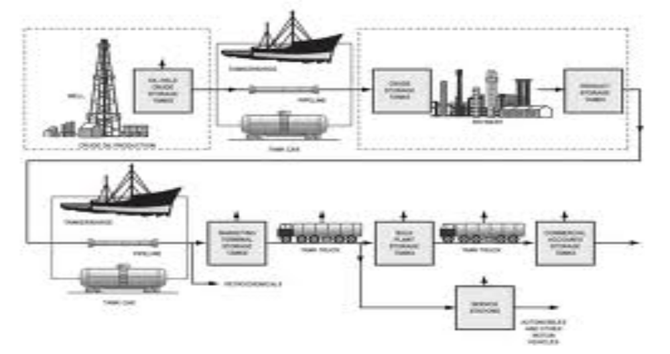

Slide 4
Distributors add efficiency by:
Breaking bulk—the consumer can buy small quantities at a time. Small and modest scale retailers can buy modest quantities.
Consolidation and Distribution- Highly inconvenient for customers to buy each product at a different store, as having to go to one store to buy produce, one store to buy meat, and other stores for other household products. There is considerable value in having everything available in a supermarket.
Wholesalers consolidate products from different manufacturers so that a large number of different products can be received in one shipment. This reduces costs by increasing the efficiency with which products can be (1) delivered and (2) received.
Notes:
The sooner you can take corrective action, the easier it will be to correct the problem.

Slide 5
Contn………………
Carrying inventory. This service reduces the temporal discrepancy between Manufacturers who may need to schedule production at relatively constant levels and consumers who need certain products only at certain times.
Financing. Certain small manufacturers may have difficulty waiting for payment until goods are sold to the end-customer. Wholesalers and retailers may negotiate lower prices from the manufacturer in return for quick payment.
Notes:
Input standards include material, labor and overhead in the form of administrative and operating costs.

Slide 6
System Effectiveness - Specialization
Many of the cost savings is associated with having an efficient system of intermediaries and result from specialization.
The distribution channel specializes in handling various phases of the distribution path.
Some specialize in retailing—usually selling a large variety of goods in small quantities to a large number of end customers.
Wholesalers, in turn, specialize in moving goods from numerous manufacturers to a large number of retailers.
Notes:
There is also the principal of Management By Sufficiency. It focuses on large important items even if they are on track.

Slide 7
Distribution Strategies
The distribution aspect includes decisions about the wholesale and retail channels of distribution and places at which the product should be made available to the customers.
Notes:
As previously mentioned, it is usually a whole lot less expensive to solve problems before they occur.

Slide 8
Channels of distribution
The channels of distribution signifies various trade links connecting the manufacturers or producers and the ultimate consumers and the users.
It includes producer of goods, final user of goods, mercantile agents and merchant middlemen engaged in transfer of goods and services.
The Channels of distribution are called trade channels, which refer to the paths through which the ownership passes from the manufacturer to the final user .
Notes:
As with planning, there are many different types of control systems. It is important to decide how much effort you want to put into controlling a particular activity.

Slide 9
The various channels of distribution are:
  A wholesaler is a middleman who purchases and sells in large quantities.
  A Retailer is defined as a dealer in goods and services who purchases from manufacturers and wholesalers and sells to the ultimate consumers.
Notes:
It is important to have regular (monthly) reviews. Once or twice a year is not enough to stay on track.

Slide 10
Levels in distribution Network
PRODUCER------------------------------------------------------------------------CONSUMER
PRODUCER-------------------------------------------------RETAILER---------CONSUMER
PRODUCER----- -------------WHOLESALER-----------RETAILER-------CONSUMER
PRODUCER--------AGENT------WHOLESALER--------RETAILER----CONSUMER

Slide 11
Producer-Consumer:
PRODUCER-------------------------CONSUMER
This is direct channel of distribution.
It implies direct sale of goods and services by the producer to the consumers.
The producer creates a link with consumers directly through door to door salesmen, or retail shop.
Direct sales have gained popularity due to high cost of distribution through the middlemen. Small producers and producers of perishable goods sell directly to the local customers.
Big producers sell directly in order to cut distribution costs. All the marketing activities are performed by the producer or manufacturer himself.
Notes:
Discipline is necessary but it has to be done properly to avoid legal problems. If you have any doubts about how to do it, have an HR person with you.

Slide 12
Producer, Retailer, and Consumer:
PRODUCER-------------------- RETAILER--------- CONSUMER
This is one stage distribution channel having one middleman i.e., retailer.
The manufacturer sells to retailer who in turn sells to consumers.
This channel of distribution is quite popular because of the emergence of departmental stores, super market and other big retail stores.
The retailers purchase in large quantities from the manufacturer and perform marketing activities to sell the product to consumers.
Notes:
TQM applies to the entire organization. It is not limited to manufacturing.

Slide 13
Producer, Wholesaler, Retailer, Consumer:
PRODUCER--------------WHOLESALER--------RETAILER-------CONSUMER
This is the most traditional channel of distribution for sale of goods.
There exist 2 middlemen in the channel, namely, wholesaler and retailer.
This channel is suitable for the products with scattered market.
Notes:
These are all tools used by operations managers to run efficient and effective production lines.

Slide 14
Producer, Agent, Wholesale, Retailer
& Consumer:
PRODUCER----AGENT-----WHOLESALER-----RETAILER---CONSUMER
This 3 stage channel of distribution.
The mercantile (agent) establishes a link between the wholesaler and the retailer.
Notes:
These are all tools used by operations managers to run efficient and effective production lines.

Slide 15
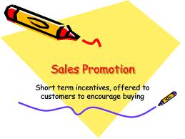
Promotions
Notes:
Fixed costs include all costs that do not normally vary with the amount of product being produced.

Slide 16
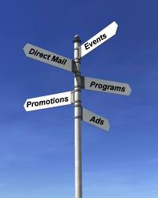
Promotions
The purpose of promotion is to inform, persuade, and influence the prospective customer’s.
The various methods widely used to inform customers about the availability of products are:
Personnel selling
Sales promotion
Advertising, and
Publicity
Notes:
Fixed costs include all costs that do not normally vary with the amount of product being produced.

Slide 17
Integrated Marketing Communication (IMC)
Involves the idea that a firm’s promotional efforts & resources allocated should be coordinated to achieve the best combined effects of the firm’s efforts.
The integrated Marketing involves making the right mix of the various promotional efforts referred as Promotional Mix & the allocation of resources for the purpose of implementing the tools and techniques which is required to make the best of the firm’s effort and thereby bring effectiveness by increase in demand.

Slide 18
The various elements of Promotional mix are:
Sales promotion: the sales promotion activities include
Samples, coupons,
Contests, Price-off offers etc.
Advertising: It involves the communication of information about a product, service to target customers through Newspaper, magazines,
Radio, T.V, out-door displays etc.
Publicity & Public relations: it involves non-paid transfer of information about a product in newspaper, trade publications, radio, T.V etc.
Personnel selling: It implies face to face contact between a seller and a buyer employing a salesman or salesgirl.
Notes:
It is important to include one time “start up” costs in the calculation. These are costs that occur once at the beginning of operations. They are not fixed or variable costs.

Slide 19
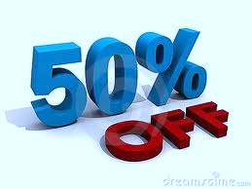
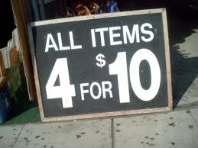
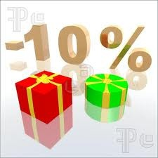
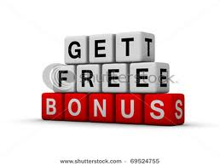
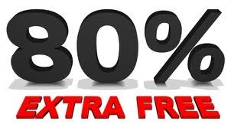
Sales promotion
Sales promotion, a key ingredient in marketing campaigns, consists of a collection of incentive tools, mostly short term, designed to stimulate quicker or greater purchase of particular products or services by consumers or the trade.
Advertising offers a reason to buy, whereas sales promotion offers an incentive to buy.

Slide 20
Sales promotion includes tools for:
Consumer promotion (samples, coupons, cash refund offers, prices off, premiums & prizes, free trial offers, warranties, tie-in promotions & cross-promotions, point-of-purchase displays, and demonstrations)
Trade promotion (prices off, advertising and display allowances, and free goods) and
Business & sales-force promotion (trade shows and conventions, contests for sales reps, and specialty advertising).

Slide 21
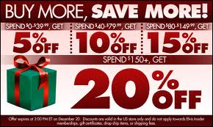
Consumer Promotions in the
Indian Market
The most frequently launched promotion is the premium offer (offering free gift in addition to the main purchase).
A sweepstake that provides a chance to win a large prize based on chance. (lucky draw or a scratch card offers).
Price-off (offering a discount on the regular price of purchase) and extra-product offer (offering an increased quantity of the product/service without an increase in the regular price) .
Buy more and save/get promotions that provide incentives to buy more units of the same products, or combinations of the same brand but different products (for example, same brand of air conditioner and refrigerator).
Exchange offers These types of promotions were used mostly for consumer durables and kitchen appliances.
Contests that provide a chance to win a large prize through skill (demonstrated by answering a question or writing a brand slogan).

Slide 22
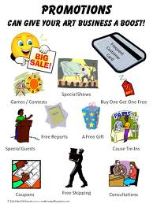
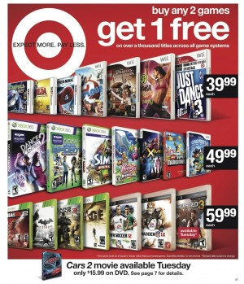
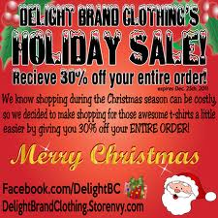
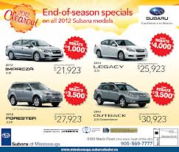

Slide 23

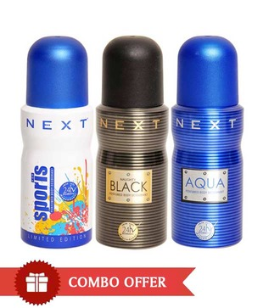
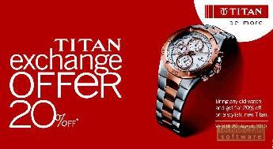


Slide 24
Objectives
Sales promotion tools vary in their specific objective.
A free sample stimulates consumer trial,
A free management-advisory service aims at building a long-term relationship with a retailer.
Sellers use incentive-type promotions to attract new triers, to reward loyal customers, and to increase the repurchase rates of occasional users.
Sales promotion attracts brand switchers, who are primarily looking for low price, good value, or premiums.
Sales promotions can be used in markets of high brand similarity & to gain permanent market share.

Slide 25
Difference between Advertising & Promotion
Previously Advertising to sales promotion ratio was about 60:40.
Today the sales promotion accounts for a total of 75%( Consumer promotion and Trade promotion) and is more popular.
Promotion is now more accepted by top management as a effective sales tool.
Advertising typically builds brand loyalty but sometimes sales promotion weakens brand loyalty, as sales promotion with its incessant prices off, coupons, deals, and premiums may devalue the product offering in the buyers' minds.

Slide 26
Sales promotion usage: Steps
Establishing Objectives
Selection of Consumer Promotion tools
Selection of Trade promotion tools
Selection of business and sales force promotion tools
Developing suitable campaign Program
Pretesting, implementing, controlling, & valuating the program

Slide 27
Establishing Objectives
Sales promotion objectives are derived from broader promotion objectives, which are derived from more basic marketing objectives developed for the product.
For consumers, objectives include encouraging purchase of large units, building trial among nonusers, and attracting switchers away from competitor’s brands. Promotions with consumers would have short-run sales impact; long-run brand equity effects.
For retailers, objectives include persuading retailer new items and higher levels of inventory, encouraging off-season buying, encouraging stocking of related items, offsetting competitive promotions, building brand loyalty and there by gaining entry into new retail outlets.

Slide 28
Selecting Consumer Promotion tools
The consumer promotion tools are selected by taking into account the type of market, sales promotion objectives, competitive conditions, and tool’s cost-effectiveness.

Slide 29
Consumer promotion tools
Samples:
Offer of a free amount of a product or service delivered door to door.
Coupons:
Certificates entitling the bearer to a stated Saving on the purchase of a specific product.
Cash Refund Offers (rebates):
Provide a price reduction after purchase.
Price Packs (cents-off deals):
Offers to consumers of ‘saving off’ the regular price of a product, flagged on the label or package. A reduced-price pack is a single package sold at a reduced price. A banded pack is two related products banded together (tooth brush and toothpaste)

Slide 30
Premiums (gifts):
Merchandise offered at a relatively low cost or free as an incentive to purchase a particular product. A with-pack premium accompanies the product is mailed to consumers who send in a proof of purchase.
Frequency Programs:
Programs providing rewards related to consumer’s purchasing frequency and intensity in taking the company's products or services.
Prizes (contests, sweepstakes, and games):
Prizes are offers to win cash, trips etc. as a result of purchasing something. A contest calls asking consumers to fill in contest entries. A game, sweepstake entries etc presents consumers with something which might help them win a prize.

Slide 31
Patronage Awards:
Values in cash or in other forms as patronage to a vendor or group of vendors.
Free Trials:
Inviting prospective purchasers to try the product without cost.
Product Warranties:
Explicit or implicit promises by seller that the product will perform as specified or the seller will fix it or refund the customer's money.
Tie-in Promotions:
Two or more brands or companies team up on coupons, refunds, and contests to increase the pulling power.
Cross-Promotions:
Using one brand to advertise another non-competing brand.
Point-of-Purchase (POP) Displays and Demonstrating:
POP displays and demonstrations at the point of purchase or sale.

Slide 32
Selecting Trade promotion tools
Manufacturer use a number of Trade promotion tools as:
Price-Off (off-invoice or off-list):
A straight discount off the list price on each purchased during a stated time period. ( Seasonal offs)
Allowance:
An amount offered in return for the retailer' agreeing to feature the manufactures product in some way. An advertising allowance compensates retailers for advertising the manufacturer’s product.
Free Goods:
Offers extra cases of merchandise to intermediatories who buy certain quantity or type.

Slide 33
Selection of business and sales force promotion tools
Trade Shows and Conventions:
Industry associations organize annual trade shows and conventions Participating vendors expect several benefits, including generating new sales leads, maintaining customer contacts, introducing new products, meeting new customers, selling more to present customers, and educating customers with publications, videos, and other audiovisual materials.
Sales Contests:
A sales contest aims at inducing the sales force or dealers to increase their sales over a stated period, with prizes (money, trips, gifts, or points) going to those who succeed.
Specialty Advertising:
Specialty advertising consists of useful, low-cost items bearing the company's name and address, and sometimes an advertising message that salespeople give to prospects and customers. Common items are ballpoint pens, calendars, key chains etc.

Slide 34
Pretesting, implementing, controlling , and evaluating the program
Although most sales promotion programs are the basis of experience, pretests, designed with tools which are appropriate and efficient. Consumers are asked to rate or rank possible deal , or trial run in limited geographic areas.
Marketing managers must prepare implementation and control plans for each individual promotion. Prepare the program prior to launching it: initial age, point-of-sale materials, and sell in time etc.
Manufacturers can evaluate the program using three methods: sales data, consumer surveys, and experiments.
Sales promotions work best when they attract competitor’s customers who then switch. If the company's product is not superior, its product share will return to its pre-promotion level.

Slide 36


