Slide 1
BUSINESS MANAGEMENT
CONCEPT OF Job analysis.
What is job description.
CONCEPT OF job specification and manpower planning.

Slide 2

JOB ANALYSIS
Job analysis is the process of studying a job to determine which activities and responsibilities it includes.
It helps an organization determine which employee is best for a specific job.
It is a way to determine the nature of the job and the duties employee has to perform.
It also provides information about what kind of people should be hired for a particular job profile.

Slide 3
It is a systematic way to collect information and make judgment about all the things related to a job.
Job analysis works in identifying, compiling and analyzing three main important component of Job i.e. Job Description, Job Specification and Job Evaluation.
STEP OF JOB ANALYSIS
Organizational Job Analysis
Selecting Representative Jobs for Analysis
Collection of Data for Job Analysis
Preparing Job Description
Preparing Job Specification

Slide 4
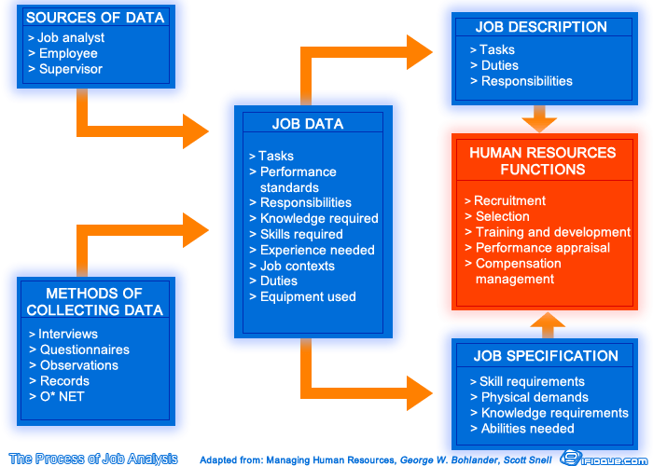
How to Conduct Job analysis?

Slide 5
JOB DESCRIPTION
The job description is collection of information about tasks, duties and responsibilities of the job holder.
A job description is an internal document that specifies the job requirements, job duties, job responsibilities, and skills required to perform a role.
a job description is usually developed by conducting a job analysis, which includes examining the tasks and sequences of tasks necessary to perform the job.
The analysis considers the areas of knowledge ,skills and abilities needed to perform the job.
Example :
Job title:
Job Summary:

Slide 6
JOB SPECIFICATION
a job specification is a written statement of educational qualifications, specific qualities, level of experience, physical, emotional, technical and communication skills required to perform a job, responsibilities involved in a job .
job specifics while the specification focuses on the person filling the position.
Example:
Must have a bachelor's degree in accounting or finance(Education Requirements)
Must have a minimum of five years of marketing work experience( Work Experience)
Has demonstrated written and verbal communication skills.(Required Skills)
Has a high level of professionalism(Personality Traits)

Slide 7
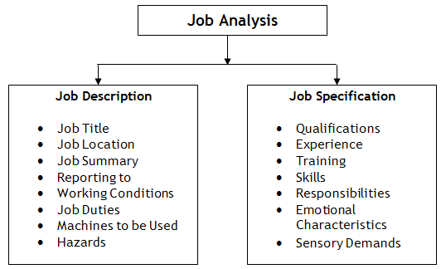

Slide 8
MANPOWER PLANNING
Manpower Planning is essentially the process of getting the number of qualified employees and seek to place the right employees in the right job at the right time, so that an organization can meet its objectives.
The objective of manpower planning is to forecast staffing level needs and work with company managers to make sure each department is properly staffed.
Manpower planning is the process of estimating. The optimum number of people required for completing a project, task, or goal within time

Slide 9
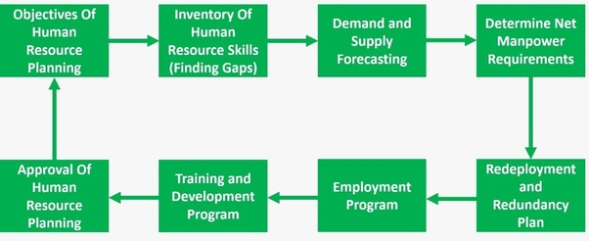
STAGES OF MAN POWER PLANNING

Slide 10
THANK YOU

