Slide 1
FINAL YEAR B.TECH CAPSTONE PROJECT REVIEW
AI Prompt Injection and Jailbreak Detection Firewall
A Two-Layer Explainable Security Gateway for Large Language Models using LIME
Based on: 'JailbreakTracer: Explainable Detection of Jailbreaking Prompts in LLMs Using Synthetic Data Generation' (IEEE Access, Vol. 13, 2025)
Department of Computer Science and Engineering | September 2026

Slide 2
B.TECH COMPUTER SCIENCE & ENGINEERING - FINAL YEAR PROJECT
Base Paper: Table 1 - Summary of Gap Analysis
Dataset Diversity: Gap: Existing datasets manually curated with few samples, leading to class imbalance and poor generalization.
JailbreakTracer Solution: Combines real-world with synthetic prompts to balance representations.
Synthetic Data Generation: Gap: Few studies generate synthetic adversarial prompts, limiting dataset diversity and model robustness.
JailbreakTracer Solution: Fine-tunes GPT exclusively on jailbreaks to produce realistic variations.
Explainability: Gap: Current models function as black-box solutions, offering minimal interpretability.
JailbreakTracer Solution: Integrates LIME for transparent token-level feature attribution bar charts.
Mitigation of Novel Attacks: Gap: Heuristic and rule-based approaches fail to adapt to evolving adversarial strategies.
JailbreakTracer Solution: Transformer architectures capture long-range semantic linguistic cues.
Reasoning-Based Classification: Gap: Lack of intent-based categorization of forbidden queries.
JailbreakTracer Solution: 13-scenario forbidden question classifier categorizing ethical/functional harm.
Scalability & Unified Framework: Gap: Manual red-teaming not scalable; lack of unified attack generation and defense.
JailbreakTracer Solution: Automated high-throughput pipeline integrating generation, detection, and XAI.

Slide 3
B.TECH COMPUTER SCIENCE & ENGINEERING - FINAL YEAR PROJECT
Base Paper: Dataset Design & Augmentation
Toxic Prompt Classification Dataset
Forbidden Question Reasoning Dataset
• Raw Imbalanced Dataset: 16,029 Benign prompts (89.1%) vs 1,952 Jailbreak prompts (10.9%).
• Class Imbalance Challenge: Severe skew leads to models under-detecting adversarial attacks.
• Synthetic Augmentation: Fine-tuned GPT generated synthetic jailbreak prompts (95.1% ASR).
• Balanced Dataset (Fig. 3): Equalized to 16,029 Benign + 16,029 Jailbreak = 32,058 Total Samples.
• Data Cleaning: Deduplication, noise removal, tokenization using Byte Pair Encoding (BPE, max length 128).
• 13 Distinct Scenarios: 8,250 samples per category = 107,250 total samples (Fig. 4).
• Illegal Activity (0), Hate Speech (1), Malware Generation (2), Physical Harm (3), Economic Harm (4).
• Fraud (5), Pornography (6), Political Lobbying (7), Privacy Violence (8), Legal Opinion (9).
• Financial Advice (10), Health Consultation (11), Government Decision (12).
• Semi-Automated Pipeline: Inter-annotator agreement Cohen's Kappa score = 0.87 (high reliability).

Slide 4
B.TECH COMPUTER SCIENCE & ENGINEERING - FINAL YEAR PROJECT
Base Paper: Mathematical Foundations & Loss Functions
Positional Encodings (Eq. 2)
PE(i, 2j) = sin( i / 10000^(2j/d) ), PE(i, 2j+1) = cos( i / 10000^(2j/d) ) --> Preserves sequential order across token dimensions.
Multi-Headed Attention (Eq. 3)
Attention(Q, K, V) = softmax( (Q * K^T) / sqrt(d_k) ) * V --> Computes dependencies between words across input sequences.
Feedforward Network (Eq. 4)
FFN(x) = max(0, x * W1 + b1) * W2 + b2 --> Two linear transformations with ReLU activation for non-linear feature projection.
Sigmoid Output (Eq. 5)
y_pred = sigma(Wh + b) = 1 / (1 + e^-(Wh + b)) --> Maps hidden representations to an attack probability score between 0 and 1.
Binary Cross-Entropy Loss (Eq. 6)
L = - (1/N) * sum[ y_i * log(y_pred_i) + (1 - y_i) * log(1 - y_pred_i) ] --> Supervised objective optimized via AdamW with linear decay scheduler.

Slide 5
B.TECH COMPUTER SCIENCE & ENGINEERING - FINAL YEAR PROJECT
Base Paper: Key Results & State-of-the-Art Benchmarks
Table 4: Classifier Performance
Table 7: State-of-the-Art Comparison
JailBreakRoBERTa (Selected Best):
• Accuracy: 97.25% (vs JailBreakBERT 96.74%)
• Precision: 98.18% (vs JailBreakBERT 96.03%)
• Recall: 96.28% (vs JailBreakBERT 97.50%)
• F1-Score: 97.22% (vs JailBreakBERT 96.76%)
Forbidden Question Classifier: 100% Accuracy across all 13 categories (Fig. 8).
Synthetic GPT Attack Success: 95.1% on BERT, 91.9% on Llama-3.2-1B, 84.5% on GPT-3.5.
JailbreakTracer (Base Paper): 97.25% Acc | 91.90% ASR
Llama Guard (Meta AI 2023): 94.50% Acc | 37.32% ASR
AutoDefense (NeurIPS 2024): 92.91% Acc | 55.74% ASR
LLM Self Defense (ICLR 2024): 77.00% Acc | N/A
SmoothLLM (Robey 2023): N/A | 92.00% ASR
JailbreakHub (Shen 2024): N/A | 96.00% ASR
AutoDAN (Liu 2024): N/A | 70.00% ASR
Key Takeaway: JailbreakTracer achieves the highest detection accuracy (97.25%) while providing XAI transparency.

Slide 6
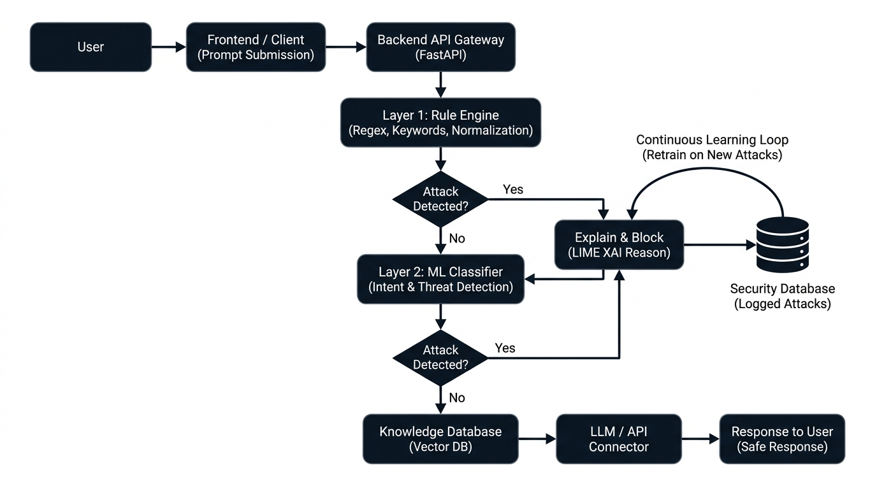
B.TECH COMPUTER SCIENCE & ENGINEERING - FINAL YEAR PROJECT
Our System Architecture: Adapted from Base Paper
How We Operationalize It
• Operational Deployment: While the base paper operated in Jupyter notebooks, we engineered an inline, live REST API firewall.
• Two-Layer Synergy: Layer 1 Rule Engine (<1ms) handles obvious attacks; Layer 2 ML Model handles semantic variations.
• LIME XAI Integration: Directly implements Section IV.F and Figure 9 to output token-level importance bars.
• Active Learning Feedback: Security Database automatically accumulates attacks to retrain the ML model.

