Slide 1

PRESENTATION ON A HOSPITAL
PRESENTED BY:
ANUBHAV KHADKA
ANJIT PARIYAR
CHANDA SHRESTHA

Slide 2
1.Background
The concept of this project came in our mind when group member visited Lagankhel polyclinic. The working system is not well managed and the process were slow. For the proper management of hospital we have decided to build a project which would keep the proper record of patient’s, doctors, report and hospital in a systematic way within the short time period.

Slide 3
2.Project Introduction
The name of our project is “A HOSPITAL”. The main concept of this project is take appointment, cancel appointment and changed the information of patient’s that has been store by admin/doctor. Its also contains many other elements like information of appointed doctors, information about doctors and report of patient’s in a systematic way. And we can easily check our reports that has been store and updated by admin/doctor.

Slide 4
2.1Objectives of project
1.To provide information of the hospital, doctor and its service
2.To make Easy for the appointment
3.Easy to view the report

Slide 5
2.2 Project feature
1. Doctor appointment
i. Take appointment
ii. Cancel appointment
2. Store patient’s information
i. Modify patient’s information
ii. Delete patient’s information
3. Allows to add doctor’s information
i. Search for specific doctors
4. Login system
5. Provides facility for viewing doctor’s information

Slide 6
3.Project specification
3.1 Functional requirement
3.1.1 Administration module:
This module enables the user to insert, update, view, search and delete the patient's, doctor's information.
3.1.2 Doctors module
It includes the information related information to the doctor as mentioned below:
Attribute of Doctor: Name, Department, Telephone number, available time
3.1.3 Patient Module
It includes the information related to the patient as mentioned below:
Data Members: Name, Patient ID, DOB,

Slide 7
3. Team structure and roles
Members Name | Symbol Number | Task Performed
Anjit Pariyar | 310520 | Coding and Documentation
Anubhav Khadka | 310521 | Coding and Documentation
Chanda Shrestha | 310597 | Coding and Documentation

Slide 8
3.1 Implementation 3.1.1Library functions
Name of library function | Description
stdio.h() | This is standard input/output header file in which Input/Output functions are declared like printf, scanf
conio.h() | This is console input/output header file which performs console input output and includes built in function
String.h() | All string related functions are defined in this header file which defines one variable type & various functions for manipulating array of characters & is also used for string operations.
Time.h() | This header file contains time and clock related functions. Date and time operations are defined in this header file.
Windows.h() | It declaration for the function of windows API

Slide 9
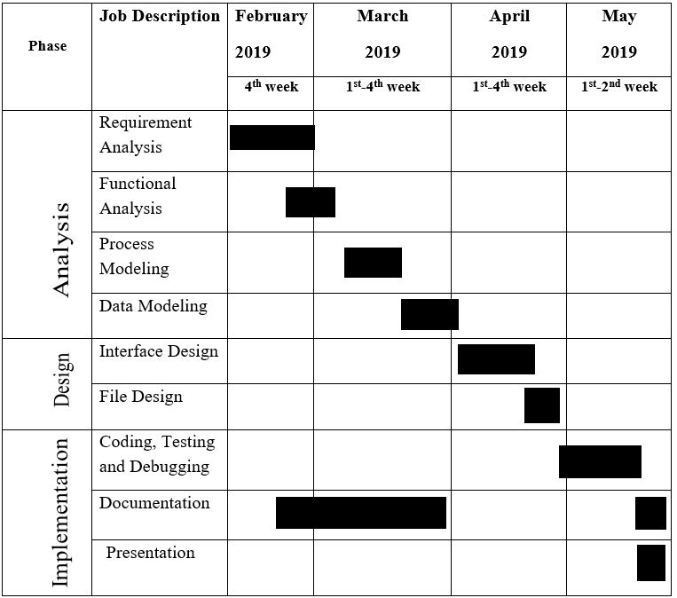
3.1.2 Gantt chart

Slide 10
4. Software and development
4.1TOOLS AND TECHNOLOGY
It has been created using the code block compiler

Slide 11
4.2 Algorithm
step1: Start
Step 2: Display menu
Choice1: Emergency
Choice 2: Doctor appointment
step1 :select department
step2 : select doctor
step3 : select time
step4 : url form
step5 : appointment complete
step6 : goto step2
Choice3: Appointed doctors
Choice 4: Our doctor
Choice5: Our department
Choice 6: Doctor login
Choice 7: Your report
Choice 8: Exit
Default: Go to step 2
Step 3: stop

Slide 12
4.3 Flowchart
start
Select department
Select doctor
Appointment task complete
Select time
Form url
stop

Slide 13
Testing
Input | Expected Output | Actual Output | Status
To add patient’s detail for appointment | Doctors can get the information of patients | appointed | True
To re-enter the patient information | Doctor can get the information patients | Changed information | True
To view patient’s report | To display all the report of patient | Displayed | True
To change the information of patients | To be added updated information of patient | Added | True
To delete patient information | Removed from the file | Removed | True
To view department list | To view the department list | Displayed | True
Input exit | To clear all the appointment of the day and generate new ID for next day | cleared | True

Slide 14
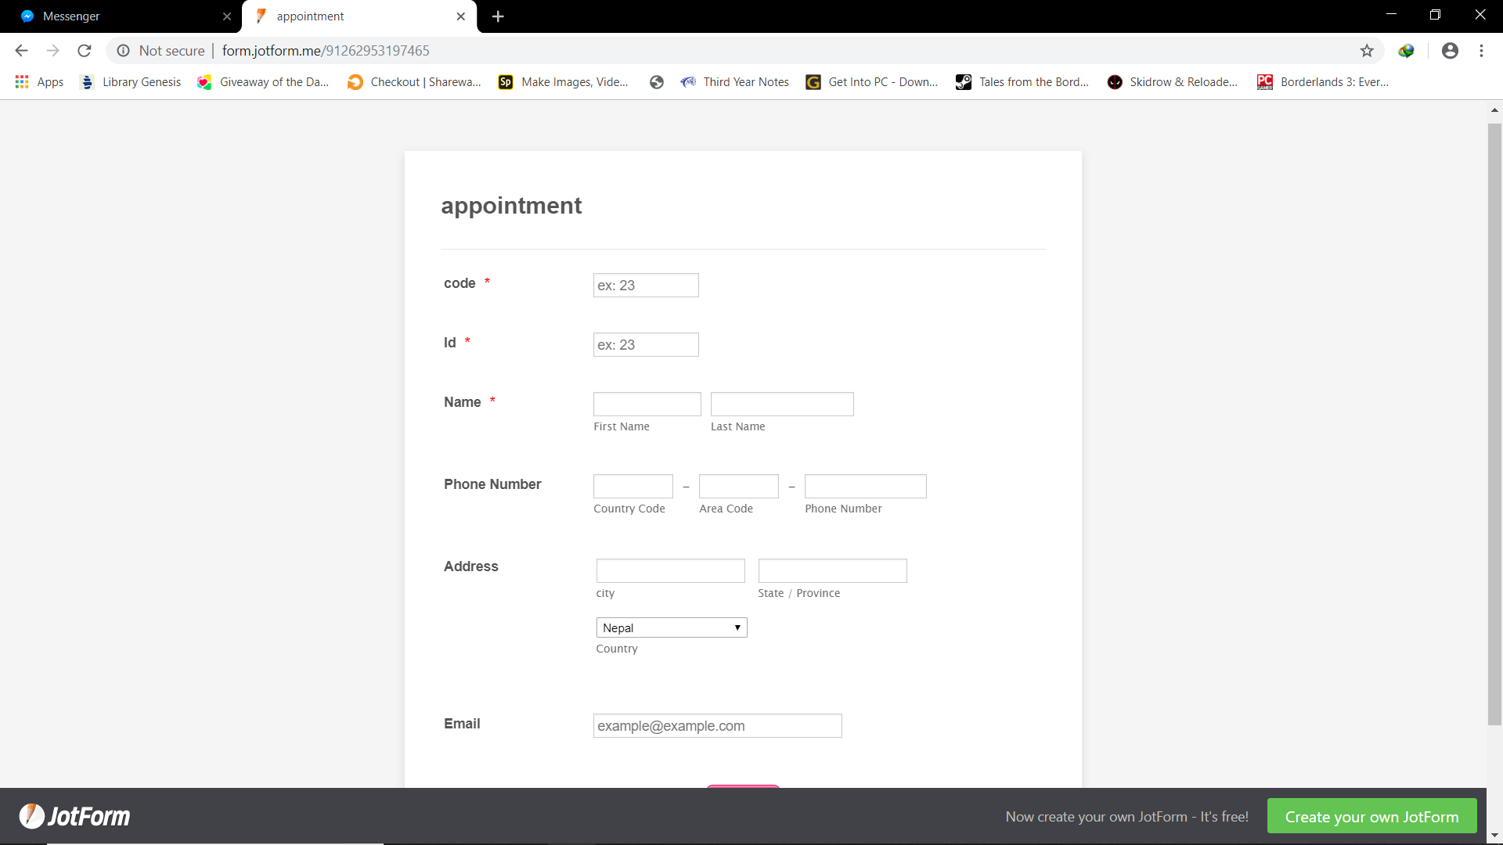

Slide 15
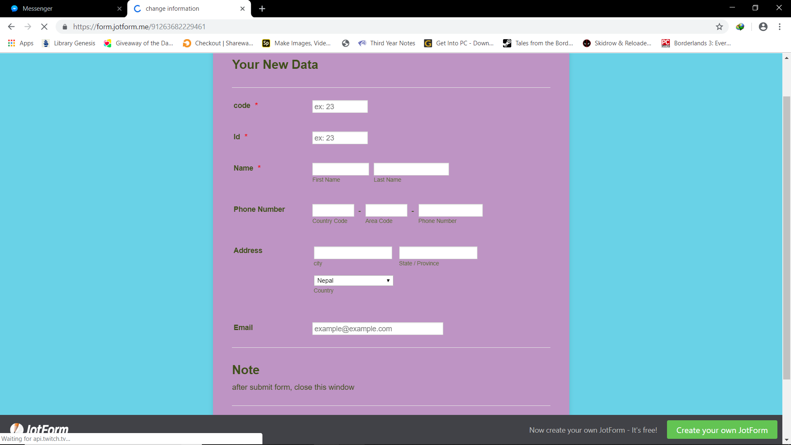

Slide 16
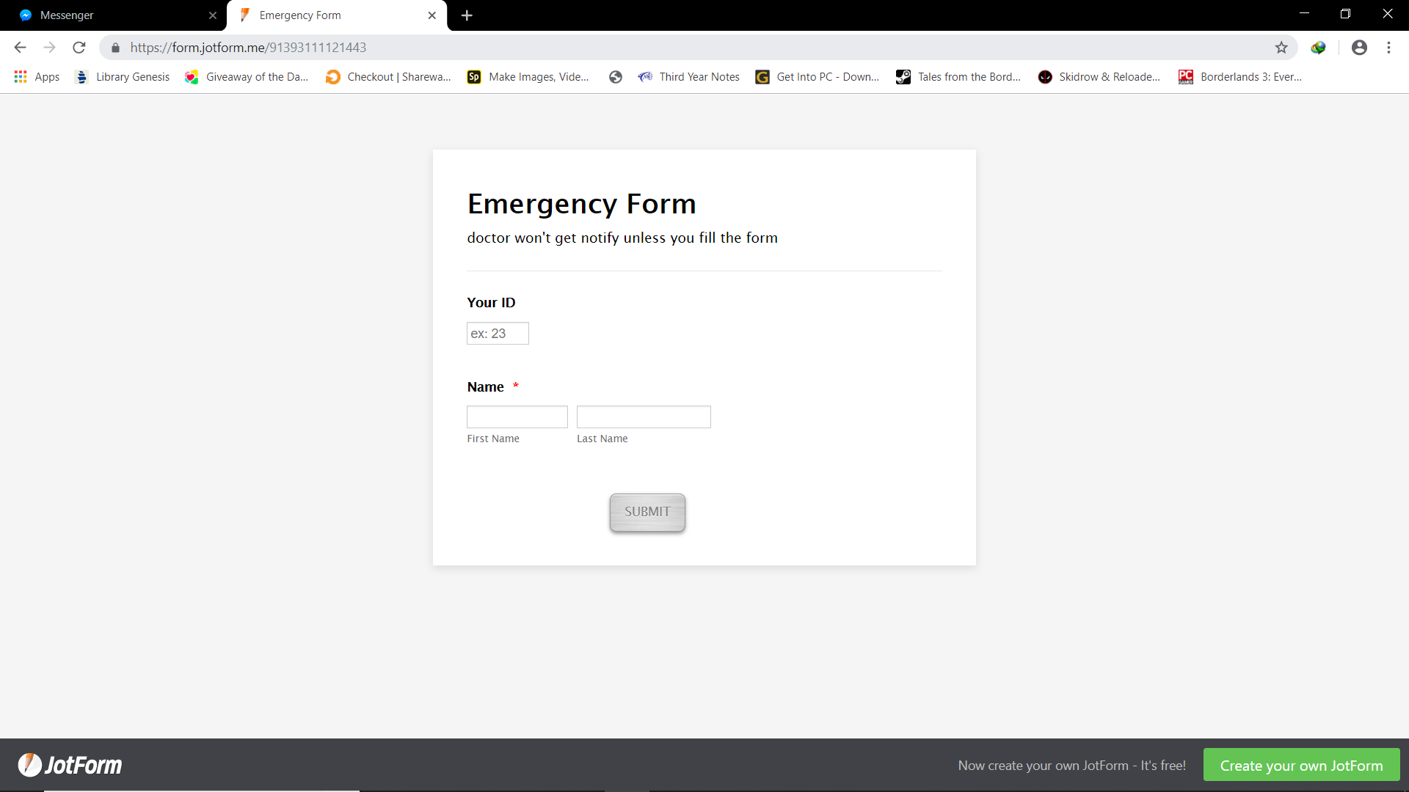

Slide 17
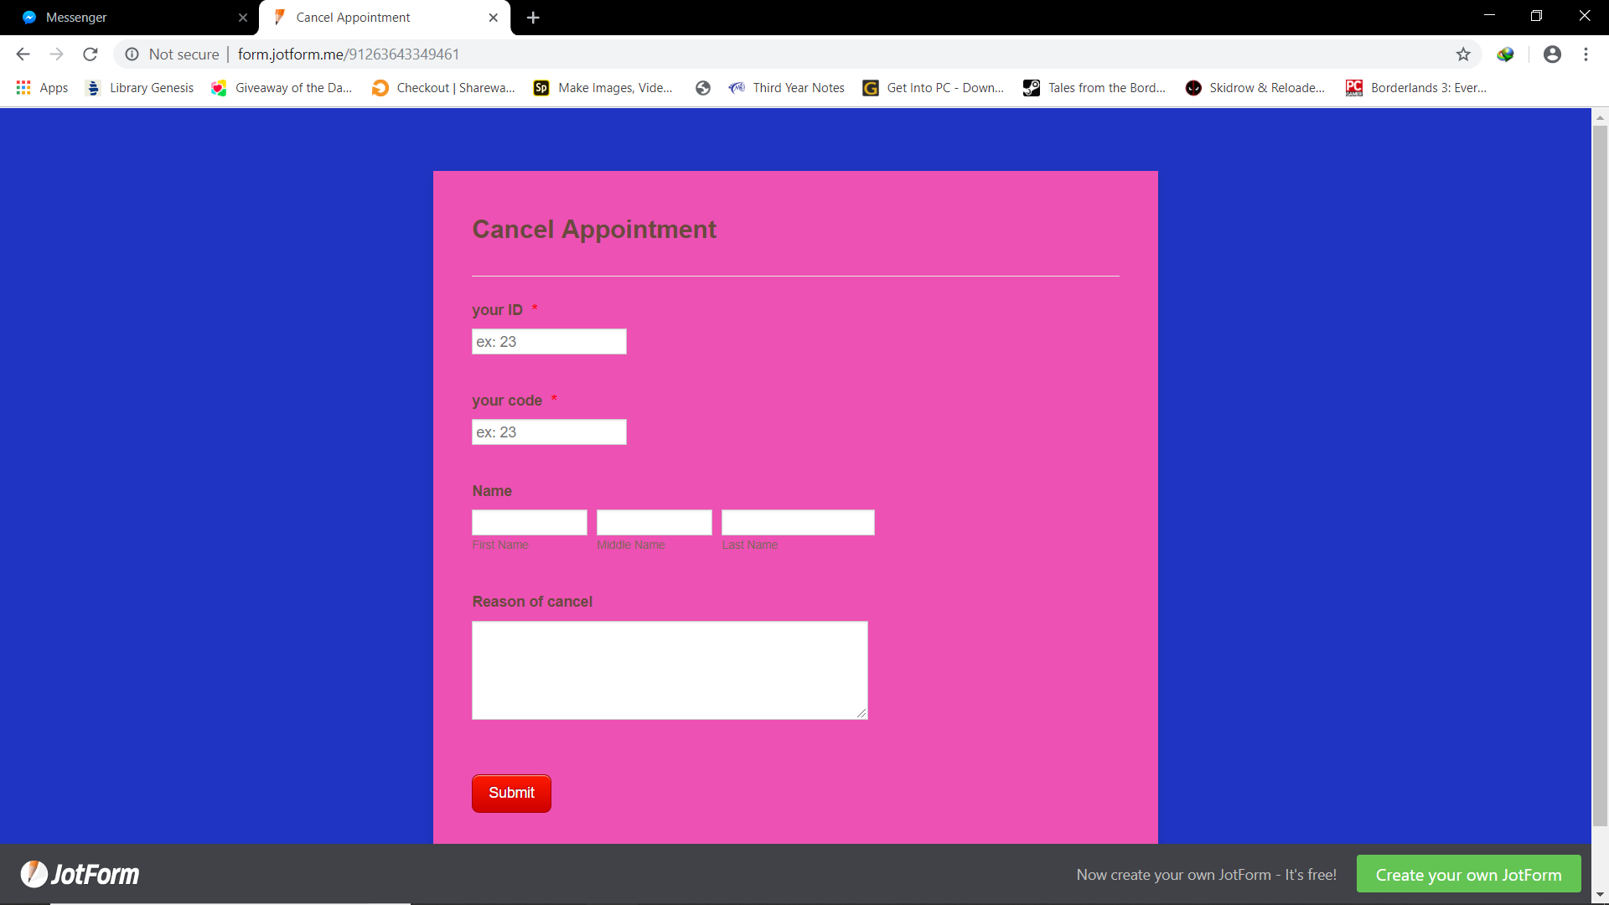

Slide 18
5 Conclusion
The project "A HOSPITAL" is for computerizing the working in a hospital and is capable of providing easy and effective storage of information related to doctors and patients. This project takes care of all the requirements of an average hospital & is capable to provide easy & effective storage of information related to patients that come up to the hospital. The project has matched the objectives set at the time of project's concept submission.
After completing this project, the project members are in the position to explain the programming concept and apply them to the modelling of real world system.

Slide 19
Limitation
Appointment fee
Can be used as standalone only
Future enhancement
Billing system

Slide 20
Reference
Dhulikhel Hospital.(2014). Retrieved March/April,2019,from https://www. Dhulikhelhospital.org/
Norvic Hospital. (1994). Retrieved March/April, 2018, from https://norvic hospital.com/
Community, G. (2011, August). Grande International Hospital. Retrieved March/April, 2019, from https://www.grandehospital.com/
Community, G. (2011, August). Grande International Hospital. Retrieved March/April, 2019, from https://www.grandehospital.com/
https://www.udemy.com/c-for-technical-interview/
Balguruswamy, "Programming in C", Tata McGraw-Hill Publishing,1992
Ram Datta Bhatta, "A Textbook of C Programming", (Reprint 2013), Shangrila Printing Services.

Slide 21


