Slide 1
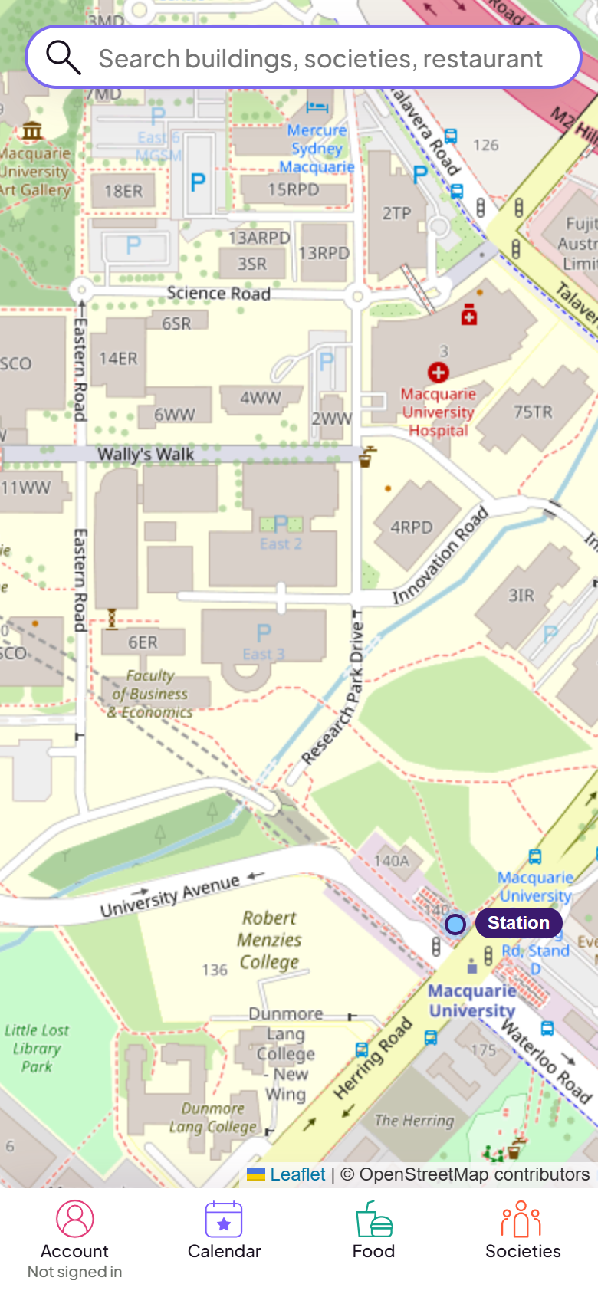
How can a new student with a disability find a society, then get to its events?
MacDirect: a campus map that shows access details, not just buildings
Notes:
TIME 0:00 to 0:30 (about 60 words)
Imagine it is your first week at Macquarie, and you use a wheelchair or find stairs hard. Societies are a great way to make friends. But before you go, you need to know: can I get into the building, is there a lift, is there an accessible toilet, and does the walk have stairs? Today I will show how MacDirect helps with those questions.

Slide 2
Societies and access details on one map
129
34 of 63
Stairs
societies
buildings show lifts and accessible toilets
warned about on the walking route
Browse as a guest, check the building and the route, then go.
Notes:
TIME 0:30 to 1:15 (about 75 words)
MacDirect is a mobile map of the Macquarie campus. It lists 129 societies and 63 named buildings. For 34 of those buildings it shows how many lifts and accessible toilets there are, read from Macquarie's own Accessibility Map. The other 29 say Not confirmed, which does not mean there is no lift. When you ask for directions, the route card tells you if the walk includes stairs. You can browse all of this as a guest, with no account.

Slide 3
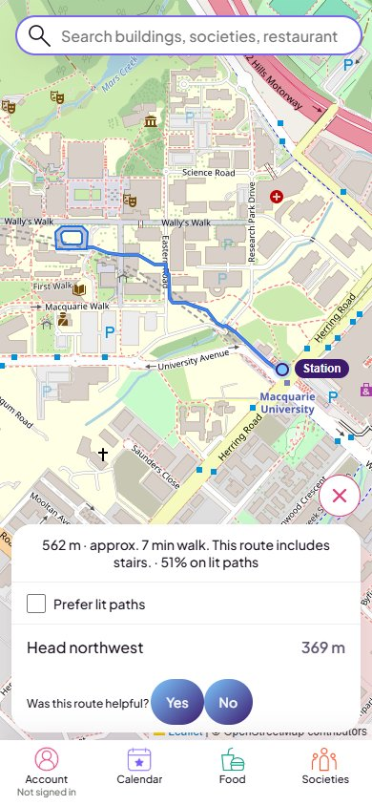
Priya's first week
Priya is a made-up example who needs step-free access. Clip recorded on the live site.
1
Finds the Law Society in Societies
2
Show on map: it meets in the Michael Kirby Law Building
3
Panel shows 1 lift and 1 accessible toilet
4
Directions: 562 m, with a warning: this route includes stairs
Notes:
TIME 1:15 to 3:15 (about 195 words). Play the clip. If the video will not play, open demo-fallback.gif from the same folder.
This is Priya. She is an example student, not a real participant, and she needs step-free access. She finds the Law Society in the Societies list and taps Show on map. The map moves to the Michael Kirby Law Building, and the panel says the Law Society meets here.
She scrolls the panel to Accessibility. It shows one lift and one accessible toilet. That is useful, but the data is read from a PDF map, so positions are approximate and she should check on site.
Now she taps Directions. The route is 562 metres, about seven minutes from the station. The card says: this route includes stairs.
This is the honest part. MacDirect warns about stairs, but it does not yet choose a step-free route for her. Five of the 63 routes from the station include stairs. So today Priya gets a warning and the lift information, not a guaranteed step-free path. A step-free option is my first target.
I did not show the mcqAI search, because it is only a stub.

Slide 4
How I tested, and how I used AI
Calendar buttons did nothing
7a55ff4 · caught by me
76
Lighthouse mobile score, one run
Name showed Saved but did not save
80d0740 · caught by the AI tester
0.35 s
Walk steps added up 34 m short
18443f4 · caught by a script
/api/map first byte, 10 requests
I reverted the AI's colour change (85a85db). Never tested: with students who have a disability, or logged-in accounts.
Notes:
TIME 3:15 to 4:15 (about 120 words)
This slide is an audit of how I used AI, not a claim that the app is perfect.
Three real bugs. I found the Calendar bug myself, because the buttons did nothing. The AI tester agent found the display name bug: the screen said Saved when the database changed nothing. A script found that the walking steps were 34 metres short of the route total.
The AI was also wrong sometimes. It built my report around lit paths, and I told it to stop. I also reverted its colour change.
For speed, I measured one Lighthouse mobile run: performance 76, and 4.5 seconds to the largest paint. The map data call took about 0.35 seconds to the first byte.
What I never tested: the app with students who have a disability, and logged-in accounts. I have also not checked the lift and toilet positions against the real campus.

Slide 5
What exists today, and what I aim for
Built and live today
Targets, not results
129 societies, 63 buildings
Lift and toilet details for 34 buildings
A warning when a route has stairs
Not yet tested with real users
A step-free route option (not built yet)
Students with a disability try the Priya task
Check lift and toilet data on site
Notes:
TIME 4:15 to 5:00 (about 95 words)
What exists today is a working app with real counts: 129 societies, 63 buildings, lift and toilet details for 34 buildings, and a stairs warning on routes. That is not the same as proven results. Nobody has tested it with real users, so I have no user numbers.
These are targets, not results. First, build a step-free route option. Second, ask students with a disability to try the Priya task, with their consent. Third, check the lift and toilet data on site.
The question stays the same: can every new student find a society and reach its events? Thank you.

