Slide 1
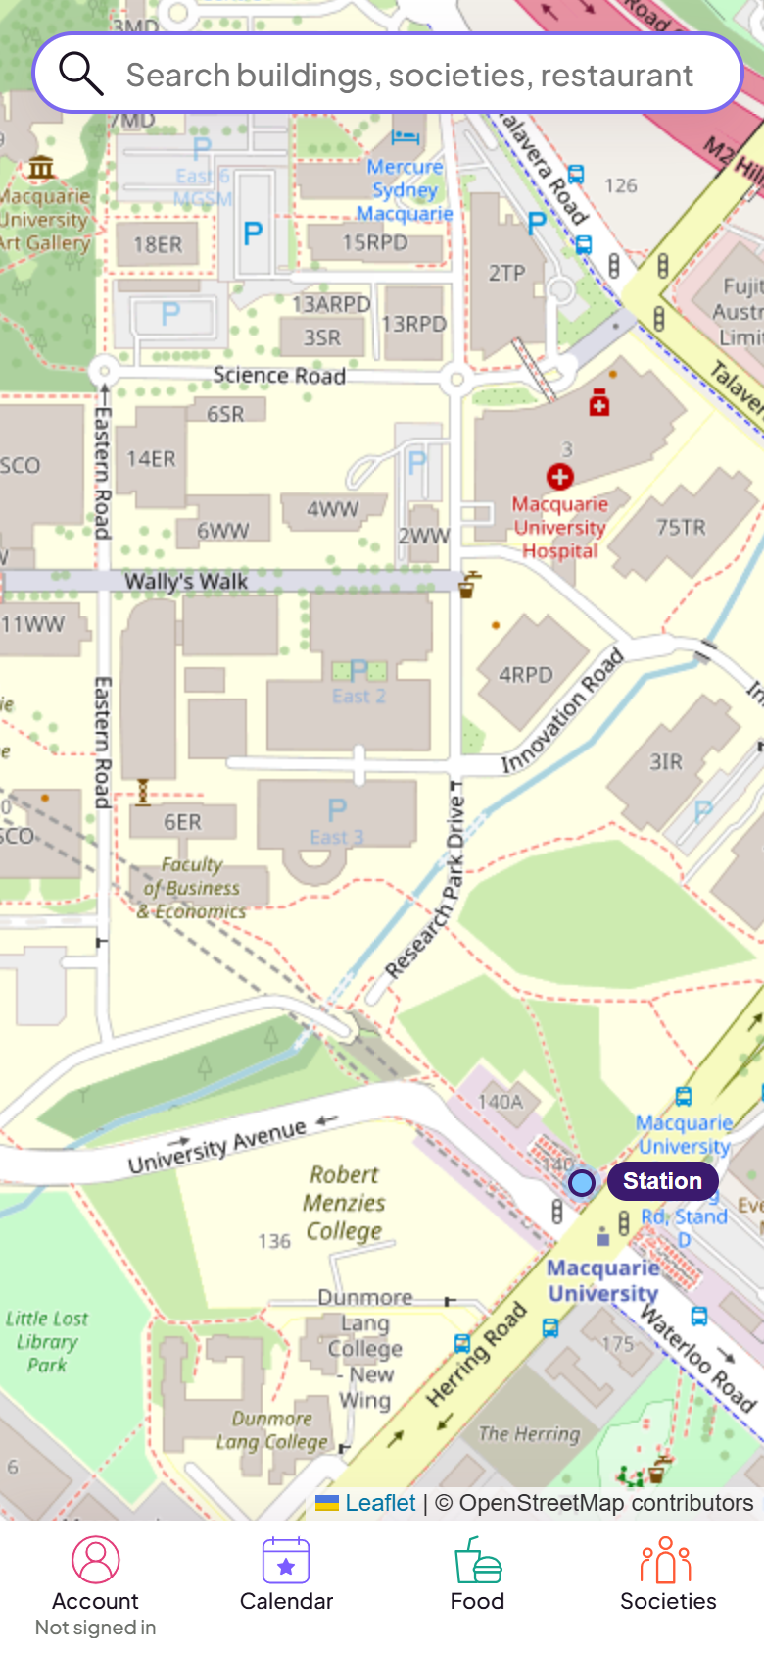
How can a new student find a society, join one, and get to its events?
MacDirect: a campus map for your first week at Macquarie
Notes:
TIME 0:00 to 0:30 (about 55 words)
Imagine it is your first week at Macquarie. People tell you societies are the best way to make friends. But how do you find one, join it, and then find the room where it meets? Today I will show MacDirect, a campus map that tries to answer that for new students.

Slide 2
MacDirect puts societies on the campus map
129
63
12
Guest
societies
named buildings
languages
mode: browse with no account
Pick a society, see where it meets, then get a walking route from the station.
Notes:
TIME 0:30 to 1:15 (about 75 words)
MacDirect is a mobile map of the Macquarie campus. It lists 129 societies and 63 named buildings, and it works in 12 languages. You do not need an account. Guest mode lets you browse the map, the societies and the food. Each society can be shown on the map, and every building has a Directions button that draws a walking route from the station. All of these are real counts from the app.

Slide 3
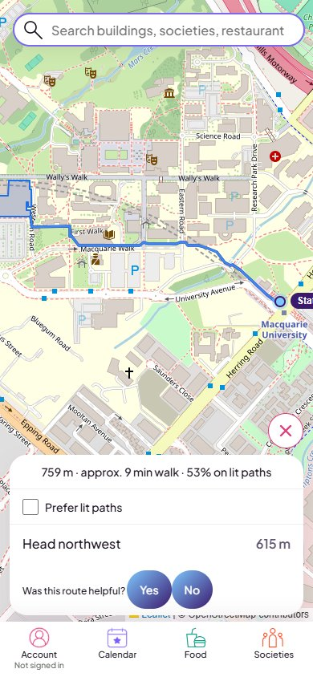
Priya's first week
Priya is a made-up example. Clip recorded on the live site.
1
Opens MacDirect as a guest
2
Societies, Hobbies, A Cappella Society
3
Show on map: it meets at 25 Wally's Walk
4
Directions: 759 m, about 9 min from the station
Notes:
TIME 1:15 to 3:15 (about 215 words). Play the clip. If the video will not play, open demo-fallback.gif from the same folder.
This is Priya. She is an example student, not a real test participant. It is her first week and she wants a hobby group. She opens MacDirect as a guest, so there is no sign-up.
She taps Societies and chooses Hobbies. She sees the A Cappella Society. She opens the card menu and taps Show on map. The map moves to 25 Wally's Walk, and the panel says the society meets here.
She taps Directions. The route is 759 metres, about a nine minute walk from the station. Priya never had to type a building name or remember where anything was. The search bar can also find societies and restaurants directly, if she prefers to search. While the clip plays, I talk through each step, so nobody is watching a silent video.
Notice that this whole story needs no login. Events are different. They live in the Calendar, which needs an account, and a society leader has to post them. So today I am showing how to find a society and walk to where it meets. I am not showing a real leader posting an event, because I have not tested that with a real leader account.
I also did not show the mcqAI search. It is only a stub and does not answer yet.

Slide 4
How I tested, and how I used AI
Calendar buttons did nothing
7a55ff4 · caught by me
76
Lighthouse mobile score, one run
Name showed Saved but did not save
80d0740 · caught by the AI tester
0.35 s
Walk steps added up 34 m short
18443f4 · caught by a script
/api/map first byte, 10 requests
I reverted the AI's colour change (85a85db).
Notes:
TIME 3:15 to 4:15 (about 115 words)
This slide is an audit of how I used AI, not a claim that the app is perfect.
Three real bugs. I found the Calendar bug myself, because the buttons did nothing. The AI tester agent found the display name bug: the screen said Saved when the database changed nothing. A script found that the walking steps were 34 metres short of the route total.
The AI was also wrong sometimes. It built my report around lit paths, and I told it to stop. I also reverted its colour change.
For speed, I measured one Lighthouse mobile run: performance 76, and 4.5 seconds to the largest paint. The map data call took about 0.35 seconds to the first byte.
What I never tested: logged-in accounts, and the machine-written translations.

Slide 5
What exists today, and what I aim for
Built and live today
Targets, not results
129 societies
63 buildings, 12 languages
Guest mode and walking routes
Not yet tested with real users
5 first-year students try the Priya task
Mobile loading under 2.5 s (4.5 s in one run today)
Native speakers check the translations
Notes:
TIME 4:15 to 5:00 (about 80 words)
What exists today is a working app with real counts. That is not the same as proven results. Nobody has tested it with real users, so I have no user numbers.
These are targets, not results. First, ask five first-year students to try the Priya task. Second, bring mobile loading under two and a half seconds. Third, ask native speakers to check the translations.
The question stays the same: can a new student find a society, join it and reach its events? Thank you.

