Slide 1

FISH MARKET
ANJU E
(MES24MCA-2006)
Department of Computer Applications
MES College of Engineering, Kuttippuram
20-08-2025

Slide 2
PRODUCT OWNER HYDERALI K (HOD) DEPARTMENT OF COMPUTER APPLICATIONS MES COLLEGE OF ENGINEERING, KUTTIPPURAM

Slide 3
TABLE OF CONTENTS
Introduction
Objective
Existing System
Proposed System
Motivation
Functionalities
Module Description
Developing Environment
Sprint Backlog
Product Backlog
User Story
Project Plans
Data Flow Diagrams
ER Diagram

Slide 4
FISH MARKET
Connects fishermen, harbour staff, customers, and delivery boys on one platform.
Removes middlemen to give fair prices to fishermen and lower costs to customers.
Lets fishermen/harbours list fish for sale online.
Customers can browse fish, place orders, and pay online.
Delivery boys can view orders and update delivery status.
Provides real-time stock updates and transparent pricing.
Improves freshness, speed, and efficiency of fish trading.

Slide 5
OBJECTIVES
To create a direct link between fishermen, harbour staff, customers, and delivery boys.
To remove middlemen and ensure fair pricing for fishermen.
To give customers easy access to fresh fish at reasonable prices.
To provide an online platform for listing, browsing, ordering, and paying for fish.
To enable real-time stock updates and order tracking.
To improve efficiency and transparency in the fish trading process.

Slide 6
EXISTING SYSTEM
Fish are sold through middlemen, reducing fishermen’s profits.
Customers pay higher prices due to added middlemen costs.
No transparent pricing for fish.
Customers cannot order or check availability online.
Multiple handling and transport steps reduce fish freshness.
Fishermen cannot track demand or manage stock efficiently.

Slide 7
PROPOSED SYSTEM
The new system will be easier to use.
It will automate many tasks to save time.
It will reduce mistakes by handling data automatically.
Different users will have their own login and access rights.
The system will keep data safe and secure.
It will give real-time updates and notifications.
It will help users and admins work faster and better.

Slide 8
MOTIVATIONS
To solve problems in the current system that are slow or difficult to use.
To save time by automating manual tasks.
To reduce errors caused by human mistakes.
To provide better access and control for different users.
To keep data safe and secure from unauthorized access.
To improve communication with real-time updates.
To make the system more efficient and reliable.

Slide 9
FUNCTIONALITIES
User registration and login with secure authentication.
Profile management to update personal details.
View available products/items or services.
Add items to a cart or list for further action.
Place orders or requests through the system.
Track order/request status in real-time.
Send feedback or complaints and view replies.

Slide 10
MODULE DESCRIPTION
Admin
● Login
● View user
● Manage boat
● Manage harbour
● Manage fish
● Manage delivery boy
● View feedback
● View complaint & send reply
● Change password

Slide 11
MODULE DESCRIPTION
Harbour:
● Login
● View profile
● View orders
● Assign order
● View boat
● View fish
● Update stock
● Change password

Slide 12
MODULE DESCRIPTION
User:
● Register
● Login
● View profile / Edit profile
● View harbour
● View fish
● Add to cart
● View cart & payment
● Send complaint & view reply
● Send feedback
● Change password

Slide 13
MODULE DESCRIPTION
Delivery boy:
● Login
● View profile
● View orders
● Update status
● Change password

Slide 14
DEVELOPING ENVIRONMENT
Programming Language: Python / Java / PHP / (Specify the language you are using)
Framework: Django
Database: MySQL / PostgreSQL / MongoDB / SQLite (Choose your database)
IDE/Code Editor: Visual Studio Code
Operating System: Windows / Linux / macOS
Version Control: Git / GitHub
Browser: Google Chrome / Firefox (For testing and debugging the web application)

Slide 15
SPRINT BACKLOG
Backlog tem | Status And Completion Date | Original Estimation in Hours | Day 1 hrs | Day 2 hrs | Day 3 hrs | Day 4 hrs | Day 5 hrs | Day 6 hrs | Day 7 hrs | Day 8 hrs | Day 9 hrs | Day 10 hrs
SPRINT1
Project setup and DB creation | 14/08/2025 | 2 | 1 | 1 | 0 | 0 | 0 | 0 | 0 | 0 | 0 | 0
User registration | 18/08/2025 | 3 | 1 | 1 | 1 | 0 | 0 | 0 | 0 | 0 | 0 | 0
login/loginout functionality | 21/8/2025 | 3 | 1 | 1 | 1 | 0 | 0 | 0 | 0 | 0 | 0 | 0
SPRINT 2
Add fish listing | 27/08/2025 | 7 | 1 | 1 | 1 | 1 | 1 | 1 | 1 | 0 | 0 | 0
Stock update in realtime | 31/08/2025 | 7 | 1 | 1 | 1 | 1 | 1 | 1 | 1 | 0 | 0 | 0

Slide 16
SPRINT BACKLOG
Backlog tem | Status And Completion Date | Original Estimation in Hours | Day 1 hrs | Day 2 hrs | Day 3 hrs | Day 4 hrs | Day 5 hrs | Day 6 hrs | Day 7 hrs | Day 8 hrs | Day 9 hrs | Day 10 hrs
SPRINT 3
Add to cart function | 05/09/2025 | 7 | 1 | 1 | 1 | 1 | 1 | 1 | 1 | 0 | 0 | 0
Checkout process and save oreders | 10/09/2025 | 7 | 1 | 1 | 1 | 1 | 1 | 1 | 1 | 0 | 0 | 0
SPRINT 4
Assign delivery boys | 15/09/2025 | 7 | 1 | 1 | 1 | 1 | 1 | 1 | 1 | 0 | 0 | 0
Payment integretion and reciepts | 20/09/2025 | 7 | 1 | 1 | 1 | 1 | 1 | 1 | 1 | 0 | 0 | 0

Slide 17
SPRINT BACKLOG
Backlog tem | Status And Completion Date | Original Estimation in Hours | Day 1 hrs | Day 2 hrs | Day 3 hrs | Day 4 hrs | Day 5 hrs | Day 6 hrs | Day 7 hrs | Day 8 hrs | Day 9 hrs | Day 10 hrs
SPRINT 5
Feedback and complaint module | 25/09/2025 | 7 | 1 | 1 | 1 | 1 | 1 | 1 | 1 | 0 | 0 | 0
Report generation | 30/09/2025 | 7 | 1 | 1 | 1 | 1 | 1 | 1 | 1 | 0 | 0 | 0
SPRINT 6
Testing and bug fixing | 06/10/2025 | 7 | 1 | 1 | 1 | 1 | 1 | 1 | 1 | 0 | 0 | 0
Deplyment and review | 12/10/2025 | 7 | 1 | 1 | 1 | 1 | 1 | 1 | 1 | 0 | 0 | 0
TOTAL |  | 50 | 9 | 9 | 8 | 6 | 6 | 6 | 6

Slide 18
PRODUCT BACKLOG
ID | NAME | PRIORITY <high/medium/low> | ESTIMATE (Hours) | STATUS <Planned/In progress/Completed>
1 | REGISTRATION | HIGH | 5 | In progress
2 | LOGIN/LOGIN OUT FUNCTIONALITY | HIGH | 5 | In progress
3 | PROJECT SETUP &DB CREATION | HIGH | 4 | In progress
4 | MANAGE BOATS & HARBOUR | HIGH | 8 | In progress
5 | MANAGE FISH LISTINGS | HIGH | 7 | In progress

Slide 19
PRODUCT BACKLOG
ID | NAME | PRIORITY <high/medium/low> | ESTIMATE (Hours) | STATUS <Planned/In progress/Completed>
6 | MANAGE DELIVERY BOYS | MEDIUM | 6 | In progress
7 | VIEW COMPLAINT & SEND REPLY | MEDIUM | 5 | In progress
8 | HARBOUR VIEW ORDER | HIGH | 6 | In progress
9 | UPDATE STOCK IN REAL TIME | HIGH | 7 | In progress
10 | ADD FISH LISTING | HIGH | 7 | In progress

Slide 20
PRODUCT BACKLOG
ID | NAME | PRIORITY <high/medium/low> | ESTIMATE (Hours) | STATUS <Planned/In progress/Completed>
11 | USER VIEW FISH LISTING | HIGH | 5 | In progress
12 | ADD TO CART FUNCTION | HIGH | 7 | In progress
13 | CHECKOUT PROCESS & SAVE ORDERS | HIGH | 7 | In progress
14 | ASSIGN DELIVERY BOYS | HIGH | 7 | In progress
15 | PAYMENT INTEGRATION & RECIEPTS | HIGH | 7 | In progress

Slide 21
PRODUCT BACKLOG
ID | NAME | PRIORITY <high/medium/low> | ESTIMATE (Hours) | STATUS <Planned/In progress/Completed>
16 | FEEDBACK & COMPLAINT MODULE | MEDIUM | 7 | In progress
17 | REPORT GENERATION | MEDIUM | 7 | In progress
18 | TESTING & BUG FIXING | HIGH | 7 | In progress
19 | DEPLOYMENT & REVIEW | HIGH | 7 | In progress

Slide 22
USER STORY
User Story ID | As a type of User | I want to <Perform some task> | So that i can <Achieve Some Goal>
1 | ADMIN | login | manage the platform
2 | ADMIN | view users | oversee who is using the platform
3 | ADMIN | manage boats | oversee who is using the platform
4 | ADMIN | manage harbours | oversee the different harbour locations
5 | ADMIN | manage fish | control the types of fish available on the platform
6 | ADMIN | manage delivery boys | handle the delivery process
7 | ADMIN | view feedback | handle the delivery process

Slide 23
USER STORY
User Story ID | As a type of User | I want to <Perform some task> | So that i can <Achieve Some Goal>
8 | ADMIN | view complaints and send replies | resolve issues
9 | ADMIN | change my password | maintain account security
10 | HARBOUR | login | manage my harbour's activities
11 | HARBOUR | view profile | check my information
12 | HARBOUR | view orders | see what customers have purchased
13 | HARBOUR | assign orders | for fulfillment
14 | HARBOUR | view boats | see which vessels are linked to my harbour

Slide 24
USER STORY
User Story ID | As a type of User | I want to <Perform some task> | So that i can <Achieve Some Goal>
15 | HARBOUR | View fish | see the fish available at my harbour
16 | HARBOUR | update stock | reflect the current availability of fish
17 | HARBOUR | change my password | secur my account
18 | USER | register | use the platform
19 | USER | login | access the system
20 | USER | view/edit profile | keep my information up-to-date
21 | USER | view harbour | browse different locations

Slide 25
USER STORY
User Story ID | As a type of User | I want to <Perform some task> | So that i can <Achieve Some Goal>
22 | USER | View fish | Find what I want to buy
23 | USER | Add to cart | Prepare for purpose
24 | USER | View cart and payment | Complete my order
25 | USER | Send a complaint and view reply | Report issue
26 | USER | Send feedback | Share my thoughts on the service
27 | USER | Change my password | Secure my account
28 | DELIVERY BOY | login | View my assigned task

Slide 26
USER STORY
User Story ID | As a type of User | I want to <Perform some task> | So that i can <Achieve Some Goal>
29 | DELIVERY BOY | view profile | check my details
30 | DELIVERY BOY | view orders | know what I need to deliver
31 | DELIVERY BOY | update status | inform the customer and the system about the delivery progress
32 | DELIVERY BOY | change my password | keep my account secure

Slide 27
PROJECT PLAN
User StoryID | Task Name | Start Date | End Date | Days | Status
1,3 | Sprint 1 | 20/08/2025 | 24/08/2025 | 10 | In progress
18 |  | 25/08/2025 | 20/08/2025 |  | In progress
1,19 |  | 30/08/2025 | 21/08/2025 |  | In progress
5 | Sprint 2 | 5/08/2025 | 27/08/2025 | 16 | In progress
16 |  | 10/08/2025 | 31/08/2025 |  | In progress

Slide 28
PROJECT PLAN
User StoryID | Task Name | Start Date | End Date | Days | Status
23 |  | 14/09/2025 | 05/09/2025 | 5 | In progress
24 | Sprint 3 | 19/09/2025 | 10/09/2025 |  | In progress
6,13,14 | Sprint 4 | 19/09/2025 | 24/09/2025 |  | In progress
24 |  | 29/09/2025 | 03/09/2025 | 10 | In progress
7,8,25,26 | Sprint 5 | 4/10/2025 | 09/10/2025 | 5 | In progress

Slide 29
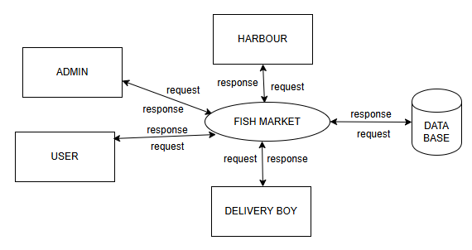
DATA FLOW DIAGRAM
Level 1

Slide 30
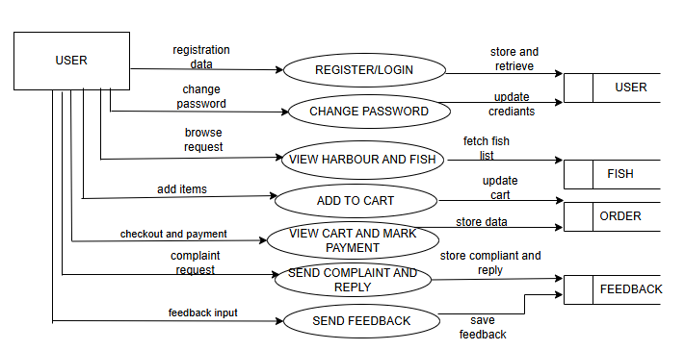
DATA FLOW DIAGRAM
Level 1.1

Slide 31
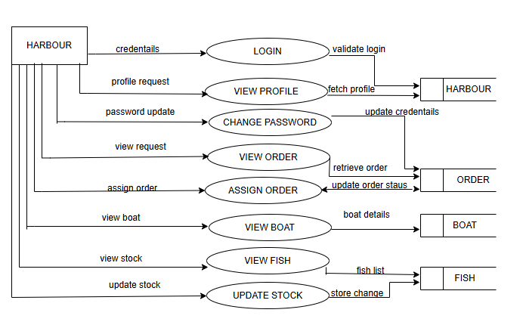
DATA FLOW DIAGRAM
Level 1.2

Slide 32
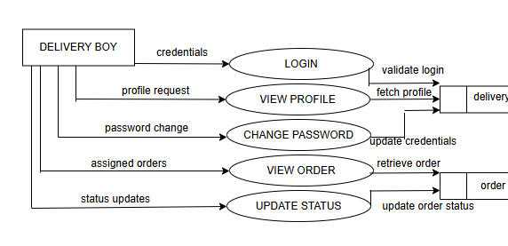
DATA FLOW DIAGRAM
Level 1.3

Slide 33
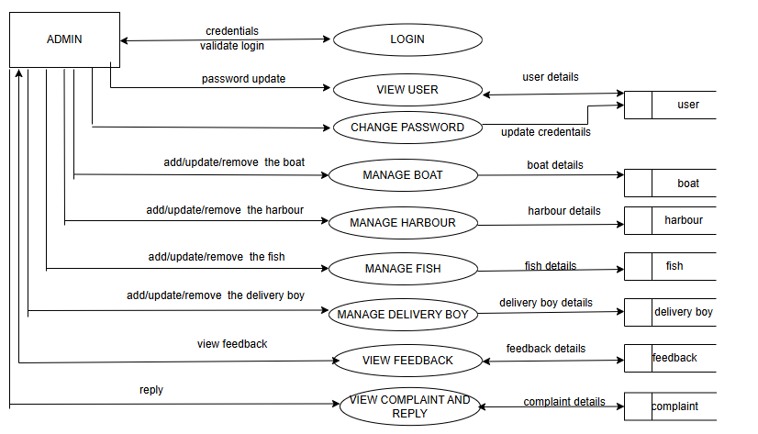
DATA FLOW DIAGRAM
Level 1.4

Slide 34
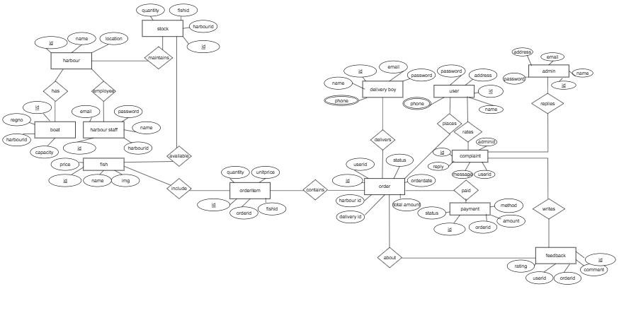
ER DIAGRAM

Slide 35
THANK YOU

