Slide 1
Driver Drowsiness Detection using Deep Learning
Name

Slide 2
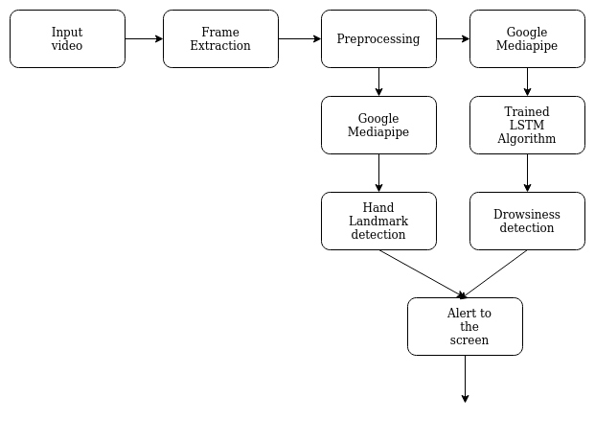
Architecture:

Slide 3
Architecture:
The webcam feed will be taken as a stream of frames/images using frame extraction.
These frames will be preprocessed such as color channel conversion, resize, etc.
Then it will be sent to the Google Mediapipe Module.
Mediapipe framework has Hand module and Face Mesh modules.
It will extract landmark points from face and hand.

Slide 4
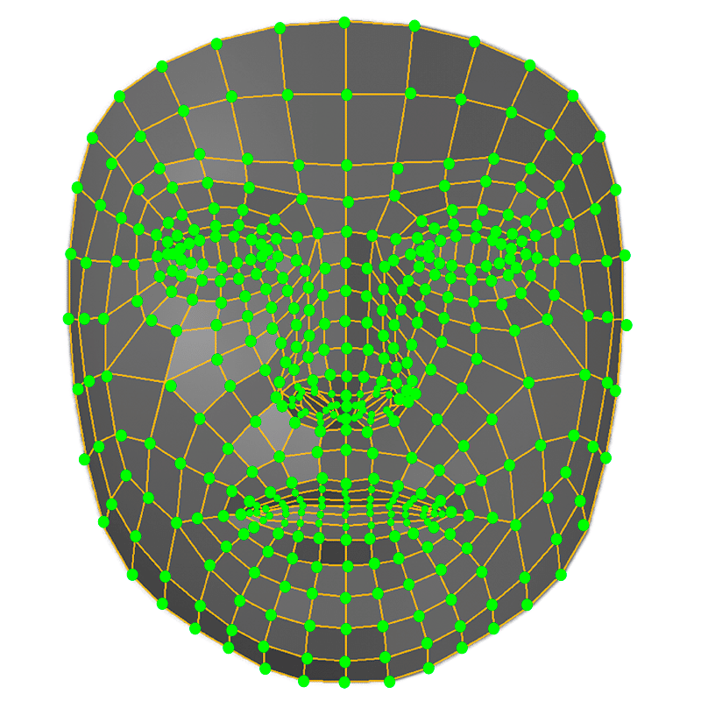
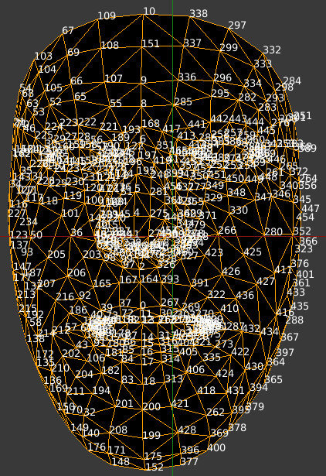
Architecture:

Slide 5
Architecture:
These face mesh points will be fed to the trained Deep Learning algorithm called LSTM (Long Short Term Memory).
LSTM is a classification algorithm for classifying high dimensional data like face, etc.
LSTM will be trained on face mesh points data collected.

Slide 6
Methodology:
Learn Google Mediapipe.
Develop a simple face landmark based drowsiness detection system.
Collect Face landmark points dataset for drowsiness.
Develop LSTM in python using Tensorflow or Pytorch library.
Train LSTM using the dataset prepared.
Test the trained algorithm.
Develop mobile phone detection part using mediapipe hand module.
Final test.

Slide 7
Work done:
Learn Google Mediapipe - completed
Develop a simple face landmark based drowsiness detection system - completed
Collect Face landmark points dataset for drowsiness - Started
Develop LSTM in python using Tensorflow or Pytorch library - Started
Train LSTM using the dataset prepared.
Test the trained algorithm.
Develop mobile phone detection part using mediapipe hand module.
Final test.

Slide 8
Work done:
Implemented a basic drowsiness detection system using only Mediapipe.
Compare the landmark points of the eyes and detect blink.
Not used LSTM now.
Will train LSTM and integrate to it.
40% completed.

