Slide 1




Analysis on Health, Education and Employment
Presented by :
Group - E
Anjuli Patel – 19242581
Dawn Walsh - 19190352
Marcelo Fischer - 20118872

Slide 2

Objective
Main Objectives : Analysing patterns and trends that effects the three aspects our report.
Education
Health
Employment
We are analysing the above data for different countries and for period of 2005 to 2020.

Slide 3
Dataset :
We have used three datasets :
Education
Health
Employment

Slide 4
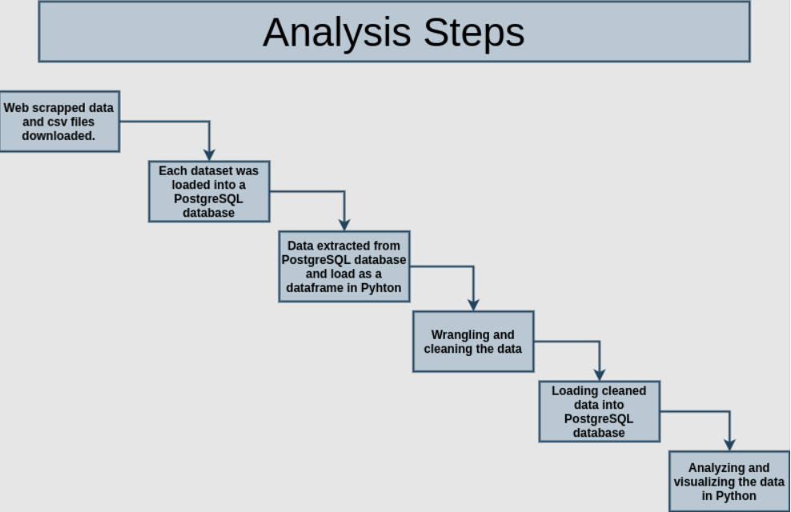
Methodologies :

Slide 5
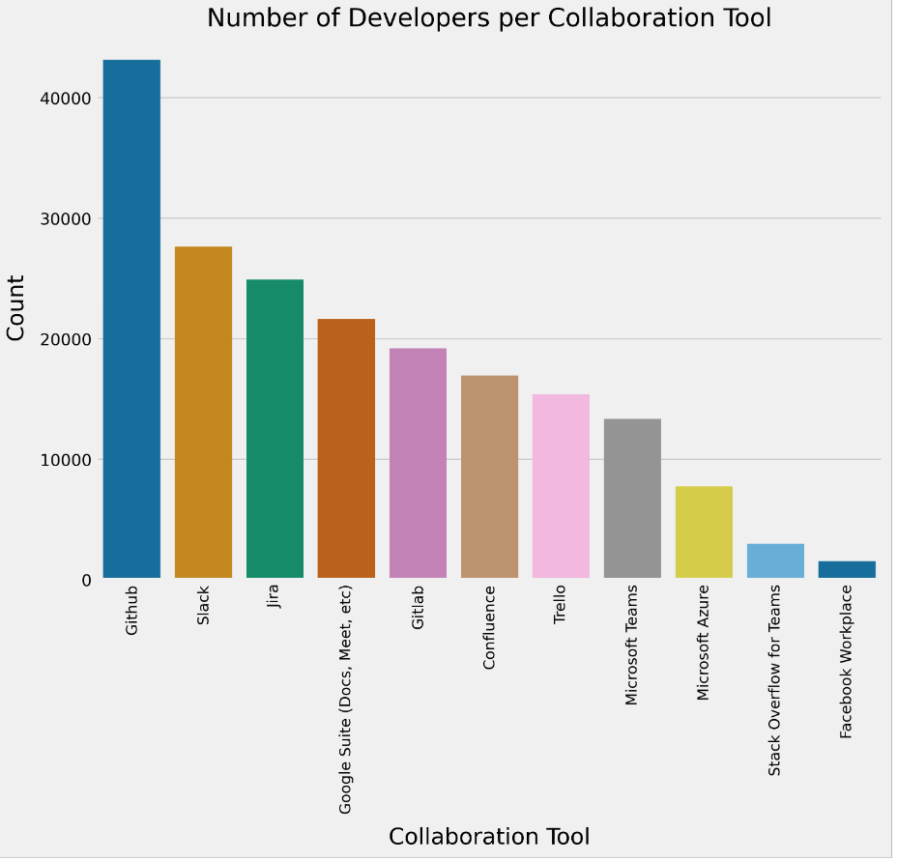
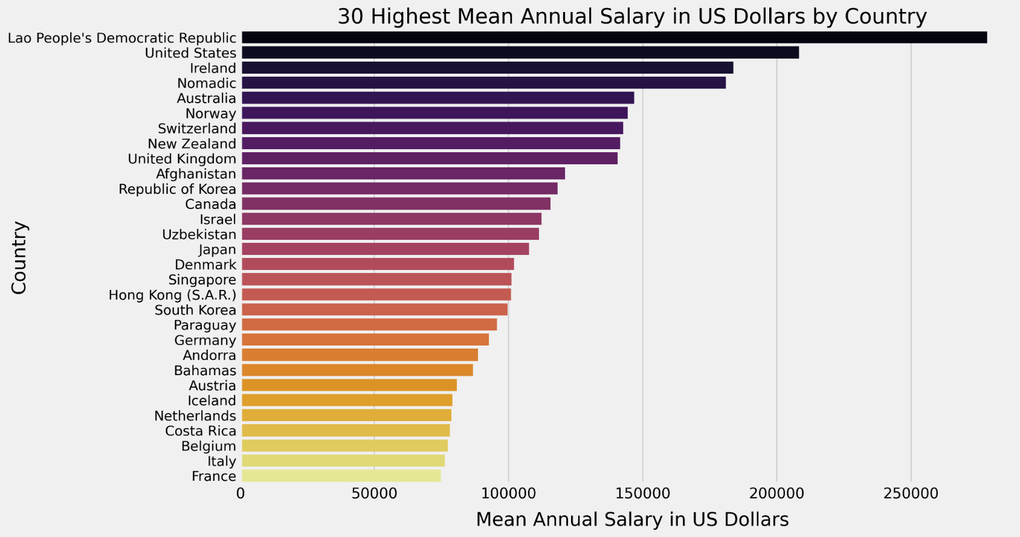
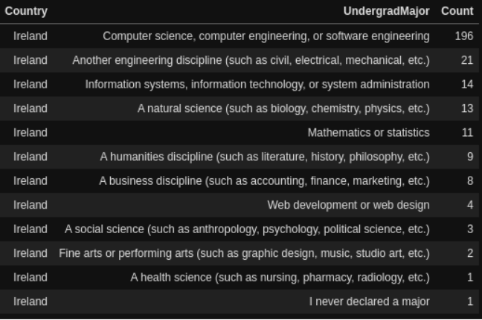
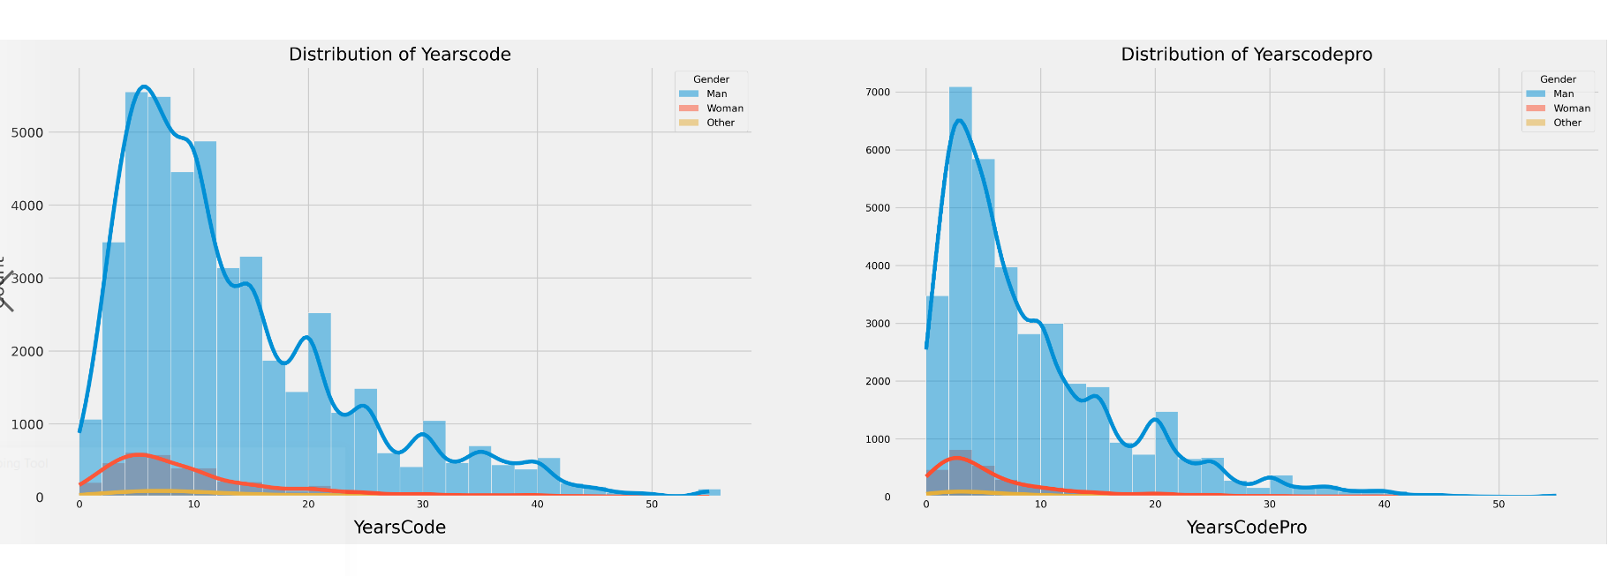
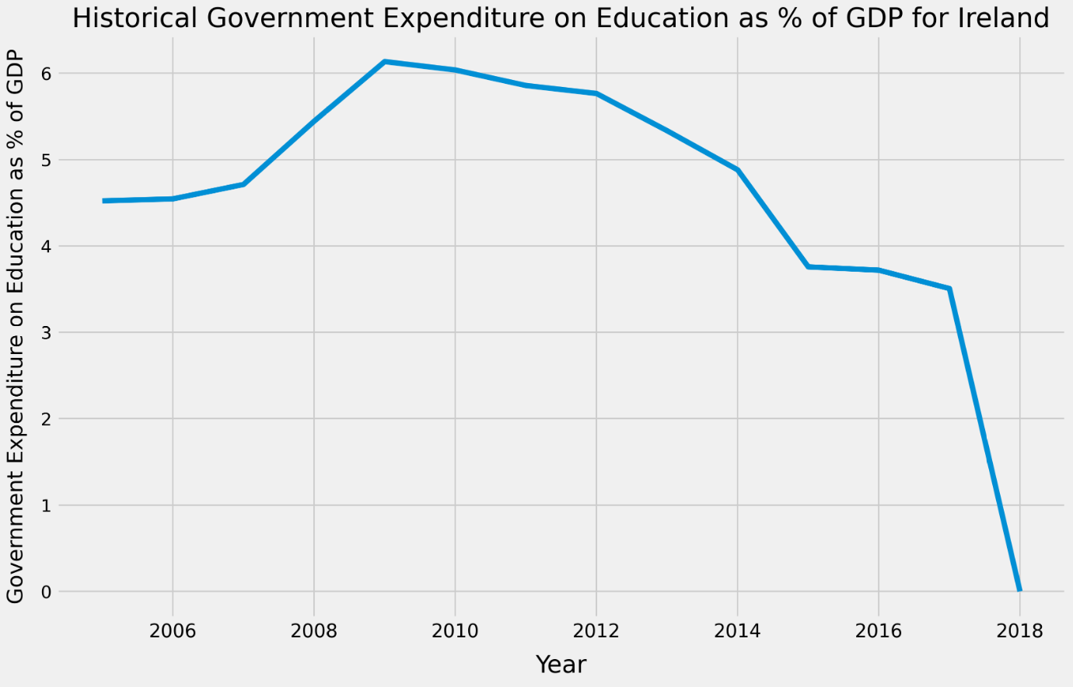
Analysis :
Abc

Slide 6
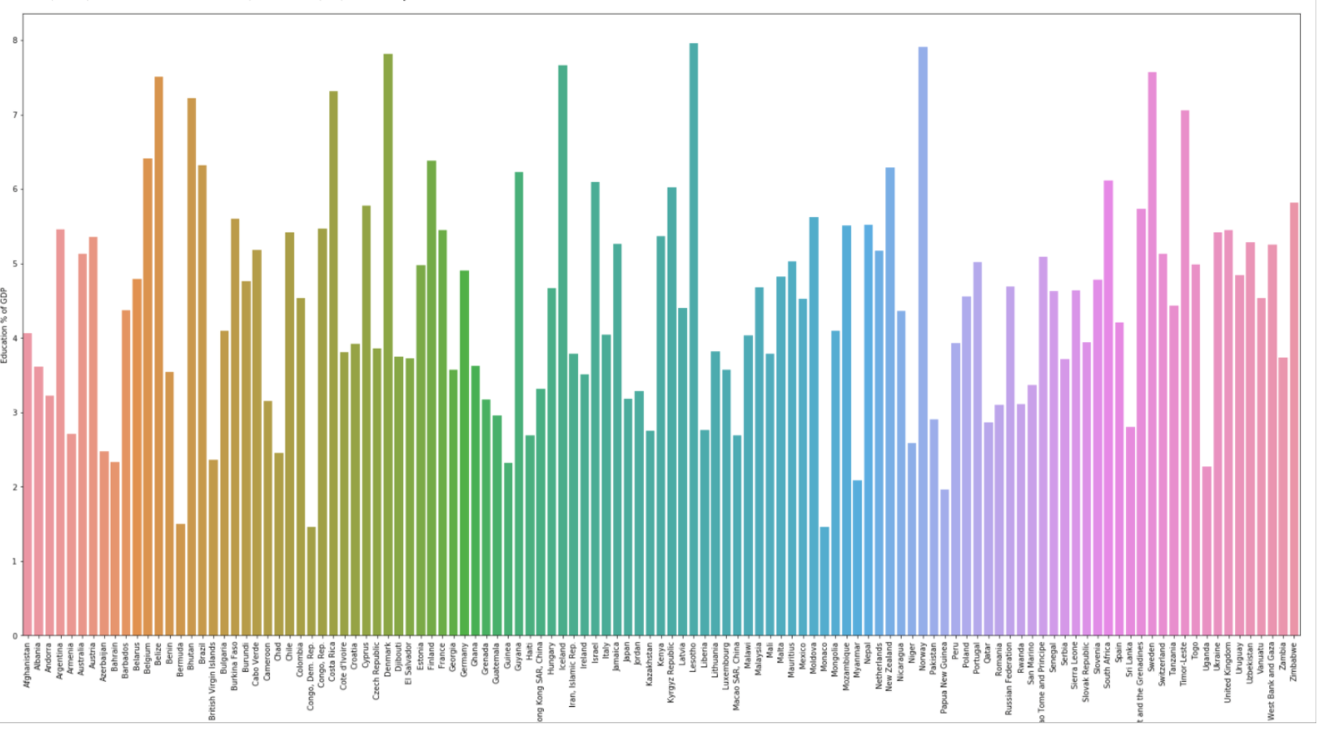
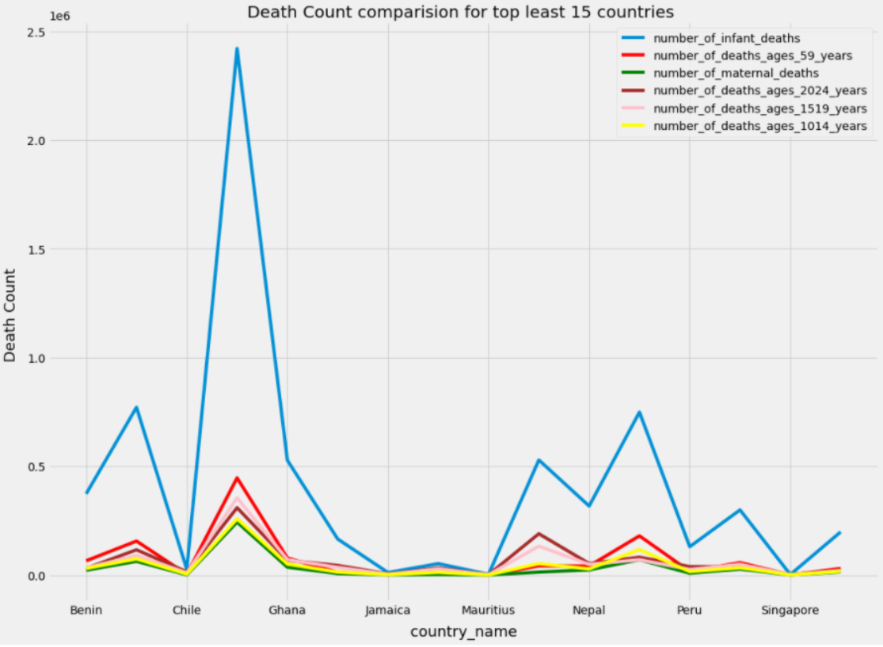
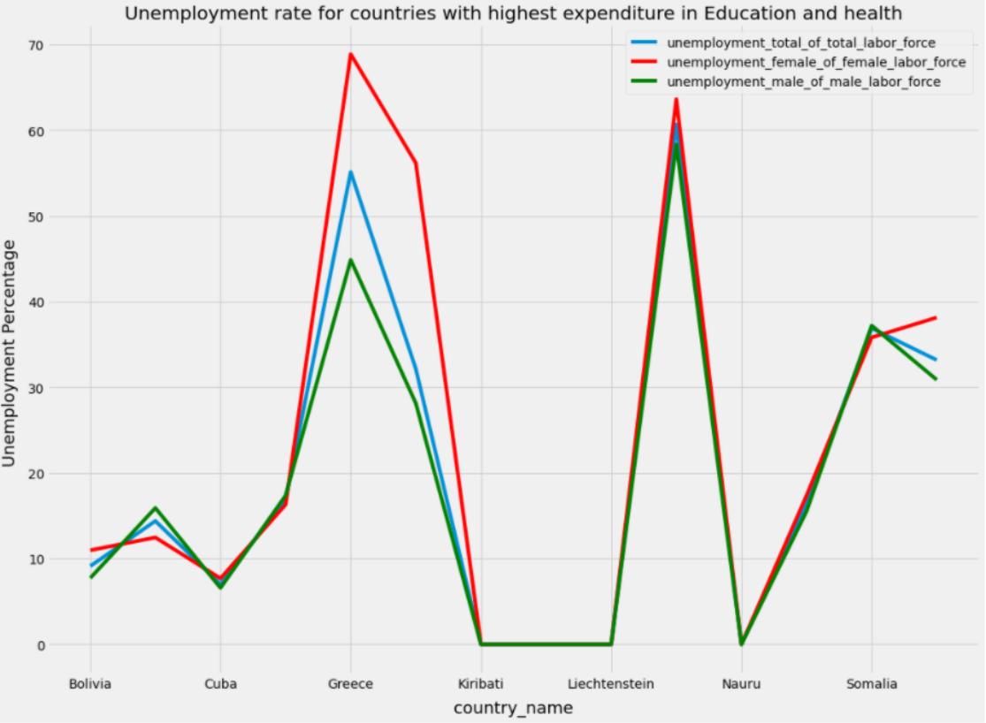
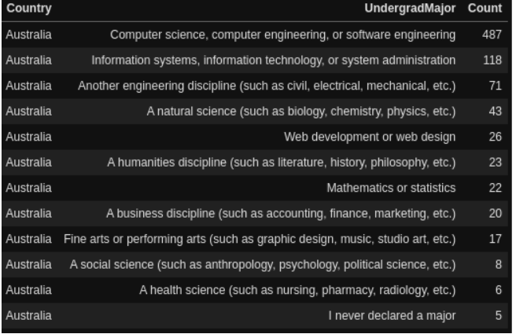
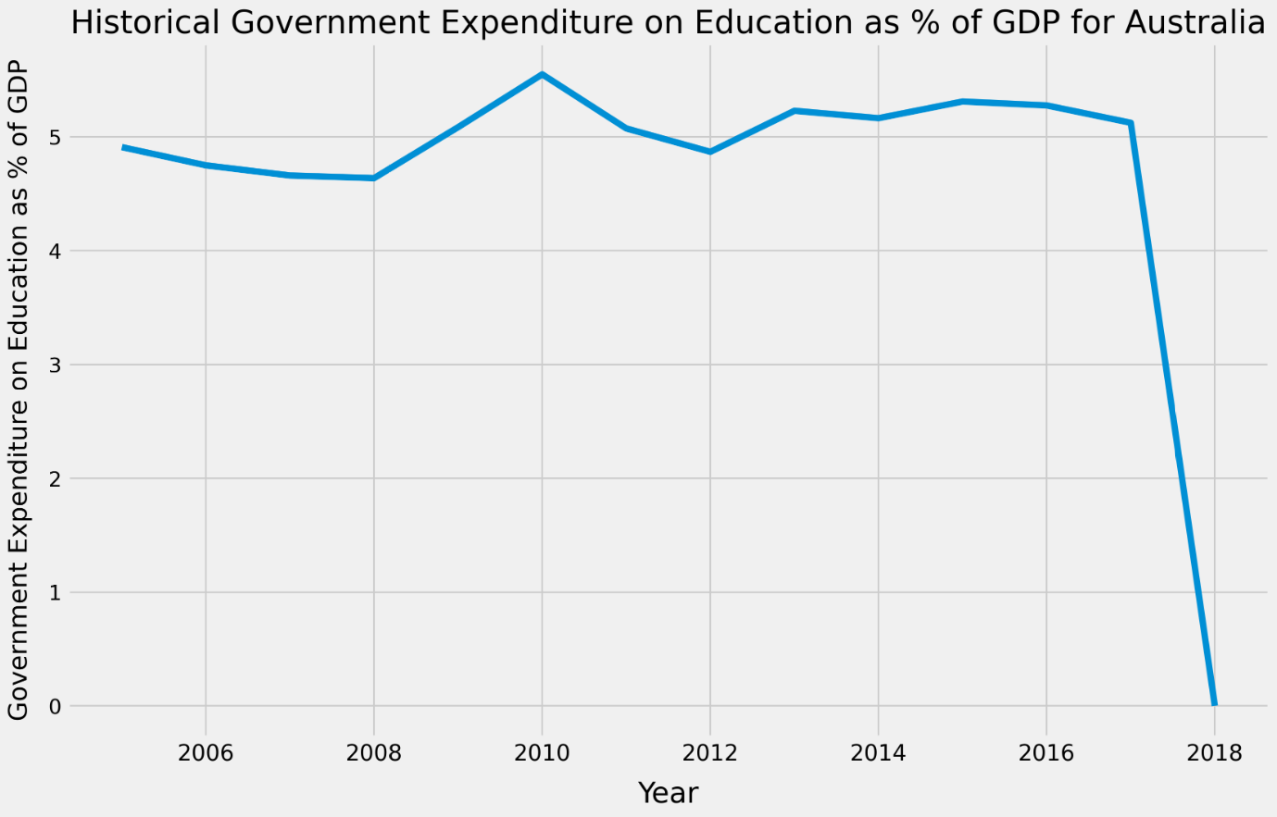
Abv

Slide 7
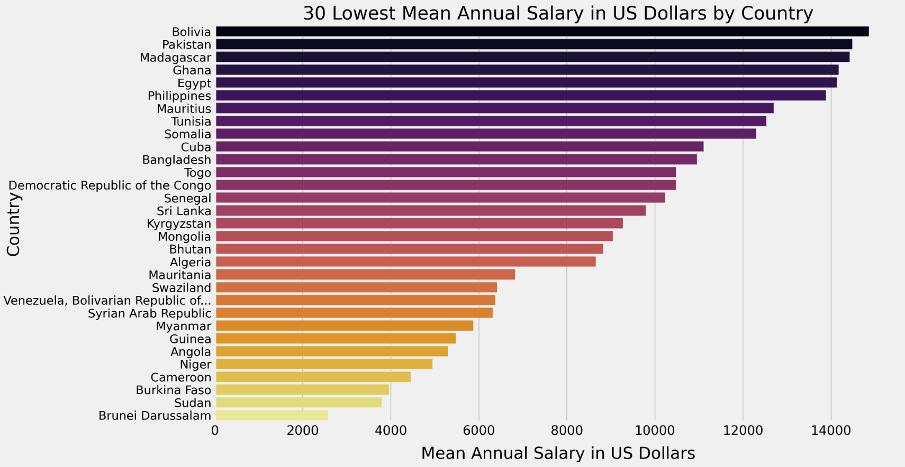
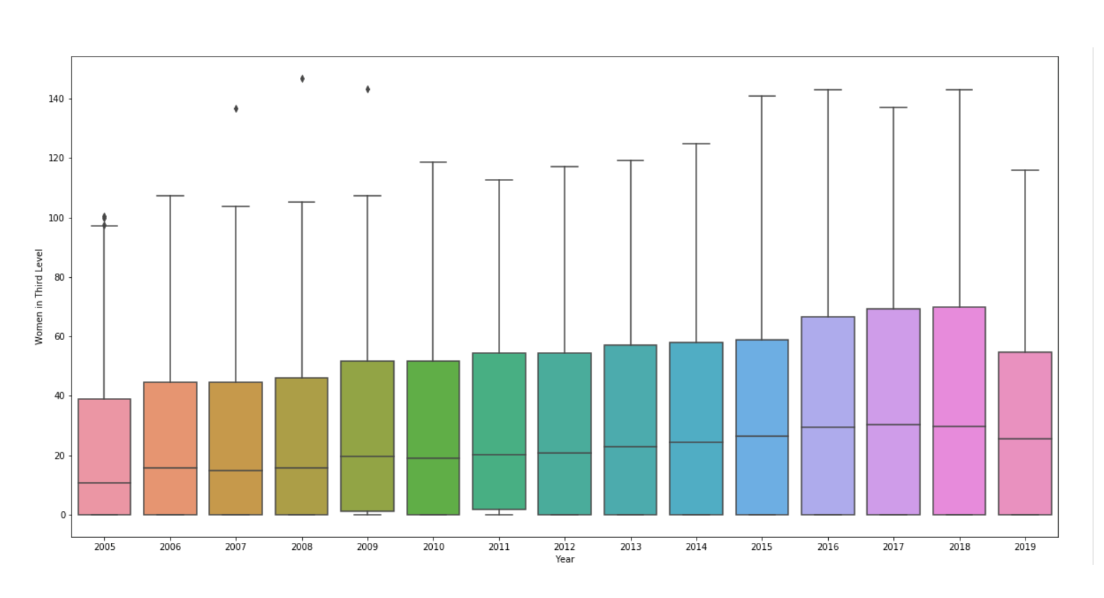
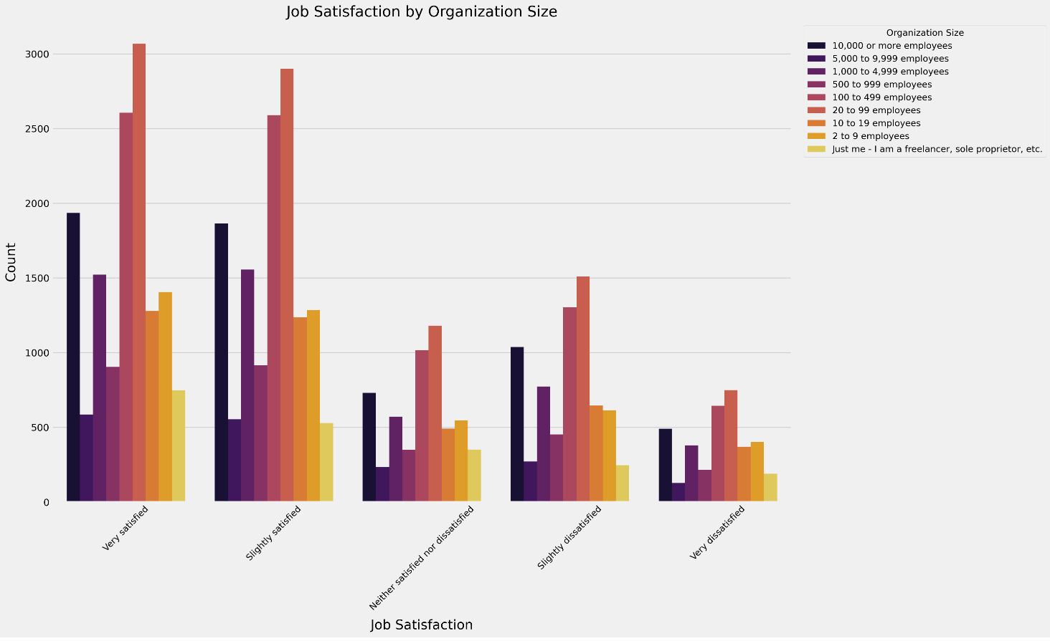
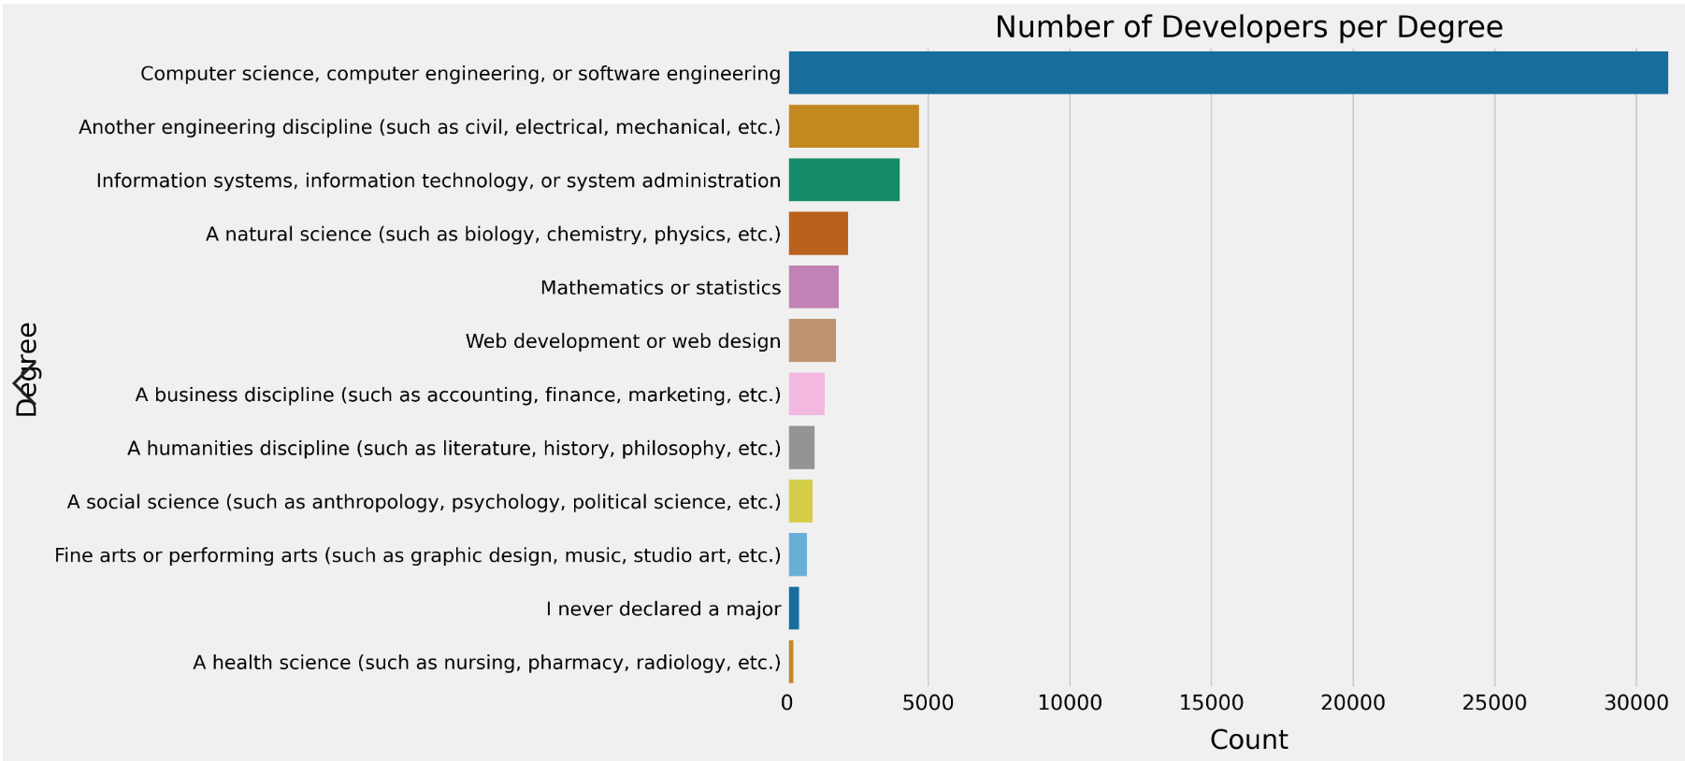
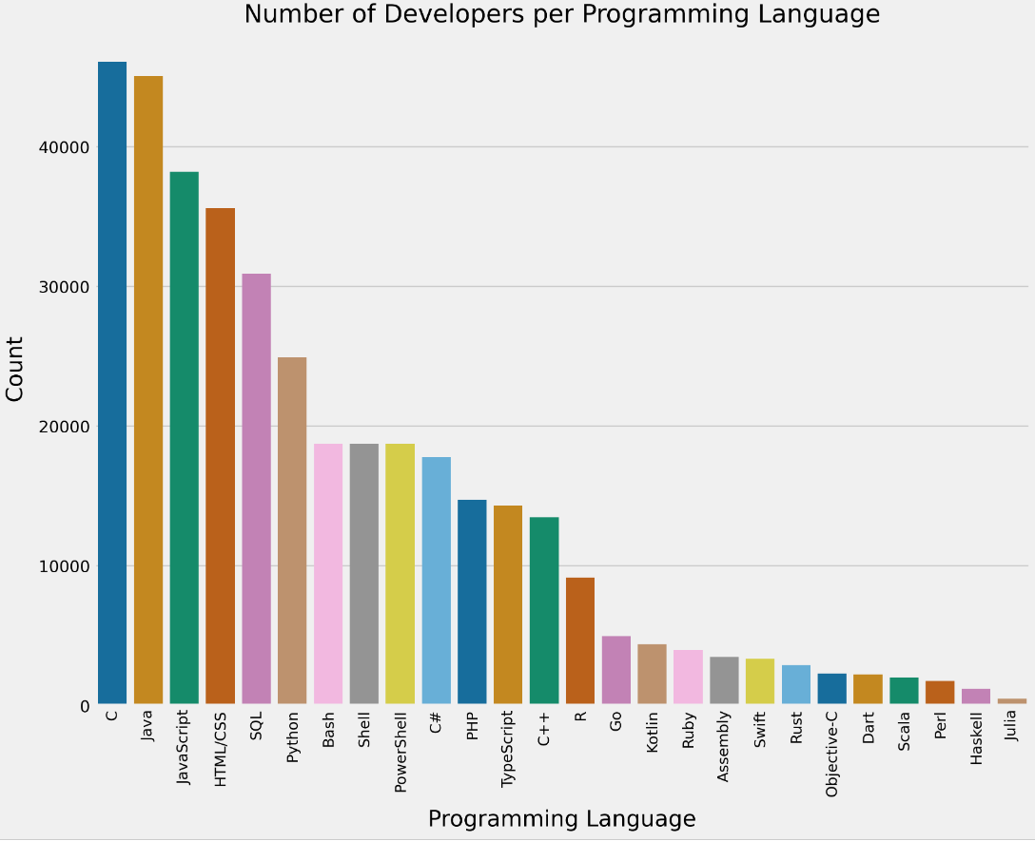
abc

Slide 8
Thank You

