Slide 1

HOMEAGLOW · NEW HIRE CARE TRAINING
Platform &
Operating Mechanics
How to read what happened to a job, handle callbacks, and explain what customers pay and cleaners earn.
Internal training material
Notes:
Welcome. This module covers Understanding Job History, Callback Handling, and C Price vs CP Pay. More topics will be added to this deck.

Slide 2
OVERVIEW
Agenda
Click a topic to jump to it.
Understanding Job History
›
Non-Logged-In Visitor Submitted a Ticket Using an Existing Customer's Email
›
1
6
Callback Handling
›
Max CP Rate (C-Facing Rate Cap)
›
2
7
C Price vs CP Pay
›
ForeverClean Membership
›
3
8
Pre-authorization Hold
›
Value of ForeverClean
›
4
9
Vouchers in CRM
›
KB - Poor Cleaning Quality (PCQ)
›
5
10
Notes:
Walk through today's agenda. In slideshow mode, click any topic to jump straight to it.

Slide 3


TOPIC 01
Understanding Job History
The record of every change made to a job, and what caused it.
YOU'LL LEARN
Why you always check it
Where to find it
How to read the columns
Practice reading one
Notes:
There are times we can't tell the full story of what happened to a job from the C/CP comms alone. The job history records every change made to the job, so we can understand how its status changed and what caused it.

Slide 4




UNDERSTANDING JOB HISTORY
Why you always check it
Comms aren't enough
Every change is logged
Check it every time
C and CP messages don't always tell the full story of a job.
How the status changed, and what caused it.
Whenever you investigate a job, before you decide on a resolution.
Rule: investigating a job? Open its job history before you resolve the ticket.
Notes:
There are instances where we cannot tell the full story of what happened to the job if we solely refer to the C/CP comms. The job history records any changes done within the job, so we can understand how the job status changed and what caused it. Check the job history whenever you're investigating a particular job, so you give the correct resolution.

Slide 5
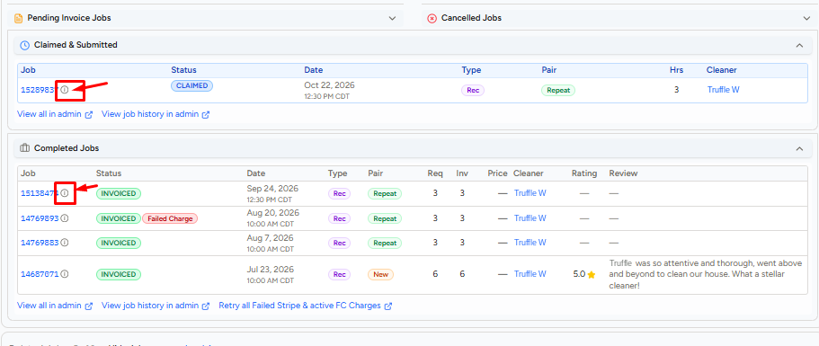

UNDERSTANDING JOB HISTORY
Where to find it
Click the ⓘ icon next to a job ID to open its job history.
The ⓘ icon
Next to each job ID, in every jobs panel
i
Click it
The job's history opens
→
Tip: investigating a job? Open its history before you decide on a resolution.
Notes:
On the customer's page in the New C CRM, every job in the jobs panels (Claimed & Submitted, Completed Jobs and so on) has a small ⓘ icon next to the job ID. Clicking it opens that job's history. Names in the screenshot are sample training details.

Slide 6
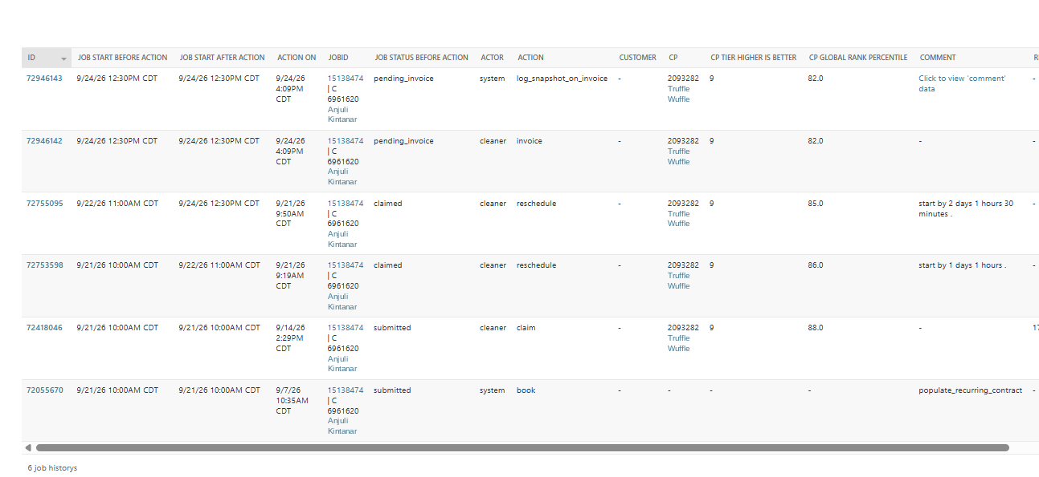
UNDERSTANDING JOB HISTORY
The job history
What that column tells you:
1 Job Start Before Action: the job start time and date at the time the action was made
2 Job Start After Action: the job start time and date after the action was made
3 Action On: the time the action was taken
4 Job Status Before Action: the status of the job before the action was taken
5 Actor: the one who took the action: the C, CP, CS, or system
6 Action: the action taken on the job. Written to be self-explanatory
7 Comment: logs any essential detail to the action
1
2
3
4
5
6
7
Notes:
TRAINER: each click (on a number or anywhere on the slide) reveals the next column description, 1 to 7, while the job history stays on screen. 1 Job Start: the job start time and date at the time the action was made. 2 Job Start After Action: the job start time after the action was made. 3 Action On: the time the action was taken. 4 Job Status Before Action: the status of the job before the action was taken. 5 Actor: the one who took the action (it can be the C, CP, CS, or system). 6 Action: the action taken on the job; actions are written in a very self-explanatory manner. 7 Comment: logs any essential detail to the action. The first column (ID) is the action ID, mostly used by product or support to edit the action in Django; CS doesn't use it. Names are sample training details.

Slide 7



UNDERSTANDING JOB HISTORY
Two things to remember
Read bottom to top
Times are in CT
The oldest action is at the bottom. The newest is at the top.
Our system time is Central Time. The customer may be in another time zone.
CONVERT WITH THE TIME FORMULA, UPPER LEFT OF THE CRM
1
Example: 8:23 AM CDT is 6:23 AM in Pacific time (PDT −2) and 9:23 AM in Eastern time (EDT +1).
Notes:
Read the job history from bottom to top. Dates and times are in CT (Central Time): our system time is CT, and customers may be in a different time zone. The time formula in the upper-left corner of the CRM helps you convert (e.g. PDT -2, MDT -1, CDT 0, EDT +1).

Slide 8
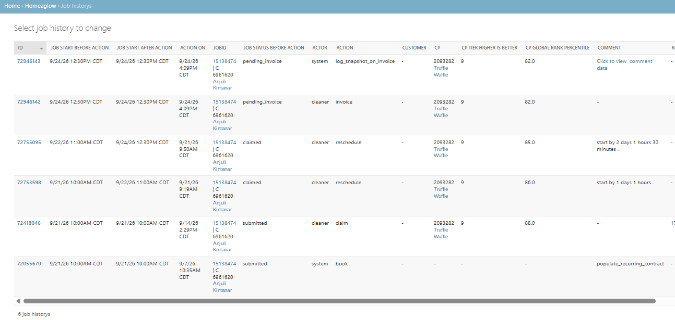

UNDERSTANDING JOB HISTORY
Reading the example
Read the job history from the bottom up.
The Story
Sept 7, 2026: the system booked a cleaning for C Anjuli Kintanar for Sept 21, 10 AM CT, through the recurring cleaning plan.
Sept 14: CP Truffle Wuffle claimed the job as scheduled.
Sept 21, 9:19 AM CT: CP Truffle Wuffle rescheduled the job from Sept 21, 10 AM CT to Sept 22, 11 AM.
Sept 21, 9:50 AM CT: CP Truffle Wuffle rescheduled the job again, from Sept 22, 11 AM to Sept 24, 12:30 PM CT.
Sept 24, 4:09 PM CT: CP Truffle Wuffle invoiced the job and the system logged it in snapshot.
Read bottom to top
Notes:
TRAINER: let trainees read the job history first (bottom to top). Then click The Story (or press the right arrow) to reveal the story one line at a time, staying on this slide. Story: On Sept 7, 2026, the system booked a cleaning for C Anjuli Kintanar scheduled for Sept 21 10AM CT through the recurring cleaning plan. On Sept 14, CP Truffle Wuffle claimed the job as scheduled. On Sept 21 9:19AM CT, CP Truffle Wuffle rescheduled the appointment from Sept 21, 10AM CT to Sept 22, 11AM. On Sept 21 9:50 AM CT, CP Truffle Wuffle rescheduled the appointment again from Sept 22, 11AM to Sept 24, 12:30 PM CT. On Sept 24, 4:09 PM CT, CP Truffle Wuffle invoiced the appointment and the system logged it in snapshot.

Slide 9

UNDERSTANDING JOB HISTORY
Practice: read a job history
Open the practice ticket and answer these four questions.
Job 12685237
1
Who booked the appointment?
2
When was the appointment initially scheduled for?
3
The customer writes: "I initially booked for Jan 12 at 1 PM, but I received a notification that I am booked for 2 PM. Why is that?"
4
What happened on Jan 8 at 5:58 PM?
Notes:
TRAINER NOTE: Open the practice job history during the slideshow using the button (https://www.homeaglow.com/nocm/homeaglow/jobhistory/?job=12685237). Give trainees time to answer, then go through the answers together, row by row from the bottom up.
Job History Activity
Ticket 1
Ticket 2
Ticket 3
Ticket 4
Ticket 5
Ticket 6
Ticket 7
Ticket 8
Ticket 9
Ticket 10
Ticket 11
Ticket 12
Ticket 13
Ticket 14
Ticket 15

Slide 10

WRAP-UP
Questions?
When in doubt, check the Knowledge Library or ask your Trainer or Team Lead.
Notes:
Open the floor for questions.

Slide 11

TOPIC 02
Callback Handling
When to call a customer back, how many times to try, and what to do next.
YOU'LL LEARN
When to call
The call steps
Answered, missed or voicemail
Keeping callbacks from slipping
Notes:
We don't have inbound phone support, but outbound calls are a tool we use whenever a customer asks for one, or when something needs an immediate answer (like confirming a double-booking). Category: Platform & Operating Mechanics.

Slide 12


CALLBACK HANDLING
Asked for a call? Call them.
We don't take inbound calls, but we call out when a customer asks, or when something needs an answer now.
AGENT DO
Callback request between 8 AM and 8 PM (customer's local time)? Call right away. The request is enough.
Respect their choice
Never lose a callback
They asked for a call, so they get one, however minor the ticket looks.
Reminders and the tracker keep promises from slipping between shifts.
Notes:
Agent Do: if a customer requests a callback within business hours (8 AM - 8 PM, customer local time), call them right away. No LTV risk or escalation is needed to justify it; the request is enough. Why: the customer's preferred communication method is respected regardless of how serious the ticket looks, and consistent steps (timed reminders, endorsement) keep a promised callback from falling through between shifts. Outbound calls are also used when something needs an immediate answer, like confirming a double-booking.

Slide 13




CALLBACK HANDLING
The call steps
STEP 1
STEP 2
STEP 3
Callback requested?
8 AM – 8 PM their time?
Call up to 3 times
No: handle the ticket as usual
Yes: Proceed to Step 2
No: email, address issue and ask for their availability
Yes: Proceed to Step 3
Primary CRM, then Google Voice, then Secondary CRM
Call order: Primary CRM, then Google Voice, then Secondary CRM.
Notes:
Step 1: did the customer request a callback? If not, this article doesn't apply; handle the ticket through normal channels. Step 2: within business hours (8 AM-8 PM customer local time)? Yes: attempt to call. No: address the concern via email and ask for their availability for a callback. Step 3: attempt to call up to 3 times, in this order: Primary CRM, then Google Voice, then Secondary CRM.

Slide 14
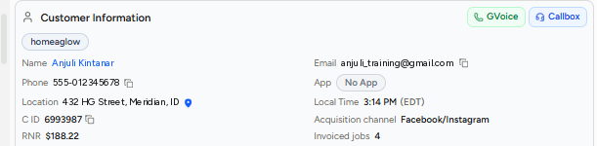


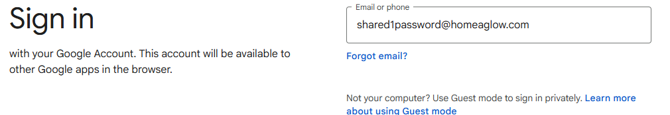


CALLBACK HANDLING
Where to call from
On the customer's page in the New C CRM.
2
1
Show screens
!
1
Callbox: primary number From list set to the primary number
1
Callbox: primary number
Call 1st, from the primary number
2
GVoice Sign in with the shared Homeaglow account
2
GVoice
Call 2nd, with Google Voice
3
Callbox: secondary number
Call 3rd, same Callbox button, Secondary Phone
3
Callbox: secondary number From list set to the Secondary Phone
Important: check Local Time (!) before making a call. 8 AM – 8 PM their time.
Notes:
Call options at the top right of Customer Information: 1 Callbox with the primary number; 2 GVoice (Google Voice); 3 Callbox with the secondary number (same Callbox button, choose the Secondary Phone in the From list). Call order: Primary CRM, then Google Voice, then Secondary CRM. TRAINER: click Show screens (or press the right arrow) to reveal each screen in order. Important: check the customer's Local Time before making a call (8 AM - 8 PM their time). Customer details are sample training data.

Slide 15




CALLBACK HANDLING
What happens next
Every call ends one of three ways.
Answered
Not answered
Voicemail
Try to resolve it on the call
Email a summary of what was discussed
Log an internal note with full call details. Calls aren't recorded
Address the concern by email
Ask for their availability for a callback
Leave a voicemail, if applicable
Send an email and an SMS
Wait 10 minutes, then check the ticket again
"Call me now"? if they reply asking for an immediate call, call right away, even inside the 10 minutes.
Notes:
Answered: attempt to resolve the issue on the call, send an email summary of what was discussed/resolved, and log an internal note about the conversation (calls are not recorded, so the next agents need to know what happened). Not answered: address the concern via email and ask for their availability for a callback. Voicemail: leave a voicemail if applicable, send email + SMS, then apply the 10-minute buffer rule: after sending the SMS, wait 10 minutes and check the ticket again. If the customer replies asking for an immediate callback, call right away, buffer or not. The buffer exists so we don't call back-to-back with no sign the customer has seen our message.

Slide 16




CALLBACK HANDLING
Once they share their availability
Create a timed reminder assigned to "Any CS", then pick your path.
Create a timed reminder, assigned to "Any CS"
On shift at that time
Not on shift
Set a calendar reminder
Put the ticket link in the invite
Log the ticket in the Callback Requests Tracker
Why two paths: a promised callback never gets lost across a shift change.
Notes:
After the customer provides availability, create a timed reminder assigned to "Any CS". If you're on shift at the scheduled time: set a calendar reminder and include the ticket link in the invite so you can jump straight back in. If you're not on shift: log the ticket in the Callback Requests Tracker (Google Sheet). This two-path structure keeps a promised callback from getting lost across a shift change.

Slide 17


CALLBACK HANDLING
What to send
Adapt these samples to the customer.
Email: outside business hours
Text: missed callback
"Hi <<Name>>, I'd be happy to hop on a call to discuss this with you. Please let me know what days and times generally work best for this week. In the meantime, I pulled up your account and <<address surface-level issues/resolutions>>. Let me know if that fully resolves your concerns! Otherwise, just reply with your availability and I'll get you scheduled."
"This is <<Name>> from Homeaglow. I tried calling but it went to voicemail — no worries, I've already addressed your concern over email. If you'd still like to hop on a call, just text me back with your availability and we'll set it up."
Notes:
Sample email if outside business hours: "Hi <<Name>>, I'd be happy to hop on a call to discuss this with you. Please let me know what days and times generally work best for this week. In the meantime, I pulled up your account and <<address surface-level issues/resolutions>>. <<If applicable>> Let me know if that fully resolves your concerns! Otherwise, just reply with your availability and I'll get you scheduled." Sample text if a callback attempt was missed: "This is <<Name>> from Homeaglow. I tried calling but it went to voicemail — no worries, I've already addressed your concern over email. If you'd still like to hop on a call, just text me back with your availability and we'll set it up."

Slide 18
WRAP-UP
Questions?
When in doubt, check the Knowledge Library or ask your Trainer or Team Lead.
Notes:
Open the floor for questions.

Slide 19

TOPIC 03
C Price vs CP Pay
What a customer is charged, and what the cleaner is paid. Related, but calculated separately.
YOU'LL LEARN
The three pricing cohorts
How the price is built
How the cleaner is paid
When a "platform fee" shows up
Notes:
The customer's price includes platform fees and taxes that don't go to the CP. The CP's pay depends on their own hourly rate and their operating model. Billing disputes are some of the most common tickets, and this is the formula reference behind Overcharged Hours, False Invoice and ETF calculations.

Slide 20


C PRICE VS CP PAY
Two separate calculations
You can't judge whether a charge is fair until you know how it's built.
Customer price
Cleaner pay
The cleaner's rate plus platform fees and taxes that don't go to the cleaner.
Based on the cleaner's own hourly rate and their operating model.
Used everywhere: Overcharged Hours, False Invoice and ETF calculations all start from these formulas.
Notes:
Customer price includes platform fees and taxes that don't go to the CP. CP pay depends on the CP's own hourly rate and operating model. Billing disputes are among the most common tickets; this is the formula reference that Overcharged Hours, False Invoice and ETF calculations draw from.

Slide 21
C PRICE VS CP PAY
Three pricing cohorts
What a customer pays on top of the cleaner's rate depends on their membership.
Cohort | Platform fee / hr | Processing fee | Sales tax
Non-FC customer | $15.00 | 5% | Varies by state
FC customer | None | 15% | Varies by state
Deactivated FC customer | $30.00 | 5% | Varies by state
Notes:
Non-FC customer: $15.00/hr platform fee, 5% processing fee, sales tax varies by state. FC customer: no platform fee, 15% processing fee, sales tax varies. Deactivated FC customer: $30.00/hr platform fee, 5% processing fee, sales tax varies.

Slide 22


C PRICE VS CP PAY
How the cleaning price is built
CLEANING PRICE
(CP hourly rate + Platform hourly rate) × Job duration
+ Processing fee + **Premium fee + **Sales tax - **credits
NOTE: **If applicable only
Active voucher
Active credits
Voucher hours come off the job duration before the price is calculated.
Credits come off the final total.
Notes:
Cleaning Price = (CP Hourly Rate + Platform Hourly Rate) x Job Duration + Processing Fee + Sales Tax + Premium Fee. If the customer has an active voucher, voucher hours are deducted from the job duration before this calculation runs. If they have active credits, those are subtracted from the final total.
Note: charges show on the customer’s card as 2 smaller charges (initial cleaning bill and transaction fee). If there’s a premium fee, it also shows as a separate charge on the customer’s credit card

Slide 23
C PRICE VS CP PAY
Let's practice!
Calculate the job cost for all 3 customer pricing cohorts using the details below.
Show Answers
Scenario
CP rate
$25.00/hr
FC customer: $65.63
$25/hr CP rate × 2.5 hrs + 15% processing fee + 8% tax − $12 credits
Non-FC customer: $101.40
($25/hr CP rate + $15/hr platform fee) × 2.5 hrs + 5% processing fee + 8% tax − $12 credits
Deactivated (cancelled) FC customer: $143.93
($25/hr CP rate + $30/hr platform fee) × 2.5 hrs + 5% processing fee + 8% tax − $12 credits
Duration
4 hours
Voucher
1.5 hours
Sales tax
8%
Credits
$12.00
Hint: take the voucher hours off the duration first.
Notes:
TRAINER: give trainees time to calculate, then click Show Answers (or press the right arrow). Each click reveals one cohort. Working: billable hours = 4 - 1.5 voucher = 2.5. FC: $25 x 2.5 = $62.50; + 15% processing = $71.88; + 8% tax = $77.63; - $12 credits = $65.63. Non-FC: ($25 + $15) x 2.5 = $100.00; + 5% = $105.00; + 8% = $113.40; - $12 = $101.40. Deactivated (cancelled) FC: ($25 + $30) x 2.5 = $137.50; + 5% = $144.38; + 8% = $155.93; - $12 = $143.93.

Slide 24
WRAP-UP
Questions?
When in doubt, check the Knowledge Library or ask your Trainer or Team Lead.
Notes:
Open the floor for questions.

Slide 25



C PRICE VS CP PAY
How the cleaner is paid
Operating model | First-time client | Repeat client
CA / CA-WA | Rate × duration + tips + surge bonus | Same
General | (Rate − $5 match fee) × duration + tips + surge bonus | Rate × duration + tips + surge bonus
Always paid
Tips
Surge bonus
Even if the customer's card, voucher or credits fail.
100% of every tip goes to the cleaner.
$1–$50 extra on some jobs, at invoicing.
Notes:
CA/CAWA: CP's hourly rate x duration + tips + surge bonus, for first-time and repeat clients. General: first-time client (CP's hourly rate - $5.00 match fee) x duration + tips + surge bonus; repeat client CP's hourly rate x duration + tips + surge bonus. Key point: Homeaglow pays the CP directly via direct deposit regardless of whether the customer's own charge succeeds; a failed card, voucher or credits never affects CP pay. Tips: 100% go to the CP. Surge bonus: an extra $1-$50 Homeaglow may pay on certain jobs upon invoicing, positioned to CPs as "Homeaglow is especially busy."

Slide 26
C PRICE VS CP PAY
When a "platform fee" shows up
FC customers have no platform fee. If one shows on an FC invoice, it's one of these cases. Not an error.
Situation | Customer pays | The "platform fee" line is
FC · General · first pairing | The cleaner's rate | The $5/hr marketing fee, taken from the cleaner's pay
FC · General · repeat pairing | The cleaner's rate | Nothing
FC · CA/CA-WA · two rates | The higher of the two rates | The difference between the rates
FC · CA/CA-WA · one rate | The cleaner's rate | Nothing
Non-FC or deactivated FC | The max CP rate | Cohort fee ($15 or $30/hr) + gap to the cleaner's rate
The principle: if the customer pays more than the cleaner's rate, the cleaner still gets their rate. The rest goes to Homeaglow.
Notes:
FC, General, first C/CP pairing: customer pays the CP's rate; the platform fee line is the $5/hr marketing fee deducted from the cleaner's pay, not an extra cost to the customer. FC, General, repeat pairing: nothing. FC, CA/CAWA, CP sets different first and repeat rates: customer pays the higher of the two whichever pairing it is; the line is the difference; the CP is paid their applicable rate and the difference goes to Homeaglow. FC, CA/CAWA, one rate: nothing. Non-FC or deactivated FC: customer pays the max CP rate, not the CP's actual rate; the line is the cohort platform fee ($15/hr non-FC, $30/hr deactivated FC) plus the gap between max rate and the CP's actual rate. Why the models differ: no marketing fee in CA/CAWA (state regulation); in exchange CPs may set separate first-pairing and repeat rates and we charge the higher.

Slide 27

C PRICE VS CP PAY
Worked example
A deactivated FC customer sees a $40/hr platform fee. Is it right?
+
=
$30/hr
$10/hr
$40/hr
Deactivated FC
platform fee
Max rate $25 −
cleaner's rate $15
Platform fee
on the invoice
Correct charge: don't reprice it and don't refund the difference. The cleaner is still paid $15/hr.
Notes:
Deactivated-FC customer, max rate $25, claiming CP's rate $15, platform fee shows $40/hr. That is the $30/hr deactivated-FC platform fee plus the $10/hr gap. The charge is correct: do not reprice it and do not refund the difference. Max rate behaves differently by membership: FC customers have a max rate too, but are charged the CP's actual rate; non-FC and deactivated-FC customers are charged the max rate while the CP is paid their own rate.

Slide 28
WRAP-UP
Questions?
When in doubt, check the Knowledge Library or ask your Trainer or Team Lead.
Notes:
Open the floor for questions. When in doubt, check the Knowledge Library or ask your Trainer or Team Lead.

Slide 29


C PRICE VS CP PAY
Max requested rate
Non-FC and deactivated FC customers are priced at the highest rate among the cleaners they requested.
REQUESTED CLEANERS
Mona
Cassandra
Yolanda
$25/hr
$30/hr
$23/hr
A requested cleaner claims
Mona claims: the customer pays Mona's rate, $25/hr.
Max requested rate: $30/hr
Requesting Cassandra shows the customer is willing to pay her rate, so it becomes their ceiling.
Someone else claims
Jeff ($18/hr) claims: the customer pays $30/hr. Jeff gets $18/hr.
Notes:
For non-FC customers, pricing follows the highest hourly rate among all the CPs they requested, not whichever CP claims. Example: the customer requests Mona ($25/hr), Cassandra ($30/hr) and Yolanda ($23/hr); the max requested rate is $30/hr. If a requested CP claims (say Mona), the customer is charged Mona's actual rate ($25/hr). If a non-requested CP claims (say Jeff at $18/hr), the customer is still charged $30/hr; Jeff is paid $18/hr and the difference goes to Homeaglow. Why: requesting Cassandra signals willingness to pay her rate, so it becomes their ceiling.

Slide 30

C PRICE VS CP PAY
Before you explain or refund a fee
Three answers tell you which case you're in.
1
2
3
Operating model
Membership status
First job together?
CA/CA-WA or General? Look for the banner.
FC, non-FC, or deactivated FC?
Is this the cleaner's first job with this customer?
Then: find the matching row in the platform fee table before you explain or refund anything.
Notes:
Before explaining or refunding any platform-fee line, establish the operating model, the membership status, and whether it is that CP's first job with this customer. Those three answers decide which row of the platform fee table you are in.
Note: To avoid manipulation in pay rate and promote fairness among clients and cleaners, while the CP can change their pay rate anytime, the CP’s pay rate will depend on:
Requested CP: Their pay rate at the time the job was booked
Non-requested CP: Their pay rate at the time the job was claimed

Slide 31

C PRICE VS CP PAY
Let's practice!
Determine the CP pay in this scenario.
Show Answers
The job
Client Repeat
Booked 5 hours
Voucher 3 hours
CP Sarah: $162.50
$28/hr repeat rate × 5 hrs + $12.50 surge bonus + $10.00 tip
CP Gab: $142.50
$24/hr × 5 hrs + $12.50 surge bonus + $10.00 tip (repeat client, so no $5 match fee)
Key point
The 3-hour voucher only lowers what the customer pays. The cleaner is still paid for all 5 hours.
Surge bonus $12.50
Tip $10.00
CP Sarah
CP Gab
CA/CA-WA Operating Model
General Operating Model
$30.00/hr first-time C/CP pair
$28.00/hr repeat C/CP pair
$24.00/hr one rate
Notes:
Scenario: C is a repeat client and books a cleaning for 5 hours. C has a 3-hour cleaning voucher that will be applied to the job. Calculate the total job pay of CP Sarah and CP Gab if the job also has a $12.50 surge bonus and a $10.00 tip. TRAINER: click Show Answers (or press the right arrow); each click reveals one answer, then the key takeaway. Working: the voucher only changes what the customer pays. The CP is paid for all 5 hours (Homeaglow pays the CP regardless of vouchers, credits or failed charges). Sarah (CA/CAWA, repeat rate $28): $28 x 5 = $140 + $12.50 surge + $10 tip = $162.50. Gab (General, repeat client so no $5 match fee): $24 x 5 = $120 + $12.50 + $10 = $142.50.

Slide 32
WRAP-UP
Questions?
When in doubt, check the Knowledge Library or ask your Trainer or Team Lead.
Notes:
Open the floor for questions.

Slide 33

TOPIC 4
Pre-Authorization Holds
What a pre-auth is, when it releases, and the DHJ exception that turns it into the first membership fee.
YOU'LL LEARN
What a pre-auth is
Standard behavior
The DHJ exception
What to tell the customer
Notes:
This module covers pre-authorization holds. The common mental model, that a pre-auth is just a hold that will release, is usually right but not always. By the end, trainees can tell which scenario they are in before they explain a hold to a customer.

Slide 34


PRE-AUTHORIZATION HOLDS
What is a pre-auth?
A temporary hold on the customer's card, not a charge.
Confirms the card
Two normal outcomes
Release timing
It checks the card is valid and has available funds. It is placed at booking.
If the job is invoiced, the pre-auth converts into the real charge. If the job doesn't proceed, it releases.
Typically within about 7 days. It is bank-dependent and outside our control.
Watch out:"it's just a hold, it will release" is usually true but not always. Check the scenario before you reach for the standard macro.
Notes:
A pre-auth is a temporary hold on the customer's card placed at booking. It confirms the card is valid and funded, but it isn't a charge. If the job is invoiced normally, it converts into the real charge. If the job doesn't proceed (cancelled, never claimed), it releases, typically within about 7 days, though timing depends on the bank and is outside our control. The standard customer-facing macro is written for this case and is accurate for it. The warning: don't reach for the macro without checking the scenario.

Slide 35
PRE-AUTHORIZATION HOLDS
Standard vs exception
Which scenario applies decides what you tell the customer.
Scenario | What happens to the pre-auth | What to tell the customer
Non-FC job, or any job with a real charge expected | Converts into the real charge when invoiced. Releases if the job is cancelled or never claimed. | The standard pre-auth macro is accurate.
DHJ, first job, fully covered by voucher | A $59 pre-auth is still created. It is used to charge the first Monthly Fee once the job completes. | Do not say it will just release. It becomes the first MF charge.
Any job cancelled before completion | Released normally, including in the DHJ case. | It will release, bank timing permitting.
Notes:
Walk the three rows. The standard macro is accurate for non-FC jobs and any job where a real charge is expected. The exception is a DHJ customer whose first job is fully covered by the voucher: the system still creates a $59 pre-auth, and it is used to charge the first Monthly Fee when the job completes, so it does not release independently. If any job is cancelled before completion, the pre-auth is released normally, DHJ included.

Slide 36
PRE-AUTHORIZATION HOLDS
The DHJ exception
Why the $59 hold does not just disappear.
What happens
Why it stays
Why it matters
Even when the voucher covers the whole first job, the system creates a $59 pre-auth at booking.
DHJ membership starts after the first completed job. With no job charge to use, the system uses the same $59 for the first MF.
Telling the customer "it will release" is wrong. It sets up a confused or upset follow-up ticket days later.
Tell them:the $59 hold is what their first ForeverClean monthly fee will be charged against once their voucher-covered cleaning is completed.
Notes:
Explain why the exception exists. Under DHJ the membership fee doesn't start until the first job is completed. When the voucher fully covers the job there is no job charge for the pre-auth to convert into, so the system uses that same $59 for the first MF instead of releasing it and charging separately. Telling the customer the hold will just release is telling them something that won't happen, and generates a confused or upset follow-up ticket a few days later. What to say: the $59 hold is what their first ForeverClean monthly fee will be charged against once their voucher-covered cleaning is completed.

Slide 37
PRE-AUTHORIZATION HOLDS
Before you explain a pre-auth
Check first, then choose your words.
1 Check the scenario
2 Customer disputes it
3 Job cancelled
Non-FC or a real charge expected: use the standard macro. DHJ, first job, fully voucher-covered: use the exception.
They expected a release and it didn't happen? Check if they are DHJ on their first job before assuming an error.
Release it normally. The exception applies only to the path where the job completes.
Cancel request:if a customer wants to cancel because they don't agree to a pre-auth, explain it first. Cancel only if they still want to after the explanation.
Notes:
Three habits. First, check which scenario applies before explaining. Second, if a customer questions a pre-auth charge because they expected a release and it didn't happen, check whether they are a DHJ customer on their first job before assuming something went wrong, since it may be expected behavior. Third, if the job is cancelled before completion, release it normally. Also: when a customer wants to cancel because they don't agree to a pre-auth charge, don't cancel the job right away. Explain the pre-auth first, and proceed to cancel only if they still want to. The related macro is 'Pre-authorization hold: explain how it works'.

Slide 38
WRAP-UP
Questions?
When in doubt, check the Knowledge Library or ask your Trainer or Team Lead.
Notes:
Open the floor for questions.

Slide 39

TOPIC 05
Vouchers in CRM
What a voucher is, how to read it in the CRM, and how each type behaves.
YOU'LL LEARN
What a voucher is
How vouchers work
Reading a voucher in the CRM
Voucher types at a glance
Notes:
Vouchers show up constantly in refund, cancellation and retention tickets. Getting the type wrong leads to real mistakes, like invalidating a voucher that should have been refundable, or telling a customer their gift card triggers a membership when it does not.

Slide 40




VOUCHERS IN CRM
What is a voucher?
A discount on a customer's cleaning, redeemed with a code and tied to their account.
Bought it
With membership
Gift or referral
From Care
Legacy DHJ: the customer paid for the voucher.
FCF: issued free when they signed up.
Sent by a friend, or bought as a gift card.
An admin courtesy voucher issued by us.
Watch your words: an FCF customer who says "I never bought a voucher" is right. Don't contradict them.
Notes:
Depending on how a customer signed up, they may have paid for it directly (Legacy DHJ), received it automatically when signing up for a membership (FCF), got it through a referral or gift, or received one from Care as a courtesy. Vouchers are the entry point for Legacy DHJ memberships: the customer's first interaction is "I bought a voucher." For FCF it is the reverse: the customer signs up for a membership directly, and the system issues a free DHJ voucher behind the scenes. All new customers move to FCF from August 3, 2026, so most new sign-ups won't have "bought a voucher" from their own perspective, even though a voucher exists on their account.

Slide 41



VOUCHERS IN CRM
How vouchers work
Hours, not dollars
Longer job?
Redeem online
One per household
Voucher hours come off the job, whatever the cleaner's rate.
Extra hours are charged at Homeaglow's standard rate.
brand.com/redeem with zip code, email and voucher code.
Only one paid voucher per address.
Notes:
Voucher hours are deducted from a cleaning's total hours regardless of the CP's hourly rate. If the customer books longer than the voucher, the extra hours are charged at Homeaglow's standard rate. Customers redeem a voucher at <<Brand Name>>.com/redeem and must enter Zip code, Email and Voucher Code. One voucher per household: we generally allow one paid voucher per household; the system detects a paid voucher on the registered address and blocks another purchase.

Slide 42
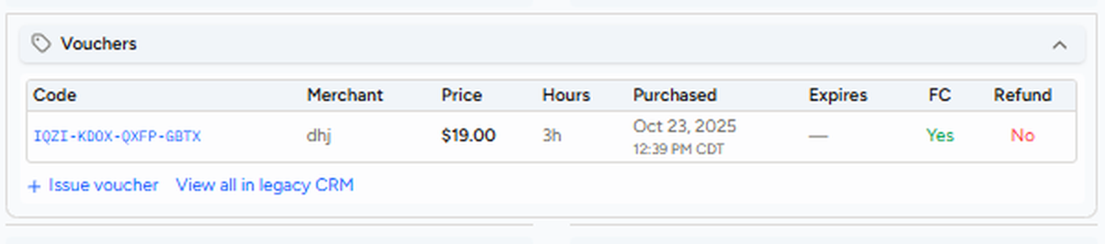
VOUCHERS IN CRM
Reading a voucher in the new CRM
Once redeemed, the voucher shows on the customer's account.
1
2
3
4
5
6
1
Code
16-letter redemption code
3
Price & hours
Paid amount and duration
5
FC & refund
Tied to FC? Refunded?
2
Merchant
The voucher type (dhj, groupon…)
4
Purchased & expires
When it was bought, when it ends
6
Actions
Issue a voucher, or open legacy CRM
Notes:
Walk through each column. Code: the 16-letter redemption code (e.g. ABCD-EFGH-IJKL-MNOP). Merchant: the voucher type, e.g. dhj, dhj_gift, groupon. Price and Hours: what was paid and the voucher duration; free FCF DHJ vouchers have no price. Purchased and Expires. FC and Refund. Use "+ Issue voucher" to issue one, and "View all in legacy CRM" for the full voucher history. In the legacy CRM the voucher sits below the card logo in an orange box; an applied voucher shows a green box with a check mark, job ID and appointment date; canceled, invalidated or expired vouchers are grayed out with the reason next to the code.

Slide 43
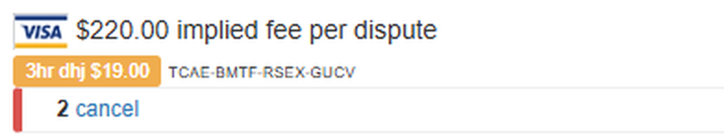
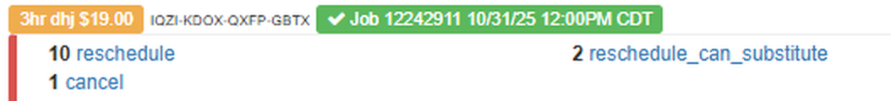

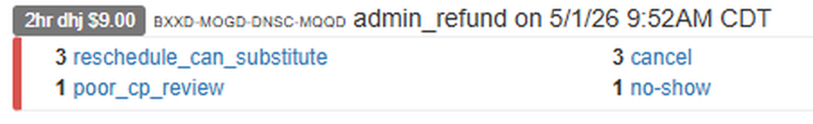


VOUCHERS IN CRM
Voucher status
In the legacy CRM, the color tells you where the voucher stands.
Unused
Orange tag. Applies to the next invoiced job.
Applied
Green tag with a check mark, job ID and date.
Grayed out
Canceled, invalidated, converted or expired. Reason next to the code.
Converted? the voucher was turned into credits equal to what the customer paid for it.
Notes:
Unused (issued or redeemed): assigned to the account and will apply to the next invoiced job, shown in an orange box with duration, type, price and the 16-letter code. Applied (used): a green box with a check mark, the job ID and the appointment date and time. Grayed out: canceled/invalidated (removed through a refund, dispute or admin invalidation), converted (turned into credits equal to the purchase price), or expired. The reason usually appears beside the code. Refunded: refunded to the customer's card on file. Examples on the slide: an unused 3hr DHJ ($19.00) sitting below the card on file; a 3hr DHJ applied to Job 12242911 on 10/31/25 (green tag); a 2hr DHJ ($9.00) grayed out with the reason admin_refund on 5/1/26.

Slide 44
VOUCHERS IN CRM
Voucher types at a glance
Type | Comes from | Invalidate? | Refund? | Expires | To credits?
DHJ | Customer purchase | Yes (CRM) | Yes (Dashboard ≤1 yr, CRM) | Never | Yes, 2nd DHJ
DHJ Gift | Referral | Yes (CRM) | No | 90 days | No
First-Time | System | Yes (CRM) | No | Never | N/A
Third-party (Groupon) | Customer purchase | Yes | Yes | 90 days | Yes, on expiry
HG 2nd | Customer purchase | No | Yes | 1 year | Yes
Admin Courtesy | CS / System | Yes (CRM) | No | 60 days | No
Homeaglow Gift Card | Customer purchase | Yes (CRM) | Yes | 2 years | No
Notes:
Use this table before you invalidate, refund or explain any voucher. DHJ refunds can be done from the C Dashboard if purchased one year ago or less, or from the CRM. A DHJ converts to credits if an unqualified customer tries to redeem a second DHJ. Third-party merchant vouchers convert to credits on expiry. Legacy DHJ is deprecated: all new customers are on the new membership model from August 3, 2026, except those who bought a DHJ before the flip and customers who came from an AD.

Slide 45
VOUCHERS IN CRM
Voucher types in the CRM (1 of 2)
DHJ voucher
Comes with a membership. The membership is only triggered once the voucher is used.
New CRM
1
Legacy
Free DHJ (new membership model)
Membership starts at sign-up: $19 discounted first MF, a free 3-hour cleaning, or a discounted first cleaning for longer jobs.
New CRM
2
Legacy
DHJ Gift
Single use. Triggers a membership. Expires in 90 days if unused.
Legacy
3
Third-party (Groupon)
No membership. Can't be split, and converts to credits on expiry.
Legacy
4
Notes:
Walk through each type and point to how it looks in the CRM. DHJ (Deals at Homejoy): the customer buys the voucher; the FC membership is only triggered once the voucher is used. Free DHJ (new membership model, all new customers from August 3, 2026): instead of buying a voucher, the customer signs up for a membership and is charged a $19 discounted first MF upfront; the system issues a free 3-hour DHJ voucher (or a discount on a longer first cleaning). Free DHJs have no price indicator in the CRM ($0.00 in the new CRM, no price on the legacy tag). DHJ Gift: shown as dhj_gift on the guest's account; single use, only the first guest can redeem it; triggers FC once used; expires in 90 days. Third-party merchant (Groupon, Living Social, Gilt City): no membership; expires 90 days after redemption; can't be split across appointments, and no admin courtesy voucher is issued for unused hours; converts to credits on expiry.

Slide 46
VOUCHERS IN CRM
Voucher types in the CRM (2 of 2)
Admin Courtesy
Issued by CS or the system. Expires in 60 days.
New CRM
5
Legacy
Homeaglow Gift Card
No membership. Valid for 2 years.
Legacy
6
Second Brand Voucher
No membership. An identical voucher bought from Homeaglow, at the same cost as the third-party merchant's.
Legacy
7
Notes:
Admin Courtesy: issued manually by CS or automatically by the system for refund requests, unworked hours, reviews or retention; expires in 60 days. The legacy example shows it applied to a job (green tag). Homeaglow Gift Card (launched December 2025): a one-time cleaning bought as a gift; does not trigger FC and isn't tied to the buyer's account; valid for 2 years. Second brand voucher (homeaglow_second_voucher): offered to customers who bought a third-party voucher, at the same cost as the third-party merchant; non-membership.

Slide 47
VOUCHERS IN CRM
When a customer wants a refund
Always find and fix the reason first.
Voucher | First response | If they ask again
Groupon | Fix the reason, send self-refund steps (comms kit macro) | Invalidate the voucher so Groupon can refund
Second brand voucher | Fix the reason, encourage them to keep it, send the self-refund link | Refund it: C CRM › Do › Voucher › Refund › 2nd Voucher
Homeaglow Gift Card | Fix the reason. Valid for 2 years, code is in the confirmation email | Escalate to your CSQ sheet for a Stripe refund
Groupon: invalidate the voucher, or Groupon may not be able to refund it.
Notes:
Groupon: determine the reason (e.g. no show, cleaning quality) and address it; use the "Refund voucher (groupon)" macro in the comms kit for self-refund instructions; invalidate the voucher, otherwise Groupon may be unable to refund. Second <<BRAND>> voucher: first response, address the reason, encourage them to keep it, and give the self-refund link and instructions; second response, refund via C CRM > Do > Voucher > Refund > 2nd Voucher and let the customer know. Homeaglow Gift Card: first response, address the reason, remind them the card is valid for 2 years and can be gifted later, point them to the purchase confirmation email for the code, and invite them to reach out again; second response, escalate to your department's CSQ sheet so the charge is refunded via Stripe.

Slide 48





VOUCHERS IN CRM
How the system handles combos
Two Groupons
The second one converts to credits.
Short job on a Groupon
No courtesy voucher for the unused hours.
DHJ or FCF, then Groupon
The Groupon converts to credits.
Past job, then Groupon
Converts to credits. New customers only.
Groupon, then DHJ
Allowed. DHJ is applied first.
2nd DHJ
Possible for some active or deactivated FC customers.
Notes:
Scenario 1: two Groupon vouchers, the second converts to credits. Scenario 2: Groupon or second brand voucher applied to a shorter job, no admin courtesy voucher for unused hours (unlike DHJ). Scenario 3: DHJ voucher or active FC, then a Groupon, the Groupon converts to credits. Scenario 4: past invoiced job, then a Groupon, converts to credits because third-party vouchers are for new customers only. Scenario 5: Groupon first then DHJ: allowed, so we can convert them to FC; the DHJ is applied first; both can be used on separate appointments. Scenario 6: active FC customers can buy a 2nd DHJ if only one is true: booking address previously serviced by a DHJ, a card tied to a previous DHJ, or a used DHJ on the account. Scenario 7: deactivated FC customers can buy a new DHJ via the /deals page if they have no unused vouchers, no active FC, and none of the flags disputed_stripe_charge_id, customer_disputed_voucher, known_customer_fraud.

Slide 49
WRAP-UP
Questions?
When in doubt, check the Knowledge Library or ask your Trainer or Team Lead.
Notes:
Open the floor for questions.

Slide 50

TOPIC 06
Non-Logged-In Visitor Tickets
Someone used an existing customer's email, but wasn't logged in.
YOU'LL LEARN
What the ticket looks like
Why it's a security checkpoint
How to respond
Notes:
Someone submits a ticket, usually via a public contact form or the Help Center, using an email address that already belongs to a registered customer. They haven't logged in, and may not actually be that customer.

Slide 51
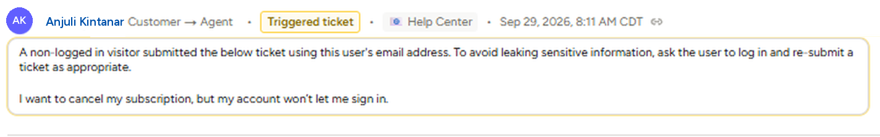
NON-LOGGED-IN VISITOR TICKETS
What it looks like
The new CRM flags these tickets for you.
1
2
3
Triggered ticket
Came in from the Help Center
System note
Sender wasn't logged in
Their message
What the visitor is asking
1
2
3
Remember: a matching email isn't proof. Anyone can type an email into a form.
Notes:
Point out: 1) the Triggered ticket badge and the source (Help Center); 2) the system note: "A non-logged in visitor submitted the below ticket using this user's email address. To avoid leaking sensitive information, ask the user to log in and re-submit a ticket as appropriate."; 3) the visitor's actual message. A matching email does not prove the person is the account owner. Anyone can type an email address into a form.

Slide 52

NON-LOGGED-IN VISITOR TICKETS
Why it matters
This is a security and privacy checkpoint, not a routine ticket.
Anyone can type an email
Wrong person, real data
Verify first
A match doesn't mean it's the account owner.
Replying to the wrong person exposes the account.
Confirm who you're talking to before you share anything.
Notes:
Two different customers, or a customer and someone impersonating them, could share visibility into the same account if you respond to the wrong party as if they were the account owner. Treat verifying identity as the first step, not an afterthought.

Slide 53



NON-LOGGED-IN VISITOR TICKETS
How to respond
Check the account first. What you find decides your reply.
First, check the account: recent jobs, address, and whether their issue matches what's on file.
Details match
Can't tell
Clearly not them
Proceed as normal. No extra hoops for a verified customer.
Reply generically. Ask them to log in, or share a couple of identifying details.
Treat it as unverified. Share nothing about the account.
Until verified: never confirm account details, upcoming appointments or charges.
Notes:
Step 1: don't assume the submitter is the account owner just because the email matches. Step 2: check the account for identifying details, such as recent job details, the address, or an issue description that matches what's on file. Confirmed (their description matches account history, they reference specifics only the owner would know): proceed normally, no extra hoops for a genuinely verified customer. Can't confirm: respond generically; don't confirm account details, upcoming appointments or charges; ask them to log in to their dashboard or give a couple of identifying details first. Clearly not the owner (mismatched details, or asking something the real owner wouldn't need to ask): treat it as an unverified inquiry and share nothing account-specific.

Slide 54
TOPIC 06
Max CP Rate
The C-facing rate cap: the highest hourly rate a cleaner can claim this customer's jobs at.
YOU'LL LEARN
What the cap does
What to flag before setting it
How the cap behaves
What to tell the customer
Notes:
An agent can set a maximum hourly rate on a customer's behalf. It's a pricing lever with real trade-offs: a lower cap protects the customer's wallet, but shrinks the pool of cleaners who can claim their jobs, possibly including their current cleaner.

Slide 55
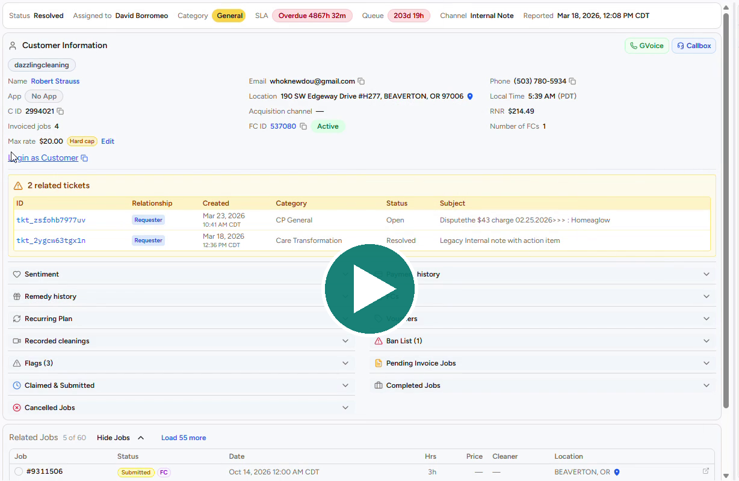

MAX CP RATE
What the cap does
Set in the CRM: Customer Information › Max rate › Set.
1
Under Customer Information, find Max rate and click Set
2
Enter the preferred hourly rate and click Save
3
Max rate now shows the amount with a Hard cap tag
▶ Watch & Learn
How to set the Max CP Rate in the CRM (29 sec)
Click the video to play it.
The hard cap applies to future submitted and claimed jobs.
Protects the customer's wallet
Cleaning requests only go to cleaners whose rates don’t exceed the cap.
Shrinks the cleaner pool
Their current cleaner may be above it. Too low, and jobs go unclaimed.
Notes:
An agent can set a maximum hourly rate on a customer’s behalf in the CRM. It caps the rate of the cleaners who can receive and claim the customer’s jobs, going forward: cleaning requests only go to cleaners whose rates don’t exceed the cap. Steps on the slide (also in the video): 1) In the CRM, under Customer Information, find Max rate (it shows "Not set" when there is no cap) and click Set. 2) In the "Set max rate cap" box, enter the customer’s preferred hourly rate and click Save. 3) Max rate now shows the amount with a Hard cap tag; click Edit to change it. The hard cap applies to future submitted and claimed jobs. TRAINER: in slideshow mode, click the video thumbnail to play the tutorial. Trade-off: a lower cap protects the customer's wallet, but shrinks the pool of CPs who can claim, possibly including their current CP if that CP's rate is above the new cap. Setting it without understanding how it interacts with booked jobs, rescheduling and admin-locked jobs is how a well-intentioned cap turns into an unclaimed-job ticket a week later.

Slide 56
MAX CP RATE
Before you set a cap
Flag these to the customer first.
They may lose their cleaner
Jobs may go unclaimed
Check the area first
Cleaners set their own rates. Theirs may be above the cap.
Especially where few cleaners charge that little.
Look at what cleaners near them charge on their dashboard.
Typical ask: most customers ask for $19–23/hr. Don't set a number blind.
Notes:
CPs set their own rates, so a lower cap can mean losing access to some of the platform's best cleaners, including the customer's current CP if that CP's rate is above the new cap. Setting it too low can mean jobs go unclaimed, especially in areas with fewer CPs at that price point. Most customers ask for $19-23/hr. Before setting the cap, check the customer's dashboard to see what CPs in their area actually charge. Don't set a number blind.

Slide 57

MAX CP RATE
How the cap behaves
Several of these aren't what you'd expect.
Scenario | What happens
Lowering the cap | Immediately lowers the rate on booked future jobs (submitted or claimed)
Raising the cap | Does nothing to existing jobs. A cap can never raise a rate
Customer reschedules | The job keeps its rate. The nightly recalculation can't push it above the cap
New job booked after the cap | Prices at or below the cap automatically
Cleaner tries to claim above it | Can't. The cap blocks the claim
Customer taps Standard / Premium | The cap stays in effect either way
Rate set on the Django job page | Admin-locked: skips the cap and the nightly sweep entirely
Charged above the cap? check whether that job's rate was set via Django first.
Notes:
The two easiest mistakes: assuming raising a cap will correct an existing job's rate (it won't; a cap can never raise a rate), and forgetting that admin-locked jobs (rate set via the Django job page) bypass the cap and the nightly sweep entirely. So a customer saying "I set a cap and this job still charged more" isn't necessarily wrong. Check whether that job was set via Django first.

Slide 58

MAX CP RATE
What to tell the customer
After the cap is set.
Best match
Estimate on claim
Rematch
Lowering it?
To cleaners at or below their rate. Never "only" or "guaranteed".
The invoice estimate shows on their dashboard right away.
They can request one up to 6 hours before the appointment.
It can change jobs they've already booked too.
Say it plainly: "the highest rate a cleaner can charge for your jobs", not "max CP rate".
Notes:
Jobs are matched to CPs at or below their selected rate whenever possible; avoid "only" or "guaranteed" language. An invoice estimate shows on their dashboard right away once a CP claims the job. They can request a rematch up to 6 hours before the appointment. If they are lowering their cap, tell them it may affect upcoming jobs they've already booked, not just future ones; this is the part that most contradicts intuition. Don't guarantee: this is a newly shipped feature still being monitored for edge cases, and admin-locked jobs bypass the cap. Terminology: don't say "max CP rate" or "max rate" to the customer; use plain language, e.g. "the highest rate a cleaner can charge for your jobs".

Slide 59
WRAP-UP
Questions?
When in doubt, check the Knowledge Library or ask your Trainer or Team Lead.
Notes:
Open the floor for questions.

Slide 60
TOPIC 07
ForeverClean Membership
What ForeverClean is, how the two enrollment models differ, and how fees, the commitment term and the ETF fit together.
YOU'LL LEARN
What ForeverClean is
DHJ vs FCF
Fees, MCT and ETF
Washington and edge cases
Notes:
This module covers ForeverClean, the membership at the center of most billing, cancellation and retention conversations. By the end, trainees can tell which enrollment model a customer is on, explain when membership starts, and walk through fees, the minimum commitment term (MCT) and the early termination fee (ETF).

Slide 61
FOREVERCLEAN MEMBERSHIP
What is ForeverClean?
A membership, not a one-time cleaning product.
A membership
Two enrollment models
Which one is it?
Customers pay a recurring Membership Fee for ongoing benefits, including discounted rates. The first cleaning is one benefit.
DHJ (Deals at HomeJoy) is the legacy model. FCF (First Cleaning Free) is the current model.
Look for the FCF banner in the New CRM or Legacy CRM. No banner? Treat the customer as DHJ.
Transition:from August 3, 2026 all new sign-ups are FCF. Both models are still active, so identify the model before you apply any membership policy.
Notes:
Start with the framing: ForeverClean is a membership, not a one-time cleaning product. The first cleaning gets the attention, but it is only one benefit. That is why recurring billing, MCT and ETF exist. Two models are live: DHJ (legacy, the customer buys a voucher) and FCF (current, the customer joins the membership and gets a free first cleaning). The quickest check is the FCF banner in the New CRM or Legacy CRM. No banner means treat the customer as DHJ. From August 3, 2026 all new sign-ups are FCF. Experiments may change how accounts are handled, so if something doesn't match the KB, check for a newer update before assuming the KB is wrong.

Slide 62
FOREVERCLEAN MEMBERSHIP
When does membership begin?
This one idea explains most DHJ vs FCF differences.
DHJ
FCF
What follows the start
The customer buys a voucher. Membership starts only after the first cleaning is completed.
The customer joins the membership first. It starts immediately at sign-up, with a free first cleaning as a benefit.
Monthly billing, the Minimum Commitment Term and self-service features all begin when membership begins.
Remember:don't memorize each difference as a separate rule. Ask "has this customer's membership started yet?"
Notes:
This is the single most important concept. In DHJ the first purchase is a voucher, so membership only begins after the first cleaning is completed. In FCF the customer joins the membership first, so it starts at sign-up. Anything that depends on an active membership (monthly billing, MCT, self-service features) follows that start date. Encourage trainees to ask 'has this customer's membership started yet?' instead of memorizing each difference.

Slide 63
FOREVERCLEAN MEMBERSHIP
DHJ vs FCF: sign-up and billing
Same program, different enrollment experience.
Topic | DHJ (legacy) | FCF (current)
Primary product | Customer purchases a voucher | Customer signs up for a membership with a free 2-3 hour first cleaning
Payment at sign-up | Voucher price only | $19 discounted first membership fee; +$19 for a 4-hr cleaning ($38), +$59 for a 6-hr ($78), before tax
Membership starts | After the first completed cleaning | Immediately at sign-up
Monthly fee | $59/month after the first completed cleaning | $19 at sign-up, then $59/month
MCT starts | After the first completed cleaning (6 months) | At sign-up (6 months)
ETF applies | After first completed cleaning, before MCT ends | Same condition
Never say it:don't call an FCF sign-up "purchasing a voucher". They enrolled in a membership that includes a free first cleaning.
Notes:
Walk the table row by row. FCF customers pay a discounted $19 first membership fee at sign-up, plus $19 more for a 4-hour first cleaning ($38 total) or $59 more for a 6-hour one ($78 total), before tax. DHJ customers pay only the voucher price, and the first $59 fee bills after the first completed cleaning. MCT is 6 months in both models but starts at different points. ETF applies in both only after a completed job and before MCT ends. Stress the language rule: never describe an FCF sign-up as 'purchasing a voucher'.

Slide 64
FOREVERCLEAN MEMBERSHIP
DHJ vs FCF: self-service and refunds
What the customer can do on their own depends on when membership starts.
Topic | DHJ (legacy) | FCF (current)
1st job is a lockout | Membership is paused. It un-pauses once the 2nd job is invoiced (lockouts count) | Membership keeps renewing
Customer self-cancel | Not available before the first completed cleaning | Available right after sign-up
Cancellation link | Not applicable before the first completed cleaning | Can be provided immediately
Refund requests | Customer can self-refund the voucher | Handled by Care under the applicable policy
Voucher after refund | Becomes "Refunded but Valid": the agent must invalidate it | Voucher invalidates automatically when membership is cancelled. Invalidate manually if the system missed it
Notes:
Self-service follows the membership start. DHJ customers can't self-cancel or get a cancellation link before the first completed cleaning because the membership hasn't started. FCF customers can, right after sign-up. Lockout on the first job: a DHJ membership is paused and un-pauses once the 2nd job is invoiced (lockouts count), while an FCF membership keeps renewing because the customer is already a paying member. For refunds, DHJ customers can self-refund the voucher and the agent must invalidate the 'Refunded but Valid' voucher. FCF refunds are handled by Care under the applicable policy, and the voucher invalidates automatically on cancellation unless the system missed it.

Slide 65
FOREVERCLEAN MEMBERSHIP
Membership fees (MF)
When the first charge happens depends on when membership starts.
 | DHJ (legacy) | FCF (current)
First charge | $59/month, once the first cleaning is completed | $19 at sign-up (+$19 for 4-hr, +$59 for 6-hr first cleaning)
Recurring charge | $59/month thereafter | $59/month after the initial charge
Before any cleaning | No membership fee bills | Customer has already paid and is an active member
Avoid:"cleanings start at $X/hour". Explain what applies to their booking or membership instead of using marketing phrases.
Notes:
The first-charge timing is the point. DHJ: $59/month starting once the first cleaning completes, nothing before. FCF: the customer pays at sign-up, then settles into $59/month. Remind trainees to avoid marketing phrases such as 'cleanings start at $X/hour'. The job is to help the customer understand their account, so explain what applies to their booking or membership.

Slide 66
FOREVERCLEAN MEMBERSHIP
Minimum Commitment Term (MCT)
The minimum stretch a customer stays a member before leaving without an early termination fee.
6 months, both models
Where the clock starts
MCT clock is not the ETF clock
MCT is the flip side of the heavily discounted first cleaning. It stops that discount being a one-time freebie.
DHJ: after the first completed cleaning. FCF: at sign-up, because membership starts immediately.
An FCF customer can be 3 months into MCT with no completed cleaning. Cancel then: no ETF applies yet.
Washington:customers in Washington are not held to the 6-month term under either model. They can cancel any time.
Notes:
MCT is 6 months in both models. It is the flip side of the heavily discounted first cleaning, so the discount isn't a one-time freebie. The clock starts after the first completed cleaning for DHJ and at sign-up for FCF. Key nuance for FCF: the MCT clock and the ETF clock are different clocks. A customer can be 3 months into MCT with no completed cleaning, and cancelling then triggers no ETF because ETF liability only exists once a job has been completed. Washington customers are not held to the 6-month term under either model.

Slide 67
FOREVERCLEAN MEMBERSHIP
Early Termination Fee (ETF)
The fee for cancelling after the first completed cleaning but before MCT ends.
Why it exists
The formula
When it applies
The first cleaning was free or heavily discounted. The ETF makes that offer sustainable. It is not a punishment.
$35/hour x duration of the first cleaning. Same for DHJ and FCF.
Only after a job has been completed, and only before MCT ends.
Before you charge it:make sure the customer understands what it is, or explicitly agrees to be charged. Silence is not agreement.
Notes:
Explain why the ETF exists, not just the formula. The first cleaning was free or heavily discounted and the cleaner is still paid in full. The ETF is what makes that offer sustainable. It is not a punishment, so never apologize for it. Formula: $35/hour x duration of the first cleaning, for both models. It applies only after a completed job and before MCT ends. Important handling rule: never charge the ETF before the customer understands it. The one exception is when the customer already understands it and explicitly agrees. Silence or no objection is not agreement.

Slide 68
FOREVERCLEAN MEMBERSHIP
Good to know
Legacy ETF cohorts
Some older DHJ customers ($49 fee) use the non-FC cleaning price formula. The FC table is the source of truth.
Washington
No MCT and no ETF. Never raise ETF or waivers. Go straight to a no-charge cancellation.
Pending cancellation
ETF charge failed. No more monthly fees. System retries and FC deactivates on success. You can cancel in the CRM to speed it up.
DHJ lockout first job
Membership is paused until the 2nd job is invoiced.
FCF lockout first job
Membership keeps renewing. The customer is already a paying member.
ETF waivers
See ETF Waivers in the Knowledge Library before waiving or reducing.
Notes:
Cover the edge cases. Some older DHJ customers on a $49 fee have an ETF computed with the non-FC cleaning price formula, so check the FC table, which is the source of truth. Washington customers have no MCT and no ETF: never bring up ETF or waivers, go straight to a no-charge cancellation. Pending cancellation means the ETF charge failed. The customer isn't charged further monthly fees, the system retries, and FC moves to deactivated once it succeeds. The agent can also cancel manually in the CRM. For waivers or reductions, point trainees to ETF Waivers in the Knowledge Library.

Slide 69
WRAP-UP
Questions?
When in doubt, check the Knowledge Library or ask your Trainer or Team Lead.
Notes:
Open the floor for questions. When in doubt, check the Knowledge Library or ask your Trainer or Team Lead.

Slide 70
TOPIC 08
Value of ForeverClean
How to talk about what the membership is worth when a customer questions the price or the monthly fee.
YOU'LL LEARN
Value first, mechanics second
Objections you will hear
Explaining the monthly fee
Explaining the ETF
Notes:
This module is about how to talk about what ForeverClean is worth. The membership mechanics tell an agent what is true. This module is about how to say it so it lands as fair rather than defensive.

Slide 71
VALUE OF FOREVERCLEAN
Lead with value
A customer asking "why am I paying this" is asking "what do I get".
Value first
What members get
Keep it simple
Answering with the formula or the date reads as deflection. Say what it is worth, then the mechanics.
Background-checked, vetted cleaners; lower hourly rates than one-time bookings; Customer Service and Trust & Safety support; booking tools.
Short, friendly and conversational. Lead with empathy and offer a real next step.
Say:"ForeverClean is our membership that lets us offer cleanings at discounted, non-marked up rates with a network of background-checked cleaners."
Suggested macros: Membership details: ForeverClean overview · FCF - Membership Explanation
Notes:
A customer asking 'why am I paying this' is really asking 'what am I getting'. Answering with only the formula, percentage or date often reads as deflection. Lead with value, then give mechanics. Members get bookings with background-checked, vetted cleaners, lower hourly rates than one-time bookings, Customer Service and Trust & Safety support, and booking and scheduling tools. Give trainees the one-line explanation on the slide to practice. Suggested macros: Membership details: ForeverClean overview; FCF - Membership Explanation.

Slide 72
VALUE OF FOREVERCLEAN
Objections you will hear
Adapt these to the customer.
Customer says | What to say
"I thought it was only $19" (DHJ) | The voucher is heavily discounted because it comes with a membership called ForeverClean, which lets us offer discounted, non-marked up rates.
"I thought it was only $19" (FCF) | The $19 is your first month's discounted membership fee. It gives you your free/discounted first cleaning. After that it renews at $59/month and keeps your rates discounted.
"I only wanted a one-time cleaning" | We offer one-time cleanings, billed at a higher hourly rate. The membership allows discounted rates while cleaners are paid fairly. Use the FC Sales Calculator for the one-time total.
Notes:
Role-play these three. When a customer thought it was only $19, the DHJ and FCF explanations differ: DHJ is a heavily discounted voucher that comes with a membership; FCF is the discounted first month's membership fee that renews at $59/month. When a customer only wanted a one-time cleaning, acknowledge that one-time cleanings exist at a higher hourly rate, give the total using the FC Sales Calculator, and explain the membership can be more cost-effective for regular bookings.

Slide 73
VALUE OF FOREVERCLEAN
Explaining the monthly fee
Three steps, in this order.
1 Start with willingness
2 Explain what it covers
3 Acknowledge usage, then help
"I'm happy to clarify that for you." Not defensive, and no "I understand you weren't aware".
Your membership keeps rates discounted with background-checked cleaners. FCF: it also gave you your first cleaning.
"I see three charges but one cleaning." Offer free months, rebooking help, schedule or RC changes.
Agent do:don't apologize for or validate frustration about the monthly fee. It is standard practice, not a service failure. Stay matter-of-fact.
Notes:
Walk through the three steps. Start with willingness to help, not defensiveness. Explain what the fee covers (DHJ: the membership that comes with the voucher; FCF: the membership that gave access to the first cleaning and keeps rates discounted). Acknowledge usage if relevant, then offer a genuinely helpful next step such as free months, rebooking help, or schedule changes. Two agent-do rules: don't apologize for or validate frustration about the monthly fee, and skip 'I understand you weren't aware', going straight to willingness to help.

Slide 74
VALUE OF FOREVERCLEAN
Customer never used the membership
The fee is not based on usage. It stays active month to month.
Offer free months
Give exact dates
Free months and MCT
"I can offer you [X] free months, covering you through [date]. Your fee resumes on [date]."
Always state the end date of the free period and the date the fee resumes. Never "a few free months".
Free months do not count toward the MCT. They only pause the fee. Say so clearly.
Next step:offer to help schedule their next cleaning right away. What date works best?
Suggested macro: [Fragment] Free month offer
Notes:
The fee is not based on usage. The membership stays active month to month, whether or not a cleaning happened. When a customer says they never used it, offer free months. Two rules every time: state the exact end date of the free period and the exact date the monthly fee resumes, and clarify that free months do not count toward the MCT, so the customer isn't left thinking their commitment shortened. Then offer to help schedule the next cleaning. Suggested macro: [Fragment] Free month offer.

Slide 75
VALUE OF FOREVERCLEAN
Explaining the ETF
Frame it as fairness to cleaners, never as a penalty.
Why it exists
Tone
Then ask
The first cleaning is free or heavily discounted and the cleaner is still paid in full. The ETF covers that if the membership ends early.
Don't position it as a penalty and don't apologize for it. Stay friendly and matter-of-fact.
Pivot to the experience: "How was your experience with your recent cleaning?"
Sample:"There is normally an Early Termination Fee before the 6-month term, since the first cleaning is heavily discounted. It ensures cleaners are paid fairly."
Suggested macro: [Fragment] ETF terms explanation
Notes:
The ETF exists because the first cleaning is free or heavily discounted, the cleaner is still paid their full rate, and the ETF covers the cost of that discount if the membership ends early. Frame it as a way to ensure the cleaner is paid fairly, never as a penalty. After the explanation, pivot to the customer's experience with their recent cleaning, since that often reveals the real reason for the cancellation. Suggested macro: [Fragment] ETF terms explanation.

Slide 76
VALUE OF FOREVERCLEAN
Do and avoid
The tone of the conversation matters as much as the facts.
Do | Avoid
Be friendly and conversational | Sounding defensive
Lead with empathy and focus on membership value | Suggesting the customer should have read the terms more carefully
Offer solutions when possible | Making the customer feel at fault
Help the customer get value from the service | Apologizing for the fee or the ETF
Notes:
Summarize the tone. Do be friendly and conversational, lead with empathy, focus on membership value, offer solutions and help the customer get value. Avoid sounding defensive, suggesting the customer should have read the terms more carefully, or making the customer feel at fault.

Slide 77
VALUE OF FOREVERCLEAN · PRACTICE
5-minute writing challenge
Read the customer's message. How would you respond?
CONTEXT
DHJ voucher deals customer. Just received their 1st cleaning and was charged the first $59 MF.
SAMPLE CS RESPONSE
I'm happy to clarify!
The $59 charge you're seeing is for your ForeverClean membership. Your first cleaning was heavily discounted because your voucher came with a membership, which costs $59/month and is billed separately from your cleanings. It gives you access to background-checked cleaners at lower hourly rates.
If you're planning to book cleanings regularly, it can be a good way to save on each visit!
I'd also love to hear how your cleaning went! If there's anything else I can help you with, just let me know.
CUSTOMER
“I have a voucher. Why did you charge me again?”
Write your reply first.
▶ Show CS response
5 minutes
Write your reply first. Then compare it with the sample.
Notes:
5-minute writing challenge. Context: a DHJ voucher deals customer just received their 1st cleaning and was charged the first $59 MF. Customer's message: "I have a voucher. Why did you charge me again?" Give trainees 5 minutes to write their reply, read a few aloud, then click to reveal the sample CS response. What a good reply does: starts with willingness (no apology for the fee), explains that the voucher came with a ForeverClean membership billed separately at $59/month, leads with the value (background-checked cleaners at lower hourly rates), and pivots to the experience ("how did your cleaning go?"). Sample response: "I'm happy to clarify! The $59 charge you're seeing is for your ForeverClean membership. Your first cleaning was heavily discounted because your voucher came with a membership, which costs $59/month and is billed separately from your cleanings. It gives you access to background-checked cleaners at lower hourly rates. If you're planning to book cleanings regularly, it can be a good way to save on each visit! I'd also love to hear how your cleaning went! If there's anything else I can help you with, just let me know."

Slide 78
WRAP-UP
Questions?
When in doubt, check the Knowledge Library or ask your Trainer or Team Lead.
Notes:
Open the floor for questions. When in doubt, check the Knowledge Library or ask your Trainer or Team Lead.

Slide 79
TOPIC 09
KB - Poor Cleaning Quality (PCQ)
When a cleaning missed the mark, and what to investigate, offer and do when the customer has not asked to cancel.
YOU'LL LEARN
What PCQ is
Investigate and act
Recovery matrix
Refund request vs admin refund
Notes:
This module covers Poor Cleaning Quality (PCQ) where the customer has not said they want to cancel. By the end, trainees can investigate a PCQ complaint, choose the right recovery offer, handle refund request questions, and know when to switch to the PCQ Retention Framework.

Slide 80
POOR CLEANING QUALITY
What is PCQ?
The outcome did not match what the customer paid for.
What counts
A service failure
Scope of this KB
Missed areas, incomplete tasks, visibly dirty areas, or a CP with incomplete supplies that hurt the quality of the job.
Not a billing issue. Credits, vouchers and re-cleans are tools. The real fix is a properly cleaned home.
Customer has not said they want to cancel. Just unhappy about a specific cleaning.
Cancel intent?the moment they want to cancel, for any reason, stop and move to the PCQ Retention Framework. ETF and waivers live there only.
Notes:
PCQ means the cleaning didn't meet professional standards: missed areas, incomplete tasks, visibly dirty areas, or a CP who brought incomplete supplies and the quality suffered. It is a service failure, not a billing issue. The goal is to restore confidence and get the home cleaned properly, with credits, vouchers and re-cleans as tools. Scope matters: this page applies only when there is no cancellation intent. The moment the customer wants to cancel, for any reason, stop and move to the PCQ Retention Framework, where ETF, waivers and cancellation offers live.

Slide 81
POOR CLEANING QUALITY
Key mindset
Facts first
Understand what went wrong before you decide on an offer.
Offers are tools
Voucher, credit or re-clean serve the goal: a home cleaned properly.
Be specific
Acknowledge the specific failure, not a generic "I understand your frustration".
Probe if vague
Give the customer space to say what went wrong.
Don't over-probe
If they already described it in detail, asking more feels like you are not listening.
No cancel intent, no ETF talk
Don't hint at waivers or cancellation terms. It plants the idea.
Notes:
Go through the six points. Gather facts before offering anything. Treat offers as tools. Be specific in empathy. Probe only when the story is vague, and don't probe when the customer already gave detail. The trap to emphasize: with no cancellation intent there is no ETF or cancellation talk of any kind. Hinting at a future waiver plants the idea of cancelling before the customer has asked.

Slide 82
POOR CLEANING QUALITY
Investigate first
Job admin and history
Which job, hours invoiced, CP identity, CP workload and ratings that day.
Messages
Customer-CP and customer-Care messages before the complaint.
Supplies overlap
Still PCQ if the cleaning was actually poor. Happy with the cleaning but annoyed about supplies is lower severity.
Refund status
Refund request already submitted? Is the 72-hour window still open?
Voucher status
Was an admin courtesy voucher auto-issued? Used or unused?
Pattern check
Isolated, or linked to a prior PCQ job? Don't assume cancel intent from a pattern.
Notes:
Before deciding on a resolution, check: job admin and job history (which job, hours invoiced, CP identity, workload and ratings), the messages, supplies overlap (still PCQ if the cleaning was actually poor), refund status and whether the 72-hour window is open, whether an admin courtesy voucher was auto-issued, and whether this connects to a prior PCQ job. A pattern alone is not cancellation intent.

Slide 83
POOR CLEANING QUALITY
Refund request rules
Check these before you point a customer to the refund button.
Rule | Detail
Request window | Customers can self-submit within 72 hours of invoice from the dashboard. The system allows up to 96 hours. That is internal only.
Window blockers | Invoiced more than 72 hours ago; an active voucher exists for the job; 2+ existing refund requests tagged cleaning quality/speed; customer said they don't want a refund.
Admin courtesy voucher | A 3-hour voucher is auto-issued for a rating of 3 stars or less, or "I want a different cleaner". Full refund options may be unavailable while it is active.
Non-consecutive PCQ | Treat as general dissatisfaction. Investigate the root cause and offer standard resolutions.
Never disclose:the 96-hour window. Disclosing it is a ZTP Level 2 violation.
Notes:
Customers can self-submit a refund request within 72 hours of invoice from the dashboard. The system technically allows up to 96 hours, but that is internal only and must never be disclosed (disclosing it is a ZTP Level 2 violation). Don't advise a refund request when the job was invoiced over 72 hours ago, an active voucher exists for the job (the refund button is blocked), the customer has 2 or more existing refund requests tagged cleaning quality or speed, or the customer has said they don't want a refund. A 3-hour admin courtesy voucher is auto-issued for a rating of 3 stars or less, or 'I want a different cleaner', which can limit refund options. Non-consecutive PCQ is general dissatisfaction.

Slide 84
POOR CLEANING QUALITY
Required agent actions
Work through all four areas.
Area | Action
Customer | Empathize with the specific experience. Probe if the explanation is vague.
Resolution | Check refund request eligibility and blockers. Refund the Premium Upsell Fee if charged (confirmed service issue). Refund the Priority Markup Fee only if the customer asks.
Account | Flag the job as customer_unsatisfied in job admin if no review yet. Block the C/CP pairing unless the customer wants the same CP. Cancel upcoming appointments or RC only if they no longer want the service.
CP | Coach or penalize as necessary. Handle any cleaning supplies issue.
Notes:
Use this as the checklist. Customer: specific empathy, probe if vague. Resolution: check refund eligibility and blockers, refund the Premium Upsell Fee if a service issue is confirmed even without refund intent, refund the Priority Markup Fee only if the customer asks. Account: flag the job customer_unsatisfied if no review yet (for jobs over 30 days, block comms first, ensure the auto-message is blocked, then remove the block), block the C/CP pairing unless the customer wants the same CP, and cancel upcoming appointments or RC only if the customer no longer wants the service. CP: coach or penalize, and handle any supplies issue.

Slide 85
POOR CLEANING QUALITY
PCQ recovery and retention matrix
Start with the recovery objective, not the offer.
Scenario | DHJ | FCF | Non-FC
PCQ, job under 4 hrs | 1 hr voucher | 1 hr voucher | 1 hr voucher or $20 credits
PCQ, job 4 hrs or more | 2 hr voucher | 2 hr voucher | 1 hr voucher or $20 credits
Cancel intent due to PCQ | Standard recovery + ETF waived if the next consecutive cleaning also has a serious issue | Standard recovery + 1 free month + ETF waived if the next consecutive cleaning also has a serious issue | N/A
High-loyalty customer (e.g. 13 invoiced jobs, 9 paid months) | Full admin refund | Full admin refund | Full admin refund
Offer only when:there is a confirmed service issue and the customer is clearly upset, hesitant to continue or has lost confidence.
Notes:
Start with the recovery objective, not the offer. Offers are not automatic entitlements. Voucher or credits may be offered even without cancellation intent only when there is a confirmed service issue and the customer is upset, hesitant or has lost confidence. Read the matrix: under 4 hours is a 1-hour voucher (DHJ and FCF) or 1-hour voucher or $20 credits (Non-FC); 4 hours or more is a 2-hour voucher for DHJ and FCF. With cancellation intent, DHJ gets standard recovery plus an ETF waiver if the next consecutive cleaning also has a serious issue, and FCF adds one free month. High-loyalty customers (for example 13 invoiced jobs and 9 paid months) get a full admin refund.

Slide 86
POOR CLEANING QUALITY
Why the offers differ
Retain first, waive second.
Free month for FCF
ETF waiver promise
Full admin refund
FCF membership begins at purchase. A poor first experience means lost membership value, so one free month restores it.
Offer one more chance with a different cleaner. If the next consecutive cleaning also has a confirmed serious issue, waive the ETF.
Loyal customers have trusted us across many jobs. Preserving the relationship is worth more than another recovery attempt.
Non-FC:smaller offer (1 hr voucher or $20 credits). No active membership, so recovery fixes the affected cleaning rather than retaining.
Notes:
Explain the reasoning so trainees don't just memorize numbers. Non-FC customers have no active membership, so recovery fixes the affected cleaning. FCF membership begins at purchase, so a poor first experience means lost membership value and the free month restores it. The ETF waiver follows 'retain first, waive second': give another chance with a different cleaner and waive the ETF if the next consecutive cleaning also has a confirmed serious issue. High-loyalty customers have trusted us repeatedly, so a full admin refund preserves a relationship worth more than another attempt. Longer jobs get a stronger recovery because the customer's investment is bigger.

Slide 87
POOR CLEANING QUALITY
Two kinds of refund
They are not interchangeable.
Refund request
Admin refund
Completed jobs
The cleaner's call. Customer submits within 72 hours. The CP may accept or decline and has 7 days to respond. Never promise it.
Ours. Comes from Homeaglow, and the CP is still paid in full. Used for the high-loyalty row.
We don't refund a completed job charge. The cleaner was paid, and CPs are independent contractors.
You control:the recovery: voucher, priority cleaning with a different cleaner, blocking the pairing, and coaching the CP.
Notes:
Two refunds that are not interchangeable. A refund request is the cleaner's call: the customer submits it within 72 hours, CPs are independent contractors who may accept or decline, they have 7 days to respond, and after that the system may issue a courtesy voucher. Never promise it. An admin refund is ours: it comes out of Homeaglow's pocket and the CP is still paid in full. We don't refund a completed job charge because the cleaner was paid. What the agent controls is the recovery: voucher, priority cleaning with a different cleaner, blocking the pairing, coaching the CP.

Slide 88
POOR CLEANING QUALITY
Handling a cleaning supplies issue
Depends on the CP's operating model.
CA / CA-WA CP
General CP
Supplies only, no quality issue
Don't penalize. Bringing complete supplies isn't required. Encourage it, and check Cleaning Notes for the customer's preference.
Add the require_new_cleaning_supplies_photo flag (CP CRM > Do > Issue) and confirm it. Skip if the supplies cohort is false or the CP is suspended + DNR.
Not PCQ and not an issue job. Offer a $20 credit, encourage rebooking, and still do the CP-side steps.
Always:confirm whether there is an actual quality issue before you decide which path applies.
Notes:
Supplies depend on the CP's operating model. CA/CA-WA: do not penalize, encourage complete supplies and check Cleaning Notes. General: add the require_new_cleaning_supplies_photo flag (CP CRM > Do > Issue), which sets the CP to norequests until a new photo is approved, and confirm the status changed. Skip it if the supplies cohort shows false or the CP is already suspended + DNR. If the customer only mentions supplies with no quality complaint, it is not PCQ and not an issue job: offer a $20 credit, encourage rebooking, and still do the CP-side steps. Always confirm whether there is a real quality issue first.

Slide 89
POOR CLEANING QUALITY · QUICK KNOWLEDGE CHECK
Quick Knowledge Check
Ask each question, then click to reveal the answer.
Missed areas, but C hasn't said they want to cancel. Which guide applies?
KB - PCQ. Cancel intent at any point? Move to the PCQ Retention Framework.
1
Can you tell C they have 96 hours to request a refund?
No. Say 72 hours. The 96-hour window is internal: disclosing it is ZTP Level 2.
2
DHJ customer, confirmed PCQ on a 3-hr job, clearly upset. Offer?
1 hr voucher (2 hr voucher if the job was 4 hrs or more).
3
Refund request vs admin refund?
Refund request: the cleaner's call, never promise it. Admin refund: ours, CP still paid.
4
PCQ for a high-loyalty C (13 invoiced jobs, 9 paid months). Offer?
Full admin refund.
5
A CA CP arrived without complete supplies. Penalize?
No. Supplies aren't required in CA/CA-WA. Encourage it; check Cleaning Notes.
6
Notes:
Quick knowledge check: KB - Poor Cleaning Quality. Ask each question and let trainees answer before revealing. Each click reveals the next answer. 1) This KB covers a customer unhappy about a specific cleaning with no cancel intent. The moment they want to cancel, for any reason, move to the PCQ Retention Framework; ETF and waivers live there only. 2) Customers can self-submit a refund request within 72 hours of invoice. The system allows up to 96 hours, but that is internal only: disclosing it is a ZTP Level 2 violation. 3) Recovery matrix: PCQ on a job under 4 hours: 1 hr voucher (DHJ and FCF; non-FC: 1 hr voucher or $20 credits); 4 hours or more: 2 hr voucher. Offer only with a confirmed service issue and a customer who is clearly upset, hesitant to continue, or has lost confidence. 4) A refund request is the cleaner's call: the customer submits within 72 hours, the CP may accept or decline and has 7 days to respond; never promise it. An admin refund comes from Homeaglow and the CP is still paid in full. 5) High-loyalty customers (e.g. 13 invoiced jobs, 9 paid months): full admin refund. 6) CA / CA-WA CPs aren't required to bring complete supplies: don't penalize; encourage it and check Cleaning Notes for the customer's preference.

Slide 90
POOR CLEANING QUALITY · PRACTICE
Let's investigate together!
Review the live ticket and investigate.
Is it PCQ? Any cancel intent?
Live ticket
1
KB - PCQ, or the PCQ Retention Framework?
Your trainer will provide a live PCQ ticket. Review it and investigate before you decide anything.
What do you check first?
2
Job admin, messages, refund status, voucher, pattern.
What actions and offer?
Trainer provides
3
Recovery matrix, refund rules, account and CP steps.
Notes:
TRAINER: share a live PCQ ticket. Give trainees a few minutes to review it on their own, then work through it together. 1) Is it PCQ (missed areas, incomplete tasks, visibly dirty areas, incomplete supplies that hurt the job)? Any cancel intent? If so, it moves to the PCQ Retention Framework. 2) What do you check first? Job admin and history, customer-CP and customer-Care messages, supplies overlap, refund request status and the 72-hour window, voucher status (admin courtesy voucher), and whether it's isolated or a pattern. 3) What actions and offer? Use the recovery matrix (only for a confirmed issue and a clearly upset customer), check refund request rules and blockers, refund the Premium Upsell Fee if charged, flag customer_unsatisfied, block the pairing, and coach or penalize the CP. Then move to Questions.

Slide 91
WRAP-UP
Questions?
When in doubt, check the Knowledge Library or ask your Trainer or Team Lead.
Notes:
Open the floor for questions. When in doubt, check the Knowledge Library or ask your Trainer or Team Lead.

