Slide 1

HOMEAGLOW · NEW HIRE CARE TRAINING
Cleaner Foundations
& the CP CRM
How cleaners join and work on Homeaglow, and the tools and rules we use to support them.
Trainees: Follow using your Homeaglow Care Training Library
Internal training material
Notes:
Welcome. This module covers the cleaner (CP) side of Homeaglow: the Cleaner Journey, the Legacy CP CRM and CP Dashboard, CP profile statuses, deactivation reasons, CP penalties on the C side, operating models, tiering, job statuses, and the Pending Invoice action guide. It ends with a knowledge check.

Slide 2
OVERVIEW
Agenda
Click a topic to jump to it.
Cleaner Journey
›
Operating Models
›
1
6
Intro to CP CRM (Legacy)
›
CP Tiering
›
2
7
Intro to CP Dashboard
›
Job Status
›
3
8
CP Profile Status
›
AG: Pending Invoice
›
4
9
CP-Facing Deactivation
›
5
Notes:
Walk through today's agenda. In slideshow mode, click any topic to jump straight to it.

Slide 3

TOPIC 01 OF 11
Cleaner Journey
The path a cleaner takes, from first hearing about us to getting paid for their first job.
YOU'LL LEARN
How cleaners find us and sign up
What blocks a cleaner from claiming
When the background check happens
What happens after the first job
Notes:
This is the mirror image of the Customer Journey, from the CP's side. It explains things you'll see constantly in CP tickets: why a CP's status shows cpprofile_setpay or cpsignica instead of active, why a background check hasn't cleared even though the CP claimed a job days ago, or why a CP can't claim jobs despite finishing registration.

Slide 4
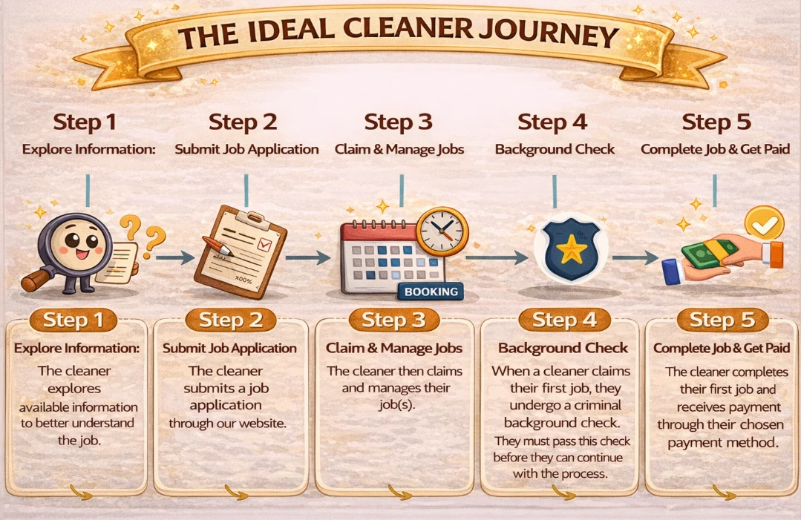
CLEANER JOURNEY
The ideal cleaner journey
Notes:
Step 1 Explore information: cleaners learn about us through homeaglow.com/apply (job descriptions, benefits, how-to videos, dashboard walkthroughs), search engines (most common), testimonials, friends and family, or by contacting Support. Step 2 Submit job application (registration). Step 3 Claim and manage jobs: the CP moves from registered to actively working. Step 4 Background check: starts only after the CP claims their first job, so they are verified before their first appointment. Step 5 Complete the job and get paid through their chosen payment method.

Slide 5
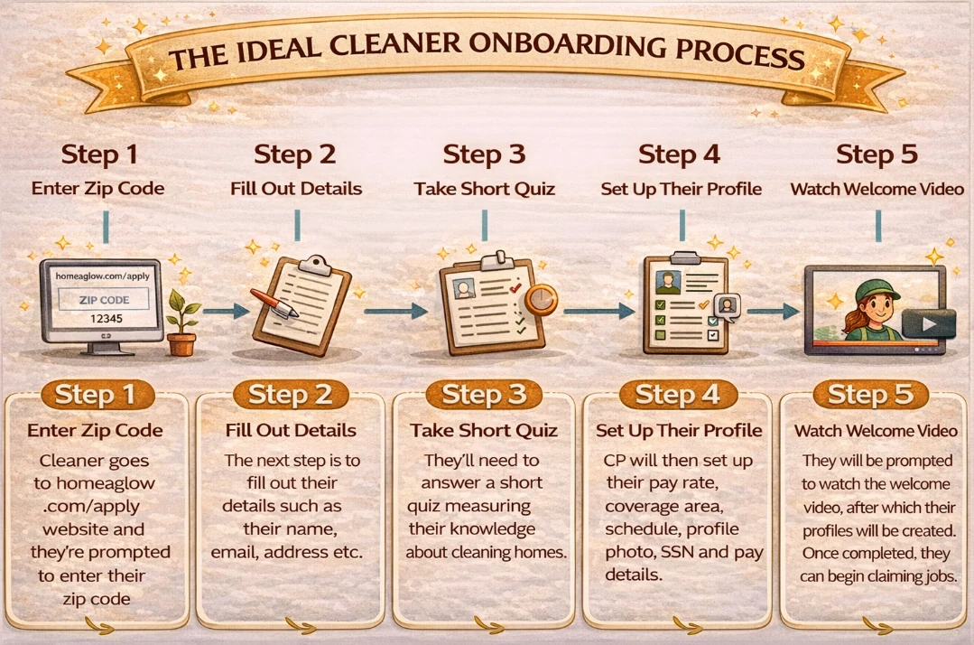
CLEANER JOURNEY · ONBOARDING
The ideal onboarding process
Notes:
Step 1: go to homeaglow.com/apply and enter a zip code. Step 2: fill out details (name, email, address etc.). Step 3: take a short quiz about cleaning homes. Step 4: set up their profile: pay rate, coverage area, schedule, profile photo, SSN and pay details. Step 5: watch the welcome video, after which their profile is created and they can begin claiming jobs. Everything before the first claim is the registration phase; the key uncertainty is whether the CP will follow through and complete a job.

Slide 6





CLEANER JOURNEY
Before the first job
Two things are required to claim jobs. The background check comes after the first claim.
REQUIRED TO CLAIM JOBS
AFTER THE FIRST CLAIM
Background check
Pay details
SSN
Starts once the cleaner claims their first job, so they're verified before that job happens.
So the cleaner can get paid. Debit cards and bank accounts are accepted.
Needed to run the background check that keeps customers safe.
Why it matters: a cleaner who "finished registering" but can't claim is usually missing pay details or an SSN.
Notes:
Registration is normally quick, but two things commonly block a CP from claiming jobs: no pay details (debit cards and bank accounts are accepted) and no SSN (needed to run the background check, which protects customer safety). Once a CP claims their first job, we assume they are committed, intend to complete it and get paid, and could keep claiming. The background check (BGC) starts only after that first claim, not at registration, so the CP is verified before the first scheduled appointment. BGCs are a free benefit for CPs and a core reason customers trust the platform.

Slide 7




CLEANER JOURNEY · STEP 5
After the job is complete
Cleaner gets paid
Review and tip
Refund requests
Cleaner refunds
Through the payment method they chose.
The customer gets a confirmation. Leaving a review and tip is optional.
If there's a service concern, the customer may ask for a refund.
Cleaners can refund on request, or proactively.
Notes:
Once a claimed job is completed: the CP processes payment based on their selected payment method; the customer gets email/SMS confirmation and is encouraged to leave a review and tip (optional); if there is a service concern such as quality, the customer may request a refund; the CP can issue a refund themselves, either in response to a request or proactively if they know they didn't fully meet expectations (some CPs do this to protect their review score).

Slide 8

WRAP-UP
Questions?
When in doubt, check the Knowledge Library or ask your Trainer or Team Lead.
Notes:
Open the floor for questions. Recap: the cleaner journey, CP CRM and Dashboard, profile statuses, deactivation codes, operating models, tiering, job statuses and the Pending Invoice action guide.

Slide 9

TOPIC 02 OF 11
Introduction to CP CRM (Legacy)
Where we manage cleaners' (CPs') accounts.
YOU'LL LEARN
What the CP CRM is for
What you'll find on a CP's page
A live walkthrough
Notes:
The Legacy CP CRM is where we manage CP (cleaner) accounts.

Slide 10

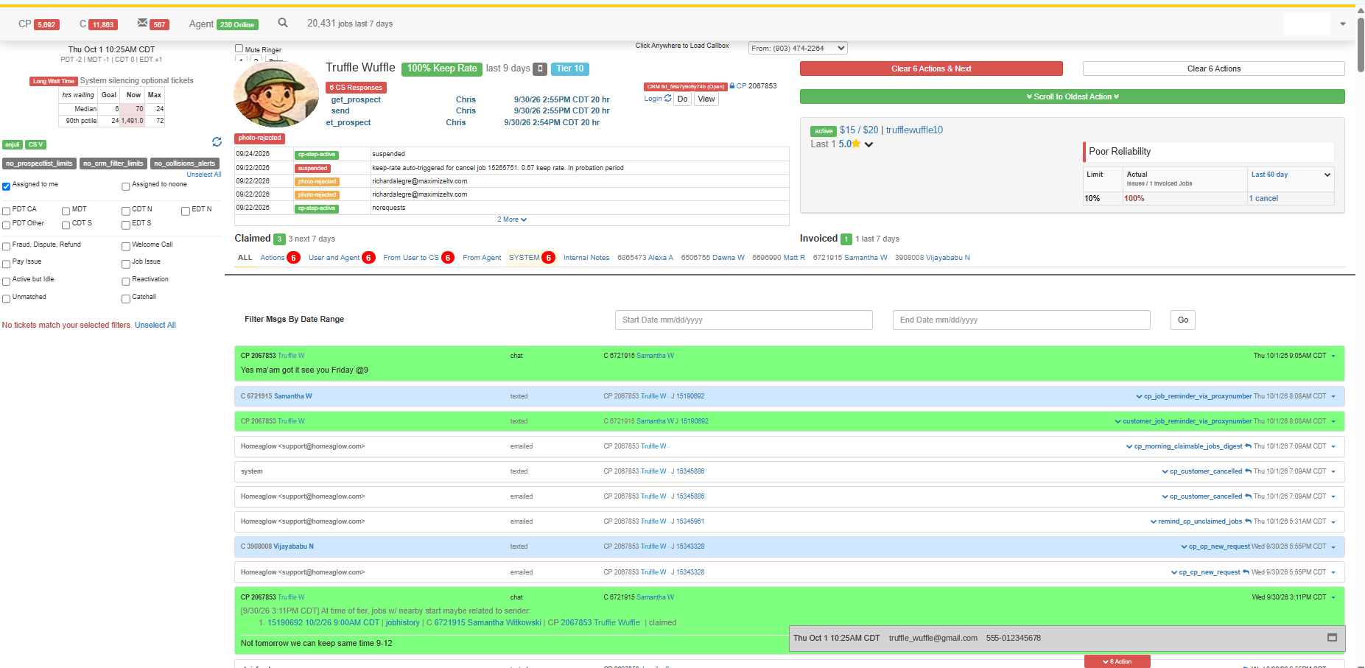





LEGACY CP CRM
Where we manage cleaner accounts
Everything about a cleaner, in one place.
Profile, status and rate
Flags and status history
Tier and keep rate
Claimed and invoiced jobs
Messages with C and CP
Legacy CP CRM, preview only. Sample training details.
Remember: tier levels and flags are internal. Never share them with a cleaner.
Notes:
The Legacy CP CRM is where we manage CP accounts. The screenshot is a preview with sample training details (Truffle Wuffle); the trainer will walk through the live system next.

Slide 11

LEGACY CP CRM
Live walkthrough
TRAINER WALKTHROUGH
The trainer will open the live Legacy CP CRM and walk you through the actual system.
Follow along and note your questions.
AS YOU WATCH, LOOK FOR
Profile and status
Flags table
Tier and keep rate
Messages
Notes:
Switch to the live Legacy CP CRM now. Do not demo from the slides. Suggested flow: open a CP account, show profile status and rate, the Flags table and status history, tier and keep rate, claimed and invoiced jobs, and the message thread. Adjust to the cohort.

Slide 12

TOPIC 03 OF 11
Introduction to CP Dashboard
Where cleaners claim and manage their jobs, and manage their account.
YOU'LL LEARN
What the cleaner sees
Claiming and managing jobs
A live walkthrough
Notes:
The CP Dashboard is the cleaner-facing side. Seeing it helps agents guide CPs step by step.

Slide 13

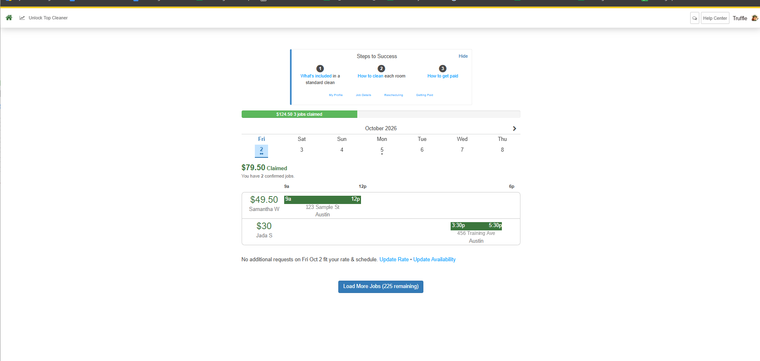




CP DASHBOARD
The cleaner's side
Where cleaners claim and manage their jobs, and manage their account.
Claim new jobs
Manage claimed jobs
Update rate & availability
Steps to Success guides
Account & Help Center
CP Dashboard, preview only. Sample training details.
Why it helps: when you know what the cleaner sees, you can guide them step by step.
Notes:
The CP Dashboard is where cleaners claim and manage their jobs and manage their account. The screenshot shows claimed jobs on a calendar, Steps to Success guides, and links to update rate and availability. Customer addresses are sample data.

Slide 14
CP DASHBOARD
Live walkthrough
TRAINER WALKTHROUGH
The trainer will open the live CP Dashboard and walk you through the actual system.
Follow along and note your questions.
AS YOU WATCH, LOOK FOR
Claiming jobs
Job calendar
Rate & availability
Account
Notes:
Switch to the live CP Dashboard now. Suggested flow: claimable jobs, the claimed-jobs calendar, a job's details, Charge Client, updating rate and availability, and account settings.

Slide 15

TOPIC 04 OF 11
CP Profile Status
The label on a cleaner's account that controls what they can do on the platform.
YOU'LL LEARN
The three statuses you'll use most
Onboarding statuses
What the system changes automatically
The test before you change one
Notes:
Every time you coach or penalize a CP in a PCQ, Overcharged Hours or Reliability ticket, you are changing (or deciding not to change) their status. Understanding what each status does is what separates "I flagged the CP" from "I understood what that flag does to their ability to work." Status history is in the CP's Flags table: when it changed, to what, and the previous status.

Slide 16

CP PROFILE STATUS
The three you'll use most
What each status lets a cleaner do.
Status | Claim new jobs | Keep claimed jobs | Dashboard | Reactivate
active | Yes | Yes | Full access | —
norequests | No | Yes | Full access | $15–25 fee*
suspended | No | No, removed | Limited (Completed Jobs only) | $15–25 fee*
cp-opt-out | No | — | — | Free, via dashboard or CS
* Not available if the cleaner has a do_not_reactivate flag, or is in a CA/CA-WA Operating Model state.
Check history: the Flags table shows when a status changed, to what, and what it was before.
Notes:
active: full standing; can claim new jobs, keep upcoming claimed jobs, full dashboard. norequests: can't claim new jobs, keeps upcoming jobs and full dashboard. suspended: can't claim, removed from upcoming jobs, limited dashboard (can still see Completed Jobs to review past pay). norequests and suspended CPs can reactivate with a fee ($15-$25 by cohort) unless they have a do_not_reactivate flag or live in a CA/CAWA Operating Model state. Probation applies for the first jobs after joining and after reactivation from suspension. cp-opt-out: the CP chose not to be available (illness, moved, no longer cleaning); they can reactivate free via the dashboard or CS.

Slide 17
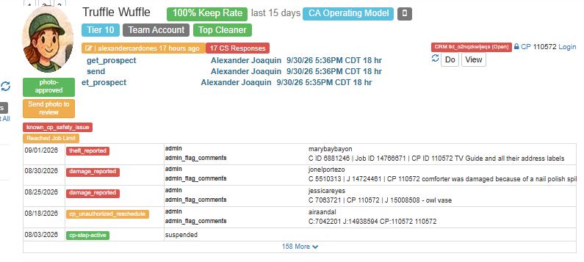
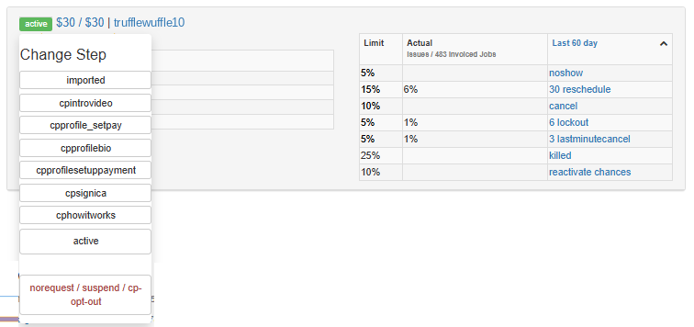
CP PROFILE STATUS
Where to see and change it
In the Legacy CP CRM.
1
2
1
Flags table
When the status changed, to what, and what it was before
2
Change Step
Pick the new status. Check the history first
Notes:
Status history: the Flags table on the CP's CRM page shows when a status changed, what it changed to, and the previous status (e.g. cp-step-active > suspended). Changing a status: use the Change Step menu and pick the new status; norequests, suspended and cp-opt-out are grouped under one option. The trainer will show the exact clicks in the live CRM. Names and photo in the screenshots are sample training details.

Slide 18
CP PROFILE STATUS
Onboarding statuses
Where a new cleaner is stuck in sign-up.
cpintrovideo
cpprofile_setpay
cpprofilebio
cpprofilesetuppayment
Hasn't finished the intro video
Hasn't set their hourly rate
Hasn't added a photo or bio
Hasn't added legal or payment info
cpsignica
cphowitworks
Imported
Hasn't accepted the Platform Access Agreement
Quiz not done, inactive 30+ days, or no photo
Former Homejoy cleaner, info imported
Notes:
Imported: was a Homejoy CP; info imported. cpintrovideo: hasn't finished the intro video. cpprofile_setpay: hasn't set hourly rate (CPs set their own rate; a $5/hr match fee may apply to first jobs with each client in General Operating Model states; CPs can update rate anytime). cpprofilebio: hasn't uploaded photo/bio. cpprofilesetuppayment: hasn't entered legal info for the BGC or payment info (they can temporarily skip payment details to see claimable jobs). cpsignica: hasn't accepted the Platform Access Agreement. cphowitworks: hasn't done the quiz, OR was active but hasn't accessed the dashboard in 30+ days (auto_update_inactive_cp_step flag), OR was active but has no photo (auto_update_bad_photo_cp_step flag).

Slide 19

CP PROFILE STATUS
What the system changes automatically
What | Moves to norequests | Moves to suspended
Keep rate | 80% or lower | Below 70% · probation: below 100%
No-shows | — | 2 in last 5 jobs · probation: any
Reviews (OCW) | Average below 4.0 | Probation: any 1- or 2-star review
Reschedules | Based on various calculations | —
Refund requests | 2 in last 10 jobs | New cleaner: 2
Supplies / profile photo | Rejected | Rejected 3 or more times
Background check | Info matches another CP | Matches a fraud-flagged CP, or not clear
Other | — | Rescheduled a job to before the account existed
Probation: new cleaners (0–2 invoiced jobs since activation) face stricter thresholds.
Notes:
System-generated status changes. Keep rate: <=80% (more than 20% cancellations) norequests; <70% suspended; in probation <100% suspended. No-shows: 2 in the last 5 jobs suspended; in probation any no-show suspended. Reviews (only OCW reviews): average <4.0 across various counts, last 4 averaged 2.8, or last 6 averaged 3.0 norequests; in probation any 1- or 2-star review suspended. Reschedules: various calculations norequests. Serious risks (false invoices, theft, damage): 2 refund requests in last 10 jobs norequests; new CP 2 suspended. Cleaning supplies photo: rejected norequests, rejected 3+ suspended. Profile photo: same. BG check: info matches another CP suspended or norequests; same info as a fraud-flagged CP suspended; not clear suspended. Misc: CP rescheduled a job to before their account was created suspended. New CPs (0-2 invoiced jobs since their latest activation) are on probation with stricter thresholds.

Slide 20
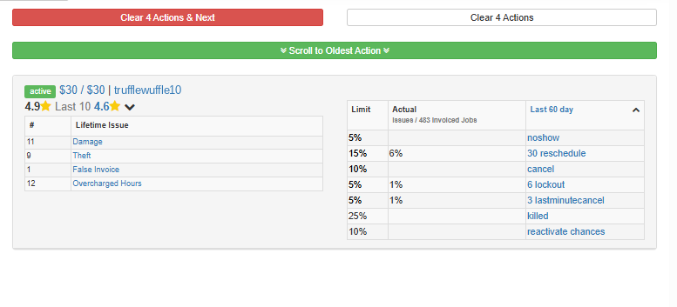
CP PROFILE STATUS
Check the numbers
The CP's CRM page shows their status and how they compare to the limits.
Status and rate
The current status, e.g. active
1
1
3
Lifetime issues
Damage, theft, false invoices, overcharged hours
2
2
Limit vs Actual
Last 60 days: issues out of invoiced jobs
3
Notes:
The panel shows the CP's current status and rate, their review score, lifetime issues (damage, theft, false invoice, overcharged hours), and a Limit vs Actual table for the last 60 days (no-shows, reschedules, cancels, lockouts, last-minute cancels). Actual is issues divided by invoiced jobs. Use it with the flag history before deciding on a status change.

Slide 21


CP PROFILE STATUS
Before you change a status
ASK YOURSELF
"If I were the customer, would I want this cleaner for my cleaning?"
Check the history first
First jobs matter
Never change a status without checking the reason or flag history.
A new customer with a bad first job is 50% less likely to stay.
Notes:
Ask: "If I were the customer, would I want this CP for my cleaning?" If no, norequests or suspended is likely appropriate after proper review. A new customer with a bad first job is 50% less likely to stay on the platform, so this protects retention as well as quality. Never change a CP's status without checking the reason or flag history first: a status change without context is how legitimate CPs get penalized for something that wasn't their fault.

Slide 22
WRAP-UP
Questions?
When in doubt, check the Knowledge Library or ask your Trainer or Team Lead.
Notes:
Open the floor for questions. Recap: the cleaner journey, CP CRM and Dashboard, profile statuses, deactivation codes, operating models, tiering, job statuses and the Pending Invoice action guide.

Slide 23

TOPIC 05 OF 11
CP-Facing Deactivation Reasons
The exact message a cleaner sees when they are set to norequests or suspended.
YOU'LL LEARN
Who reads the reason
Job-related reason codes
Account and conduct codes
Notes:
A CP-facing deactivation reason is a specific reason code plus a templated sentence. The same code is stored as the value of the deactivation flag.

Slide 24


CP-FACING DEACTIVATION
One reason, two audiences
The reason you enter isn't just an internal note.
The cleaner
Our data
Sees it on their dashboard as the reason they were deactivated.
Stored as the flag's value, so we can track deactivation patterns.
Rule: always use the exact reason code format. Never write a freeform reason.
Notes:
When you change a CP's status to norequests or suspended, the reason shows on the CP's own dashboard and is stored in our database as the status flag's value, which is how we track deactivation patterns. Using the wrong code, or skipping the format, breaks both. Rule: always use the exact reason code format. Never write a freeform reason.

Slide 25
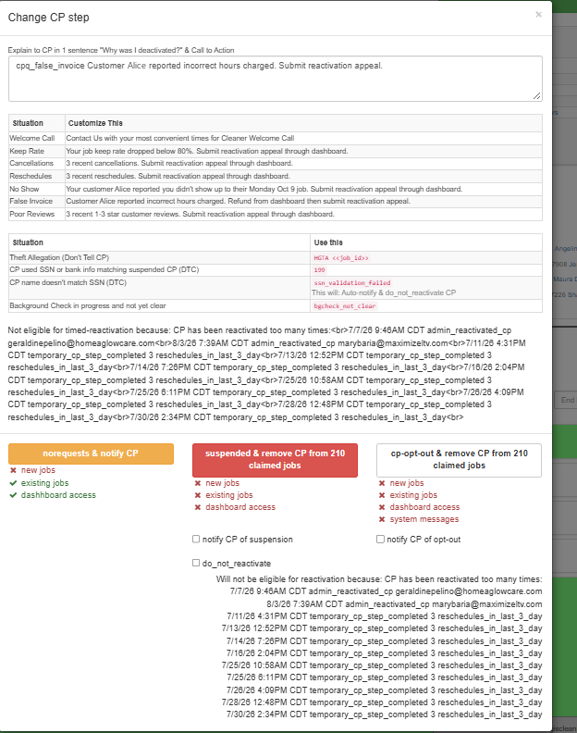
CP-FACING DEACTIVATION
Where you enter the reason
The Change CP step window in the Legacy CP CRM.
Reason box
Type the code and sentence the cleaner will see
1
1
2
Reference tables
Templated wording and codes by situation
2
Status buttons
norequests, suspended or cp-opt-out, plus notify options
3
3
Rule: use the exact code format. Never a freeform reason.
Notes:
Top: the CP-facing reason box ("Explain to CP in 1 sentence: Why was I deactivated? & Call to Action"); the sample shows cpq_false_invoice. Middle: reference tables with templated wording by situation and codes to use (HGTA, 199, ssn_validation_failed, bgcheck_not_clear). Bottom: the three status buttons: norequests & notify CP (no new jobs, keeps existing jobs and dashboard); suspended & remove CP from claimed jobs (no new jobs, existing jobs or dashboard); cp-opt-out & remove CP from claimed jobs (also stops system messages), with notify and do_not_reactivate checkboxes. The window also shows whether the CP is eligible for timed reactivation.

Slide 26
CP-FACING DEACTIVATION
Reason codes
Fill in the <placeholders>. Keep the rest word for word.
Reason for deactivation | CP-facing reason format
Accepted cash payment | cpq_cash Cash Payment J <JOB ID>
Cancellation | cpq_cancel Your customer <C'S NAME> reported you cancelled their <DAY, DATE> job. Submit reactivation appeal through dashboard.
False invoice | cpq_false_invoice Customer <C'S NAME> reported incorrect hours charged. Submit reactivation appeal.
No-show | cpq_noshow Your customer <C'S NAME> reported you didn't show up to their <DAY, DATE> job. Submit reactivation appeal through dashboard.
Overcharged hours | cpq_overcharge Customer <C'S NAME> reported incorrect hours charged. Submit reactivation appeal.
Invalid use of "Report Issue" to cancel | cpq_invalid_cancel Upon review, your <emergency/customer cancellation> report has been deemed invalid. Submit reactivation appeal through dashboard.
Invalid use of "Report Issue" to reschedule on C's behalf | cpq_invalid_reschedule Upon review, your customer reschedule report has been deemed invalid. Submit reactivation appeal through dashboard.
Reschedule unauthorized by the customer | cpq_reschedule Your customer <C'S NAME> reported you rescheduled their <DAY, DATE> job without permission. Submit reactivation appeal through dashboard.
Rude/unprofessional behavior | cpq_quality Unprofessional behavior
Theft | HGTA <JOB ID>
Notes:
Examples: cpq_cash Cash Payment J 1234567 / cpq_cancel Your customer Joseph reported you cancelled their Monday Oct 9 job. Submit reactivation appeal through dashboard. / cpq_false_invoice Customer Mary reported incorrect hours charged. Submit reactivation appeal. / cpq_noshow Your customer Janis reported you didn't show up to their Monday Oct 9 job. Submit reactivation appeal through dashboard. / cpq_overcharge Customer Kyle reported incorrect hours charged. Submit reactivation appeal. / cpq_invalid_cancel Upon review, your customer cancellation report has been deemed invalid. Submit reactivation appeal through dashboard. / cpq_reschedule Your customer George reported you rescheduled their Monday Oct 9 job without permission. Submit reactivation appeal through dashboard. / HGTA 1234567. Rule: always use the exact reason code format; never write a freeform reason.

Slide 27
WRAP-UP
Questions?
When in doubt, check the Knowledge Library or ask your Trainer or Team Lead.
Notes:
Open the floor for questions. Recap: the cleaner journey, CP CRM and Dashboard, profile statuses, deactivation codes, operating models, tiering, job statuses and the Pending Invoice action guide.

Slide 28

TOPIC 06 OF 11
CP Penalty: C-Side Handling
What to do on the cleaner's side when a customer reports a problem with their cleaner.
YOU'LL LEARN
Your two jobs, in order
Why we pause instead of suspend
The five-step process
The action for each offense
Notes:
This covers what you do on the CP side when a customer reports a no-show, cancellation, false invoice, overcharged hours, missing supplies, rude behavior and similar issues. Category: Service Issue.

Slide 29
CP PENALTY: C-SIDE HANDLING
Two jobs, in this order
1
2
Resolve the customer's issue
Take the CP-side action
Use the related article for that issue first.
Pause, coach, flag and document.
Not your call: permanent decisions and suspensions belong to the CP-side team, Trust & Safety, or the system.
Notes:
First resolve the customer's issue using the related article for that issue. Then take the CP-side action: pause, coach, flag and document. You don't make the permanent decision about the CP, and you don't suspend CPs yourself: that belongs to the CP-side team, Trust & Safety, or the system. You are seeing one incident, from one side; the CP-side team sees the CP's full history and hears the CP's side before deciding anything permanent.

Slide 30


CP PENALTY: C-SIDE HANDLING
Pause, don't suspend
You're seeing one incident from one side. The two statuses affect other customers very differently.
norequests (pause)
suspended
Can't claim new jobs
Keeps upcoming claimed jobs, so other customers keep their cleanings
Removed from every upcoming claimed job
Those customers are notified their cleaning is affected
EXAMPLE
A customer reports their cleaner came without supplies. The cleaner has 4 other jobs this week. Pausing lets those 4 customers keep their cleanings. Suspending would cancel all 4.
Notes:
norequests: the CP can't claim new jobs but keeps their upcoming claimed jobs. suspended: the CP is removed from every upcoming claimed job, and those customers are notified. Suspending over one complaint may cancel several other customers' cleanings. Example: a customer reports the CP arrived without supplies. The CP has four claimed jobs this week with other customers who had no problems. norequests stops new claims and lets those four customers keep their cleanings; suspending would cancel all four.

Slide 31


CP PENALTY: C-SIDE HANDLING
The default, and what you don't do
DEFAULT CP-SIDE ACTION
norequests + coaching + the relevant flag + an internal note
C-SIDE AGENTS DON'T
Suspend a CP
Add a DNR flag
Deactivate a CP
Reactivate a CP
Except the false-invoice exception
Never
Never permanently
The CP-side team decides
Notes:
Default CP-side action: norequests + coaching + the relevant flag + an internal note. C-side agents don't suspend a CP (except the false-invoice exception), add a DNR flag, permanently deactivate a CP, or reactivate a CP.

Slide 32

CP PENALTY: C-SIDE HANDLING
Exceptions to the default
Situation | What to do
Safety concern (theft, damage, threats, harassment, someone else working the account) | Route to Trust & Safety and follow their process
The system already suspended the CP after your flag or report | Leave it. Coach, explain how to appeal from the dashboard, add your note
First warning-level offense | Coach only. No status change
False invoice (even "the cleaner never came") | norequests, and ask the CP what happened. GPS alone can't confirm
Multiple false invoices that look abusive | You may set suspended. The only time you do. Never add DNR
Safety first: anything that makes the customer feel unsafe goes to Trust & Safety.
Notes:
Safety concern: theft, damage, threats, harassment, someone else doing jobs under the CP's account, or anything that makes the customer feel unsafe: route to Trust & Safety and follow the T&S process. System auto-suspended after your flag/report (e.g. no-show report, second cp_false_invoice on a new CP): leave it, don't override or downgrade; coach the CP, tell them about the penalty and how to appeal from their dashboard, add your internal note. First instance of a warning-level offense: coach only, no status change (false invoices are not warning-level). False invoice: norequests and ask the CP what happened, even when the customer says the CP never came (GPS alone can't confirm; CPs aren't required to turn it on). Multiple false invoices with an abusive pattern: you may set suspended; the only case a C-side agent sets suspended. Never add DNR.

Slide 33




CP PENALTY: C-SIDE HANDLING
The process
Five steps, in order.
STEP 1
STEP 2
STEP 3
STEP 4
STEP 5
Safety issue?
Already suspended?
Find the offense
Coach the CP
Leave a note
Yes: route to Trust & Safety. Done
Check the Issues table. Yes: leave it, coach, note. Done
Take the action in the table
What was reported and how to appeal
So the CP-side team doesn't re-investigate
Notes:
Step 1: Is this a safety issue? Yes: route to Trust & Safety; you're done on the CP side. Step 2: Did the system already suspend the CP? Check the CP's Issues table after adding your flag or report. Yes: leave the status, send the coaching macro, add your note; you're done. Step 3: find the offense in the table and take the listed action. Step 4: coach the CP. Step 5: leave an internal note.

Slide 34
CP PENALTY: C-SIDE HANDLING · STEP 3
The action for each offense
Customer reported | Flag / report | CP status | Coaching
No-show or CP cancellation | Job Admin > No Show, or cancel from the CP Dashboard if the CP should be penalized. | Lean coaching. norequests only if repeat | No-show / cancellation macro
Unauthorized reschedule | — | 1st: no change · 2nd+: norequests | Warning macro
False invoice (incl. "never came") | cp_false_invoice (may auto-suspend new CPs) | norequests if not auto-suspended | False invoice macro
Overcharged hours | cp_overcharged_hours (refund 30+ min) | norequests | Overcharged Hours series
Accepted cash | accepting_cash_not_allowed_warning (by macro) | 1st: no change · 2nd+: norequests | Accepted Cash macro
Missing supplies (Gen Op) | require_new_cleaning_supplies_photo | Set by the flag | No/Incomplete Supplies macro
Missing supplies (non-Gen Op) | — | No change | No/Incomplete Supplies macro
Rude / unprofessional (not safety) | — | norequests | Coaching macro
Easy to miss: reschedules and accepted cash are coaching-only the first time. Check for a past warning.
Notes:
No-show or CP cancellation: report via Job Admin > No Show, or cancel the job from the CP Dashboard when the CP should be penalized; either usually makes the system set norequests or suspended. Lean coaching; set norequests yourself only if the CP already has a couple of no-shows or cancellations. Overcharged hours: cp_overcharged_hours flag if the refund is 30+ minutes. Accepted cash: the macro adds accepting_cash_not_allowed_warning. Supplies (Gen Op): require_new_cleaning_supplies_photo sets norequests automatically. Easy to miss: unauthorized reschedule and accepted cash are coaching-only on the first instance; check message history and flags for a previous warning before pausing. Macros: No Show/Cancellation (No Request); Unauthorized Reschedule (Warning); False Invoice (With Penalty); Overcharged Hours series; Accepted Cash (Coaching) / (Warning + Account Adjustment); No/Incomplete Cleaning Supplies; Rude to Customer (Coaching).

Slide 35
CP PENALTY: C-SIDE HANDLING · STEPS 4 & 5
Coach, then document
Step 4: Coach the CP
Step 5: Internal note
Explain exactly what was reported
If you paused them, say so and explain how to appeal from their dashboard
Never hint at an outcome ("you'll probably be reactivated"). The CP-side team decides
CP No Request — J <JOB ID>
Reported by C: <what the customer said, one line>
Evidence: <comms, GPS if available, CTJ, photos>
Action: <flag> / <status> / <macro sent>
C-side resolution: <refund, credits, rebook>
Notes:
Coaching message: explain specifically what was reported; tell the CP their account is paused (if you paused it) and how to appeal through their dashboard; do not hint at an outcome ("you'll probably be reactivated", "this could be permanent"). The CP-side team decides. Internal note: the CP-side team uses it to decide on reactivation; a clear note saves them from investigating again. Template: CP No Request — J <JOB ID> / Reported by C: <what the customer said, one line> / Evidence: <what you verified: comms, GPS if available, CTJ, photos> / Action: <flag added> / <status set> / <macro sent> / C-side resolution: <refund, credits, rebook, etc.>

Slide 36
CP PROFILE STATUS & CP-FACING DEACTIVATION · QUICK KNOWLEDGE CHECK
Quick Knowledge Check
Ask each question, then click to reveal the answer.
A CP is on norequests. Can they keep jobs they already claimed?
Yes. They just can't claim new jobs.
1
norequests vs suspended: what's the difference?
Suspended also loses claimed jobs, and the dashboard is limited to Completed Jobs.
2
What do you check before changing a CP's status?
The Flags table history. Ask: "Would I want this cleaner for my cleaning?"
3
A new CP on probation has a no-show. What does the system do?
Moves them to suspended (probation: any no-show).
4
Where do you enter the CP-facing reason, and how?
Change CP step window (Legacy CP CRM). Exact reason code format, never freeform.
5
A customer reports a CP no-show. Which reason code?
cpq_noshow: "Your customer <C's name> reported you didn't show up to their <day, date> job…"
6
Notes:
Quick knowledge check: CP Profile Status and CP-Facing Deactivation Reasons. Ask each question and let trainees answer before revealing. Each click reveals the next answer. Answers: 1) Yes: norequests can't claim new jobs but keeps claimed ones, with full dashboard access. 2) Suspended can't claim new jobs, claimed jobs are removed, and the dashboard is limited to Completed Jobs; reactivation for both is a $15–25 fee (not available with a do_not_reactivate flag or in CA/CA-WA). 3) Check the reason or flag history in the Flags table first, and ask "If I were the customer, would I want this cleaner for my cleaning?" 4) New cleaners (0–2 invoiced jobs since activation) are on probation: any no-show moves them to suspended. 5) In the Change CP step window in the Legacy CP CRM; always use the exact reason code format, never a freeform reason, because the cleaner sees it on their dashboard and it's stored as the flag value. 6) cpq_noshow Your customer <C'S NAME> reported you didn't show up to their <DAY, DATE> job. Submit reactivation appeal through dashboard.

Slide 37
WRAP-UP
Questions?
When in doubt, check the Knowledge Library or ask your Trainer or Team Lead.
Notes:
Open the floor for questions. Recap: the cleaner journey, CP CRM and Dashboard, profile statuses, deactivation codes, operating models, tiering, job statuses and the Pending Invoice action guide.

Slide 38

TOPIC 07 OF 11
Operating Models
The rules that apply to a customer or cleaner, based on where they are.
YOU'LL LEARN
The two models
How to tell which one applies
What changes between them
Notes:
Apply the wrong model and you are applying the wrong policy entirely: reactivation fees, supply requirements, hourly rates and cancellation penalties all differ.

Slide 39


OPERATING MODELS
Two models
Location decides which rules apply.
CA / CA-WA Operating Model
General Operating Model
California, New Jersey, Illinois, Massachusetts, Washington
Shows as a banner next to the user's name on the CRM
All other states
No banner on the CRM
Quick check: no operating model banner on the CRM means General Operating Model.
Notes:
CA / CA-WA Operating Model: California, New Jersey, Illinois, Massachusetts, Washington. Users in this model have a banner next to their name on the CRM. General Operating Model: all other states; no banner. If no operating model banner is present, the user is in the General Operating Model.

Slide 40

OPERATING MODELS
How to spot it
Look next to the user's name on the CRM.
1
Operating model banner
CA or CA-WA Operating Model
No banner?
General Operating Model
1
—
Check first: look for the banner before applying fees, penalties or pay rules.
Notes:
Users in the CA or CA-WA Operating Model have a banner next to their name on the CRM. No banner means the General Operating Model. The sample shows a CA Operating Model cleaner.

Slide 41
OPERATING MODELS
What changes between them
 | CA / CA-WA | General
Pay to reactivate | Disabled: no reactivation fee | Enabled: $15–25 fee
Cleaning supplies photo | Not required. Don't penalize | Required. Missing means norequests
CP hourly rate | Separate first-time and repeat-client rates | One rate. $5/hr match fee on first-time client jobs
CP job cancellation | Can cancel within a window without penalty, depending on notice | Penalized. Affects keep rate
Own cleaning business | Must certify it's registered (WA: Universal Business Identifier) | Not applicable
CP Swap | Enabled | Enabled
Check first: look for the banner before applying fees, penalties or pay rules.
Notes:
Day to day: if a CA/CAWA CP didn't bring cleaning supplies, coach but don't penalize, and don't apply the require_new_cleaning_supplies_photo flag. When calculating first-time-client pay, check the model: General CPs lose $5/hr on that job; CA/CAWA CPs don't. Whether a CP cancellation is penalized depends on the model and how much notice was given. CA/CAWA CPs must certify their business is registered and give the business name, except WA CPs, who register with the Department of Revenue and give a Universal Business Identifier.

Slide 42
WRAP-UP
Questions?
When in doubt, check the Knowledge Library or ask your Trainer or Team Lead.
Notes:
Open the floor for questions. Recap: the cleaner journey, CP CRM and Dashboard, profile statuses, deactivation codes, operating models, tiering, job statuses and the Pending Invoice action guide.

Slide 43

TOPIC 08 OF 11
CP Tiering
How cleaners are ranked, and why it decides who sees and claims a job first.
YOU'LL LEARN
Why tiering exists
What each tier gets
Requested CPs and swapping
Notes:
Important: CP Tiering is internal information only. Disclosing tier levels, tiering logic or how matching works to a CP or customer is a Zero Tolerance Policy violation.

Slide 44



CP TIERING
Stronger cleaners see jobs first
Without tiers, the first cleaner to click would get the job, whatever their record.
Tier 1 to 10
Earlier access
More jobs
A ranking based on how the cleaner has performed.
Higher tiers see jobs earlier.
Higher tiers can claim more jobs at once.
ZTP: tiering is internal. Never share tier levels or tiering logic with a cleaner or customer.
Notes:
Claimable jobs are first-come, first-served, so standing alone has little effect on who claims. Without tiering, customers could be matched with CPs with low reviews or poor reliability just because they claimed first. Tiering controls when CPs even see a job. It explains why a requested CP couldn't claim in time, or why a higher-tier CP swapped into a lower-tier CP's job. To check a CP's tier: click the Tier banner on CRM, or CP View > CleanerTier for full Tier History.

Slide 45
CP TIERING
Where to see the tier
On the cleaner's CRM page.
1
Tier banner
Click it for full tier history
Or CP View > CleanerTier
Same tier history
1
—
ZTP: tier levels are internal. Never share them with a cleaner or customer.
Notes:
Click the CP's Tier banner on the CRM, or go to CP View > CleanerTier, to see their full Tier History. Tiering is internal: never share it with a CP or customer (ZTP).

Slide 46
CP TIERING
What each tier gets
"With requested CPs" means the customer asked for specific cleaners on that job.
Tier | Sees FC jobs (with / without requested CPs) | Sees off-brand jobs | Swap protection | Claim limit
Requested CP | Once submitted | Per their tier | Always | Per their tier
Tier 10 | 48 hrs before / once submitted | Never | Always | No limit
Tier 9 | 48 hrs / 96 hrs before | Never | Under 48 hrs | No limit
Tier 8 | 36 hrs / 72 hrs before | 24 hrs before | Under 36 hrs | No limit
Tier 7 | 24 hrs / 48 hrs before | Once submitted | Under 24 hrs | 4
Tier 6 | 24 hrs / 36 hrs before | Once submitted | Under 24 hrs | 3
Tiers 5 – 3 | 24 hrs before (with requested CPs) | Once submitted | Under 24 hrs | 2
Tiers 2 – 1 | 24 hrs before (with requested CPs) | Once submitted | Under 24 hrs | 1
Notes:
Requested CP: sees FC jobs once submitted; off-brand and claim limit follow their actual tier; protected from swaps at all times. Tier 10: FC jobs 48 hrs before start if requested CPs exist, otherwise once submitted; can't see off-brand; always protected; no limit. Tier 9: 48 hrs (requested) / 96 hrs (none); no off-brand; can't be swapped <48 hrs; no limit. Tier 8: 36 / 72 hrs; off-brand 24 hrs before start; protected <36 hrs; no limit. Tier 7: 24 / 48 hrs; off-brand once submitted; protected <24 hrs; max 4. Tier 6: 24 / 36 hrs; max 3. Tier 5: 24 hrs if requested CPs exist; max 2. Tiers 4 and 3: same as Tier 5; max 2. Tiers 2 and 1: same; max 1.

Slide 47


CP TIERING
Requested cleaners and swapping
Requested cleaners
Swapping
See the job as soon as the customer submits it
Can claim it and replace a non-requested cleaner
Still follow their own tier's claim limit
A higher-tier cleaner can swap in if the job is 24–48+ hrs away
Customer sees a new match. The swapped-out cleaner is told the customer cancelled
Protected if they messaged with the customer in the past month
ZTP: swapping is internal. Never tell a cleaner or customer that a swap happened.
Notes:
Requested CPs are set in Job Admin under job.customer.requested_cp. Swapping: higher-tier CPs can swap into a job claimed by a lower-tier CP if the job is more than 24-48 hours away (depending on tier). The customer sees they were matched with a different, usually better-suited cleaner; the swapped-out CP is told the customer cancelled. This framing is deliberate. Exception: a CP is protected if they have sent and received at least one non-system message with the customer in the past month. Swapping is internal: disclosing it is a ZTP violation.

Slide 48
WRAP-UP
Questions?
When in doubt, check the Knowledge Library or ask your Trainer or Team Lead.
Notes:
Open the floor for questions. Recap: the cleaner journey, CP CRM and Dashboard, profile statuses, deactivation codes, operating models, tiering, job statuses and the Pending Invoice action guide.

Slide 49

TOPIC 09 OF 11
Job Statuses
The stage a booking is in, and what that means for the ticket in front of you.
YOU'LL LEARN
The job lifecycle
Submitted, Claimed, Invoiced
Cancelled and Pending Invoice
What the customer and cleaner can do
Notes:
The same complaint ("my cleaner never showed") is handled completely differently depending on whether the job is Submitted, was Claimed and abandoned, or is in Pending Invoice. Knowing the statuses means reading the account instead of guessing.

Slide 50
JOB STATUSES
The job lifecycle
A job can be cancelled at almost any stage. It doesn't have to pass through every status.
Pending
Submitted
Claimed
Pending Invoice
Invoiced
Cancelled
Note: an Invoiced job only becomes Cancelled through a full refund.
Notes:
Normal path: Pending (right after the customer clicks Book; only visible via direct link) > Submitted > Claimed > Pending Invoice > Invoiced. Submitted, Claimed, Pending Invoice and Invoiced can each become Cancelled. Pending can also become Cancelled (e.g. an expired Handshake booking). Invoiced only becomes Cancelled through a full refund, not a direct status change.

Slide 51
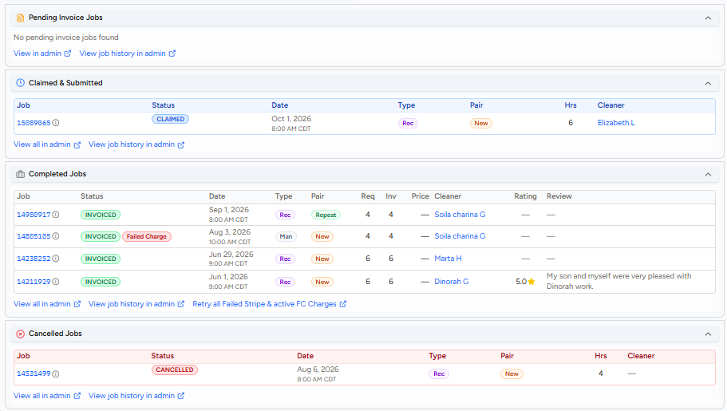
JOB STATUSES
Where to look in the CRM
On the customer's page in the New C CRM, jobs are grouped by status.
Pending Invoice Jobs
Time has passed, not invoiced yet
1
1
2
Claimed & Submitted
Upcoming: waiting for a cleaner, or claimed
2
3
Completed Jobs
Invoiced. Watch for a Failed Charge tag
3
Cancelled Jobs
Cancelled at any stage
4
4
Note: At any stage, avoid telling the customer what to do if we can already take action to resolve their issue.
❌ “You can reschedule your appointment to Nov 30 under Manage Appointment on your Dashboard.”
✅ “I’ve taken care of rescheduling your appointment to your preferred date, Nov 30.”
Notes:
The customer page groups jobs into panels: Pending Invoice Jobs (past their scheduled time but not yet invoiced; a count badge shows how many), Claimed & Submitted (upcoming jobs, either still waiting for a cleaner or already claimed), Completed Jobs (invoiced jobs, with type, hours requested vs invoiced, cleaner, rating and review; a Failed Charge tag shows a charge that didn't go through), and Cancelled Jobs. Each panel links to View all in admin and View job history in admin.

Slide 52



JOB STATUSES · SUBMITTED
Submitted
The job is officially requested and sent to available cleaners nearby.
Who can book
12 and 48 hours
Alternate times
Priority Request
Customers, cleaners for repeat clients, and CS via the CRM.
Customers can book at least 12 hrs ahead. Under 48 hrs adds a priority fee.
Unclaimed 24 hrs before start? The system adds alternate times.
Within 24–48 hrs of start, the job is boosted to more cleaners.
Customer can't do alternate times? add the do_not_auto_add_alternate_start_times flag (Flags > +Add Flags in the new CRM).
Notes:
Who can book: customers (dashboard), CPs for repeat clients (dashboard or the CP App Handshake feature, if the C has <2 failed charges and no known_customer_fraud flag, the CP is active, under their claim limit, rate <= $30 and no more than $5 above the C's last max requested rate, no deactivation flag, and they aren't banned), and CS via CRM. Bookings can be made up to 12 hours before start; within 48 hours a system priority fee applies (not for CRM bookings). If still unclaimed 24 hours before start, the system adds alternate start times (10 AM-2 PM that day and the next 2 days); add do_not_auto_add_alternate_start_times (C CRM > Do) if the customer objects. can_substitute may flip to True if unclaimed <=48 hrs before start and no requested CP can claim. A submitted job becomes a Priority Request within 24-48 hours of start: more notifications, and CPs with rates up to 14% above the C's previous max can claim. Common tickets: match anxiety, last-minute requests, gender preference (rematch >6 hrs before), specific CP requests (only change Requested CPs if the customer explicitly asks).

Slide 53
JOB STATUSES · SUBMITTED
Common issues: Submitted
What customers ask while the job waits for a cleaner.
Match anxiety
"Has my request been claimed? When will it be?"
A submitted job is automatically upgraded to a Priority Request within 24–48 hours of the start time.
1
Last-minute job request
CS can book a cleaning less than 12 hours in advance through the CRM. Priority markups don't apply to jobs booked via the CRM.
2
Wants a cleaner of a specific gender
There's no gender option. They can rematch any time 6+ hours before start, and add preferences to the cleaning notes.
3
Wants a specific cleaner
Change their Requested CPs on the Job Admin Page, only if they explicitly ask.
4
Trainer demo
Strict schedule, only certain dates/times
Unclaimed 24 hrs before start, the system may add alternate times. To stop it: New CRM › Flags › + Add Flags › do_not_auto_add_alternate_start_times.
5
Notes:
1) Match anxiety: the customer asks if their request has been claimed, or when it will be. A submitted job is automatically upgraded to a Priority Request within 24-48 hours of the start time. 2) Last-minute job request: CS may book cleaning requests as soon as 12 hours in advance. Priority markups do not apply to jobs booked via CRM. 3) Customer wants a cleaner of a specific gender: there is no option to select a gender, but customers may request to be rematched with another cleaner any time more than 6 hours before the job start time if they don't like the cleaner who claims. Preferences can also be added to the cleaning notes. 4) Customer wants a specific cleaner for an upcoming appointment: we can change the customer's Requested CPs through the Job Admin Page, only if they explicitly request it. TRAINER NOTE: walk trainees through how to change Requested CPs on the Job Admin Page. 5) Customer has a strict schedule and can only do certain dates/times: to increase the likelihood of the job being claimed, the system may automatically add alternate start times if the job is still unclaimed 24 hours before it starts. To stop this, add the flag: C CRM > Do > do_not_auto_add_alternate_start_times.

Slide 54

JOB STATUSES · CLAIMED
Claimed
A cleaner claimed the job, and the customer gets the cleaner's info.
The customer can
The cleaner can
Reschedule 6+ hrs before start (not the 12-hour new-booking rule)
Rematch: Manage Appointment > Change My Cleaner, until 6 hrs before
Cancel
File a lockout claim
Reschedule, if the customer agrees
Cancel from their dashboard if they can't agree
ZTP: higher-tier cleaners may swap in. Swapping is internal: never mention it.
Notes:
Customers can reschedule via dashboard 6+ hours before start (new bookings need 12+ hours; don't apply the 12-hour rule to a reschedule). A priority fee may apply if the new slot is <48 hours away. Rematch: C Dashboard > Manage Appointment > Change My Cleaner, available until 6 hours before start. CP swapping can happen (internal). The CP can file a lockout (OCW: up to 24 hrs after start; CP App: 5 min before to 1 hr after start), reschedule (with the C's agreement, even after the job time passed), or cancel from their dashboard if no agreement. Reschedule may be unavailable if the C had 2+ undesired changes (CP reschedules, no-shows, system cancels) in the last 7 days.

Slide 55
JOB STATUSES · CLAIMED
Common issues: Claimed Stage
What customers ask once a cleaner has claimed the job.
Claimed at a different date than booked
Check the job history: was it claimed at an alternate date and time, or rescheduled by the cleaner?
1
Confirmations from 2 different cleaners
Check the job history: did the first cleaner cancel, or were they swapped out?
2
Wants their cleaner changed
Change the cleaner from the Job Admin Page.
3
Trainer demo
Wants the appointment rescheduled
Reschedule from the C Dashboard, or cancel and rebook from the CRM if rescheduling would add a priority fee.
4
5
CP Cancellations
Help the customer get a new cleaner if the request is still active, or offer priority cleaning if the appointment was canceled.
Notes:
1) Job is claimed at a different date than initially booked: check the job history to see if the job was claimed at an alternate date and time, or was rescheduled by the cleaner. 2) Customer reports they received confirmations from 2 different cleaners: check the job history to see if the first cleaner cancelled or was swapped out. Remember swapping is internal: never mention it to the customer. 3) Customer wants their cleaner changed: change the cleaner from the Job Admin Page. TRAINER NOTE: demo how to change the cleaner on the Job Admin Page. 4) Customer wants the appointment rescheduled: reschedule from the C Dashboard, or cancel and rebook from the CRM if rescheduling would result in a priority fee.

Slide 56
JOB STATUSES · INVOICED
Invoiced
The cleaner clicked Charge Client. The customer is charged and the cleaner gets paid.
The customer can
The cleaner can
Leave a review and tip
Request a refund if there's an issue
Issue a refund
Review the customer in the CP App
Note: a full refund changes an Invoiced job to Cancelled.
Notes:
This status occurs after the cleaner completes the job and invoices by clicking Charge Client on their dashboard. Once invoiced, the customer can leave a review and tip, or request a refund if there is an issue (covered in a separate session). The cleaner can issue a refund and leave a review for the C via the CP App. An invoiced job becomes Cancelled once a full refund is issued.

Slide 57
JOB STATUSES · INVOICED
Common issues: Invoiced Stage
What customers raise once the job has been charged.
Poor Cleaning Quality
Not satisfied with the cleaning
Follow the Poor Cleaning Quality process guide.
1
Overcharged Hours
Billed for the wrong number of hours
Follow the Overcharged Hours process guide.
2
False Invoice
Billed, but the cleaner never showed
Follow the False Invoice process guide.
3
Lockout
Cleaner couldn't get in and filed a lockout
Follow the Lockout validation process.
4
Billing Inquiry
Wants their charges explained
Provide clarification of the charges.
5
Notes:
Each issue has its own process guide in the Knowledge Library, covered in later sessions. 1) Poor Cleaning Quality (PCQ): the customer is not satisfied with the cleaning; follow the Poor Cleaning Quality process guide. 2) Overcharged Hours (OCH): the customer reports an incorrect number of hours billed; follow the Overcharged Hours process guide. 3) False Invoice: the cleaner billed the customer even though they didn't show up; follow the False Invoice process guide. 4) Lockout (LO): the cleaner couldn't get into the customer's home and submitted a lockout; follow the Lockout validation process. 5) Billing Inquiry: the customer asks for an explanation of their charges; provide clarification of the charges (see C Price vs CP Pay in Platform & Operating Mechanics).

Slide 58
JOB STATUSES · CANCELLED
Cancelled
Can happen at almost any stage. Why depends on where the job was.
Status before | Why it was cancelled
Pending | Booked by the cleaner with Handshake, but the customer didn't confirm before it expired
Submitted | Cancelled by the customer, by CS in the CRM, or automatically by the system
Claimed | Cleaner cancelled too late for another to claim, or the customer/CS cancelled or reported a no-show
Pending Invoice | Cancelled by the customer or cleaner, or by CS in the CRM
Invoiced | Fully refunded by the cleaner or CS
Cancel via CRM: you can waive last-minute fees, and the cleaner isn't penalized.
Notes:
Customers can cancel via dashboard unless invoiced (a Last-Minute Cancellation fee may apply <6 hrs before start). CPs can cancel via dashboard or CP App unless invoiced, but it may affect their Keep Rate; no penalty if they report an emergency, a safety concern, or that the client wants to cancel via the CP App. CS can cancel via C CRM > Do > Job > Cancel: lets us waive LMC fees (job admin page) and doesn't penalize the CP. System cancels if unclaimed at 0, 12 or 24 hours before start, or if the C has a known_customer_fraud flag, no card on file, a declined pre-auth, requested CPs ineligible with can_substitute = False, or an unapproved Handshake booking.

Slide 59


JOB STATUSES · CANCELLED
Common issues: Cancelled Stage
The tickets you'll see most once a job is cancelled.
Customer last-minute cancellation
Last-minute CP cancellation
CP no-show
No CP claims the appointment
Goal: help the customer get a cleaning right away.
Notes:
The four most common tickets at this stage: a customer last-minute cancellation, a last-minute CP cancellation, a CP no-show, and no CP claiming the appointment. Whatever the reason, the goal is the same: help the customer get a cleaning right away. Each issue has its own process guide in the Knowledge Library, covered in later sessions.

Slide 60

JOB STATUSES · PENDING INVOICE
Pending Invoice
The booked time has passed and the job isn't invoiced yet. The status changes automatically.
The customer can
The cleaner can
Report "My cleaning was completed" (this invoices it)
Cancel. A last-minute fee may apply
Edit duration, extras, address and notes
Click Charge Client to invoice
Edit hours. Adding hours needs the customer's OK
Reschedule (cleaner only), cancel, or file a lockout
Next: Pending Invoice doesn't mean the job was done. See the action guide.
Notes:
Once the scheduled duration has elapsed from the start time and the CP hasn't invoiced, the job moves from Claimed to Pending Invoice. It can be invoiced by the CP (Charge Client) or the customer (reports "My cleaning was completed"). Changes are still possible: reschedule (CP only), cancel, edit details. The C can cancel (LMC fee may apply), edit duration and extras, update address, edit notes, and via Report an Issue: confirm completion, ask for ETA, cancel. The CP can edit duration before Charge Client but needs the C's permission to add hours; can review the C; can file a lockout (OCPW up to 24 hrs after start; CP App 5 min before to 1 hr after); can reschedule with the C's agreement or cancel.

Slide 61
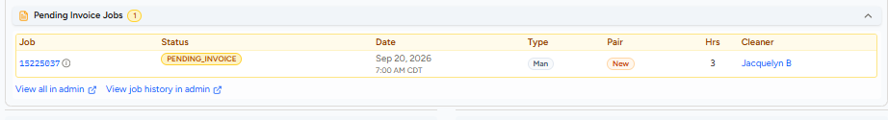
JOB STATUSES · PENDING INVOICE
Spotting a Pending Invoice job
It shows in its own panel at the top of the customer's jobs.
1
2
Count badge
How many Pending Invoice jobs the customer has
PENDING_INVOICE status
The job, date, hours and cleaner
1
2
Act on it: a Pending Invoice job needs action, even if the customer asked about something else.
Notes:
When a customer has a Pending Invoice job, the Pending Invoice Jobs panel shows a count badge and lists the job with a PENDING_INVOICE status, date, type, hours and cleaner. CS must act on it even when it isn't the customer's stated concern; see the AG: Pending Invoice action guide.

Slide 62
JOB STATUSES · QUICK KNOWLEDGE CHECK
Quick Knowledge Check
Ask each question, then click to reveal the answer.
A customer wants a cleaning in 8 hours. Can they book it?
Not themselves (12-hr minimum). CS can book it in the CRM, with no priority markup.
1
A Submitted job is still unclaimed 24 hrs before start. What happens?
The system adds alternate times (unless the do_not_auto_add_alternate_start_times flag is on).
2
Claimed job: until when can the customer reschedule or rematch?
Up to 6 hours before the start time.
3
How does an Invoiced job become Cancelled?
Only through a full refund.
4
The booked time passed and the job isn't invoiced. Status? Was it done?
Pending Invoice. It doesn't mean done: it needs action.
5
C got confirmations from 2 different cleaners. First step?
Check the job history: did the first cleaner cancel, or were they swapped? Never mention swapping.
6
Notes:
Quick knowledge check: Job Statuses. Ask each question and let trainees answer before revealing. Each click reveals the next answer. Answers: 1) Customers can book at least 12 hours ahead (under 48 hours adds a priority fee); CS can book less than 12 hours ahead through the CRM, and priority markups don't apply to CRM bookings. 2) If a Submitted job is unclaimed 24 hours before start, the system adds alternate times; if the customer can't do other times, add the do_not_auto_add_alternate_start_times flag (New CRM > Flags > + Add Flags). Within 24–48 hours of start it's also boosted as a Priority Request. 3) Once claimed, the customer can reschedule or rematch (Manage Appointment > Change My Cleaner) up to 6 hours before the start. 4) An Invoiced job only becomes Cancelled through a full refund (by the cleaner or CS). 5) Pending Invoice: the booked time passed and it isn't invoiced yet; the status changes on a timer, so it doesn't mean the cleaning happened. Act on it even if the customer asked about something else. 6) Check the job history: did the first cleaner cancel, or were they swapped out? Swapping is internal (ZTP): never mention it.

Slide 63

TOPIC 10 OF 11
AG: Pending Invoice
What to do with a Pending Invoice job, and how to pick the right cancellation reason.
YOU'LL LEARN
Why Pending Invoice needs action
The three-step action guide
Agreed reschedules
Cancellation reason codes
Notes:
Action Guide: Pending Invoice. CS is required to take action on Pending Invoice jobs even when it isn't the customer's or cleaner's stated concern.

Slide 64


AG: PENDING INVOICE
Pending Invoice doesn't mean done
The status changes on a timer, not because the cleaning happened.
IT COULD MEAN
EXAMPLE
The cleaner couldn't finish and is rescheduling
Jan 2, 10 AM
3-hour job
The customer asked to cancel, not processed yet
Pending Invoice at 1 PM
automatically
The job was done but not invoiced
Rule: act on every Pending Invoice job, even when it isn't what the user asked about.
Notes:
Example: a job on January 2 at 10 AM for 3 hours changes to Pending Invoice at 1 PM automatically. It may also mean the CP couldn't complete the cleaning and is coordinating a reschedule, the customer requested a cancellation that hasn't been processed, or the job was completed but not invoiced. That is why CS must act on Pending Invoice jobs even when it isn't the stated concern.

Slide 65
AG: PENDING INVOICE
The action guide
Three steps, in order.
1
2
3
Review the comms
Act on the evidence
Not sure? Check 72 hrs
Read C and CP messages, and anything they sent to CS. Was the job completed?
Completed, not completed, or not sure: each has its own path.
Past 72 hrs since end: waive the fee, cancel, send comms. Not yet: ask the customer, consider calling.
Clear evidence? you can cancel before 72 hrs if the comms show the cleaning didn't happen.
Notes:
Step 1: review the C/CP comms and any C or CP messages to CS to identify whether the job was completed. Step 2: act on the evidence (next slide). Step 3: if evidence is insufficient, check whether 72 hours have passed since the job's end time. Yes: waive the cancellation fee so the C isn't charged, cancel with the appropriate reason, send C and/or CP comms. No: message the C to confirm whether the job was completed, and consider calling the C/CP. Even before 72 hours, you can cancel if comms clearly show the cleaning didn't happen.

Slide 66

AG: PENDING INVOICE · STEP 2
Act on the evidence
Completed
Not completed
Not sure
Customer confirmed a different duration: invoice in the CP Dashboard with the new hours, message both, coach the cleaner
Customer confirmed, same duration: Report an Issue > My Cleaning was Completed
Not confirmed yet: ask the customer for the duration, ask the cleaner to invoice
Customer cancelled: cancel from the C CRM
Cleaner cancelled: cancel from the CP Dashboard to penalize, or the C CRM for no penalty
Go to Step 3: check whether 72 hrs have passed since the job ended
Notes:
Completed: check whether the C messaged us confirming completion. If yes and the C confirmed a different duration: invoice in the CP Dashboard with the updated duration, tell the C we marked it completed, tell the CP we invoiced on their behalf with the duration, and coach the CP about leaving jobs pending. If yes and same duration: mark completed in the C dashboard (Select job > Report an Issue > My Cleaning was Completed). If the C hasn't confirmed: message the C to confirm the duration and the CP to invoice. Not completed: if the C initiated the cancellation, cancel from the C CRM. If the CP initiated, cancel from the CP dashboard to penalize the CP, or from the C CRM if no penalty should apply. Not sure: go to Step 3.

Slide 67
AG: PENDING INVOICE · SCENARIO
They agreed to reschedule, but the job wasn't changed
Check the comms: did they agree on a specific date and time?
Yes, a specific date and time
No specific date or time
Reschedule the job to that date and time in the CP Dashboard
Under 72 hrs since end: message both with reschedule instructions
72+ hrs: waive the fee, cancel via C CRM > Do with the reason for whoever asked to reschedule, and send the customer rebooking steps
Notes:
Yes, specific date/time agreed: proactively reschedule the job to that date/time via the CP dashboard. No specific date/time: check whether 72 hours have passed since the job end time. Not yet: send C and CP comms about the pending job with reschedule instructions. Yes: waive the cancellation fee, cancel via C CRM > Do with the reason that matches who initiated the reschedule, and tell the C the job was cancelled with rebooking instructions.

Slide 68
CANCELLATION REASON CODES
Customer reasons
Pick the reason that matches what your investigation found.
Reason code | Use when | Reason code | Use when
Customer credit card failed | Card is invalid, can't be charged | Customer moved | Moved or moving
Failed pre-auth | Still wants to cancel after the pre-auth is explained | Customer schedule | A schedule conflict
Customer disputed charge | Disputed Homeaglow charges before | Customer change frequency | Changing their recurring frequency
Customer price | Disagrees with the cost | Last job lockout / LMC | Inactive, last job was a lockout or LMC
Customer wants one time | Doesn't want recurring cleanings | Customer double-booked | Two cleanings under 7 days apart
Customer doesn't want service | No reason, or unreachable with an invalid address | Customer wants requested CP | Only wants their requested cleaner
Notes:
Customer credit card failed: proactive, if we likely can't charge an invalid card. Failed pre-auth: explain the pre-auth first; cancel only if the C still wants to. Customer disputed credit card charge: proactive, if the C previously disputed Homeaglow charges. Customer price: disagrees with the cost. Customer wants one time: doesn't want a recurring schedule or only wanted a one-time. Customer doesn't want service: no reason given, membership-only reason, or invalid address with an unresponsive C after multiple attempts. Customer moved. Customer schedule: schedule conflict. Customer change frequency: changing RC frequency. Customer last job was lockout/LMC: proactive, inactive C with a prior LO/LMC. Customer double-booked: two cleanings on the same date or under 7 days apart. Customer wants requested CP: only wants their requested cleaner, who couldn't take it.

Slide 69
CANCELLATION REASON CODES
Cleaner and other reasons
Reason code | Use when | Reason code | Use when
CP Quality | Previous cleaner didn't meet expectations (PCQ) | Escalated safety issue | Cancelled for a safety concern
CP no-show / reschedule | Cleaner tried to reschedule, rescheduled without consent, or no comms | Homeaglow UI | A system or dashboard issue
CP cancellation | Cleaner cancelled, no reschedule attempt | Voucher invalid move-out | Move-out clean, extra hours refused
No CP Claimed | No cleaner claimed the job | Natural Disaster | Cancelled due to a natural disaster
Remember: the reason should match who initiated the cancellation and why.
Notes:
CP quality: the C wants to cancel because the previous CP didn't meet expectations, or due to PCQ. CP no-show/reschedule: the CP needs to cancel but tried to reschedule; no C/CP comms and the C hasn't said why; or the CP rescheduled without consent. CP cancellation: CP-initiated with no reschedule attempts. No CP claimed: the C cancels because no cleaner claimed. Escalated safety issue. Homeaglow UI: system or dashboard issue. Voucher invalid move-out: job was a move-out clean and the C refused required extra hours. Natural disaster.

Slide 70

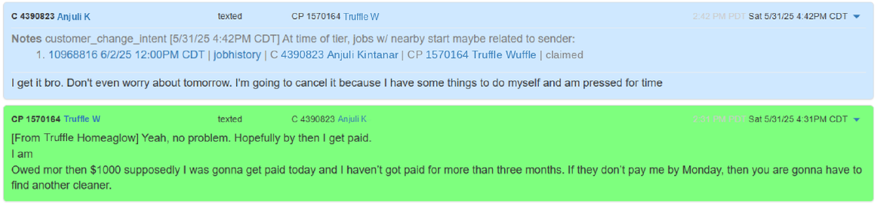
AG: PENDING INVOICE · PRACTICE
Let's practice!
How will you handle the following scenario?
Scenario: the job has already been in Pending Invoice for 75 hours when you opened the ticket. Here are the C/CP comms.
Hint: check the action guide. Was the job completed, and who initiated the change?
Notes:
TRAINER: give trainees a few minutes, then discuss. Read the comms: the customer told the cleaner "I'm going to cancel it because I have some things to do myself", and the cleaner agreed ("Yeah, no problem"). The job has been in Pending Invoice for 75 hours. Suggested answer (trainer to confirm): the comms clearly show the cleaning did not happen and the customer initiated the cancellation, so per the action guide cancel the job from the C CRM (no CP penalty) with the matching customer reason code, and send the C and/or CP comms. It is also past 72 hours since the job end time. Also discuss the cleaner's message about not being paid: it is not part of resolving this job, but should be noted and routed appropriately.

Slide 71

AG: PENDING INVOICE · PRACTICE
Practice writing
5-minute writing drill
Show Sample Comms
Scenario
5 min
You're working on a ticket with a Pending Invoice job.
The evidence is insufficient to confirm whether the cleaning was completed: there was only a call exchange between the C and the CP.
The job has been in Pending Invoice for 22 hours.
Write the comms to confirm with the C whether the job was completed.
Hi <C>,
Just checking in about your appointment on <Date> with <CP Name>. Did everything go as planned? If so, can you let me know how many hours the cleaning took?
If it wasn’t completed, I’d be happy to help find you another cleaner through priority booking. Just let me know what date and time works best for you, and I’ll take care of it.
Let me know if there’s anything else I can help you with!
-CS, Homeaglow HQ
Notes:
Give trainees 5 minutes to write their comms, then click Show Sample Comms (or press the right arrow) to reveal the sample. Discuss differences. Sample: Hi <C>, Just checking in about your cleaning on <Date> with <CP Name>. Were you able to get the cleaning done? If not, I'd be happy to help find you another cleaner through priority booking. Just let me know what date and time works best for you, and I'll take care of it. Let me know if you need anything else! -CS, Homeaglow HQ

Slide 72
WRAP-UP
Questions?
When in doubt, check the Knowledge Library or ask your Trainer or Team Lead.
Notes:
Open the floor for questions. Recap: the cleaner journey, CP CRM and Dashboard, profile statuses, deactivation codes, operating models, tiering, job statuses and the Pending Invoice action guide.

Slide 73


Knowledge Check
Time to check what you've learned. Your trainer will explain the format.
Trainer note: format and questions set by the trainer.
Notes:
TRAINER NOTE: The trainer decides the knowledge check format, questions and difficulty based on the cohort.

