Slide 1
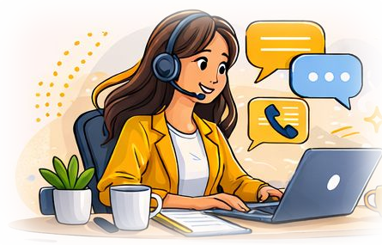
HOMEAGLOW · NEW HIRE CARE TRAINING
Customer Foundations
& the C CRM
The rules we never bend, the path every customer takes, and the tools we use to help them.
Internal training material
Notes:
Welcome trainees. This module covers six topics: Zero Tolerance Policy, the Customer Journey, the Legacy C CRM, the C Dashboard, the New C CRM, and a hands-on CRM activity.

Slide 2
OVERVIEW
Agenda
Six topics. Topics 3 to 6 happen mostly in the live systems.
# | Topic | You will learn
01 | Zero Tolerance Policy | The non-negotiables, and exactly how to avoid them
02 | Customer Journey | The five steps every customer moves through
03 | Legacy C CRM | Our central hub, and a live walkthrough
04 | C Dashboard | What the customer sees and manages
05 | New C CRM | Where we respond to customers
06 | C CRM Activity | Hands-on practice, set by your trainer
Notes:
Walk through the agenda. Point out that topics 3 to 5 are live demos: the slides only set up what trainees will see.

Slide 3


TOPIC 01 OF 06
Zero Tolerance Policy
The non-negotiables: behaviors that are never acceptable with customers or cleaners.
YOU'LL LEARN
What ZTP is and why it exists
Violations by level
Penalties and other conditions
Exactly what to do to avoid each one
Notes:
ZTP is different from the rest of the Knowledge Library. Most articles are about judgment; this one is about hard lines that create legal, security, compliance or trust risk. Spend time here: every rule on the next slides says exactly what to do.

Slide 4




ZERO TOLERANCE POLICY
Not judgment calls. Hard lines.
Violations carry consequences regardless of intent.
Legal
Security
Trust
Wording, auto-renewal and state laws we must follow.
Personal data, logins and payment details stay protected.
Customers and cleaners can rely on how we treat them.
Unsure? Stop and ask a Team Lead before you act. Asking is always better than a violation.
Notes:
Most KB articles teach judgment and best practice. ZTP is the handful of things that, done wrong, are not just a bad customer experience: they create legal, security or compliance exposure for Homeaglow. Knowing it protects the agent's QA score and standing, and keeps every interaction safe and trustworthy. Rule of thumb: if you are ever unsure whether an action crosses a line, stop and ask a Team Lead first.

Slide 5
ZERO TOLERANCE POLICY
Violations at a glance
Every violation is an auto-fail on QA, except capturing or sharing work screens.
Level 3
Most severe
Level 2
Serious
Level 1
Still a ZTP
Security violation
Capturing or sharing work screens
Card info not removed
Ticket avoidance
OCC / ARL accounts
Legal wording
Internal notes sent out
Disclosing internal info
Improper AI tool use
Not unsubscribing
WA cancellations
Rude / argumentative comms
Bug reporting process
Editing Django
Thumbtack accounts
Notes:
Full list from the KB, by level. L3: Security violation; Capturing or sharing work screens (no QA score). L2: Not removing a C or CP's card info sent to CS; Ticket avoidance; Incorrect handling of OCC-ARL accounts; Non-compliance with legal wording changes; Sending internal notes as email/SMS; Disclosing internal information; Improper usage of AI tools; Not unsubscribing customers who opt out; Mishandling Washington State cancellations. L1: Rude/argumentative comms; Not following the bug reporting process; Editing Django inappropriately; Handling a Thumbtack account.

Slide 6

ZERO TOLERANCE POLICY
Penalties
Penalties grow with the level and with each repeat.
 | Level 1 | Level 2 | Level 3
1st instance | Final warning (NTE) | Suspension, up to 5 days | Subject to termination
2nd instance | Suspension, up to 3 days | Subject to termination | —
3rd instance | Subject to termination | — | —
Remember: 3 ZTPs of any level means termination. L1s clear after 6 months.
Notes:
Other conditions: 3 ZTPs of any level means termination. An L1 followed by an L2 means a 1-week suspension. Previously suspended for an L1 and then commits an L2 means termination. Multiple ZTPs of different levels in the same week: the penalty follows the higher level. L1 clearing period is 6 months. For Incorrect Handling of OCC accounts, the QA score is set at a minimum of -$25, not stacked on the LTV computation; if the standard markdown is higher, that is used.

Slide 7




SECURITY & COMPLIANCE
Protect sensitive information
Security violation
Level 3
Card details sent to CS
Level 2
Double-check the recipient before sending any auto-login link or secure info.
Never share login credentials.
Keep documents with personal data (payment info, IDs, tax forms) inside our systems.
Notify a Team Lead right away so the card info is removed from the CRM.
Direct the customer to the CC update page on their dashboard.
Never ask for card info or card photos, and never put card details in internal notes.
Internal notes sent out
Level 2
Disclosing internal info
Level 2
Use internal notes only for risk assessments, offers/action plans and internal follow-ups.
Check the channel before you send: an internal note never goes out as an email or SMS.
Never discuss CP DTC flags, CP Swap details, CP Tiering levels, fraud/safety flags or unreleased NCW features.
Test: not in the Help Center or public comms? It's internal.
Notes:
Security violations: sending an auto-login link to the wrong person, sharing login credentials, mishandling documents with personal data (payment info, IDs, tax forms). A wrong auto-login link can expose private details and create legal/privacy risk. Card info: required for PCI compliance. If you receive card info, notify a Team Lead to remove it from the CRM and direct the customer to the CC update page on their dashboard. Internal notes are for risk assessments, offers/action plans and internal follow-ups. Internal info never to discuss: CP DTC flags, CP Swap details, CP Tiering levels, known fraud/safety flags, features not yet released on NCW.

Slide 8
SECURITY & COMPLIANCE · LEVEL 2
Say it the legal way
Cleaners are independent contractors, not Homeaglow employees. Always word it that way.
Do say | Don't say
Your cleaner on Homeaglow | Your Homeaglow cleaner
Find a cleaner on Homeaglow | Find a Homeaglow cleaner
Your cleaner / Your cleaner Alice | Our cleaner
Your cleaner will see you at <address> | We will see you at <address>
Your cleaner was unable to | We were unable to
Your requested cleaner is still reviewing | We are still waiting for your requested cleaner
Notes:
Legal Wording Compliance (Level 2, auto-fail). CPs are Independent Contractors. Referring to Homeaglow itself is fine: "your Homeaglow cleaning" and "your cleaning on Homeaglow" are both OK. Ask trainees to rewrite a few sentences out loud.

Slide 9



SECURITY & COMPLIANCE · LEVEL 3
Work screens stay on work screens
No exceptions, even if the screen looks blurred, covered or empty.
Never photograph it
Never capture it
Never share it
No photos or videos of a work screen, with a phone or any other device.
No screenshots or screen recordings of a work screen.
Nowhere: not personal chats, social media or coworker group chats.
Why: once a capture leaves our systems, we can't delete it, track it or undo it.
Notes:
Anything on a work screen can include names, addresses, payment details, internal notes, flags, other tabs or pop-up notifications. Once a capture exists outside our systems we cannot delete it, track it or undo it. "I blurred it" or "nothing was on screen" does not count: the risk is the capture itself. Level 3: subject to termination on the first instance.

Slide 10




CUSTOMER HANDLING
Handle these customers by the rules
OCC / ARL accounts
Level 2
Unsubscribe requests
Level 2
In Auto-Renewal Law states, cancel the FC immediately when asked: no extra steps, no delays.
Unsure? Check the OCC Non-Retention Process or ask a Team Lead before replying.
Customer says "don't contact me" or replies STOP / UNSUBSCRIBE: unsubscribe them.
Confirm the unsubscribe to them, then handle any other pending items as usual.
Washington State cancellations
Level 2
Rude / argumentative comms
Level 1
Process the cancellation immediately.
No ETF, never cite MCT, and no retention offers before cancelling.
Never present ETF or MCT terms as if they apply.
No condescending ("You didn't understand...") or passive-aggressive ("As I've told you before...") replies.
Educate, personalize and focus on resolution. Never argue.
Notes:
OCC-ARL: some states have Auto-Renewal Laws requiring immediate cancellation on request, with no extra steps or delays. Failing to cancel an FC when required is the ZTP; if the correct call was not to cancel but a retention offer was given anyway, that is a markdown, not a ZTP. Unsubscribe: if a customer says they don't want to be contacted, or replies STOP/UNSUBSCRIBE to an email. Washington State: WA customers are exempt from both MCT and the ETF; this is a standing legal exemption, not a case-by-case waiver. Tone: condescending ("You didn't understand...", "As I've already said...") and passive-aggressive ("As I've told you before...", "You should already know this.") replies. Do: educate, personalize, focus on resolution. Don't: argue, use generic statements, over-empathize.

Slide 11




OPERATIONAL COMPLIANCE
Follow the process, every time
Ticket avoidance
Level 2
Bug reporting process
Level 1
Work every ticket assigned to your department, including hard ones and charge disputes.
Never use CRM/NavBar filters to dodge tickets, or clear a ticket without resolving it.
Unsure if it needs action? Ask in the designated Slack channel.
Check the Confirmed Bugs Tracker first, then submit the Bug Validation Form.
Once a card is escalated, don't add sample or unrelated comments.
Editing Django
Level 1
Thumbtack accounts
Level 1
Only make the CS-approved edits listed in the KB.
Escalate review edits in NCW and job history edits for LMCs/LOs to SMEs or Managers.
When in doubt, don't edit it. Escalate it.
Spot it: system flag in New CRM, an internal note, or the customer says so.
Transfer to the Thumbtack queue and notify an available Aftersales agent.
Then stop: don't reply, resolve or take any other action.
Notes:
Ticket avoidance: deliberately skipping a ticket that needs a response or action. Clearing a ticket where the customer just says "thanks", "got it" or similar is NOT avoidance. Bug reporting: file a report when an issue can't be fixed by a dashboard/CRM update, or when something might be a bug or product idea. Bug Validation Form and Confirmed Bugs Tracker are linked in the KB. Django bypasses system codes, so one wrong edit can create bugs or data issues. CS-editable: duplicate account placeholders, a CP's SSN, invalidating flags (except Holdpay), reassigning/adjusting voucher duration, editing a DHJ voucher's MF/MCT (if no FC table yet), marking a CP review hidden (approved cases only), editing/restricting Requested CPs (if unavailable on OCW), manually adding CPs to recreated jobs. Thumbtack: transferring without reaching an Aftersales agent is still compliant: the transfer is the compliance action.

Slide 12

TOPIC 02 OF 06
Customer Journey
The map of a customer's whole experience, from first hearing about us to their cleaning.
YOU'LL LEARN
The five steps
How customers find us
Three ways to sign up
Where tickets come from
Notes:
Every ticket sits somewhere on this journey. Knowing where an issue sits lets you anticipate needs and pick the right playbook.

Slide 13







CUSTOMER JOURNEY
Five steps, one journey
Every ticket you handle sits somewhere on this path.
STEP 1
STEP 2
STEP 3
STEP 4
STEP 5
Learns about us
Signs up
Books
Manages the appointment
Receives and pays
Why it matters: know where the customer is, and you'll know which playbook to use.
Notes:
Understanding the full shape lets you anticipate what a customer needs before they fully explain it, catch friction before it becomes a complaint, and know where an issue sits. A booking problem needs a very different response from a post-cleaning service issue, even when the tone sounds the same. This page is the map; playbooks like PCQ, Overcharged Hours and Retention are what you use once you know where you are.

Slide 14





STEP 1 · LEARNS ABOUT US
How customers find us
Search engines
Our websites
TV commercials
Friends & family
Social media
The most common source
Homeaglow and sister brands
Referrals
Facebook, YouTube, TikTok
Most common: search engines.
Notes:
Customers find us through our website (homeaglow.com) or a sister brand (Dazzling Cleaning, Cozy Maid, Bubbly Cleaning, Dapper Maids); search engines, the most common source; TV commercials; friends and family referrals; and social media (Facebook, YouTube, TikTok, etc).

Slide 15

STEP 2 · SIGNS UP
Three ways to sign up
The path a customer took shapes their billing and what options they have.
1
2
3
Legacy DHJ
First Cleaning Free
Non-member
Bought a discounted voucher from <brand>.com/deal.
Joins the membership directly. Pays $19 upfront.
Groupon, gift card, one-time or trial cleaning. No membership.
Since Aug 3, 2026: all new membership sign-ups are First Cleaning Free.
Notes:
Legacy DHJ: the customer buys a discounted voucher from <brand>.com/deal. First Cleaning Free (FCF): signs up for a membership directly, pays $19 upfront (more for a longer first cleaning), membership starts immediately. From August 3, 2026 all new sign-ups are FCF only, so DHJ is a closed, shrinking group. Non-member: third-party merchant vouchers (Groupon, Living Social, Gilt City) never converted; Homeaglow Gift Cards (never trigger FC); one-time cleanings sold by Inside Sales (paid upfront, full price); trial cleanings sold by Inside Sales (regular price, 30 days to cancel the membership without obligation). Non-members are billed differently and have nothing to "cancel"; the question is usually just whether a specific charge should be refunded.

Slide 16



STEPS 3 & 4 · BOOKS AND MANAGES
Booking and managing
6
hours before start
Books
Members are prompted to add:
Up until then, from their dashboard, customers can:
A recurring schedule
Alternate start times
Reschedule
Cancel
Match a new cleaner
Both raise the odds of a match.
Notes:
Booking: customers with a voucher or membership are prompted to opt into a recurring schedule and add alternate start times; both increase the odds of a successful match. Customers without one are not required to. Managing: through their dashboard, up to 6 hours before the start time, a customer can reschedule, cancel, or match with a different cleaner.

Slide 17




STEP 5 · RECEIVES AND PAYS
Where service issues start
The booking finalizes here, and most Service Issues tickets begin here too.
Poor cleaning quality
False invoice
Overcharged hours
Theft / damage
The cleaning didn't meet expectations.
Charged when no cleaning happened.
Charged for more time than was worked.
An item missing or damaged after the cleaning.
Next: each issue has its own playbook in the Knowledge Library.
Notes:
Common issues after the cleaning: Poor Cleaning Quality (didn't meet expectations), False Invoice (charged when no cleaning happened), Overcharged Hours (charged for more time than the CP worked), Theft/Damage (missing or damaged item). Each has its own playbook under Service Issues; this page only shows where they surface.

Slide 18
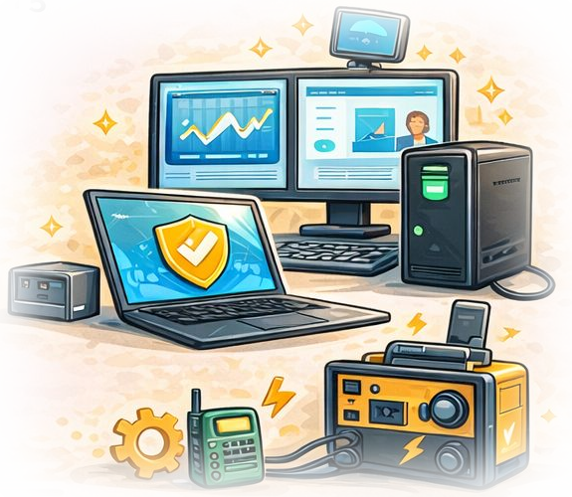
TOPIC 03 OF 06
Introduction to C CRM (Legacy)
Our central hub for customers, cleaners, jobs and payments.
YOU'LL LEARN
What the CRM is for
Why we have two CRMs
A live walkthrough
Notes:
We currently have two CRM systems. We start with the Legacy C CRM because many actions still live there.

Slide 19
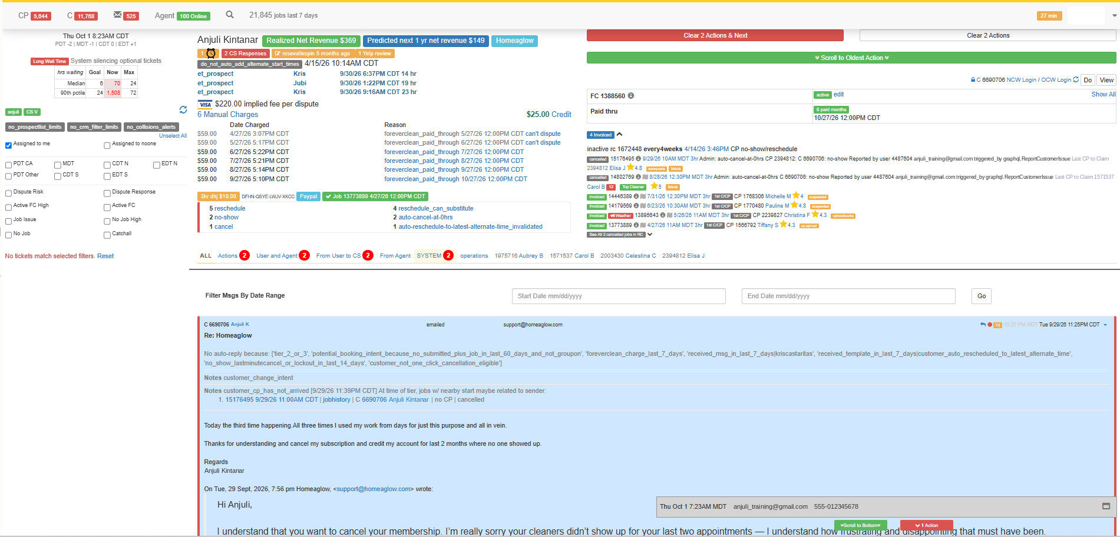




LEGACY C CRM
One hub for everything
Where we manage accounts, talk to users and find what we need to help them.
Customer & cleaner accounts
Jobs
Payments
Messages with users
Tickets
Daily targets
Legacy C CRM, preview only. Sample training details.
Two CRMs: we have a Legacy CRM and a New CRM. We start with Legacy.
Notes:
The CRM is the central hub for managing customer and cleaner accounts, jobs and payments. It is also where we communicate with users, manage tickets, see our daily targets, and access the information that helps us handle users' concerns. We currently have two CRM systems; we introduce the Legacy CRM first. The screenshot is only a preview; the trainer will walk through the live system next. Customer details in the screenshot are sample training data, not a real customer.

Slide 20


LEGACY C CRM
Live walkthrough
TRAINER WALKTHROUGH
The trainer will open the live Legacy C CRM and walk you through the actual system.
Follow along and note your questions.
AS YOU WATCH, LOOK FOR
Account details
Jobs and charges
Messages and tickets
Daily targets
Notes:
Switch to the live Legacy C CRM now. Do not demo from the slides. Suggested flow: open a customer account, show account details and flags, job history and charges, the message/ticket thread, and where daily targets show. Adjust to the cohort.

Slide 21
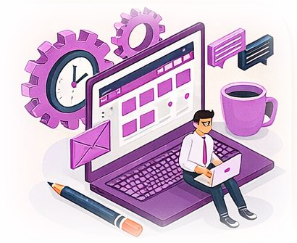
TOPIC 04 OF 06
Introduction to C Dashboard
Where customers manage their account and bookings.
YOU'LL LEARN
What the customer sees
What they can do themselves
A live walkthrough
Notes:
The C Dashboard is the customer-facing side. Seeing it helps agents guide customers and understand what they already tried.

Slide 22

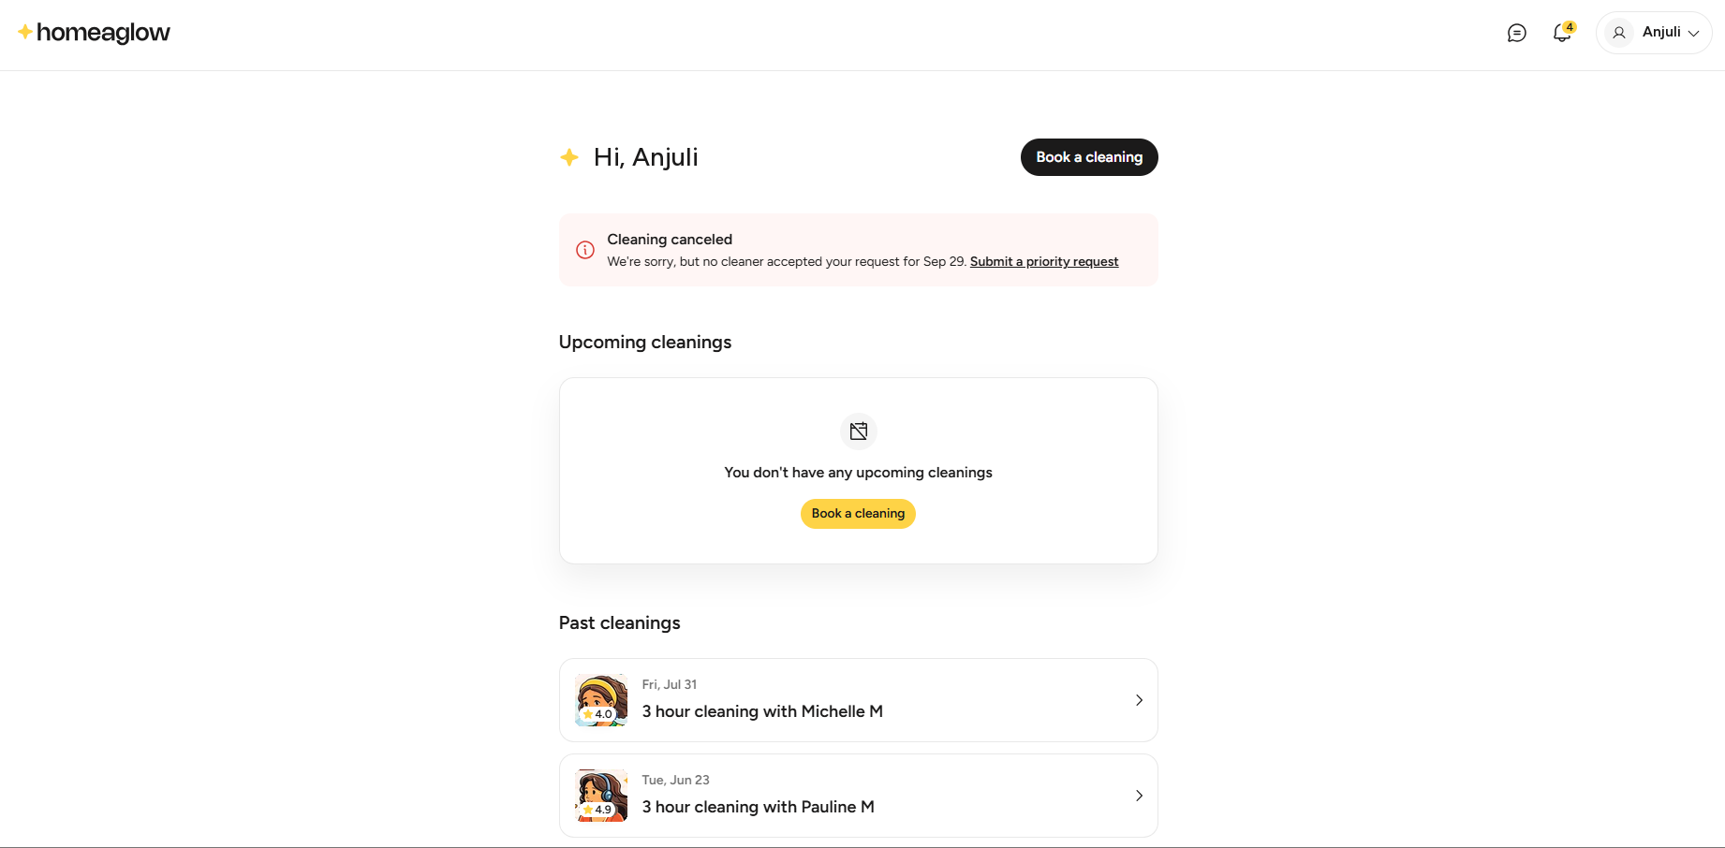


C DASHBOARD
The customer's side
Where customers manage their account and bookings.
Book a cleaning
Alerts about their bookings
Upcoming cleanings
Past cleanings
Account settings
C Dashboard, preview only. Sample training details.
Why it helps: when you know what the customer sees, you can guide them step by step.
Notes:
The Customer dashboard is where customers manage their account and bookings: book a cleaning, see upcoming and past cleanings and alerts (e.g. a cancelled cleaning), and, up to 6 hours before start, reschedule, cancel or match with a different cleaner. Knowing what they see lets agents point customers to self-serve steps and understand what they have already tried. Customer details and cleaner photos in the screenshot are training placeholders.

Slide 23


C DASHBOARD
Live walkthrough
TRAINER WALKTHROUGH
The trainer will open the live C Dashboard and walk you through the actual system.
Follow along and note your questions.
AS YOU WATCH, LOOK FOR
The home view
Upcoming cleanings
Past cleanings
Account settings
Notes:
Switch to the live C Dashboard now. Suggested flow: home view and alerts, booking a cleaning, managing an upcoming cleaning (reschedule, cancel, match), past cleanings, and account settings.

Slide 24
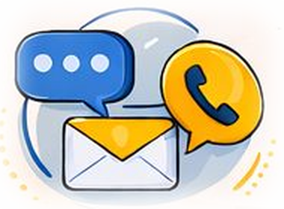
TOPIC 05 OF 06
Introduction to New C CRM
Where we respond to customers today.
YOU'LL LEARN
What the New CRM is for
When you still need Legacy
A live walkthrough
Notes:
The New C CRM is where agents respond to customers. Some actions are still only available in the Legacy CRM.

Slide 25
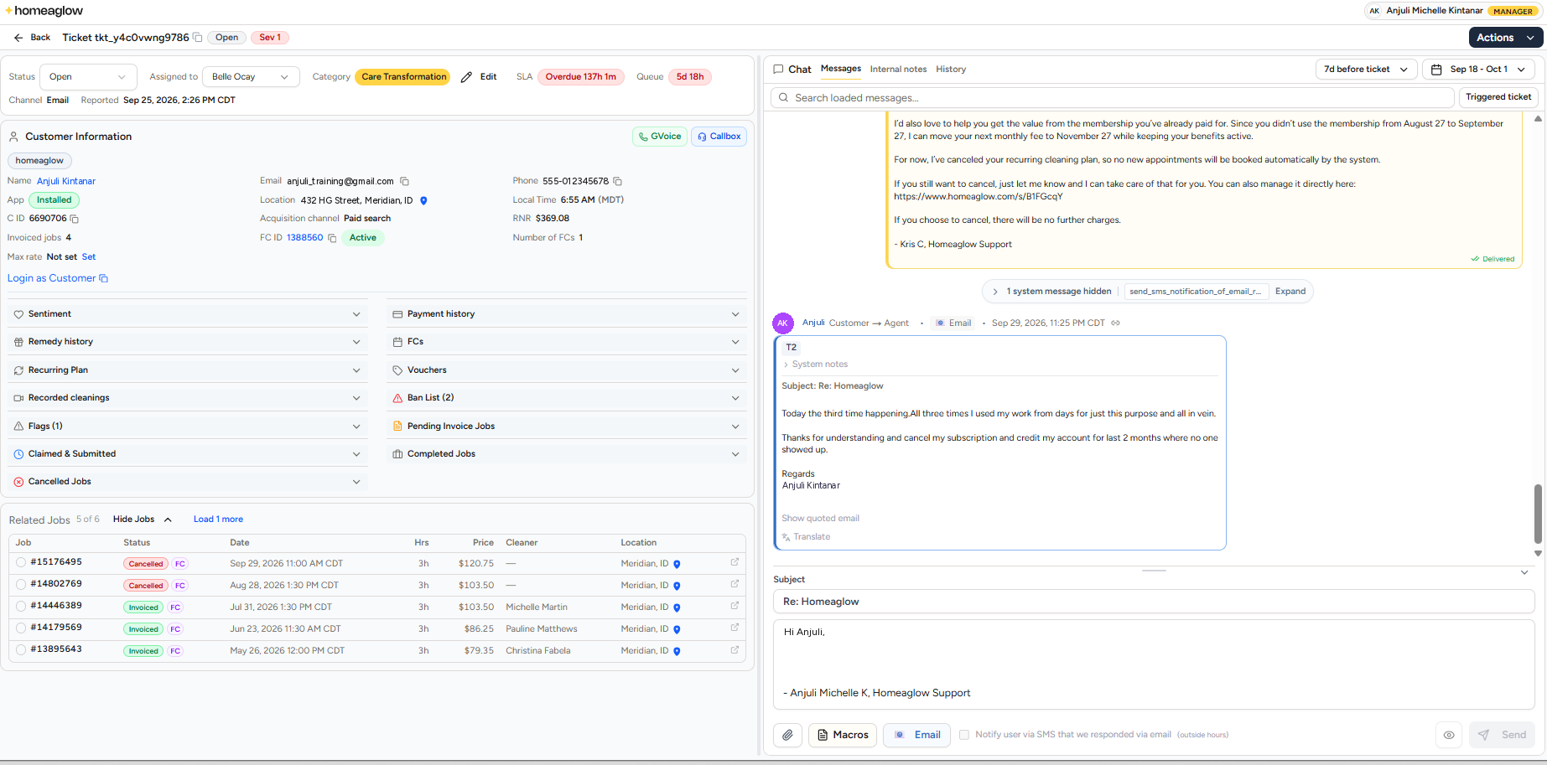


NEW C CRM
Where we respond to customers
Every reply to a customer goes out from the New C CRM.
Ticket status and SLA
Customer information
Related jobs
Messages and internal notes
Reply with macros
New C CRM, preview only. Sample training details.
Important: some actions can still only be done in the Legacy CRM.
Notes:
The New C CRM is where we respond to customers. The screenshot is a preview of a ticket: ticket header, customer information, related jobs, and the message thread with the reply box. Customer details are sample training data. The trainer walks through the live system next.

Slide 26

NEW C CRM
Two CRMs, one workflow
NEW C CRM
LEGACY C CRM
Respond to customers
Some actions still live here
Every reply to a customer goes out from here.
Use it for actions the New CRM can't do yet.
Important: reply in the New CRM. Switch to Legacy only for actions the New CRM can't do yet.
Notes:
Important: we respond to customers through the New CRM. At this time, there are still some actions that can only be done in the Legacy CRM, so agents use both. The trainer will point out which actions still require Legacy during the walkthrough.

Slide 27

NEW C CRM
Live walkthrough
TRAINER WALKTHROUGH
The trainer will open the live New C CRM and walk you through the actual system.
Follow along and note your questions.
AS YOU WATCH, LOOK FOR
Ticket and status
Customer info
Replying to customers
What still needs Legacy
Notes:
Switch to the live New C CRM now. Suggested flow: ticket header (status, assignee, category, SLA), customer information panel, related jobs, the message thread and internal notes, composing a reply with macros. Call out which actions still require the Legacy CRM.

Slide 28

TOPIC 06 OF 06
C CRM Activity
Put what you saw into practice.
YOU'LL LEARN
Work in the live CRM
Practice real scenarios
Ask questions as you go
Notes:
Trainer decides the activity format, scenarios, and level of difficulty based on trainee readiness.

Slide 29



C CRM ACTIVITY
Activity setup
Your trainer will set the activity for this cohort.
Format
Scenarios
Difficulty
Solo, pairs or groups
Which cases to work
Based on readiness
Click to add
Click to add
Click to add
Trainer note: trainer decides the format, scenarios and difficulty based on trainee readiness.
Notes:
TRAINER NOTE: Trainer decides the activity format, scenarios, and level of difficulty based on trainee readiness. Fill in the three boxes on this slide before the session (or live with the class).

Slide 30
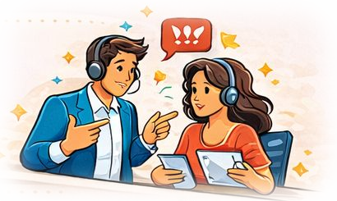
WRAP-UP
Questions?
When in doubt, check the Knowledge Library or ask your Trainer or Team Lead.
Notes:
Open the floor for questions. Recap: ZTP hard lines, the five-step customer journey, and the three systems: Legacy C CRM, C Dashboard and New C CRM.

