Slide 1

Proposed Project
Drug Repurposing By Identifying Existing Drugs Which Can Be Effective For New Indications Based On Genomic Data And Computational Methods.
Presented By
Afia Anjum Id 2014751124
Farjana Sultana Rafi Id-2014751143
Sanzida Akter Chadne Id:2014751147
Guided By
Mr.Al-Imtiaz
Assistant Professor & Head, CSE
Fatema Tuj Tarannom Esty
Lecrurer of CSE department

Slide 2
Agenda
Introduction
Related Work
Problem Statement
Contribution
Methodology
Result
Conclusion

Slide 3
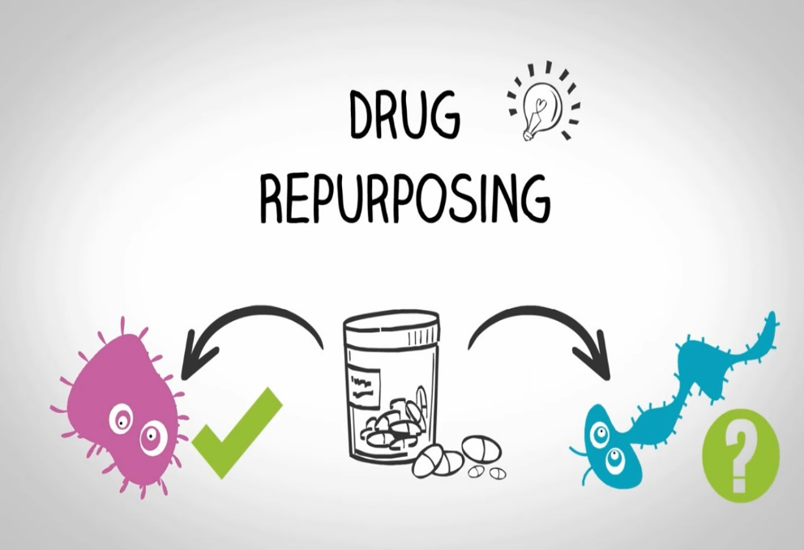
Introduction
Drug repurposing involves using known drugs for new uses.
It is a strategy to find new uses for existing drugs.
Various computational methods, including genomic signatures and interaction networks, are employed.
Fig1: Drug Repurposing

Slide 4
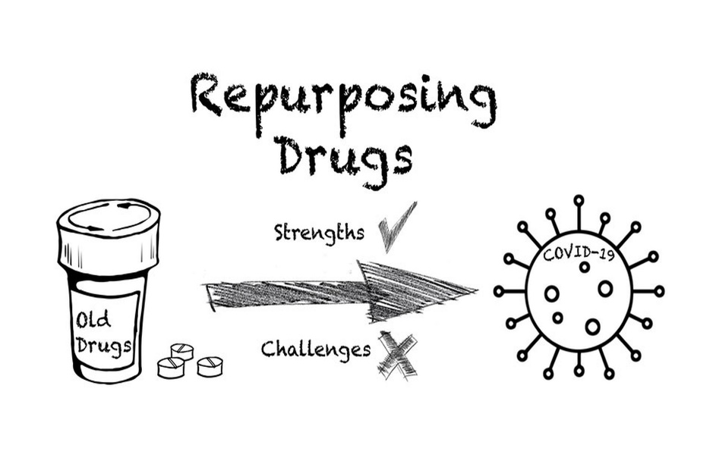
Why Drug Repurposing Matters
• Faster and cost-effective drug development.
• Utilizing drugs with established safety profiles.
• Addressing medical needs more efficiently.
Fig 2:Drug repurposing for Covid-19

Slide 5
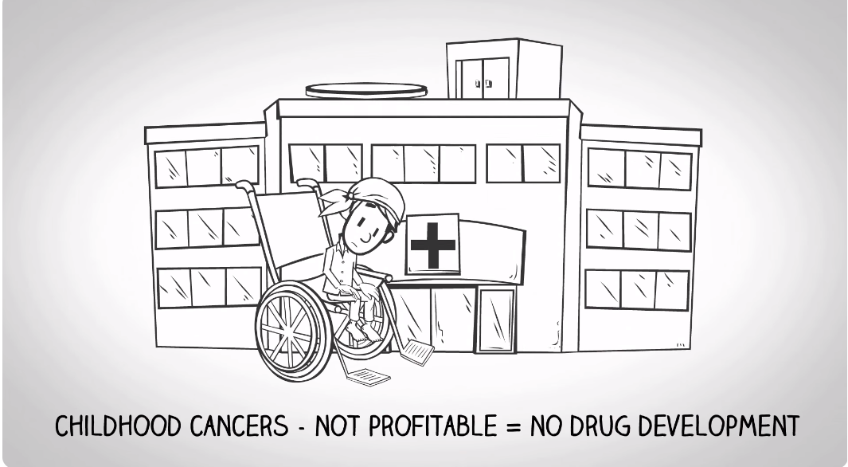
Example of Drug Repurposing
Fig 3: Example of Cancer patient

Slide 6
Example of Drug Repurposing
Repurposed Drug Treatment
Drug
Development
Can cost $250k.
3 years to get to market.
3 in 10 successful.
Can cost >$1 billion.
12 years to get to market.
1 in 10,000 successful.

Slide 7
Related Work-1
Real world approach:
Real-world data uncovers hidden drug-disease connections.
Data comes from individuals' health without biased data collection
[Reference: paper1 : Briefings in Bioinformatics, Volume 22, Issue 2, March 2021, Pages 1604 -1619,DOI: https://doi.org/10.1093/bib/bbz176]
https://academic.oup.com/bib/article/22/2/1604/5732424

Slide 8
Related Work-2
Moleculer approaches
Molecular approaches use omics data (genomic, transcriptomic, proteomic)
Transcriptomics and genomics are common due to data reliability.
Transcriptomics studies gene expression levels.
[Reference:paper 2 :International standard serial number (ISSN): 0950-9232 Electronic international standard serial number (eISSN): 1476-5594.] https://www.nature.com/articles/onc2017328

Slide 9
Related Work-3
Experimental screening approaches
Utilizes known molecules, often with safety and MoA knowledge.
Involves in-depth screening.
Uses smaller libraries (500-2000 compounds).
[Reference: paper 3: Vol 8 No 4 (2020): Vol 8 No 4 (2020): Volume 8 Issue 4 July - August. 2020 DOI: https://doi.org/10.22270/ajprd.v8i4.634]
https://www.ajprd.com/index.php/journal/article/view/634

Slide 10
Problem Statement
• Lack of data for AI and ML approaches.
• Relies on omic data availability.
• Challenges in accurately reversing gene expression.
• High cost .
• Time-consuming, delaying drug development.

Slide 11
Contribution
• Accelerates drug development by finding new uses for approved drugs, reducing time and costs.
• Offers potential solutions for diseases with rising mortality rates like cholera and various cancers.

Slide 12
Methodolgy-1
Inverse genomic signature approach
Inverse genomic signature approach finds drugs opposite to disease genes.
It uses a database called Connectivity Map (cMap) with gene data from thousands of compounds.
Identified new treatments for diseases like IBD and potential drugs for influenza and MERS-CoV.

Slide 13
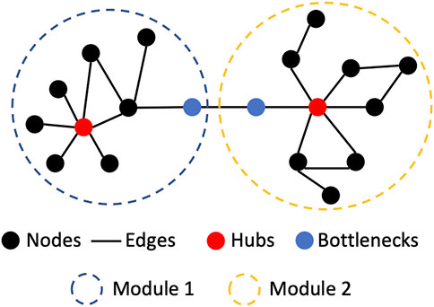
Methodolgy-2
Network Based Approach
Drug repurposing vital for rare diseases.
Mei et al. used MLNM for CNS disease repurposing.
Analyzed gene expression, disease pathways, FDA drugs, and late-stage compounds.
Built a CNS disease network based on shared factors.
Identified drug candidates with strict criteria.
Fig 4:Network based Approach

Slide 14
Result
Repurpose existing drugs for rare diseases.
Analyze genomic data.
Use computational techniques.
Discover new medical uses.

Slide 15
Conclusion
• Involves the significance of drug repurposing.
• Potential drugs must be tested for real-world effectiveness.
• Drug repurposing can benefit rare infectious diseases.

Slide 16
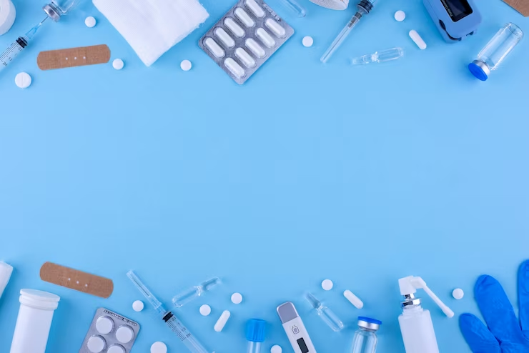
Thank You

