Slide 1
PRODUCT
CAMPUS
LOOP
A trusted campus exchange for
things students no longer need.
PRODUCT MANAGEMENT MINOR PROJECT
Presented by Anas Anjum | November 2026
BUY / SELL
DONATE
CAMPUSLOOP / PRODUCT MANAGEMENT MINOR PROJECT
01

Slide 2
01 / THE OPPORTUNITY
Useful items stay idle. Students still need them.
A two-sided campus problem: unused supply on one side, unmet student demand on the other.
SUPPLY SIDE
DEMAND SIDE
Items with value
are left unused
Students need affordable
pre-owned essentials
↔
67%
kept in a room or
thrown away
0 / 13
reported using a platform
to buy or sell used items
8 of 12 responses to the unused-item follow-up
Survey respondents relied on informal alternatives
CampusLoop connects useful items with students who need them.
Source: CampusLoop student survey; unused-item response n=12; platform-use question n=13.
CAMPUSLOOP / PRODUCT MANAGEMENT MINOR PROJECT
02

Slide 3
02 / PRODUCT PROCESS
From discovery to a measurable product plan
The work follows the product lifecycle: define the problem before prioritising, designing and planning the solution.
01
DISCOVER
02
DEFINE
03
SPECIFY &
PRIORITIZE
04
DESIGN
05
PLAN
06
LAUNCH
Survey · interviews
competitor review
Problem · users
vision
PRD · 12 stories
RICE / MoSCoW
8 wireframes
clickable Figma
MVP / V2 / V3
metrics + roadmap
GTM positioning
channels + seeding
›
›
›
›
›
MEASURE & ITERATE
Track weekly exchanges, verified sign-ups, listing completion and four-week retention.
Use feedback to inform the next discovery cycle.
The project abstract is a supporting summary of the work, not a separate lifecycle stage.
CAMPUSLOOP / PRODUCT MANAGEMENT MINOR PROJECT
03

Slide 4
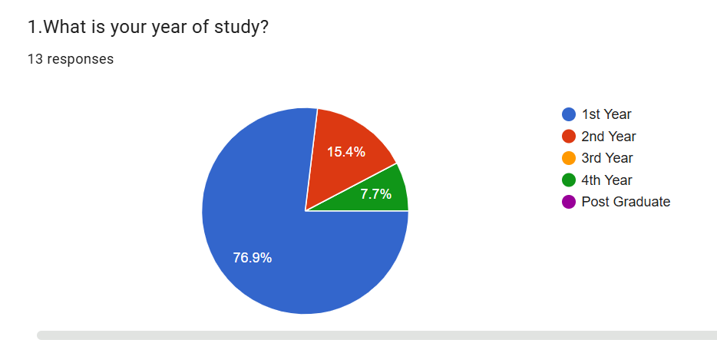
03 / USER RESEARCH
A small, focused first round of student research
The research was used to surface early needs and product hypotheses—not to claim campus-wide representativeness.
13
2
10
What the research explored
Survey responses
Student interviews
Survey questions
Google Forms · anonymous
Both first-year students
Year, residence, habits, trust
• Unused items and current disposal
• Buying / selling behaviour
• Trust and safety preferences
• Interest in buy, sell and donate together
Who answered?
77% were first-year students (10 of 13).
62% were day scholars (8 of 13). Hostel residents were underrepresented (1 of 13).
Question-level counts vary from 11 to 13. The survey was a convenience sample shared through student groups.
CAMPUSLOOP / PRODUCT MANAGEMENT MINOR PROJECT
04

Slide 5
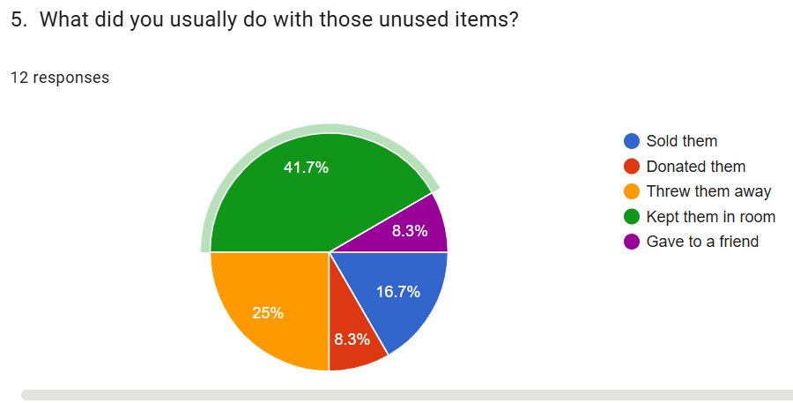
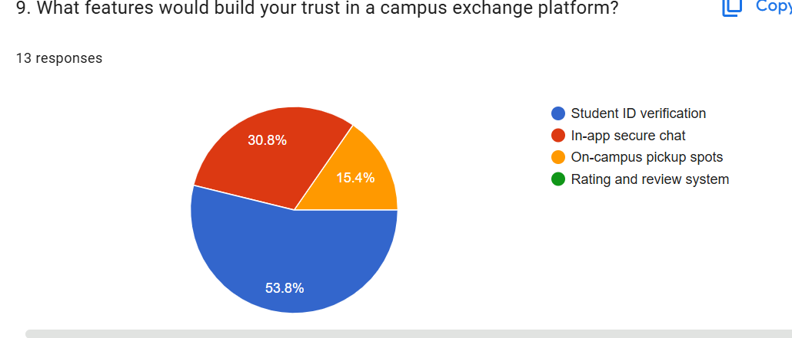
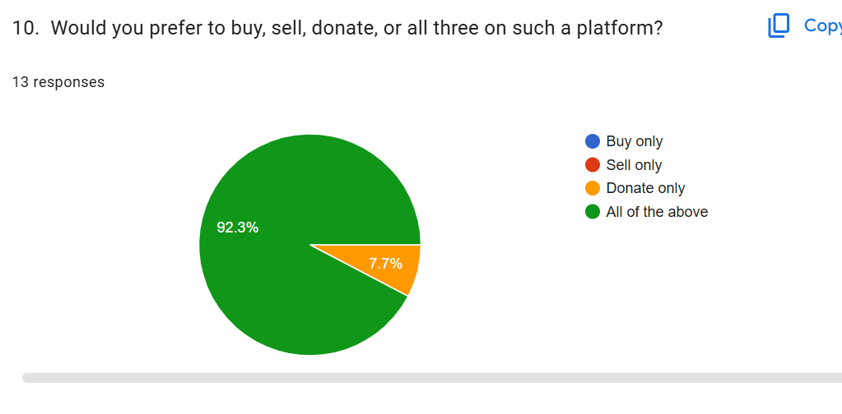
04 / SURVEY SIGNALS
Three findings shaped the product direction
The strongest signals point toward reuse, verification and a combined exchange model.
66.7%
53.8%
92.3%
kept idle or discarded
selected student ID verification
want buy, sell and donate
Unused-item actions · n=12
Trust feature · n=13
Preferred platform model · n=13
Product implication: make student verification visible and make donation a first-class option.
Source: Google Forms. Percentages are calculated from the response counts shown in the original charts.
CAMPUSLOOP / PRODUCT MANAGEMENT MINOR PROJECT
05

Slide 6
05 / INTERVIEW INSIGHTS
Students want affordability without sacrificing trust
Both interviewees were first-year students. Their comments add context to the survey signals.
Students want affordable, good-condition items from a trusted campus community.
AFFORDABILITY
VERIFICATION
TRANSPARENCY
Finding second-hand academic books in good condition at reasonable prices.
Both participants saw college ID or institutional email verification as important.
Clear photos, descriptions and item-condition details help buyers decide.
CAMPUS CONVENIENCE
SIMPLE DISCOVERY
SELL / DONATE
Students preferred exchanging items within their own college community.
Clear categories for books, stationery, electronics and essentials.
No convenient place to pass on unused items to genuine students.
These are qualitative themes from two interviews, not findings that can be generalised to the whole college.
CAMPUSLOOP / PRODUCT MANAGEMENT MINOR PROJECT
06

Slide 7
06 / COMPETITIVE LANDSCAPE
The gap is campus relevance + structured discovery
CampusLoop is positioned between broad classifieds and informal student group chats.
ALTERNATIVE
WHAT IT OFFERS
GAP IDENTIFIED IN THE PRD
OLX
Large audience; many categories
No campus filter; spam risk
Facebook Marketplace
Familiar profiles; easy to use
No student verification
Quikr
Wide reach
General-purpose and cluttered
Campus WhatsApp / Telegram
Free; familiar student community
Messages get buried; no structured search
Doing nothing
No effort
Useful items remain idle or are discarded
CampusLoop hypothesis: verified students + searchable listings + a built-in donate option.
Competitor observations are taken from the CampusLoop PRD and should be treated as a project-level comparison.
CAMPUSLOOP / PRODUCT MANAGEMENT MINOR PROJECT
07

Slide 8
07 / PRODUCT VISION
A campus-only exchange, built around student trust
One focused experience for buying, selling and donating useful pre-owned items.
Keep useful things moving within the student community.
01
02
03
VERIFIED COMMUNITY
EASY DISCOVERY
REUSE BY DEFAULT
Campus email or student ID check before account activation.
Search, categories and clear item details help students find relevant listings.
Sell an item or choose “Donate for free” when money is not the goal.
MVP: THE CORE EXCHANGE
NOT IN MVP
Verification · Listings · Donate option · Search / filters · Item details · Seller contact · Sold / given status · Basic reporting
Payments · delivery · cross-campus listings · advanced ratings
CAMPUSLOOP / PRODUCT MANAGEMENT MINOR PROJECT
08

Slide 9
08 / REQUIREMENTS & PRIORITISATION
Turn the product vision into testable scope
The PRD contains 12 user stories, with acceptance criteria and release mapping.
MVP REQUIREMENTS
TOP RICE SCORES
Must-have stories
RANK
USER STORY
RICE
• US1 Student verification
1
US4 · Item details
20.0
• US2 Create a listing with photos
2
US6 · Donate items
9.6
• US3 Search and filter
• US4 View item details
3
US2 · Create listing
9.0
• US6 Donate items for free
4
US1 · Verified sign-up
8.0
• US9 Mark as sold or given
• US12 Basic listing reports
5
US3 · Search & filter
7.2
Verification stays in MVP: trust is a gating need, even though RICE is not its only decision input.
RICE = Reach × Impact × Confidence ÷ Effort. Scores are estimates from the PRD, not measured performance.
CAMPUSLOOP / PRODUCT MANAGEMENT MINOR PROJECT
09

Slide 10
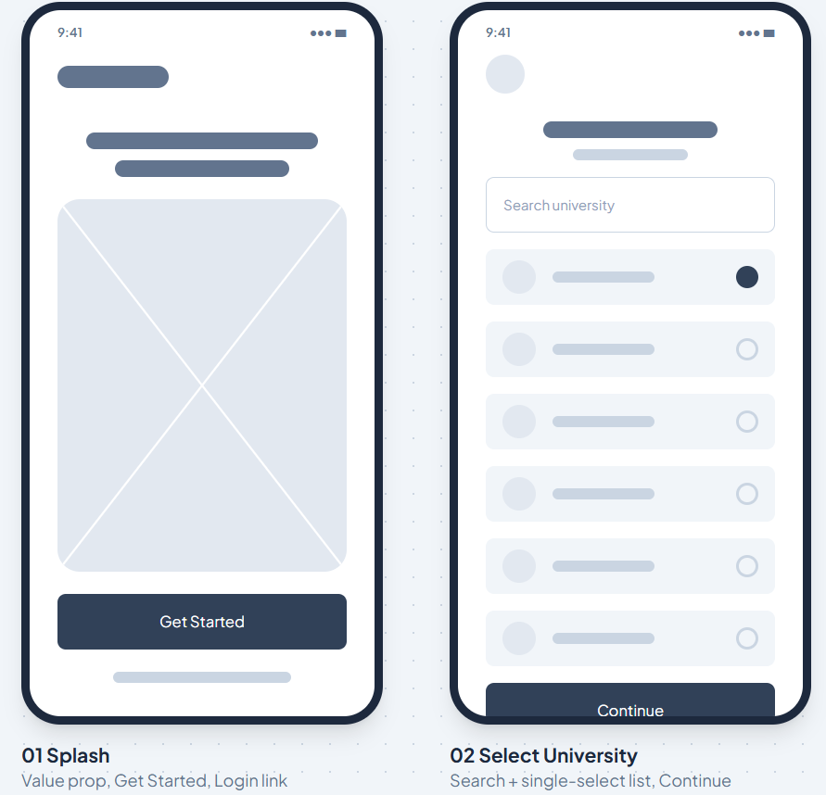
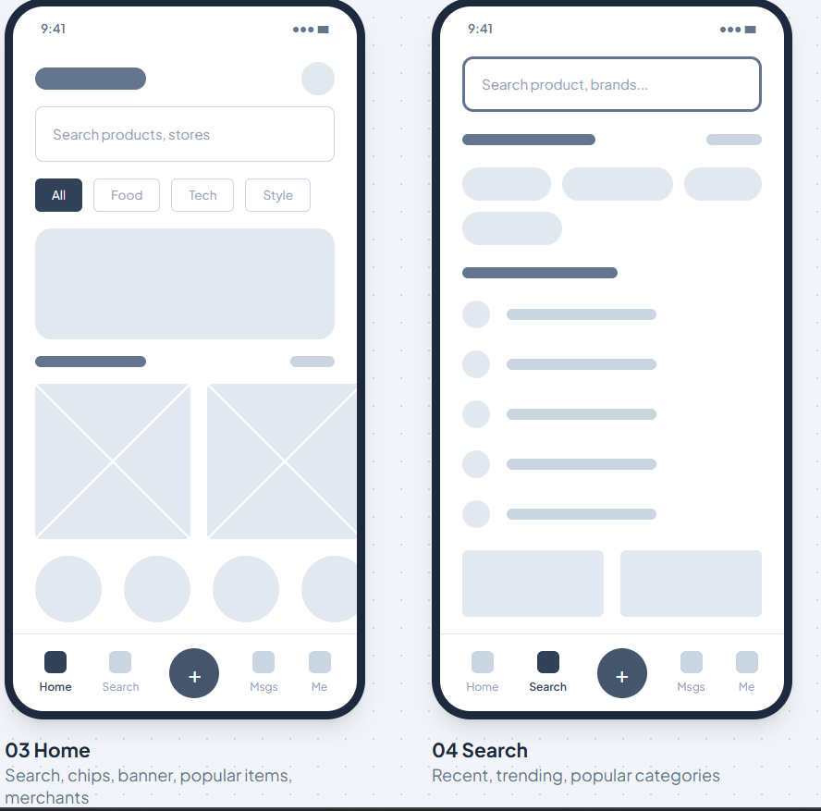
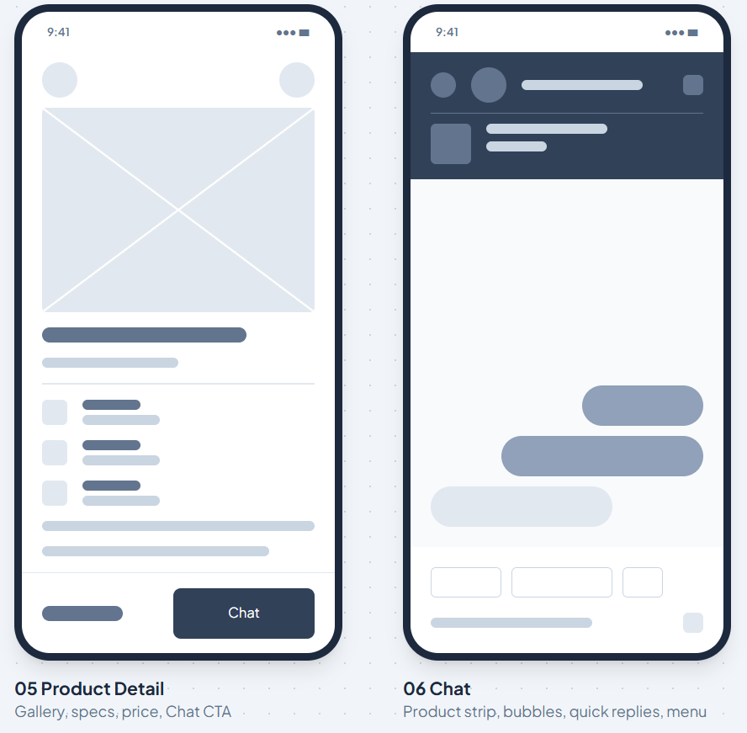
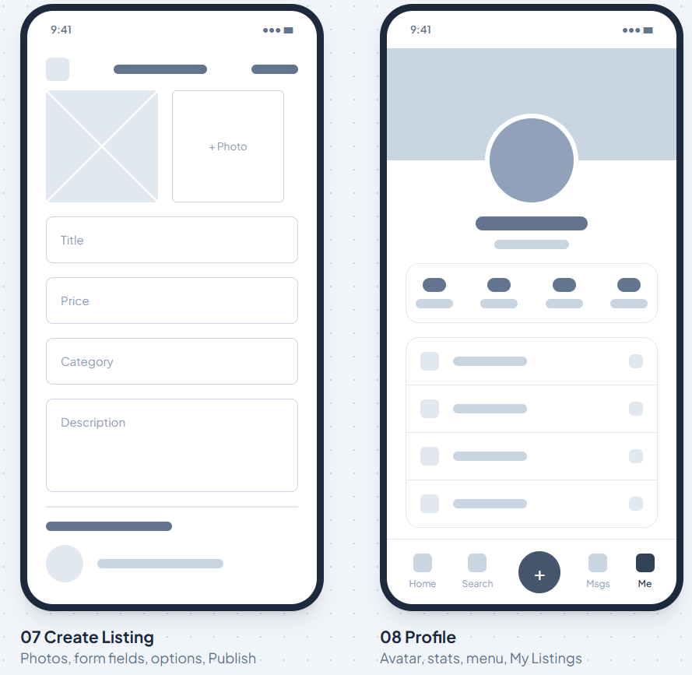
09 / DESIGN
Eight low-fidelity screens define the core experience
The wireframes cover onboarding, discovery, product evaluation, seller contact and listing management.
01–02
Welcome & select university
03–04
Home & search
05–06
Item detail & chat
07–08
Create listing & profile
Design direction: modern, minimal and premium; mobile-first; clear labels; visible verification and transparent item information.
CAMPUSLOOP / PRODUCT MANAGEMENT MINOR PROJECT
10

Slide 11
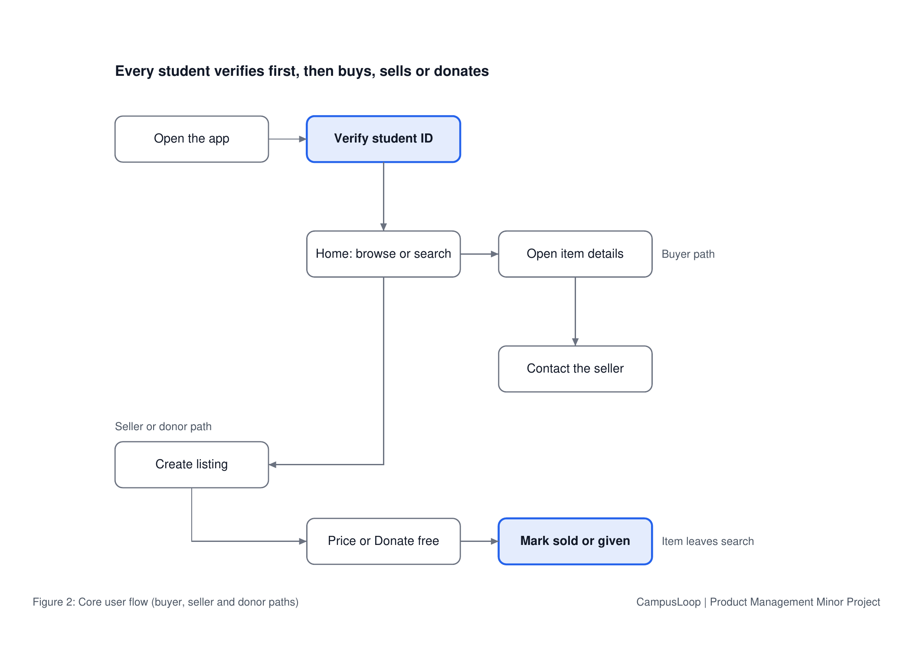
10 / CLICKABLE PROTOTYPE
The prototype connects the buyer, seller and donor journeys
Use this slide to open Figma and demonstrate the key interactions live.
LIVE DEMO
Open the clickable Figma prototype
Show the path from student verification to browsing, opening item details, contacting a seller, and creating a listing or donation.
OPEN FIGMA PROTOTYPE ↗
Prototype status: clickable design concept.
No production app has been built or launched.
Figma link embedded in the button above.
CAMPUSLOOP / PRODUCT MANAGEMENT MINOR PROJECT
11

Slide 12
11 / ROADMAP
Build the trusted exchange first; add depth later
A phased roadmap keeps the first release focused on completing a safe exchange.
MVP
V2
V3
TRUSTED EXCHANGE
SMOOTHER EXCHANGE
HABIT & TRUST
• Verified student sign-up
• Listings + donation
• Search, filters, item details
• Seller contact, status, report
• In-app chat
• Saved / favorite items
• On-campus meetup suggestions
• Impact tracker
• Seller ratings
Prove students can find and pass on items within one campus.
Reduce friction once the core exchange behaviour is established.
Support repeat use and trust after enough exchange activity exists.
Timing is indicative; each phase should be revisited using research and pilot data.
CAMPUSLOOP / PRODUCT MANAGEMENT MINOR PROJECT
12

Slide 13
12 / MEASUREMENT
Define how the pilot will show progress
The North Star captures completed exchanges; the supporting KPIs measure adoption, marketplace activity and repeat use.
NORTH STAR METRIC
Items exchanged or donated per week
2–3 / week
by the end of week 4
5 / week
≥25%
≥20%
VERIFIED SIGN-UPS
LISTING COMPLETION
4-WEEK RETENTION
New verified student accounts per week.
Published listings marked sold or given within 30 days.
Week-1 active users returning for a meaningful action in week 4.
These are proposed four-week pilot targets—not actual results. Review them after collecting real usage data.
Measure a completed exchange only when an item is marked sold or given (or completion is otherwise confirmed).
CAMPUSLOOP / PRODUCT MANAGEMENT MINOR PROJECT
13

Slide 14
13 / LAUNCH & CONCLUSION
Start with one campus. Build trust before scale.
A simple go-to-market approach: create initial supply, launch within existing student communities, then learn.
01
02
03
SEED LISTINGS
LAUNCH FREE
GROW THROUGH CAMPUS
Invite early student contributors and collect genuine book, study-material and essentials listings.
Open access within one college; make buying, selling and donation easy to understand.
Use class / hostel groups, college social pages, student clubs and word of mouth.
CampusLoop keeps useful things moving
within the student community.
Research-led • Prioritised • Designed • Ready for prototype testing
Thank you | Questions
CAMPUSLOOP / PRODUCT MANAGEMENT MINOR PROJECT
14

