Slide 1

SafeSpace: Cyberbullying Detection
Helen Huang
Vincent Marklynn
Anjali Sebastian
Yong Long Tan

Slide 2
Why?
95% of teens in the U.S. are online.
- 59% of US teens have experience cyberbullying.
- Twice likely to attempt suicide if experience cyberbullying.
- 33% of victims experience social anxiety.
Content moderation prevents cyberbullying.
*Statistics from https://dataprot.net/statistics/cyberbullying-statistics/

Slide 3
Data
51K + LabelLed Tweets
39K Cyberbullying Comments, 12K not cyberbullying comments
Clean and Process Tweets before transfer learning
Assess Results

Slide 4
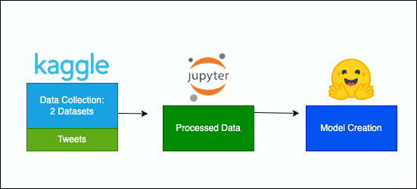
How we built it?

Slide 5
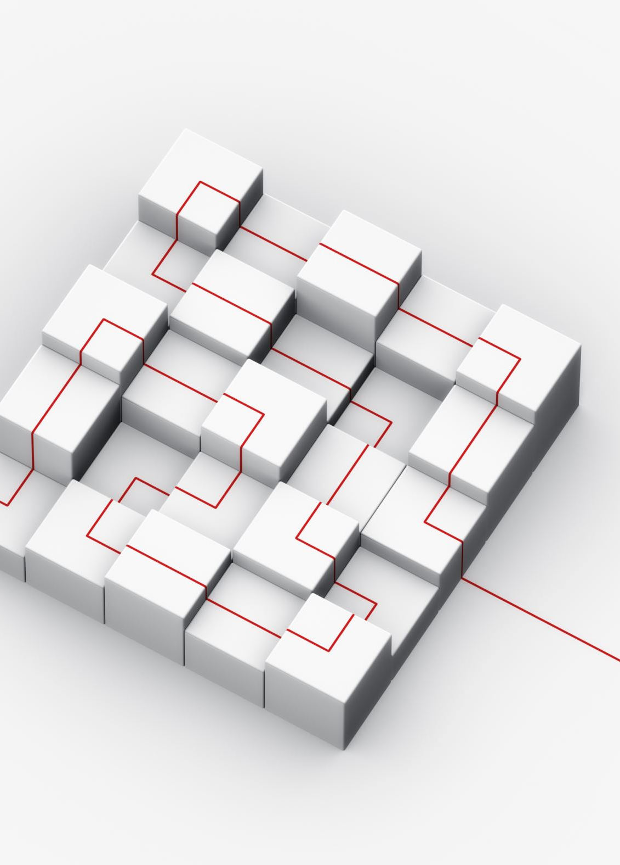
Model
DistilBERT
Uses the Transformer architecture.
Fine Tuning
3 Epochs

Slide 6
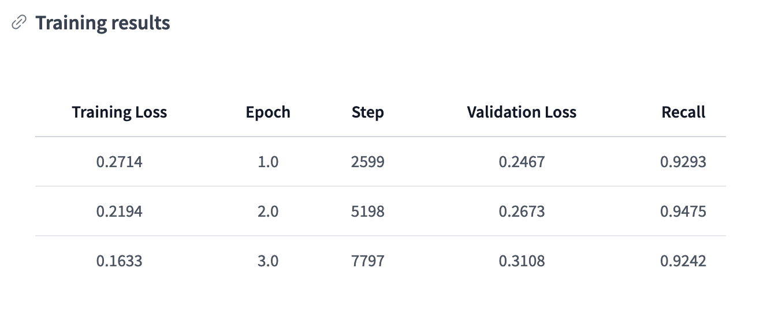
Metrics and Results

Slide 7
Demo
https://huggingface.co/vmarklynn/cyberbully_test_recall_v1
Git Hub Repository​ https://github.com/anjumorris/detect-cyberbullying.git​

Slide 8
Future Work and Impact
OpenSource moderation tool for smaller communities
Expandable to audio and video content
Try other LLMs

Slide 9

Thank You

