Slide 1
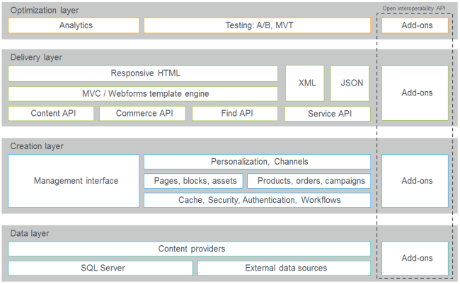
Architecture: Episerver has an open and layered architecture, allowing for almost any type of integration using standard technology

Slide 2
Optimization layer measures, analyzes and optimizes the performance of website content, such as conversion rates for a campaign landing page.
Delivery layer includes support for responsive design and templates based on Web Forms and MVC, and also support for building advanced search and filtering features.
Creation layer manages content such as pages and blocks, or e-commerce content such as products and orders. Content can be personalized, and can also be part of an approval workflow with authorization applied.
Data layer provides the information from one or more content providers (which can originate from the database) and external data sources that are integrated with Episerver.

Slide 3
Episerver CMS
Episerver CMS provides core features for content and presentation management:
Typed model for content types
Bulit-in components supporting both MVC and Web Forms
Administration and edit views
Projects and multi-publishing
Publishing workflow
Globalization support
Friendly URL management
Version management

Slide 4
Technical foundation
Microsoft .NET Framework and ASP.NET
Javascript and Dojo toolkit
EPiServer (in EPiServer.dll) Version: 6
The PageData class contains information about a specific page. This includes the name of the page (PageName), reference (PageLink) and URL (LinkURL). All built-in and custom properties defined for the page type are available through the Property property.
PageData is in many respects synonymous with the Web page that it is holding properties for. One example of this is the Changed property, which holds last change date and time for the PageData object, i.e. the Web page.
CurrentPage["PageName"] (type object)

Slide 5
public abstract class PageBase : Page, IPageSource, ICurrentPage
This class inherits from Page, which has the core functionality for setting up and rendering a standard Web form (.aspx file.) The PageBase class extends the functionality of the Page class with EPiServer-specific features as access to configuration settings (Configuration property), user information (CurrentUser property) and information about the current EPiServer page (CurrentPage property.)
The PageBase class is an abstract class, meaning it cannot be instantiated. This class is the base class of all template classes in EPiServer. TemplatePage is the most used class as base for Web forms.
PageBase also implements the IPageSource interface, which enables you to retrieve other EPiServer pages easily.
Note: If you use anything apart from templates that inherit from PageBase to create EPiServer page types, no dynamic content will be presented on the Web page.

Slide 6
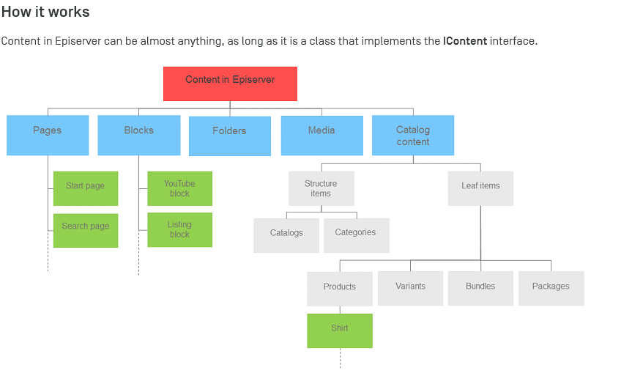

Slide 7
--- The End ---
http://world.episerver.com/documentation/Items/Developers-Guide/Episerver-CMS/9/Architecture/Architecture/
http://world.episerver.com/documentation/cms/get-started-with-cms/3--creating-a-start-page/
http://jondjones.com/category/episerver/

