Slide 1
CLR in .net
Anju munoth

Slide 2
.net framework
.NET is a managed programming language that offers the ability to program any kind of application, target any platform, abstract what is usually said to be low-level programming, such as memory management, object initialization, and finalization, and access any operating system, and so on.

Slide 3
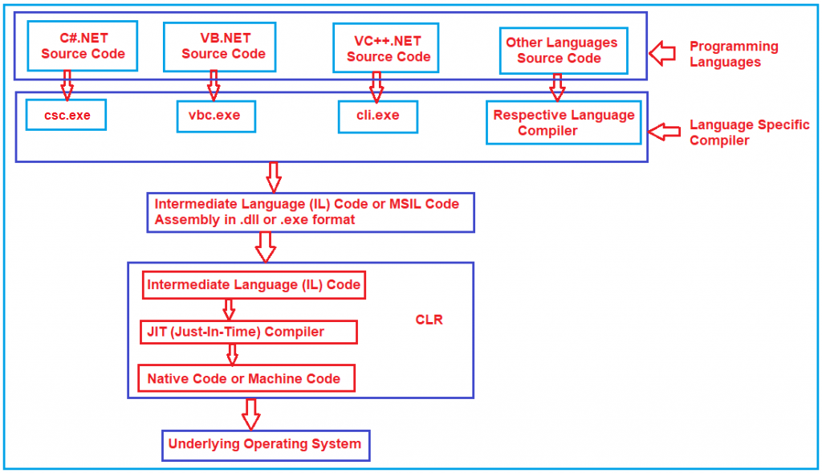

Slide 4
.net framework
When dealing with .NET Framework, all compliant languages (such as C# and VB) are actually only the frontend a programmer uses to interact with real .NET language, such as Microsoft Common Intermediate Language (CIL).
When a programmer builds code with Visual Studio, they trigger the compiler to produce the CIL from the source code.
Compiler itself is also usable by any command prompt or script because of being a simple console application.
Together with the Intermediate Language (IL), any compiler of .NET languages also produces relative metadata that is definitely required for datatype validation in class member invocation, to reflect types, members,and so on.
This module was made by IL and metadata, together with a Windows Portable Executable (PE32 or PE32+ for a 64-bit target platform) header,defines the kind of module (.dll or .exe) and the CLR header.
This header defines the version of .NET used and relative options, produce a file package known as Assembly, which also contains the eventually linked resources such as images, icons, and so on.

Slide 5
assembly with all its layers, showing the .NET physical file structure with the system headers, CLR header, code metadata, and body:

Slide 6
.net framework
Once the compilation succeeds, we can launch the application (or link the DLL as a reference to other applications) with the usual double-click.
The PE32(+) header will run the executable as an unmanaged application, which will try to load the .NET environment by launching the CLR with relative configuration as available in the assembly file, such as the .NET version, requested target platform, and others.
On a system without the proper .NET framework runtime available, the whole application will break execution
while on any valid system, the application will run normally.

Slide 7
Application startup lifecycle within the CLR

Slide 8
.net framework
Once the metadata loads successfully, any method is ready to run within the Just-in-Time (JIT) compiler of the CLR.
JIT compiles the platform independent CIL language in a platform-specific optimized language that can be executed on the underlying system, method by method, in a lazy fashion.
Once a method is actually compiled, this compiled code is injected into the in-memory metadata of the assembly, so as to not have to compile it again until the application remains loaded in the memory.

Slide 9
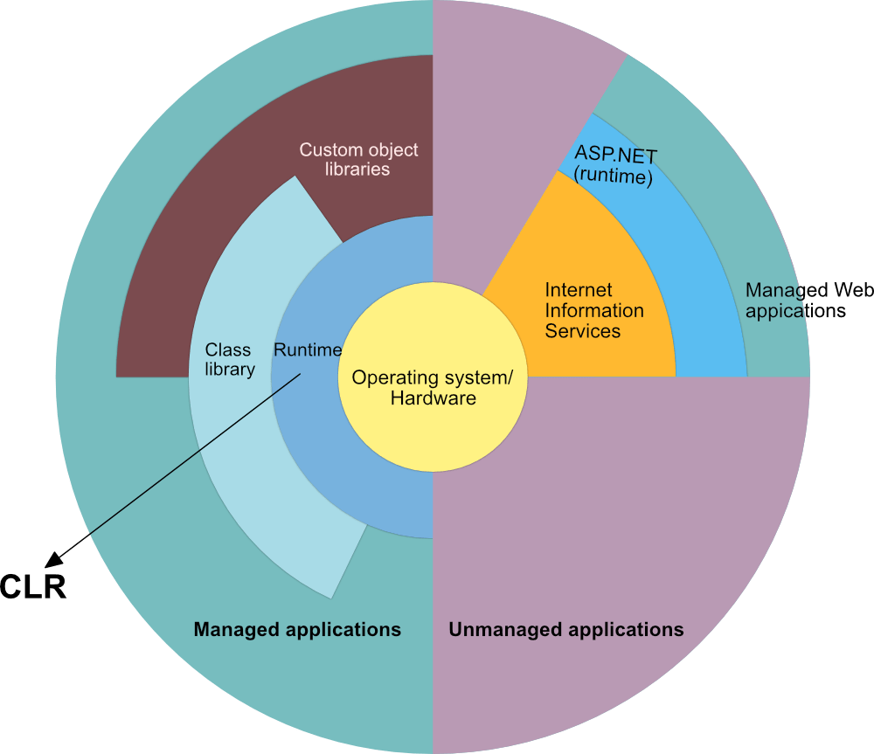

Slide 10
Managed and unmanaged code
Managed code --code whose execution is managed by a runtime called the Common Language Runtime or CLR, regardless of the implementation (for example, Mono, .NET Framework, or .NET Core/.NET 5+).
CLR is in charge of taking the managed code, compiling it into machine code and then executing it.
On top of that, the runtime provides several important services such as automatic memory management, security boundaries, and type safety.
C/C++ program, also called "unmanaged code".
In the unmanaged world, the programmer is in charge of pretty much everything.
Actual program is, essentially, a binary that the operating system (OS) loads into memory and starts.
Everything else, from memory management to security considerations are a burden of the programmer.
Managed code is written in one of the high-level languages that can be run on top of .NET, such as C#, Visual Basic, F# and others.
When you compile code written in those languages with their respective compiler, you don't get machine code -get Intermediate Language code which the runtime then compiles and executes.
C++ is the one exception to this rule, as it can also produce native, unmanaged binaries that run on Windows.

Slide 11
Intermediate Language & execution
IL--Product of compilation of code written in high-level .NET languages.
Once you compile your code written in one of these languages, you will get a binary that is made out of IL.
IL is independent from any specific language that runs on top of the runtime; there is even a separate specification for it
Once you produce IL from your high-level code, you will most likely want to run it.
This is where the CLR takes over and starts the process of Just-In-Time compiling, or JIT-ing your code from IL to machine code that can actually be run on a CPU.
In this way, the CLR knows exactly what your code is doing and can effectively manage it.
Intermediate Language is sometimes also called Common Intermediate Language (CIL).

Slide 12
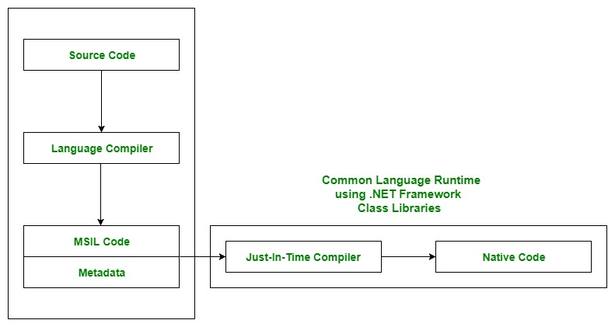

Slide 13
Common Language Runtime (CLR) in C#
Common Language Runtime (CLR) is a component of the Microsoft .NET Framework that manages the execution of .NET applications.
Responsible for loading and executing the code written in various .NET programming languages, including C#, VB.NET, F#, and others.
When a C# program is compiled, the resulting executable code is in an intermediate language called Common Intermediate Language (CIL) or Microsoft Intermediate Language (MSIL).
Code is not machine-specific, and it can run on any platform that has the CLR installed.
When the CIL code is executed, the CLR compiles it into machine code that can be executed by the processor.

Slide 14
Working of CLR
1. Compilation and Execution:
C# program gets compiled into Intermediate Language (IL) code, which is platform-independent.
CLR then uses a Just-In-Time (JIT) compiler to convert the IL code into machine-specific code while the program runs.
2. Services Provided by CLR:
CLR handles automatic memory management through Garbage Collection, preventing memory leaks.
It ensures that data types are used correctly and safely.
The CLR checks the IL code for security risks before running it.
3. Cross-Language Integration: CLR allows code from different .NET languages (C#, VB.NET, F#) to work together seamlessly through the Common Type System (CTS).

Slide 15
Key Components of CLR
CLR provides a common runtime or execution environment as there are more than 60 .NET programming languages.
Common Language Specification (CLS): It defines common rules so that code written in different languages can interoperate.
Managed Code: The MSIL code which is managed by the CLR is known as the Managed Code. For managed code CLR provides three .NET facilities:
Unmanaged Code: Before .NET development, programming languages like.COM Components & Win32 API do not generate the MSIL code. So these are not managed by CLR rather managed by Operating System.

Slide 16
Key Components of CLR
Security Manager
JIT Compiler
Memory Manager
Garbage Collector
Exception Manager
Common Language Specification (CLS)
Common Type System (CTS)

Slide 17
Key Components of CLR – Security Manager
Basically two components to managing security.
CAS (Code Access Security)
CV (Code Verification)
Used to check the privileges of the current user and then check whether the user is allowed to access the assembly or not.
Also checks what kind of rights or authorities this code has and whether it is safe to be executed by the Operating System or not.
These types of security checks are managed by the Security Manager Component of CLR in .NET Application.

Slide 18
Key Components of CLR -JIT Compiler
Converts IL code into machine code specific to the system at runtime, optimizing execution.
Responsible for Converting the MSIL code into Native Code (Machine Code or Binary code) that is going to be executed by the Operating System.
Native Code (Machine Code or Binary code) is directly understandable by the system hardware.
JIT compiles the code just before the execution and then saves this translation in memory.

Slide 19
Key Components of CLR –Exception Manager
Exception Manager component of CLR in the .NET Framework redirects the control to execute the catch or finally blocks whenever an exception has occurred at runtime.
If we have not handled the Runtime Exception, then the Exception Manager with throw the exception and abnormally terminate the program execution at the line where the exception has occurred.

Slide 20
Key Components of CLR
Garbage Collector: Automatically manages memory by freeing unused objects, reducing the need for manual memory management.
Common Type System (CTS): Ensures that different data types across languages are understood by CLR and can work together. 2 Types of CTS that every .NET programming language have:
Value Types: Value Types will store the value directly into the memory location. These types work with stack mechanisms only. CLR allows memory for these at Compile Time.
Reference Types: Reference Types will contain a memory address of value because the reference types won’t store the variable value directly in memory. These types work with Heap mechanism. CLR allot memory for these at Runtime.

Slide 21
Common Type System (CTS) in .NET Framework:
.NET Framework supports many programming languages such as C#, VB.NET, J#, etc.
Every programming language has its own data type.
One programming language data type cannot be understood by other programming languages.
But, there can be situations where we need to communicate between two different programming languages.
For example, we need to write code in the VB.NET language and that code may be called from C# language.
In order to ensure smooth communication between these languages, the most important thing is that they should have a Common Type System (CTS) which ensures that data types defined in two different languages get compiled to a common data type.
CLR in .NET Framework will execute all programming language’s data types.
This is possible because CLR has its own data types which are common to all programming languages.
At the time of compilation, all language-specific data types are converted into CLR’s data type.
This data type system of CLR is common to all .NET Supported Programming languages and this is known as the Common Type System (CTS).

Slide 22
CLS (Common Language Specification) in .NET Framework:
CLS (Common Language Specification) is a part of CLR in the .NET Framework.
.NET Framework supports many programming languages such as C#, VB.NET, J#, etc.
Every programming language has its own syntactical rules for writing the code which is known as language specification.
One programming language’s syntactical rules (language specification) cannot be understood by other programming languages.
But, there can be situations where we need to communicate between two different programming languages.

Slide 23
CLS (Common Language Specification) in .NET Framework:
In order to ensure smooth communication between different .NET Supported Programming Languages, the most important thing is that they should have Common Language Specifications which ensures that language specifications defined in two different languages get compiled into a Common Language Specification.
CLR in .NET Framework will execute all programming language’s code.
This is possible because CLR has its own language specification (syntactical rules) which are common to all .NET Supported Programming Languages.
At the time of compilation, every language compiler should follow this language specification of CLR and generate the MSIL code.
This language specification of CLR is common for all programming languages and this is known as Common Language Specifications (CLS).

Slide 24
Role of CLR in the Execution of a C# Program
Suppose we have written a C# program and save it in a file which is known as the source code.
Language specific compiler compiles the source code into the msil(microsoft intermediate language) which is also known as the cil(common intermediate language) or il(intermediate language) along with its metadata.
Metadata includes all the types, actual implementation of each function of the program. MSIL is machine-independent code.
Clr provides the services and runtime environment to the msil code.
Internally clr includes the jit(just-in-time) compiler which converts the msil code to machine code which further executed by cpu.
Clr also uses the .Net framework class libraries.
Metadata provides information about the programming language, environment, version, and class libraries to the clr by which clr handles the msil code.
As clr is common so it allows an instance of a class that written in a different language to call a method of the class which written in another language.

Slide 25
Benefits of CLR
Optimizes runtime execution and program interaction.
Programs can run on any system that supports CLR without needing recompilation.
Provides type safety and checks for potential security risks in code.
Automatically handles memory allocation and cleanup.
Allows code written in different languages to work together.
Makes it easier to build scalable, multithreaded applications.

Slide 26
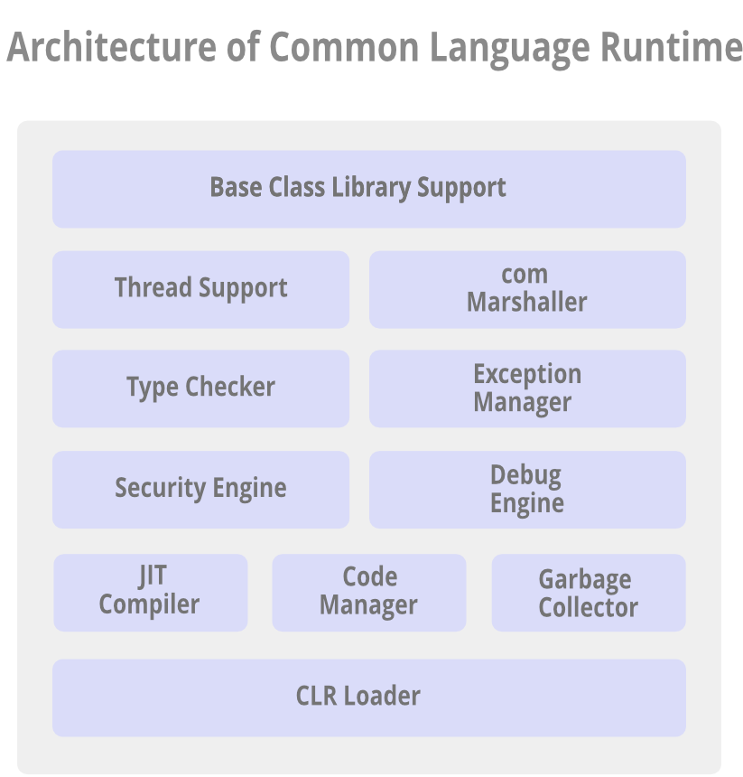

Slide 27
Architecture of Common Language Runtime
Base Class Library Support: CLR provides support for the base class library.
BCL contains multiple libraries that provide various features such as Collections, I/O, XML, DataType definitions, etc. for the multiple .NET programming languages.
Thread Support: CLR provides thread support for managing the parallel execution of multiple threads.
System.Threading class is used as the base class for this.

Slide 28
Architecture of Common Language Runtime
COM Marshaller: Communication with the COM (Component Object Model) component in the .NET application is provided using the COM marshaller.
Provides the COM interoperability support.
Type Checker: Type safety is provided by the type checker by using the Common Type System (CTS) and the Common Language Specification (CLS) that are provided in the CLR to verify the types that are used in an application.

Slide 29
Architecture of Common Language Runtime
Exception Manager: Exception manager in the CLR handles the exceptions regardless of the .NET Language that created them.
For a particular application, the catch block of the exceptions are executed in case they occur and if there is no catch block then the application is terminated.
Security Engine: Handles the security permissions at various levels such as the code level, folder level, and machine level.

Slide 30
Architecture of Common Language Runtime
Debug Engine: An application can be debugged during the run-time using the debug engine.
There are various ICorDebug interfaces that are used to track the managed code of the application that is being debugged.
JIT Compiler: The JIT compiler in the CLR converts the Microsoft Intermediate Language (MSIL) into the machine code that is specific to the computer environment that the JIT compiler runs on.
Compiled MSIL is stored so that it is available for subsequent calls if required.

Slide 31
Architecture of Common Language Runtime
Code Manager: Manages the code developed in the .NET framework i.e. the managed code.
Managed code is converted to intermediate language by a language-specific compiler and then the intermediate language is converted into the machine code by the Just-In-Time (JIT) compiler.
Garbage Collector: Automatic memory management is made possible using the garbage collector in CLR.
Automatically releases the memory space after it is no longer required so that it can be reallocated.
CLR Loader: Various modules, resources, assemblies, etc. are loaded by the CLR loader.
Loads the modules on demand if they are actually required so that the program initialization time is faster and the resources consumed are lesser

Slide 32
Fundamentals of memory
The following list summarizes important CLR memory concepts:
Each process has its own, separate virtual address space.
All processes on the same computer share the same physical memory and the page file, if there's one.
By default, on 32-bit computers, each process has a 2-GB user-mode virtual address space.
As an application developer, you work only with virtual address space and never manipulate physical memory directly.
Garbage collector allocates and frees virtual memory for you on the managed heap.
If you're writing native code, you use Windows functions to work with the virtual address space. These functions allocate and free virtual memory for you on native heaps.

Slide 33
Fundamentals of memory
Virtual memory can be in three states:
State | Description
Free | The block of memory has no references to it and is available for allocation.
Reserved | The block of memory is available for your use and can't be used for any other allocation request. However, you can't store data to this memory block until it's committed.
Committed | The block of memory is assigned to physical storage.

Slide 34
Fundamentals of memory
Virtual address space can get fragmented, which means that there are free blocks known as holes in the address space.
When a virtual memory allocation is requested, the virtual memory manager has to find a single free block that is large enough to satisfy the allocation request.
Even if you have 2 GB of free space, an allocation that requires 2 GB will be unsuccessful unless all of that free space is in a single address block.
You can run out of memory if there isn't enough virtual address space to reserve or physical space to commit.
The page file is used even if physical memory pressure (demand for physical memory) is low.
The first time that physical memory pressure is high, the operating system must make room in physical memory to store data, and it backs up some of the data that's in physical memory to the page file.
The data isn't paged until it's needed, so it's possible to encounter paging in situations where the physical memory pressure is low.

Slide 35
Memory
Define a variable of the chosen type
Allocate enough free memory to contain the variable:
Reserve some bytes in the operating system's memory stack to contain the variable
Use the variable:
Instantiate the variable with the needed value
Do whatever is needed with such variable, for example – Define variable, allocate memory, use your variable, deallocate memory
De-allocate the freed memory:
Once the variable becomes useless, free the related memory for further usage by this or other applications

Slide 36
Memory management issues
Using the wrong type, wasting memory, or going against an overflow of the type
Memory leak: This occurs anytime we forget to de-allocate memory, or by letting the application always consume more memory, and offer an easy-to-predict result.
Memory corruption: Occurs when we free memory by deallocating some variable, but somewhere in our code, we still use this memory (because it is referred by another variable as a pointer),unaware of such de-allocation.
This happens because when we deallocate variables and relative memory, we must always be sure of updating (or de-allocating) all eventually related pointers that otherwise may still point to a freed memory area that could also contain other data.

Slide 37
CLR and memory
Declaring a variable of any type
Instantiating the variable with a valid value:
CLR makes the difference between value-types and referencetypes regarding initial values of variables before assignation.
Reference-types have an initial value of null (Nothing in VB).
Value-types (all primitive-types except string and object),instead, are always valued at the default value.
Value-types may support a null value through the class Nullable<T> or by adding the character ?at the type ending, like int? (only in C#).
Using the variable

Slide 38
Automatic Memory Management
Automatic memory management is one of the services that the Common Language Runtime provides during Managed Execution.
CLR’s garbage collector manages the allocation and release of memory for an application.
For developers, this means that you do not have to write code to perform memory management tasks when you develop managed applications.
Automatic memory management can eliminate common problems, such as forgetting to free an object and causing a memory leak, or attempting to access memory for an object that has already been freed.

Slide 39
Memory management and CLR
memory management is done completely by the CLR, which allocates the needed variable memory plus some overhead (a pointer to a type instance and a sync block index) as soon as the variable is instantiated.
A target-system sized integer pointer that points to an instance of type class represents the type of the variable and the another value of the same size used for synchronizing the variable usage.
This means that on any 32-bit system, any variable will add 2 x 32-bit values, while for 64-bit systems, a variable will add 2 x 64-bit values.
This explains the small additional memory usage that occurs on 64-bit systems.
All those objects are arranged in sequence in a memory area called the managed heap.

Slide 40
Managed stack
CLR also manages another internal memory area called the managed stack.
Each thread handles its own stack (this is why often we refer it as the thread stack) by storing all value-types values in a Last-In-First-Out (LIFO) manner.
Purpose of CLR is to abstract memory allocation; thus, directly trying to impact that the kind of memory used is actually some kind of inference in CLR itself.
Possible to use explicitly stack memory by switching to C# in unmanaged coding (with a proper keyword, such as unsafe) using C++ related techniques, or using only value-types such as integers, double, chars, and so on in managed C#.
When using managed C#, the stack memory is available only until we program in a procedural way.
This happens because any type within an object (a reference-type) will be stored in the managed heap.
Although storing data in the stack will boost the value read/write speed in the memory, it is like programming in the 1960s.

Slide 41
Heap
heap is a growing list of bytes that contains a First-In-First-Out (FIFO) collection.
Always slightly bigger than needed, as it quickly accepts new values, exactly the same as any .NET List<T> collection.
CLR also has a pointer or cursor that is always pointing to the newly available space for any future allocation.

Slide 42
Heap memory allocation model

Slide 43
Heap
heap population job occurs on a portion of memory that is assigned to the application by the CLR, the address space, in which the Windows environment is actually a Virtual Address Space because it can span from physical memory to page files.
This whole application's memory space is then divided into regions—small memory portions side by side to assemble table pages for the compiled CIL, plus metadata and other regions that are eventually created as more memory requests occur.

Slide 44
Allocating Memory
When you initialize a new process, the runtime reserves a contiguous region of address space for the process called the managed heap.
Managed heap maintains a pointer to the address where the next object in the heap will be allocated.
Initially, this pointer is set to the managed heap's base address.
All reference types are allocated on the managed heap.
When an application creates the first reference type, memory is allocated for the type at the base address of the managed heap.
When the application creates the next object, the garbage collector allocates memory for it in the address space immediately following the first object.
As long as address space is available, the garbage collector continues to allocate space for new objects in this manner.
Allocating memory from the managed heap is faster than unmanaged memory allocation.
Because the runtime allocates memory for an object by adding a value to a pointer, it is almost as fast as allocating memory from the stack.
In addition, because new objects that are allocated consecutively are stored contiguously in the managed heap, an application can access the objects very quickly.

Slide 45
Memory availability in Microsoft Windows systems and CLR

Slide 46
Memory availability in Microsoft Windows systems and CLR
Although for Windows-based systems the theoretic virtual memory available for application address space is 8 GB (64-bit) or 1.5 GB (32-bit), always remember that the address space may be fragmented.
This will easily reduce real address space availability for simple variables like huge collections.
This is why a CLR running at 32-bit usually raises an OutOfMemoryException error at around 1 GB of memory consumption if we simply populate a huge List<T>.

Slide 47
Garbage collection
Difficult part of the job of CLR is freeing such a heap: instead of an unmanaged language in which this job is assigned to the programmer, here, the CLR de-allocates the memory just when the variable exits the scope (ifit lives in a managed stack) or when there is no more reference by any other object and it exits the scope (if it lives in a managed heap).
Job occurs in a lazy fashion with an internal heuristic that also looks for memory requests.
This is why, on a system with high address space available, an application that consumes 100 MB of memory can simply continue consuming the same amount of memory, although it is not used anymore if the application does nothing.
However, as soon as possible, when the application needs to create new objects, it could trigger the memory cleanup of the heap by starting an operation named garbage collection

Slide 48
Garbage collection
GC is the engine that cleans up the memory of managed heap within the CLR with an internal algorithm and its own triggering engine.
Although it is impossible to know exactly when the GC will fire, has known trigger points, for instance, when CLR needs lots of new memory.
GC memory cleanup operation is named collect.
Microsoft gives us the ability to trigger the collector manually, by invoking the GC.Collect method.
Although this option is available, manually triggering the GC is something to avoid because every usage will interfere with CLR abstraction of the underlying system.
The GC collection occurs multiple times until the process is alive and running.
Its execution has the goal of freeing the memory from objects that are not in use anymore by any code block, or that are not referred by any other living object.

Slide 49
Garbage collection
Any surviving object is then marked as a survivor object.
This marking phase is crucial in the GC logic.
Each survival will increment the survival counter for such an object.
The first time an object is analyzed by the GC is in generation zero of its mark counter.
Multiple survivals will bring this counter to generation-1 or generation-2.
In CLR, the most unchanging objects (survived through all GCs) are marked in generation-2.
Garbage collection always starts by pausing all threads of the application, and then the managed heap is scanned to find unused objects and can service them.

Slide 50
Releasing Memory
Garbage collector's optimizing engine determines the best time to perform a collection based on the allocations being made.
When the garbage collector performs a collection, it releases the memory for objects that are no longer being used by the application.
Determines which objects are no longer being used by examining the application's roots.
Every application has a set of roots.
Each root either refers to an object on the managed heap or is set to null.
An application's roots include static fields, local variables and parameters on a thread's stack, and CPU registers.
Garbage collector has access to the list of active roots that the just-in-time (JIT) compiler and the runtime maintain.
Using this list, it examines an application's roots, and in the process creates a graph that contains all the objects that are reachable from the roots.

Slide 51
Releasing Memory
Objects that are not in the graph are unreachable from the application's roots.
GC considers unreachable objects garbage and will release the memory allocated for them.
During a collection, the garbage collector examines the managed heap, looking for the blocks of address space occupied by unreachable objects.
As it discovers each unreachable object, it uses a memory-copying function to compact the reachable objects in memory, freeing up the blocks of address spaces allocated to unreachable objects.
Once the memory for the reachable objects has been compacted, the garbage collector makes the necessary pointer corrections so that the application's roots point to the objects in their new locations.
It also positions the managed heap's pointer after the last reachable object.

Slide 52
Releasing Memory
Note that memory is compacted only if a collection discovers a significant number of unreachable objects.
If all the objects in the managed heap survive a collection, then there is no need for memory compaction.
To improve performance, the runtime allocates memory for large objects in a separate heap.
GC automatically releases the memory for large objects.
However, to avoid moving large objects in memory, this memory is not compacted.

Slide 53
Generations and Performance
To optimize the performance of the garbage collector, the managed heap is divided into three generations: 0, 1, and 2.
Runtime's garbage collection algorithm is based on several generalizations that the computer software industry has discovered to be true by experimenting with garbage collection schemes.
First, it is faster to compact the memory for a portion of the managed heap than for the entire managed heap.
Secondly, newer objects will have shorter lifetimes and older objects will have longer lifetimes.
Lastly, newer objects tend to be related to each other and accessed by the application around the same time.

Slide 54
Generations and Performance
Runtime's garbage collector stores new objects in generation 0.
Objects created early in the application's lifetime that survive collections are promoted and stored in generations 1 and 2.
Because it is faster to compact a portion of the managed heap than the entire heap, this scheme allows the garbage collector to release the memory in a specific generation rather than release the memory for the entire managed heap each time it performs a collection.

Slide 55
Generations and Performance
Garbage collector performs a collection when generation 0 is full.
If an application attempts to create a new object when generation 0 is full, the garbage collector discovers that there is no address space remaining in generation 0 to allocate for the object.
GC performs a collection in an attempt to free address space in generation 0 for the object.
GC starts by examining the objects in generation 0 rather than all objects in the managed heap.
Most efficient approach, because new objects tend to have short lifetimes, and it is expected that many of the objects in generation 0 will no longer be in use by the application when a collection is performed.
In addition, a collection of generation 0 alone often reclaims enough memory to allow the application to continue creating new objects.

Slide 56
Generations and Performance
After the garbage collector performs a collection of generation 0, it compacts the memory for the reachable objects
GC then promotes these objects and considers this portion of the managed heap generation 1.
Because objects that survive collections tend to have longer lifetimes, it makes sense to promote them to a higher generation.
As a result, the garbage collector does not have to reexamine the objects in generations 1 and 2 each time it performs a collection of generation 0.

Slide 57
Generations and Performance
After the GC performs its first collection of generation 0 and promotes the reachable objects to generation 1, it considers the remainder of the managed heap generation 0.
Continues to allocate memory for new objects in generation 0 until generation 0 is full and it is necessary to perform another collection.
At this point, the garbage collector's optimizing engine determines whether it is necessary to examine the objects in older generations.
For example, if a collection of generation 0 does not reclaim enough memory for the application to successfully complete its attempt to create a new object, the garbage collector can perform a collection of generation 1, then generation 2.
If this does not reclaim enough memory, the garbage collector can perform a collection of generations 2, 1, and 0.
After each collection, the garbage collector compacts the reachable objects in generation 0 and promotes them to generation 1.
Objects in generation 1 that survive collections are promoted to generation 2.
Because the garbage collector supports only three generations, objects in generation 2 that survive a collection remain in generation 2 until they are determined to be unreachable in a future collection.

Slide 58
Releasing Memory for Unmanaged Resources
For the majority of the objects that your application creates, you can rely on the garbage collector to automatically perform the necessary memory management tasks.
Unmanaged resources require explicit cleanup.
Common type of unmanaged resource --Object that wraps an operating system resource, such as a file handle, window handle, or network connection.
Although the GC is able to track the lifetime of a managed object that encapsulates an unmanaged resource, it does not have specific knowledge about how to clean up the resource.
When you create an object that encapsulates an unmanaged resource, it is recommended that you provide the necessary code to clean up the unmanaged resource in a public Dispose method.

Slide 59
Releasing Memory for Unmanaged Resources
By providing a Dispose method, you enable users of your object to explicitly free its memory when they are finished with the object.
When you use an object that encapsulates an unmanaged resource, you should be aware of Dispose and call it as necessary.

Slide 60
Conditions for a garbage collection
Garbage collection occurs when one of the following conditions is true:
System has low physical memory.
The memory size is detected by either the low memory notification from the operating system or low memory as indicated by the host.
Memory that's used by allocated objects on the managed heap surpasses an acceptable threshold.
This threshold is continuously adjusted as the process runs.
The GC.Collect method is called.
In almost all cases, you don't have to call this method because the garbage collector runs continuously.
Method is primarily used for unique situations and testing.

Slide 61
Loader Heap
Loader Heap in .NET is a special memory region used by the Common Language Runtime (CLR) to store metadata, method tables, and static variables.
Unlike the Object Heap, which is managed by the Garbage Collector (GC), the Loader Heap is not garbage-collected—meaning objects stored there persist for the lifetime of the application.
Key Characteristics of the Loader Heap
Stores static objects, method tables, and type metadata.
Used for JIT-compiled code and runtime type information.
Objects in the Loader Heap do not get garbage collected.
Helps optimize performance by reducing memory fragmentation.

Slide 62
Difference Between Object Heap & Loader Hea
Feature | Object Heap | Loader Heap
Managed by GC? | ✅ Yes | ❌ No
Stores Static Objects? | ❌ No | ✅ Yes
Stores Metadata? | ❌ No | ✅ Yes
Lifetime | Temporary (GC cleans up) | Permanent (until app exits)

