Slide 1
Promises
Anju Munoth

Slide 2
Promises
A promise is commonly defined as a proxy for a value that will eventually become available.
Promises are one way to deal with asynchronous code, without getting stuck in callback hell.
Promises have been part of the language for years (standardized and introduced in ES2015), and have recently become more integrated, with async and await in ES2017.
Async functions use promises behind the scenes, so understanding how promises work is fundamental to understanding how async and await work.
Promise object represents the eventual completion (or failure) of an asynchronous operation and its resulting value.

Slide 3
Promises
Promise is a proxy for a value not necessarily known when the promise is created.
It allows you to associate handlers with an asynchronous action's eventual success value or failure reason.
This lets asynchronous methods return values like synchronous methods: instead of immediately returning the final value, the asynchronous method returns a promise to supply the value at some point in the future.

Slide 4
Promises
Promise is in one of these states:
pending: initial state, neither fulfilled nor rejected.
fulfilled: meaning that the operation was completed successfully.
rejected: meaning that the operation failed.
A pending promise can either be fulfilled with a value or rejected with a reason (error).
When either of these options happens, the associated handlers queued up by a promise's then method are called.
If the promise has already been fulfilled or rejected when a corresponding handler is attached, the handler will be called, so there is no race condition between an asynchronous operation completing and its handlers being attached.

Slide 5
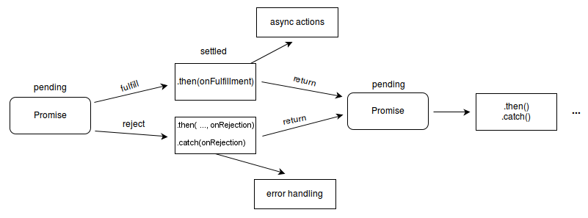

Slide 6
How promises work
Once a promise has been called, it will start in a pending state. This means that the calling function continues executing, while the promise is pending until it resolves, giving the calling function whatever data was being requested.
The created promise will eventually end in a resolved state, or in a rejected state, calling the respective callback functions (passed to then and catch) upon finishing.

Slide 7
Creating a promise
The Promise API exposes a Promise constructor, which you initialize using new Promise()
let done = true
const isItDoneYet = new Promise((resolve, reject) => {
if (done) {
const workDone = 'Here is the thing I built'
resolve(workDone)
} else {
const why = 'Still working on something else'
reject(why)
}
})

Slide 8
Promises
Promise checks the done global constant, and if that's true, the promise goes to a resolved state (since the resolve callback was called); otherwise, the reject callback is executed, putting the promise in a rejected state.
If none of these functions is called in the execution path, the promise will remain in a pending state
Using resolve and reject, we can communicate back to the caller what the resulting promise state was, and what to do with it.
In the previous slide we just returned a string, but it could be an object, or null as well

Slide 9
const fs = require('fs')
const getFile = (fileName) => {
return new Promise((resolve, reject) => {
fs.readFile(fileName, (err, data) => {
if (err) {
reject(err) // calling `reject` will cause the promise to fail with or without the error passed as an argument
return // and we don't want to go any further
}
resolve(data)
})
})
}
getFile('/etc/passwd')
.then(data => console.log(data))
.catch(err => console.error(err))

Slide 10
Chaining promises
A promise can be returned to another promise, creating a chain of promises.
A great example of chaining promises is the Fetch API, which we can use to get a resource and queue a chain of promises to execute when the resource is fetched.
The Fetch API is a promise-based mechanism, and calling fetch() is equivalent to defining our own promise using new Promise().

Slide 11
const status = response => {
if (response.status >= 200 && response.status < 300) {
return Promise.resolve(response)
}
return Promise.reject(new Error(response.statusText))
}
const json = response => response.json()
fetch('/todos.json')
.then(status) // note that the `status` function is actually **called** here, and that it **returns a promise***
.then(json) // likewise, the only difference here is that the `json` function here returns a promise that resolves with `data`
.then(data => { // ... which is why `data` shows up here as the first parameter to the anonymous function
console.log('Request succeeded with JSON response', data)
})
.catch(error => {
console.log('Request failed', error)
})

Slide 12
Handling errors
In the example, we had a catch that was appended to the chain of promises.
When anything in the chain of promises fails and raises an error or rejects the promise, the control goes to the nearest catch() statement down the chain.

Slide 13
Handling errors
new Promise((resolve, reject) => {
throw new Error('Error')
}).catch(err => {
console.error(err)
})
// or
new Promise((resolve, reject) => {
reject('Error')
}).catch(err => {
console.error(err)
})

Slide 14
Promise.all()
If you need to synchronize different promises, Promise.all() helps you define a list of promises, and execute something when they are all resolved.
const f1 = fetch('/something.json')
const f2 = fetch('/something2.json')
Promise.all([f1, f2])
.then(res => {
console.log('Array of results', res)
})
.catch(err => {
console.error(err)
})

