Slide 1
Security in mongodb
Anju munoth

Slide 2
Introduction To MongoDB Security And Authentication
There are 4 ways you can use while secure your database

Slide 3
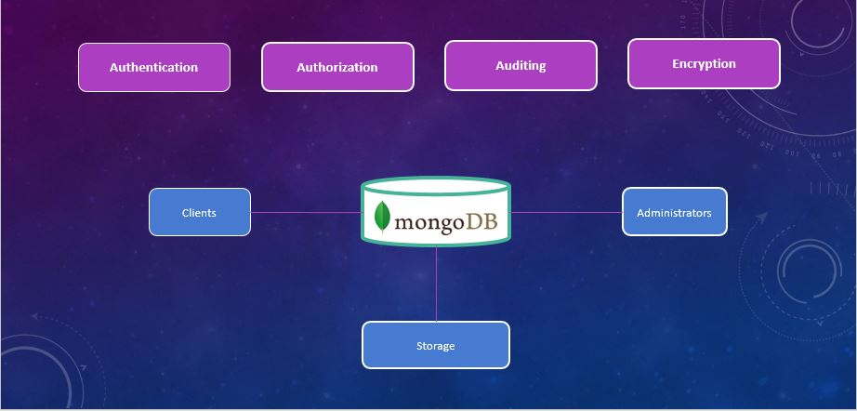

Slide 4
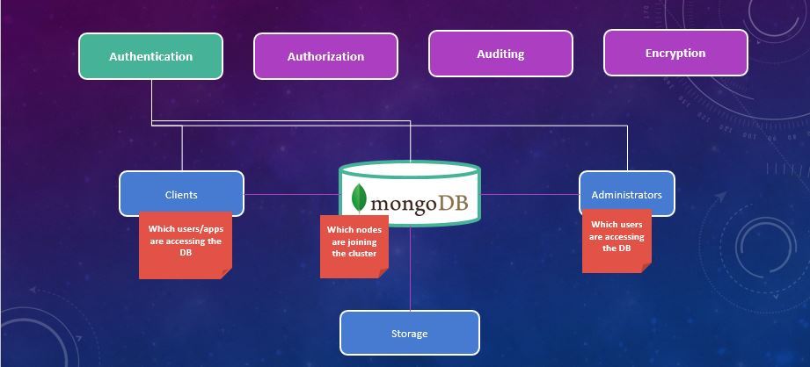
Authentication

Slide 5
Authentication
Enable access control and specify the authentication mechanism.
Can use the default MongoDB authentication mechanism or an existing external framework.
Authentication requires that all clients and servers provide valid credentials before they can connect to the system.
In clustered deployments, enable authentication for each MongoDB server.

Slide 6
Configure Role-Based Access Control
Create a user administrator first, then create additional users.
Create a unique MongoDB user for each person and application that accesses the system.
Create roles that define the exact access a set of users needs.
Follow a principle of least privilege.
Then create users and assign them only the roles they need to perform their operations.
A user can be a person or a client application.

Slide 7
Encrypt Communication
Configure MongoDB to use TLS/SSL for all incoming and outgoing connections.
Use TLS/SSL to encrypt communication between mongod and mongos components of a MongoDB deployment as well as between all applications and MongoDB.

Slide 8
Encrypt and Protect Data
Starting with MongoDB Enterprise 3.2, the WiredTiger storage engine’s native Encryption at Rest can be configured to encrypt data in the storage layer.
If you are not using WiredTiger’s encryption at rest, MongoDB data should be encrypted on each host using file-system, device, or physical encryption.
Protect MongoDB data using file-system permissions.
MongoDB data includes data files, configuration files, auditing logs, and key files.

Slide 9
Limit Network Exposure
Ensure that MongoDB runs in a trusted network environment and limit the interfaces on which MongoDB instances listen for incoming connections.
Allow only trusted clients to access the network interfaces and ports on which MongoDB instances are available.

Slide 10
Audit System Activity
Track access and changes to database configurations and data.
MongoDB Enterprise includes a system auditing facility that can record system events (e.g. user operations, connection events) on a MongoDB instance.
These audit records permit forensic analysis and allow administrators to verify proper controls.

Slide 11
Run MongoDB with a Dedicated User
Run MongoDB processes with a dedicated operating system user account.
Ensure that the account has permissions to access data but no unnecessary permissions.

Slide 12
Run MongoDB with Secure Configuration Options
MongoDB supports the execution of JavaScript code for certain server-side operations: mapReduce and $where.
If you do not use these operations, disable server-side scripting by using the --noscripting option on the command line.
Use only the MongoDB wire protocol on production deployments.
Keep input validation enabled. MongoDB enables input validation by default through the wireObjectCheck setting. This ensures that all documents stored by the mongod instance are valid BSON.

Slide 13
Authentication
Can divide authentication mechanisms into two categories.
Client and user authentication - which deals with how clients of the database authenticate to mongodb.
Internal authentication -how different members of a replica set or sharded cluster authenticate with one another.
Here are all of the different authentication mechanisms currently supported with mongodb

Slide 14
Authentication
Can divide authentication mechanisms into two categories.
Client and user authentication - which deals with how clients of the database authenticate to mongodb.
Internal authentication -how different members of a replica set or sharded cluster authenticate with one another.
Here are all of the different authentication mechanisms currently supported with mongodb

Slide 15
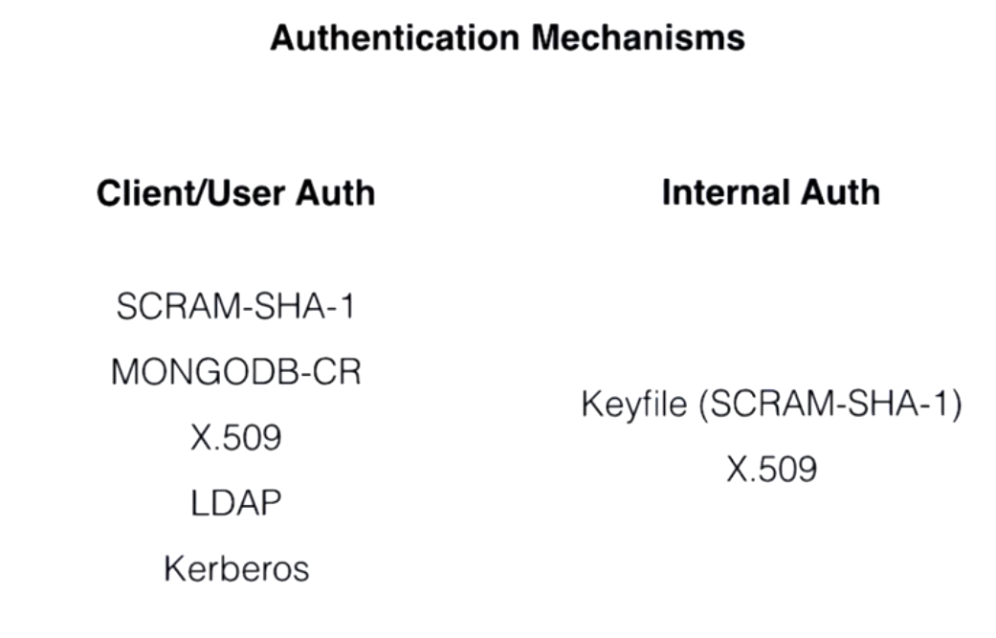

Slide 16
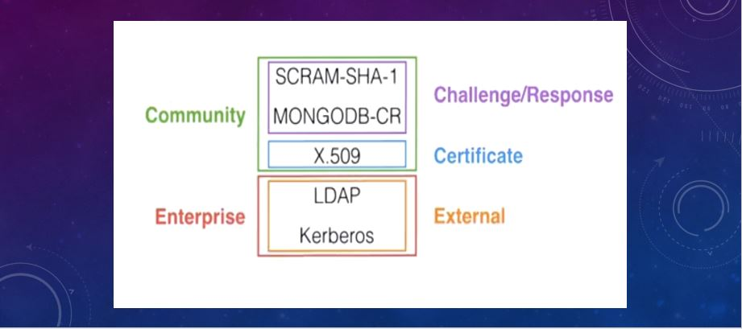

Slide 17
Internal Authentication
In addition to verifying the identity of a client, MongoDB can require members of replica sets and sharded clusters to authenticate their membership to their respective replica set or sharded cluster

Slide 18
Enable Access Control
Enabling access control on a MongoDB deployment enforces authentication, requiring users to identify themselves.
When accessing a MongoDB deployment that has access control enabled, users can only perform actions as determined by their roles.

Slide 19
User Administrator
With access control enabled, ensure you have a user with userAdmin or userAdminAnyDatabase role in the admin database.
This user can administrate user and roles such as: create users, grant or revoke roles from users, and create or modify customs roles.

Slide 20
rbac
MongoDB employs role-based access control (RBAC) to determine access for users.
A user is granted one or more roles that determine the user’s access or privileges to MongoDB resources and the actions that user can perform.
A user should have only the minimal set of privileges required to ensure a system of least privilege.
Each application and user of a MongoDB system should map to a distinct user.
This access isolation facilitates access revocation and ongoing user maintenance.

Slide 21
rbac
If you have enabled access control for your deployment, can use the localhost exception to create the first user in the system.
This first user must have privileges to create other users.
with the localhost exception, you can only create users on the admin database.
Once you create the first user, you must authenticate as that user to add subsequent users.
For routine user creation, you must possess the following permissions:
To create a new user in a database, you must have the createUser action on that database resource.
To grant roles to a user, you must have the grantRole action on the role’s database.
The userAdmin and userAdminAnyDatabase built-in roles provide createUser and grantRole actions on their respective resources.

Slide 22
add a user administrator to a MongoDB
Step 1:Start MongoDB without access control.
Start a standalone mongod instance without access control.
For example, open a terminal and issue the following:
mongod --port 27017

Slide 23
add a user administrator to a MongoDB
Step 2:Connect to the instance.
For example, open a new terminal and connect a mongo shell to the instance:
mongo --port 27017
Specify additional command line options as appropriate to connect the mongo shell to your deployment, such as --host.

Slide 24
add a user administrator to a MongoDB
Step 3: Create the user administrator.
From the mongo shell, add a user with the userAdminAnyDatabase role in the admin database.
Include additional roles as needed for this user.
For example, the following creates the user myUserAdmin in the admin database with the userAdminAnyDatabase role and the readWriteAnyDatabase role.
db.createUser(
{ user: "myUserAdmin",
pwd: passwordPrompt(), // or cleartext password
roles: [ { role: "userAdminAnyDatabase", db: "admin" }, "readWriteAnyDatabase" ] })

Slide 25
add a user administrator to a MongoDB
Starting in version 4.2 of the mongo shell, can use the passwordPrompt() method in conjunction with various user authentication/management methods/commands to prompt for the password instead of specifying the password directly in the method/command call.
However, can still specify the password directly as you would with earlier versions of the mongo shell.
database where you create the user is the user’s authentication database.
Although the user would authenticate to this database, the user can have roles in other databases; i.e. the user’s authentication database does not limit the user’s privileges

Slide 26
add a user administrator to a MongoDB
Step 4:Re-start the MongoDB instance with access control.
Shut down the mongod instance. For example, from the mongo shell, issue the following command: db.adminCommand( { shutdown: 1 } )
Exit the mongo shell.
From the terminal, re-start the mongod instance with the --auth command line option or, if using a configuration file, the security.authorisation setting
mongod --auth
Clients that connect to this instance must now authenticate themselves as a MongoDB user. Clients can only perform actions as determined by their assigned roles.

Slide 27
add a user administrator to a MongoDB
STEP 5: Connect and authenticate as the user administrator.
Using the mongo shell, can:
Connect with authentication by passing in user credentials, or
Connect first without authentication, and then issue the db.auth()method to authenticate.

Slide 28
Authenticate after Connection
EConnect the mongo shell to the mongod:
mongo --port 27017
In the mongo shell, switch to the authentication database (in this case, admin), and use db.auth(<username>, <pwd>) method to authenticate:
use admin
db.auth("myUserAdmin", passwordPrompt()) // or cleartext password
Enter the password when prompted

Slide 29
Authenticate during Connection
Start a mongo shell with the -u <username>, -p, and the --authenticationDatabase <database> command line options:
mongo --port 27017 --authenticationDatabase "admin" -u "myUserAdmin" –p
Enter your password when prompted.

Slide 30
add a user administrator to a MongoDB
Step 5:Create additional users as needed for your deployment.
Once authenticated as the user administrator,
Use db.createUser() to create additional users.
Can assign any built-in roles or user-defined roles to the users.
database where you create the user is that user’s authentication database.
Although the user would authenticate to this database, the user can have roles in other databases; i.e. the user’s authentication database does not limit the user’s privileges.

Slide 31
add a user to MongoDB
use test
db.createUser(
{
user: "myTester",
pwd: passwordPrompt(), // or cleartext password
roles: [ { role: "readWrite", db: "test" },
{ role: "read", db: "reporting" } ]
})

Slide 32
Localhost Exception
can create users either before or after enabling access control.
If you enable access control before creating any user, MongoDB provides a localhost exception which allows you to create a user administrator in the admin database.
Once created, you must authenticate as the user administrator to create additional users as needed.

Slide 33
Authentication
Authentication is the process of verifying the identity of a client.
When access control, i.e. authorization, is enabled, MongoDB requires all clients to authenticate themselves in order to determine their access.
Although authentication and authorization are closely connected, authentication is distinct from authorization.
Authentication verifies the identity of a user; authorization determines the verified user’s access to resources and operations.

Slide 34
Authentication Methods
To authenticate as a user, you must provide a username, password, and the authentication database associated with that user.
To authenticate using the mongo shell, either:
Use the mongo command-line authentication options (--username, --password, and --authenticationDatabase) when connecting to the mongod or mongos instance, or
Connect first to the mongod or mongos instance, and then run the authenticate command or the db.auth() method against the authentication database.

Slide 35
Authentication Mechanisms
MongoDB supports a number of authentication mechanisms that clients can use to verify their identity.
These mechanisms allow MongoDB to integrate into your existing authentication system.
MongoDB supports multiple authentication mechanisms:
SCRAM (Default)
x.509 Certificate Authentication.
In addition to supporting the aforementioned mechanisms, MongoDB Enterprise also supports the following mechanisms:
LDAP proxy authentication, and
Kerberos authentication

Slide 36
User Management Interface
To add a user, mongodb provides the db.createUser() method.
When adding a user, can assign roles to the user in order to grant privileges.
The first user created in the database should be a user administrator who has the privileges to manage other users.
Can also update existing users, such as to change password and grant or revoke roles

Slide 37
Authentication Database
When adding a user, create the user in a specific database. This database is the authentication database for the user.
A user can have privileges across different databases; that is, a user’s privileges are not limited to their authentication database.
By assigning to the user roles in other databases, a user created in one database can have permissions to act on other databases.
The user’s name and authentication database serve as a unique identifier for that user. That is, if two users have the same name but are created in different databases, they are two separate users.
If you intend to have a single user with permissions on multiple databases, create a single user with roles in the applicable databases instead of creating the user multiple times in different databases.

Slide 38
Authenticate a User
To authenticate as a user, must provide a username, password, and the authentication database associated with that user.
To authenticate using the mongo shell, either:
Use the mongo command-line authentication options (--username, --password, and --authenticationdatabase) when connecting to the mongod or mongos instance, or
Connect first to the mongod or mongos instance, and then run the authenticate command or the db.auth() method against the authentication database.

Slide 39
Authentication
use reporting
db.createUser(
{
user: "reportsUser",
pwd: passwordPrompt(), // or cleartext password
roles: [
{ role: "read", db: "reporting" },
{ role: "read", db: "products" },
{ role: "read", db: "sales" },
{ role: "readWrite", db: "accounts" }
] })

Slide 40
role-based access control
Role based access control as the name implies is a model where for any given user we’re going to go ahead and assign a role to that user.
And that role is going to be assigned over a given namespace.
Gives us a high level of responsibility isolation for operational tasks

Slide 41
Privileges
A privilege consists of a specified resource and the actions permitted on the resource.
A resource is a database, collection, set of collections, or the cluster.
If the resource is the cluster, the affiliated actions affect the state of the system rather than a specific database or collection.
An action specifies the operation allowed on the resource.

Slide 42
Inherited Privileges
A role can include one or more existing roles in its definition, in which case the role inherits all the privileges of the included roles.
A role can inherit privileges from other roles in its database.
A role created on the admin database can inherit privileges from roles in any database.

Slide 43
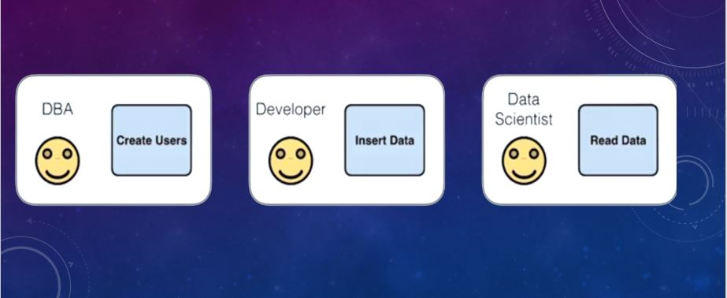

Slide 44
Build in Role
MongoDB grants access to data and commands through role-based authorization and provides built-in roles that provide the different levels of access commonly needed in a database system.
A role grants privileges to perform sets of actions on defined resources.
A given role applies to the database on which it is defined and can grant access down to a collection level of granularity.
Each of MongoDB’s built-in roles defines access at the database level for all non-system collections in the role’s database and at the collection level for all system collections.
MongoDB provides the built-in database user and database administration roles on every database.
MongoDB provides all other built-in roles only on the admin database.

Slide 45
Centralized User Data
MongoDB stores all user information, including name, password, and the user's authentication database, in the system.users collection in the admin database.
Do not access this collection directly but instead use the user management commands.

Slide 46
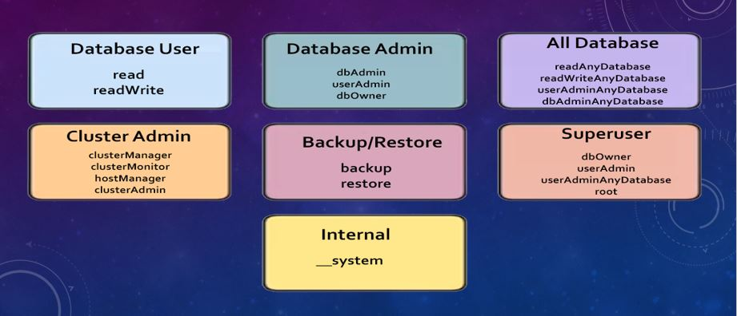

Slide 47
Database User Roles
Every database includes the following client roles:
Read
readWrite

Slide 48
read
Provides the ability to read data on all non-system collections and on the following system collections: system.indexes, system.js, and system.namespaces collections.
The role provides read access by granting the following actions:
changeStream
collStats
dbHash
dbStats
find
killCursors
listIndexes
listCollections

Slide 49
readwrite
Provides all the privileges of the read role plus ability to modify data on all non-system collections and the system.js collection.
The role provides the following actions on those collections:
collStats convertToCapped createCollection dbHash dbStats dropCollection createIndex dropIndex | find insert killCursors listIndexes listCollections remove renameCollectionSameDB update

Slide 50
Database Administration Roles
Every database includes the following database administration roles:
dbAdmin
dbOwner
userAdmin

Slide 51
dbAdmin
Provides the ability to perform administrative tasks such as schema-related tasks, indexing, and gathering statistics. This role does not grant privileges for user and role management.
Provides the following actions on the database’s system.indexes, system.namespaces, and system.profile collections:
collStats dbHash dbStats find killCursors listIndexes listCollections dropCollection and createCollection on system.profile only

Slide 52
dbAdmin
Provides the following actions on all non-system collections. This role does not include full read access on non-system collections:
bypassDocumentValidation collMod collStats compact convertToCapped createCollection createIndex dbStats dropCollection | dropDatabase dropIndex enableProfiler reIndex renameCollectionSameDB storageDetails validate

Slide 53
userAdmin
Provides the ability to create and modify roles and users on the current database.
Since the userAdmin role allows users to grant any privilege to any user, including themselves, the role also indirectly provides superuser access to either the database or, if scoped to the admin database, the cluster. userAdmin role explicitly provides the following actions
changeCustomData changePassword createRole createUser dropRole dropUser grantRole revokeRole setAuthenticationRestriction viewRole viewUser

Slide 54
dbOwner
The database owner can perform any administrative action on the database.
This role combines the privileges granted by the readWrite, dbAdmin and userAdmin roles.

Slide 55
Backup and Restoration Roles
The admin database includes the following roles for backing up and restoring data:
backup

Slide 56
backup
Provides minimal privileges needed for backing up data.
This role provides sufficient privileges to use the MongoDB Cloud Manager backup agent, Ops Manager backup agent, or to use mongodump to back up an entire mongod instance.
Provides the insert and update actions on the mms.backup collection in the admin database and on the settings collection in the config database.

Slide 57
backup
anyResource | cluster | find
listDatabases action listCollections action listIndexes action | appendOplogNote getParameter listDatabases serverStatus (Starting in MongoDB 4.2) | all non-system collections in the cluster, including those in the config and local databases The following system collections in the cluster: system.indexes, system.namespaces, system.js, and system.profile the admin.system.users and admin.system.roles collections the config.settings collection legacy system.users collections from versions of MongoDB prior to 2.6 | insert and update actions on config.settings collection

Slide 58
All-Database Roles
The following roles are available on the admin database and provide privileges which apply to all databases except local and config:
readAnyDatabase
readWriteAnyDatabase
userAdminAnyDatabase
dbAdminAnyDatabase

Slide 59
readAnyDatabase
Provides the same read-only privileges as read on all databases except local and config.
The role also provides the listDatabases action on the cluster as a whole.
Changed in version 3.4: Prior to 3.4, readAnyDatabase includes local and config databases. To provide read privileges on the local database, create a user in the admin database with read role in the local database.

Slide 60
readWriteAnyDatabase
Provides the same privileges as readWrite on all databases except local and config. The role also provides the listDatabases action on the cluster as a whole.
Changed in version 3.4: Prior to 3.4, readWriteAnyDatabase includes local and config databases. To provide readWrite privileges on the local database, create a user in the admin database with readWrite role in the local database.

Slide 61
userAdminAnyDatabase
Provides the same access to user administration operations as userAdmin on all databases except local and config.
userAdminAnyDatabase role does not restrict the privileges that a user can grant.
As a result, userAdminAnyDatabase users can grant themselves privileges in excess of their current privileges and even can grant themselves all privileges, even though the role does not explicitly authorize privileges beyond user administration.
This role is effectively a MongoDB system superuser.

Slide 62
userAdminAnyDatabase
cluster | system.users and system.roles collections on the admin database | admin.system.users and admin.system.roles collections:
authSchemaUpgrade invalidateUserCache listDatabases | collStats dbHash dbStats find killCursors planCacheRead | createIndex dropIndex

Slide 63
dbAdminAnyDatabase
Provides the same privileges as dbAdmin on all databases except local and config. The role also provides the listDatabases action on the cluster as a whole.
Changed in version 3.4: Prior to 3.4, dbAdminAnyDatabase includes local and config databases.
To provide dbAdmin privileges on the local database, create a user in the admin database with dbAdmin role in the local database.

Slide 64
Superuser Roles
Several roles provide either indirect or direct system-wide superuser access.
The following roles provide the ability to assign any user any privilege on any database, which means that users with one of these roles can assign themselves any privilege on any database:
dbOwner role, when scoped to the admin database
userAdmin role, when scoped to the admin database
userAdminAnyDatabase roleE

Slide 65
db.auth()
Used to authenticates a user to a database.
db.auth() method can accept either:
the username and password.
db.auth( <username>, <password> )
a user document that contains the username and password, and optionally, the authentication mechanism and a digest password flag.
db.auth( {
user: <username>,
pwd: <password>,
mechanism: <authentication mechanism>,
digestPassword: <boolean>
} )

Slide 66
db.auth()
Name | Description | Required / Optional | Type
username | Specifies an existing username with access privileges for this database. | Required | string
password | Specifies the corresponding password. | Required | string
mechanism | Specifies the authentication mechanism used. Defaults to either: SCRAM-SHA-1 on new 3.0 installations and on 3.0 databases that have been upgraded from 2.6 with authSchemaUpgrade; or MONGODB-CR otherwise. | Optional | string
digestPassword | Determines whether the server receives digested or undigested password. Set to false to specify undigested password. For use with SASL/LDAP authentication since the server must forward an undigested password to saslauthd. | Optional | boolean

Slide 67
db.auth()
Assume that A user document for a database that contains the username "mynewuser" and password "myuser123". The following example will authenticate the user for the database.
db.auth( "mynewuser", "myuser123" );
Output:
> db.auth( "mynewuser", "myuser123" );
1

Slide 68
db.updateUser()
Used to update the user’s profile on the database on which you run the method.
An update to a field completely replaces the previous field’s values. This includes updates to the user’s roles array.
Syntax:
db.updateUser(
"<username>",
{ customData : { <any information> },
roles : [ { role: "<role>", db: "<database>" } | "<role>", ... ],
pwd: "<cleartext password>"
},
writeConcern: { <write concern> }
)

Slide 69
db.updateUser()
Name | Description | Required / Optional | Type
username | The name of the user to update. | Required | string
update | A document containing the replacement data for the user. This data completely replaces the corresponding data for the user. | Required | document
writeConcern | The level of write concern for the update operation. The writeConcern document takes the same fields as the getLastError command. | Optional | document

Slide 70
db.updateUser()
Name | Description | Required / Optional | Type
customData | Any arbitrary information. | Optional | document
roles | The roles granted to the user. An update to the roles array overrides the previous array’s values. | Optional | array
pwd | The user’s password. | Optional | string
In the roles field, can specify both built-in roles and user-defined role.
To specify a role that exists in the same database where db.updateUser() runs, you can either specify the role with the name of the role: "readWrite"
Or you can specify the role with a document, as in:
{ role: "<role>", db: "<database>" }
To specify a role that exists in a different database, specify the role with a document.

Slide 71
Required Access
You must have access that includes the revokeRole action on all databases in order to update a user’s roles array.
You must have the grantRole action on a role’s database to add a role to a user.
To change another user’s pwd or customData field, you must have the changeAnyPassword and changeAnyCustomData actions respectively on that user’s database.
To modify your own password and custom data, you must have privileges that grant changeOwnPassword and changeOwnCustomData actions respectively on the user’s database.

Slide 72
Example: MongoDB: db.updateUser() method
> db.getUser("mynewuser");
{
"_id" : "test.mynewuser",
"user" : "mynewuser",
"db" : "test",
"roles" : [
{
"role" : "readWrite",
"db" : "test"
},
{
"role" : "dbAdmin",
"db" : "test"
}
]
}
db.updateUser( "mynewuser",
{
customData : { employeeId : "0x3039" },
roles : [
{ role : "read", db : "assets" }
]
}
);
> db.getUser("mynewuser");
{
"_id" : "test.mynewuser",
"user" : "mynewuser",
"db" : "test",
"roles" : [ {
"role" : "read",
"db" : "assets"
} ],
"customData" : {
"employeeId" : "0x3039"
}}

Slide 73
db.getUser()
The db.getUser() method is used to return user information about the specified user from a database. The user must exist on the database on which the method runs.
Syntax:
db.getUser(username)
username | The name of the user for which to retrieve information. | Required | string

Slide 74
db.getUsers()
The db.getUsers() method is used to return information for all users associated with a database.
Syntax:
db.getUsers()

Slide 75
db.dropAllUsers()
Used to remove all users associated with a database.
Syntax:
db.dropAllUsers(writeConcern)
Removes all users from the current database with the write concern mentioned
The dropAllUsers method removes all users from the database.
writeConcern- The level of write concern for the removal operation. The writeConcern document takes the same fields as the getLastError command. Required document
use test
db.dropAllUsers( {w: "majority", wtimeout: 5000} );

Slide 76
db.dropUser()
Used to removes the user form the current database.
Syntax:
db.dropUser(username, writeConcern)
username The name of the user to remove from the database. Required string
writeConcern The level of write concern for the removal operation. The writeConcern document takes the same fields as the getLastError command. Optional document
Before dropping a user who has the userAdminAnyDatabase role, ensure you have at least another user with user administration privileges
use test
db.dropUser("mynewuser", {w: "majority", wtimeout: 4000})

Slide 77
db.changeUserPassword()
Used to changes an existing user’s password.
Syntax:
db.changeUserPassword(username, password)
Updates a user’s password. Run the method in the database where the user is defined, i.e. the database you created the user.
The following operation changes the password of the user named mynewuser in the test database to user1234.
db.changeUserPassword("mynewuser", "user1234");

Slide 78
db.grantRolesToUser()
Used to grants an additional role and its privileges to a user.
Syntax:
db.grantRolesToUser( "<username>", [ <roles> ], { <writeConcern> } )
user The name of the user to whom to grant roles. Required string
roles An array of additional roles to grant to the user. Required array
writeConcern The level of write concern for the modification. The writeConcern document takes the same fields as the getLastError command. Optional document

Slide 79
db.grantRolesToUser()
In the roles field, Can specify both built-in roles and user-defined role.
To specify a role that exists in the same database where db.grantRolesToUser() runs, you can either specify the role with the name of the role:
"readWrite"
Or you can specify the role with a document, as in:
{ role: "<role>", db: "<database>" }
To specify a role that exists in a different database, specify the role with a document.

Slide 80
db.grantRolesToUser()
The following grantRolesToUser() operation gives mynewuser the read role on the orders database.
use test
db.grantRolesToUser(
"mynewuser",
[ "readWrite" , { role: "read", db: "orders" } ],
{ w: "majority" , wtimeout: 4000 }
);

Slide 81
db.revokeRolesFromUser()
Used to remove a one or more roles from a user on the current database.
Syntax:
db.revokeRolesFromUser( "<username>", [ <roles> ], { <writeConcern> } )
user The name of the user from whom to revoke roles. Required string
roles The roles to remove from the user. Required array
writeConcern The level of write concern for the modification. The writeConcern document takes the same fields as the getLastError command. Optional document
use test
db.revokeRolesFromUser( "mynewuser",
[ { role: "read", db: "orders" }, "readWrite" ], { w: "majority" } );

Slide 82
db.getRole()
Used to returns information for the specified role.
Returns the roles from which this role inherits privileges.
Syntax:
db.getRole(rolename, showPrivileges)
showPrivileges If true, returns the role’s privileges. Pass this argument as a document: {showPrivileges: true}. Optional document
rolename The name of the role. Required String
use admin
db.getRole( "myroll1" );
db.getRole( "myroll1", { showPrivileges: true } );

Slide 83
db.getRoles()
Used to return information for all the user-defined roles in a database on which the command runs.
db.getRoles()
If run without an argument, db.getRoles() returns inheritance information for the database’s user-defined roles.
rolesInfo Set this field to 1 to retrieve all user-defined roles. Required integer
showPrivileges Set the field to true to show role privileges, including both privileges inherited from other roles and privileges defined directly. By default, the command returns only the roles from which this role inherits privileges and does not return specific privileges. Optional boolean
showBuiltinRoles Set to true to display built-in roles as well as user-defined roles. Optional boolean

Slide 84
db.getRoles()
use payroll
db.getRoles(
{
rolesInfo: 1,
showPrivileges:true,
showBuiltinRoles: true
}
)

Slide 85
db.dropRole()
Used to delete a user-defined role from the database on which you run the method.
db.dropRole(rolename, writeConcern)
rolename The name of the user-defined role to remove from the database. Required string
writeConcern The level of write concern for the removal operation. The writeConcern document takes the same fields as the getLastError command. Optional document
Example:
use payroll
db.dropRole( "myroll1", { w: "majority" } )

Slide 86
db.dropAllRoles()
The db.dropAllRoles() method is used to delete all user-defined roles associated with a database.
db.dropAllRoles(writeConcern)
writeConcern The level of write concern for the removal operation. The writeConcern document takes the same fields as the getLastError command. Optional document
Example
use test
db.dropAllRoles( { w: "majority" } );

Slide 87
Authentication
Must have the revokeRole action on a database to revoke a role on that database.
Must have the grantRole action on a database to grant a role on that database.

Slide 88
User Defined Role
Sometimes we have specific requirements that do not exactly fit a particular user.
When we create a role, we create it on a specific database, so the role name and the database that it was created on define a unique role.
After giving the role a name, you specify what over roles you’d like to inherit privileges from.
It’s important to note that for any given role created on a specific database, we can only include resources and inherent roles defined on that same database. For example, if we define a role in the products database, we can’t inherit that role on the orders database.

Slide 89
Create a User-Defined Role
Roles grant users access to MongoDB resources. MongoDB provides a number of built-in roles that administrators can use to control access to a MongoDB system.
However, if these roles cannot describe the desired set of privileges, can create new roles in a particular database.
Except for roles created in the admin database, a role can only include privileges that apply to its database and can only inherit from other roles in its database.
A role created in the admin database can include privileges that apply to the admin database, other databases or to the cluster resource, and can inherit from roles in other databases as well as the admin database.

Slide 90
Create a User-Defined Role
To create a new role, use the db.createRole() method, specifying the privileges in the privileges array and the inherited roles in the roles array.
MongoDB uses the combination of the database name and the role name to uniquely define a role.
Each role is scoped to the database in which you create the role, but MongoDB stores all role information in the admin.system.roles collection in the admin database.

Slide 91
Prerequisites
To create a role in a database, you must have:
the createRole action on that database resource.
the grantRole action on that database to specify privileges for the new role as well as to specify roles to inherit from.
Built-in roles userAdmin and userAdminAnyDatabase provide createRole and grantRole actions on their respective resources.
To create a role with authenticationRestrictions specified, you must have the setAuthenticationRestriction action on the database resource which the role is created

Slide 92
Create role example
use admin
db.createRole(
{
role: "myroll1",
privileges: [
{ resource: { cluster: true }, actions: [ "addShard" ] },
{ resource: { db: "config", collection: "" }, actions: [ "find", "update", "insert", "remove" ] },
{ resource: { db: "users", collection: "usersCollection" }, actions: [ "update", "insert", "remove" ] },
{ resource: { db: "", collection: "" }, actions: [ "find" ] }
],
roles: [
{ role: "read", db: "admin" }
]
},
{ w: "majority" , wtimeout: 5000 }
);

Slide 93
Create a Role to Manage Current Operations
The following example creates a role named manageOpRole which provides only the privileges to run both db.currentOp() and db.killOp()
Connect to mongod or mongos with the privileges specified in the Prerequisites section.
The following procedure uses the myUserAdmin created in Enable Access Control.
mongo --port 27017 -u myUserAdmin -p 'abc123' --authenticationDatabase 'admin'
The myUserAdmin has privileges to create roles in the admin as well as other databases.

Slide 94
Create a new role to manage current operations.
manageOpRole has privileges that act on multiple databases as well as the cluster resource. As such, you must create the role in the admin database.
use admin
db.createRole(
{ role: "manageOpRole",
privileges: [
{ resource: { cluster: true }, actions: [ "killop", "inprog" ] },
{ resource: { db: "", collection: "" }, actions: [ "killCursors" ] }
],
roles: [] } )

Slide 95
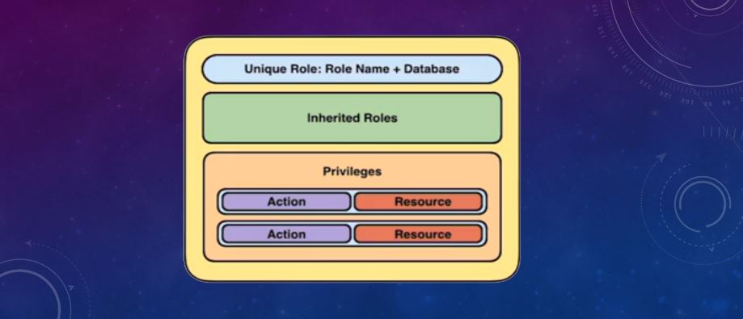

Slide 96
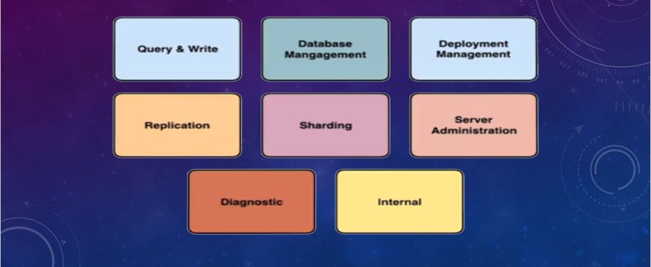
Actions
You can think of actions as verbs while resources are the subjects of these verbs.Within MongoDB, we have several different types of actions

Slide 97
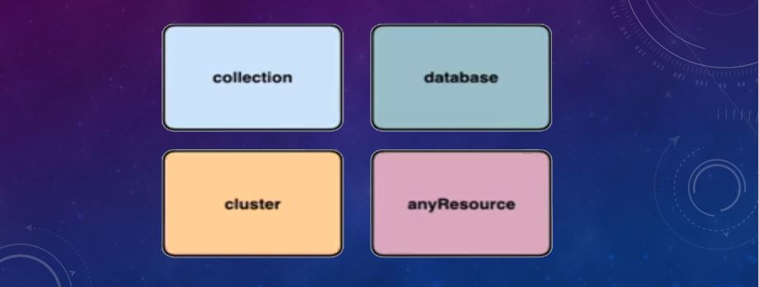
Resources
They are the subjects of our actions. Resources will eventually have their state or behaviour change in some form by an action. Mongo DB has four resources; collections, databases, clusters, and the special any resource. All of these resources will be defined by a resource document

Slide 98
To create a user in a MongoDB deployment, connect to the deployment, and then use the db.createUser() method to add the user.
Username/Password Authentication
The following operation creates a user in the reporting database with the specified name, password, and roles.
use reporting
db.createUser(
{
user: "reportsUser",
pwd: "12345678",
roles: [
{ role: "read", db: "reporting" },
{ role: "read", db: "products" },
{ role: "read", db: "sales" },
{ role: "readWrite", db: "accounts" }
]
}
)

Slide 99
db.createUser()
Bb.Createuser(user, writeconcern)
Creates a new user for the database on which the method is run. Db.Createuser() returns a duplicate user error if the user already exists on the database.
The db.Createuser() method has the following syntax:
User- document- the document with authentication and access information about the user to create.
Writeconcern- document- optional. The level of write concern for the creation operation. The writeconcern document takes the same fields as the getlasterror command.

Slide 100
The user document defines the user and has the following form:
{
user: "<name>",
pwd: "<cleartext password>",
customData: { <any information> },
roles: [
{ role: "<role>", db: "<database>" } | "<role>",
...
],
authenticationRestrictions: [
{
clientSource: ["<IP>" | "<CIDR range>", ...]
serverAddress: ["<IP>" | "<CIDR range>", ...]
},
...
]
}

Slide 101
user document has the following fields
Field | Type | Description
user | string | The name of the new user.
pwd | string | The user’s password. The pwd field is not required if you run db.createUser() on the $external database to create users who have credentials stored externally to MongoDB.
customData | document | Optional. Any arbitrary information. This field can be used to store any data an admin wishes to associate with this particular user. For example, this could be the user’s full name or employee id.
roles | array | The roles granted to the user. Can specify an empty array []to create users without roles.
authenticationRestrictions | array | Optional. The authentication restrictions the server enforces on the created user. Specifies a list of IP addresses and CIDRranges from which the user is allowed to connect to the server or from which the server can accept user

Slide 102
Roles
In the roles field, can specify both built-in roles and user-defined roles.
To specify a role that exists in the same database where db.createUser() runs, you can either specify the role with the name of the role:
"readWrite"
Or you can specify the role with a document, as in:
{ role: "<role>", db: "<database>" }
To specify a role that exists in a different database, specify the role with a document.

Slide 103
use products
db.createUser( { user: "accountAdmin01",
pwd: "changeMe",
customData: { employeeId: 12345 },
roles: [ { role: "clusterAdmin", db: "admin" },
{ role: "readAnyDatabase", db: "admin" },
"readWrite"] },
{ w: "majority" , wtimeout: 5000 } )
The operation gives accountAdmin01 the following roles:
the clusterAdmin and readAnyDatabase roles on the admin database
the readWrite role on the products database

Slide 104
The following operation creates accountUser in the products database and gives the user the readWrite and dbAdmin roles.
use products
db.createUser(
{
user: "accountUser",
pwd: "password",
roles: [ "readWrite", "dbAdmin" ]
}
)

Slide 105
Create User without Roles
The following operation creates a user named reportsUser in the admin database but does not yet assign roles:
use admin
db.createUser(
{
user: "reportsUser",
pwd: "password",
roles: [ ]
}
)

Slide 106
Create Administrative User with Roles
The following operation creates a user named appAdmin in the admin database and gives the user readWrite access to the config database, which lets the user change certain settings for sharded clusters, such as to the balancer setting.
use admin
db.createUser(
{
user: "appAdmin",
pwd: "password",
roles:
[
{ role: "readWrite", db: "config" },
"clusterAdmin"
]
}
)

Slide 107
Create User with Authentication Restrictions
The following operation creates a user named restricted in the admin database. This user may only authenticate if connecting from IP address 192.0.2.0 to IP address 198.51.100.0.
use admin
db.createUser(
{
user: "restricted",
pwd: "password",
roles: [ ],
authenticationRestrictions: [ {
clientSource: ["192.0.2.0"],
serverAddress: ["198.51.100.0"]
} ]
}
)

Slide 108
db.auth()
Allows a user to authenticate to the database from within the shell.
The db.auth() method can accept either:
the username and password.
db.auth( <username>, <password> )
a user document that contains the username and password, and optionally, the authentication mechanism and a digest password flag.
db.auth( {
user: <username>,
pwd: <password>,
mechanism: <authentication mechanism>,
digestPassword: <boolean>
} )

Slide 109
Parameters
Parameter | Type | Description
username | string | Specifies an existing username with access privileges for this database.
password | string | Specifies the corresponding password.
mechanism | string | Optional. Specifies the authentication mechanism used. Defaults to either: SCRAM-SHA-1 on new 3.0+ installations MONGODB-CR otherwise.
digestPassword | boolean | Optional. Determines whether the server receives digested or undigested password. Set to false to specify undigested password. For use withSASL/LDAP authentication since the server must forward an undigested password to saslauthd

Slide 110
Examples
Creating the users
Open your `mongo` shell and switch to the `admin` database
use admin
Create the “admin” user
db.createUser({ user: "admin", pwd: "adminpassword", roles: [{ role: "userAdminAnyDatabase", db: "admin" }] })

Slide 111
Examples
can check that the user has been correctly create with this command:
db.auth("admin", "adminpassword")
The command will log you in as admin. Now exit the shell.
need to start mongod with the --auth option after setting up the user.

Slide 112
$ mongod --auth
Terminal 2:
Use admin
db.createUser({user:"admin_name", pwd:"1234",roles:["readWrite","dbAdmin"]})
if you want to add without roles (optional):
db.createUser({user:"admin_name", pwd:"1234", roles:[]})
to check if authenticated or not:
db.auth("admin_name", "1234")
it should give you:
1
else :
Error: Authentication failed.
0

Slide 113
1) Start MongoDB without access control.
mongod --dbpath /data/db
2) Connect to the instance.
mongo
3) Create the user administrator. The following creates a user administrator in the admin authentication database. The user is a dbOwner over the some_db database and NOT over the admin database, this is important to remember.
use admin
db.createUser(
{
user: "myDbOwner",
pwd: "abc123",
roles: [ { role: "dbOwner", db: "some_db" } ]
}
)

Slide 114
Or if you want to create an admin which is admin over any database:
use admin
db.createUser(
{
user: "myUserAdmin",
pwd: "abc123",
roles: [ { role: "userAdminAnyDatabase", db: "admin" } ]
}
)
4) Stop the MongoDB instance and start it again with access control.
mongod --auth --dbpath /data/db
5) Connect and authenticate as the user administrator towards the admin authentication database, NOT towards the some_db authentication database. The user administrator was created in the admin authentication database, the user does not exist in the some_db authentication database.
use admin
db.auth("myDbOwner", "abc123")
You are now authenticated as a dbOwner over the some_db database. So now if you wish to read/write/do stuff directly towards the some_db database you can change to it.

Slide 115
6) Create a normal user. This user will be created in the some_db authentication database down below.
use some_db
db.createUser(
{
user: "myNormalUser",
pwd: "xyz123",
roles: [ { role: "readWrite", db: "some_db" },
{ role: "read", db: "some_other_db" } ]
}
)
7) Exit the mongo shell, re-connect, authenticate as the user.
use some_db
db.auth("myNormalUser", "xyz123")
db.foo.insert({x:1})
use some_other_db
db.foo.find({})

Slide 116
Can authenticate yourself from the command line using
mongo --port 27017 -u "myUserAdmin" -p "abc123" --authenticationDatabase "admin"

Slide 117
Kerberos Authentication
Users that will authenticate to MongoDB using an external authentication mechanism, such as Kerberos, must be created in the $external database, which allows mongos or mongod to consult an external source for authentication.
Changed in version 3.6.3: To use sessions with $external authentication users (i.e. Kerberos, LDAP, x.509 users), the usernames cannot be greater than 10k bytes.
For Kerberos authentication, you must add the Kerberos principal as the username. You do not need to specify a password.

Slide 118
Kerberos Authentication
use $external
db.createUser(
{
user: "reportingapp@EXAMPLE.NET",
roles: [
{ role: "read", db: "records" }
]
}
)

Slide 119
LDAP Authentication
Users that will authenticate to MongoDB using an external authentication mechanism, such as LDAP, must be created in the $external database, which allows mongos or mongod to consult an external source for authentication.
Changed in version 3.6.3: To use sessions with $external authentication users (i.e. Kerberos, LDAP, x.509 users), the usernames cannot be greater than 10k bytes.
For LDAP authentication, you must specify a username. You do not need to specify the password, as that is handled by the LDAP service.

Slide 120
LDAP Authentication
Adds the reporting user with read-only access to the records database.
use $external
db.createUser( {
user: "reporting",
roles: [ { role: "read", db: "records" } ]
})

Slide 121
Auditing
Auditing is an enterprise feature of MongoDB, and for certain organizations and administrators, auditing is a very important part of security infrastructure.
Auditing can be used for a myriad of things, but from a security perspective, it is most often used for the following three things.
First, it’s often used for accountability of users of our database
. Auditing is also commonly used to investigate suspicious activity.
And finally, it is used to monitor and gather data about specific database activities.

Slide 122
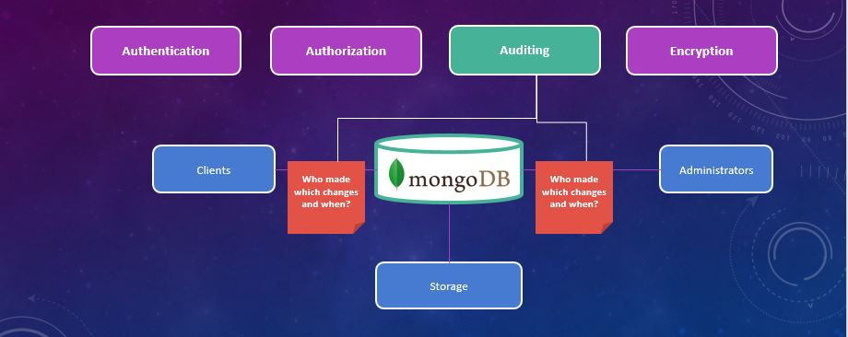

Slide 123
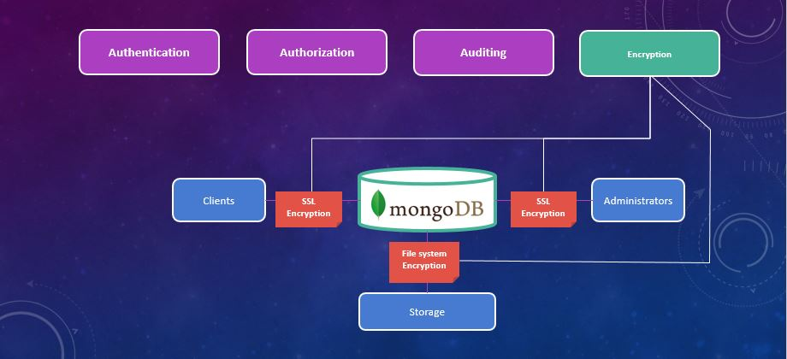

Slide 124
Encryption
Encryption plays an important part in any security infrastructure.
Encryption type
1. Transport Encryption - refers to encrypting information over network traffic between the client and the server
2. Encryption at rest - encrypting the data that we store on disk

Slide 125
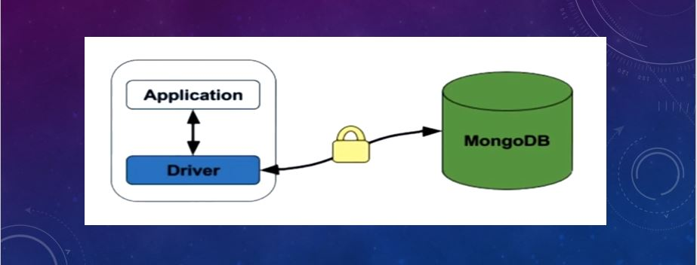
Transport Encryption
Transport encryption, as the name implies, refers to encrypting information over network traffic between the client and the server.

Slide 126
Encryption at Rest
Storage engine encryption with MongoDB is a four-step process.
First, a master key is generated. This key will be used to encrypt each individual database key.
The second step, is to generate a key for each database. After a key has been generated for a particular database, that key can be used to encrypt that actual database.
Application level Encryption is not an actual feature of MongoDB. To encrypt a document or field within our data,
Can write a custom encryption and decryption routine for our application. Or, of course, we can use a commercial solution for encryption within our application.

Slide 127
