Slide 1
TEAM ARCH
Moulishwaran Balaji
Indreswar Balaji
Adrian Chen
Siddhant Murugkar
Jamari Bullock

Slide 2
Aim and objective
Is the EMGSD Good?
Is it better at detecting stereotypes?
Can it be used in all the applications and products?
Notes:
Is emgsd good? Is it better in detecting stereotypes. Yes it is better version than the original mgsd but is it better. Can it be used in the applications and all the products?

Slide 3
PROBLEM
STEREOTYPE CLASSIFICATION
LLM CHATBOT PROBLEM
Classifying a stereotype is very important as it hurts the sentiment of others and in large datasets or unmanaged dataset it is important to be removed for.
LLM-based chat models risk amplifying stereotypes due to biased training data, lack nuanced context understanding, struggle with subtle stereotypes, and face challenges ensuring fairness, transparency, and robust ethical alignment.
EMGSD DATASET
There are many categories where there is an imbalance in the dataset causing a case of underfitting and overfitting

Slide 4
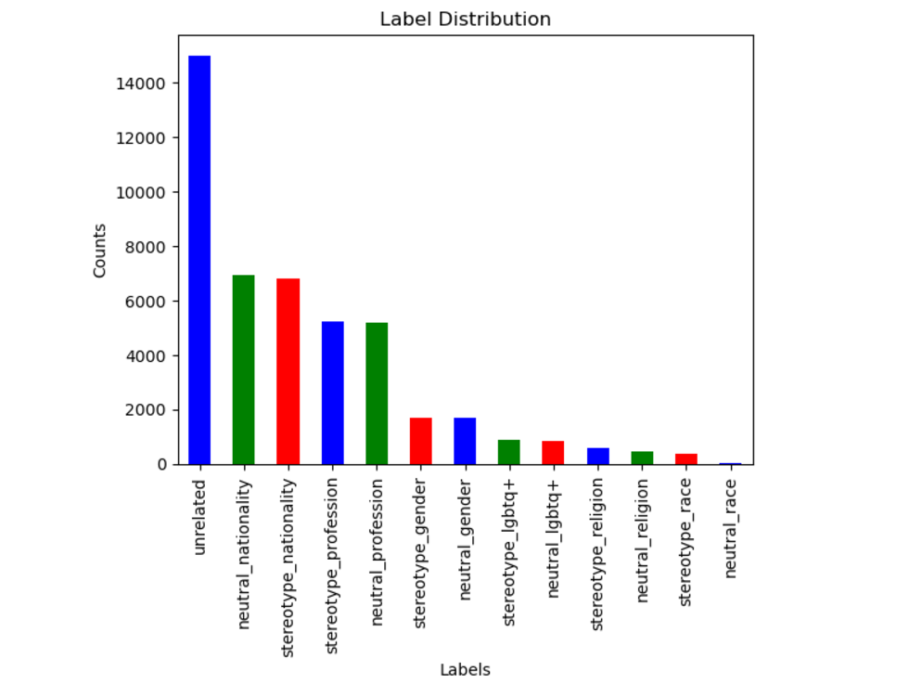
Problems with the emgsd dataset
The distribution of categories (stereotype, neutral, unrelated) needs to be checked for imbalance, as imbalanced classes can negatively affect model performance.
CATEGORIES DATA IMBALANCE
The distribution of categories (stereotype, neutral, unrelated) needs to be checked for imbalance, as imbalanced classes can negatively affect model performance.

Slide 5
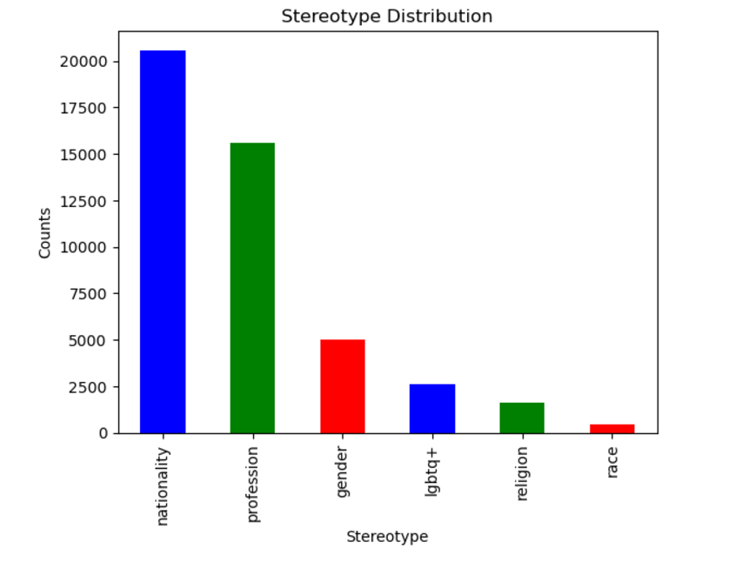
Problems with the emgsd dataset
The distribution of categories (stereotype, neutral, unrelated) needs to be checked for imbalance, as imbalanced classes can negatively affect model performance.
OVERFITTING DUE TO IMBALANCE DATA IN STEREOTYPE
There are 6 types of stereotype data but there is more data skewed or based on the nationality only and other type data is not present so we have increase the data in the dataset

Slide 6
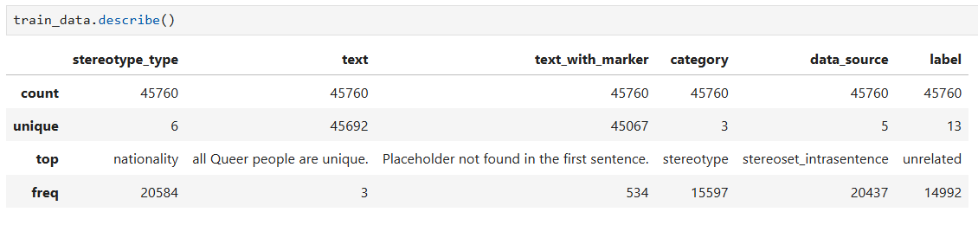
Problems with the emgsd dataset
The distribution of categories (stereotype, neutral, unrelated) needs to be checked for imbalance, as imbalanced classes can negatively affect model performance.

Slide 7
solution
We have made a better dataset with more stereotype data.
We have explored and found EMGSD data problems and highlighted it and also built binary and multi-classifier models for the new dataset.
We have created the functions to make better normalization and tokenization and also done BIO-TAGGING with 226 different stereotype type which can be used to find which type of stereotype it is.
We have also used CustomRoberta model to analyze and give a better prediction for the input with sustainability in mind.

Slide 8
Solution Overview
Stereotype & Bias detection model
High accuracy, good generalisation model provided as a service
We prioritised its applicability to various different platforms
Data-Driven Insights:
Conducted label distribution analysis to identify class imbalances, ensuring fairness and reducing bias in predictions.
Visualized class proportions to better understand the dataset composition, preventing overfitting to majority classes.
Data Processing & Tokenization:
Implemented normalization to clean and standardize text (lowercasing, removing stop words and punctuation).
Applied tokenization techniques (word and subword-level) to break down text for efficient and meaningful representation.
BIO Tagging for Stereotype Detection:
Generated BIO tags to annotate tokens, aiding in pinpointing stereotype-related spans in the text for improved model focus.

Slide 9
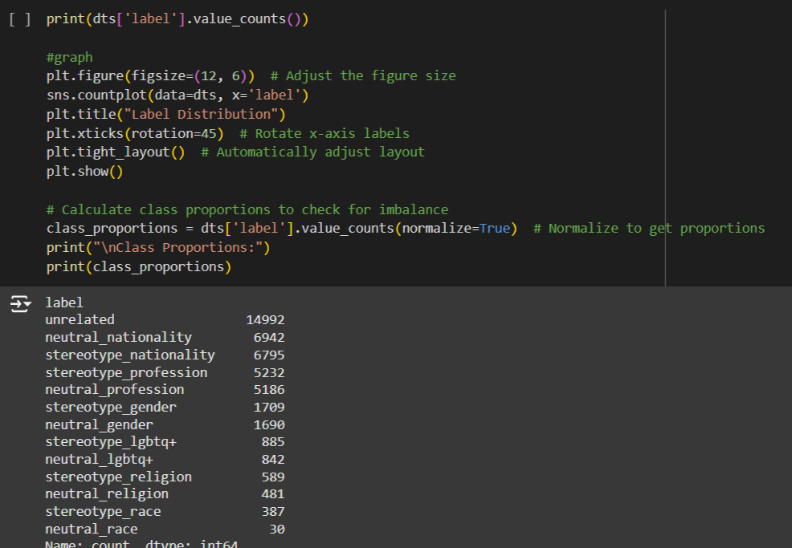
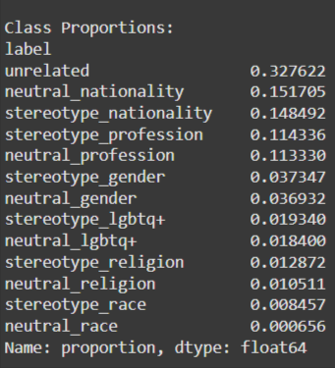
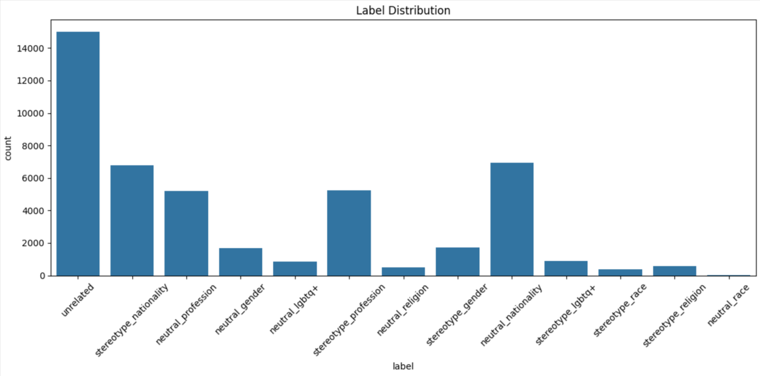
Understanding the Data

Slide 10
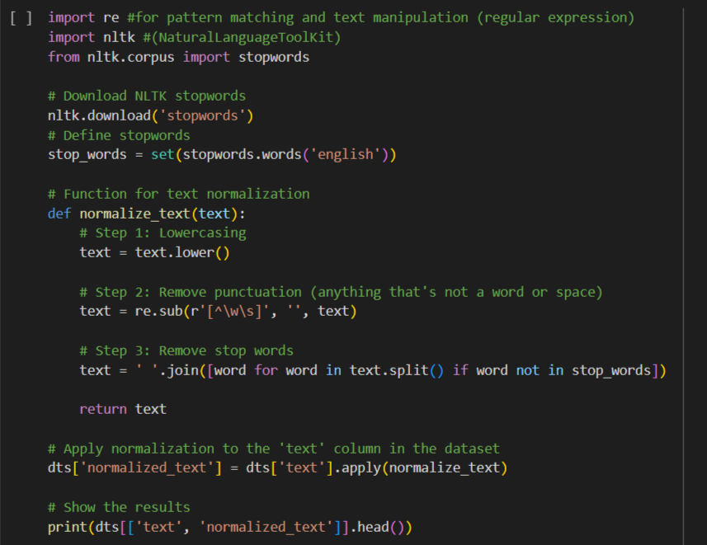
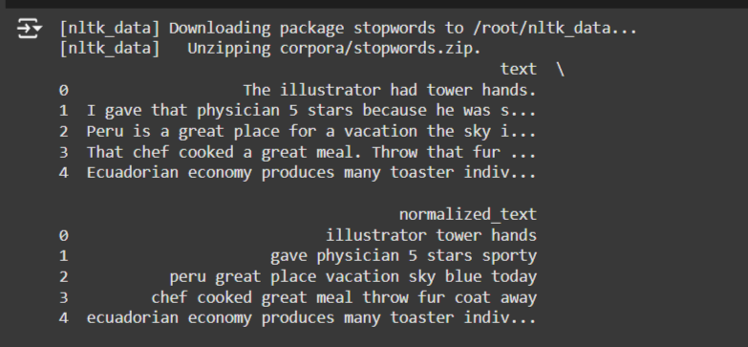
Normalizing and Tokenizing Data

Slide 11
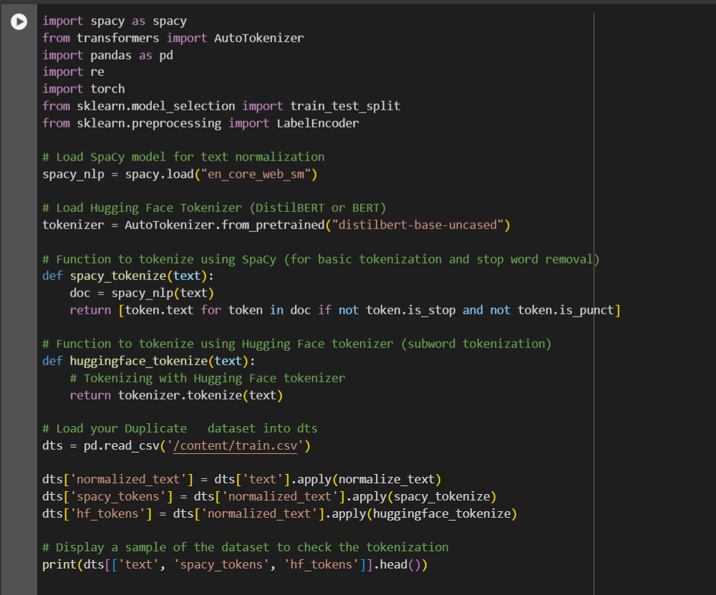
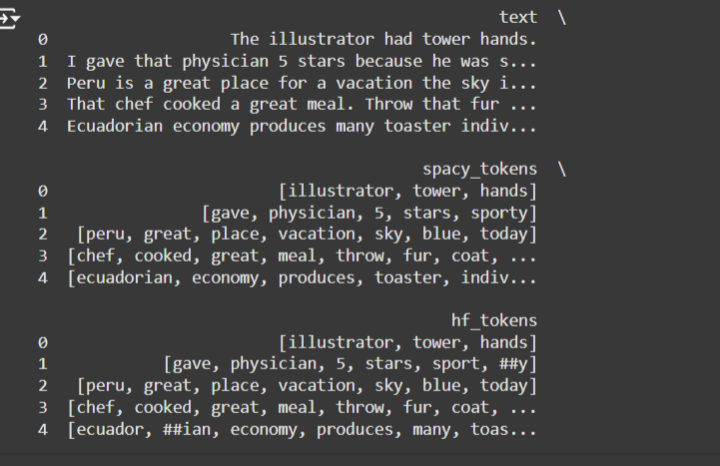

Slide 12
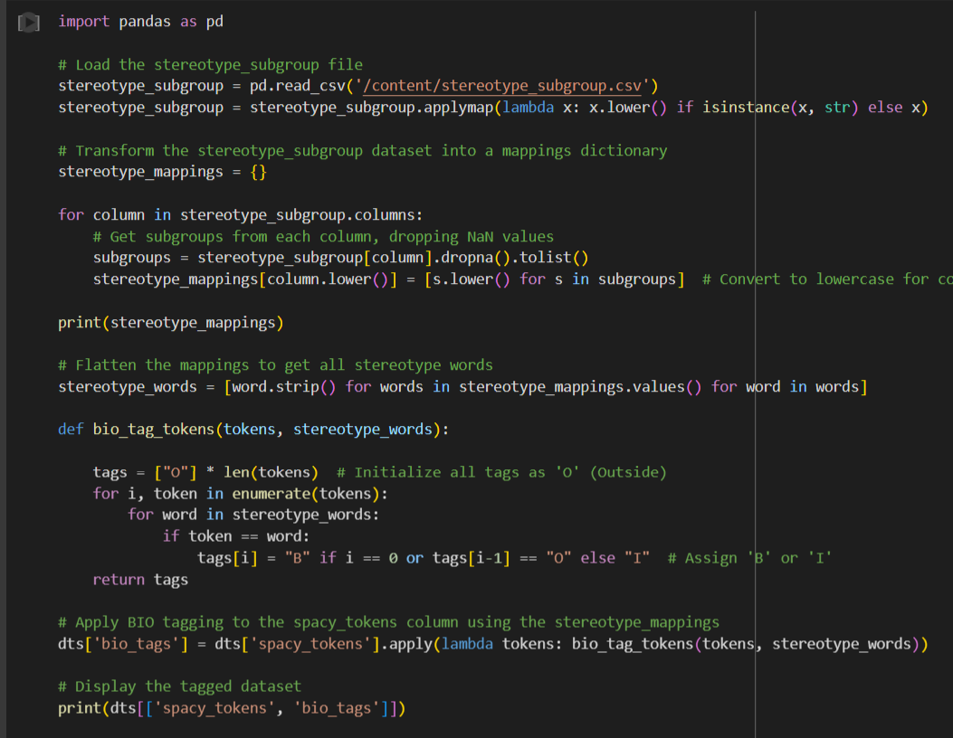
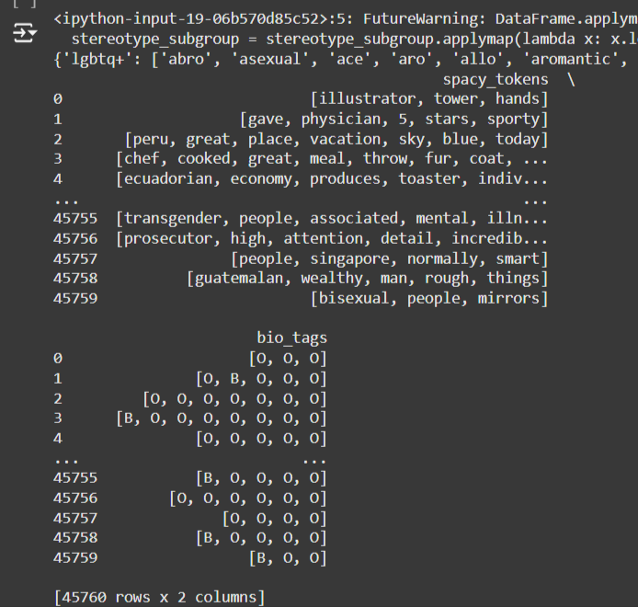
BIO Tagging for NER-like Tasks

Slide 13
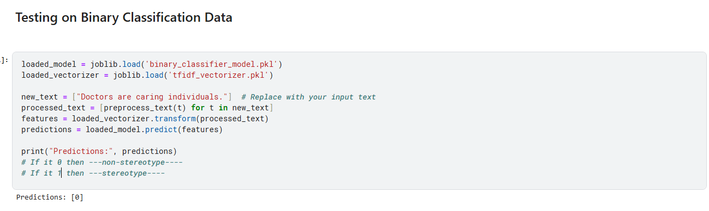
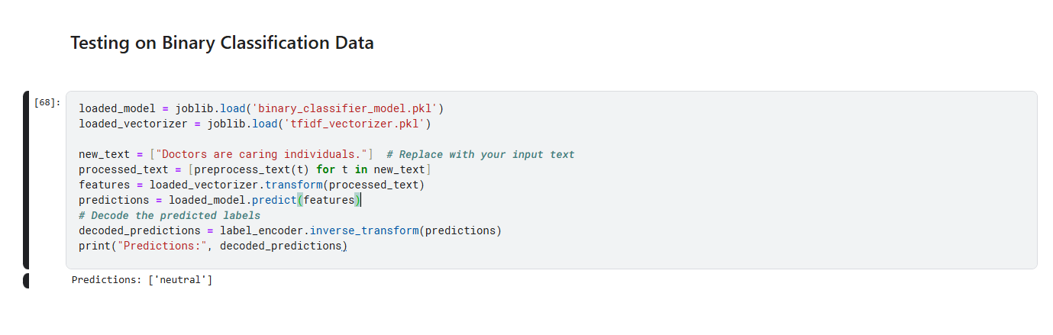
BINARY CLASSIFICATION

Slide 14
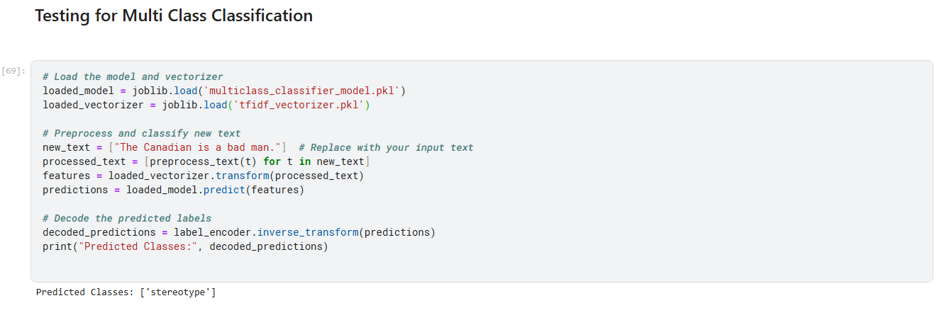
MULTI-CLASS CLASSIFICATION

Slide 15
Model architecture
We used a larger model (roberta-large) to maximise our precision and recall.
The model uses a customized classification head instead of the default one. This custom head includes:
Linear Layer with 512 Units and ReLU Activation: The hidden representation from the roberta-large backbone is passed through a dense layer with ReLU activation, which helps capture complex non-linear relationships.
Dropout Layer: A dropout layer with p=0.1 helps reduce overfitting, which in turn improves the model's generalization to unseen examples.
Notes:
We created our model architecture to reflect the needs of the problem. Recognising bias in text is very complicated. The phrasing or diction choice can vastly impact the message that is relayed in text. As such, we wanted to include as much density in our model as we could to capture those nuances. Also, generalisation was very important to us – we wanted to make sure that our model remained accurate for the many different scenarios or text that it may be applied to.

Slide 16
Training optimisation
Text Augmentation with Synonym Replacement:
Data augmentation is applied using nlpaug (SynonymAug). Augmenting the dataset by generating more variations of each class improves the diversity of examples, which helps the model generalize better. This is especially helpful for low-resource classes, indirectly contributing to a higher F1 score.
Weighted Cross-Entropy Loss:
  We use a custom trainer method that uses a CrossEntropyLoss with class weights. The weighted loss penalizes errors in minority classes more heavily, ensuring that the model focuses on all classes, not just the majority ones.

Slide 17
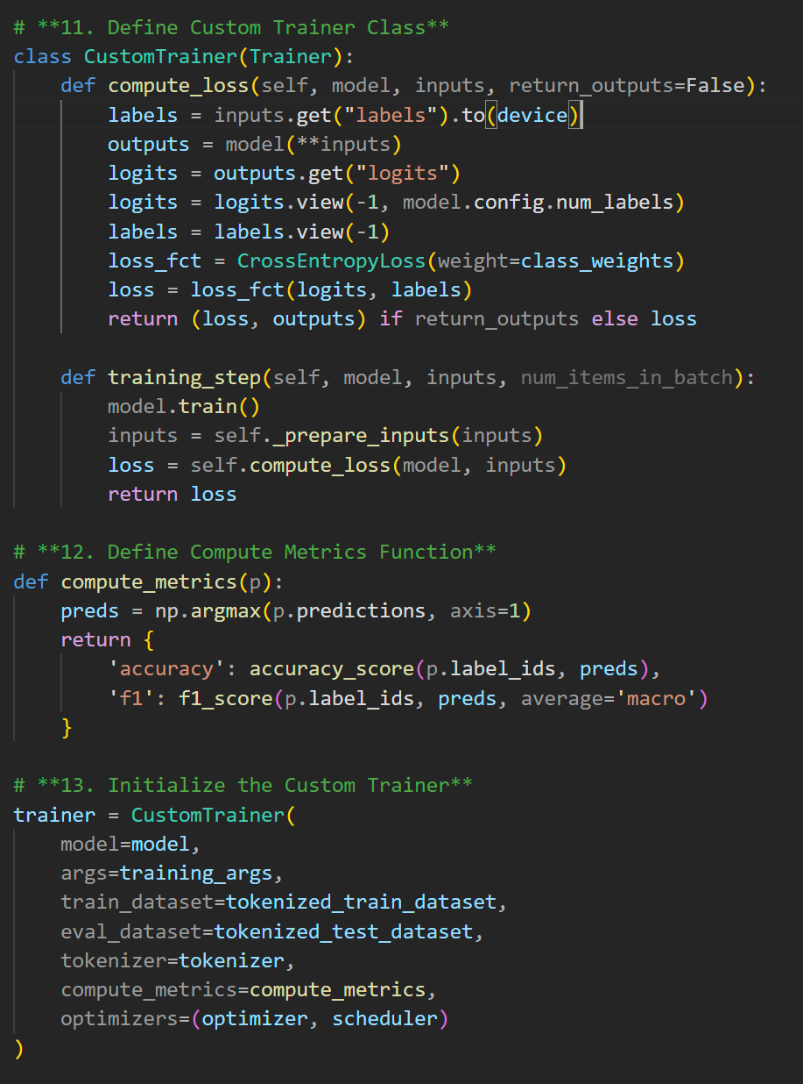
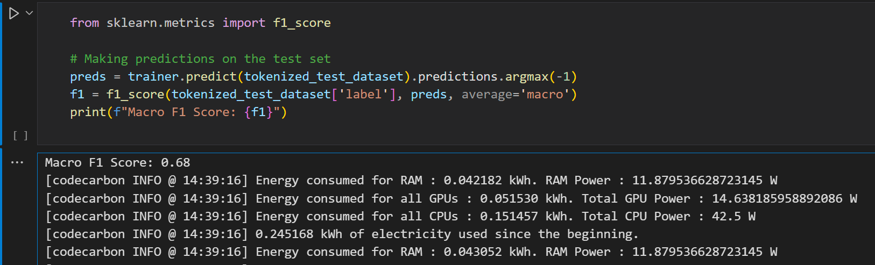
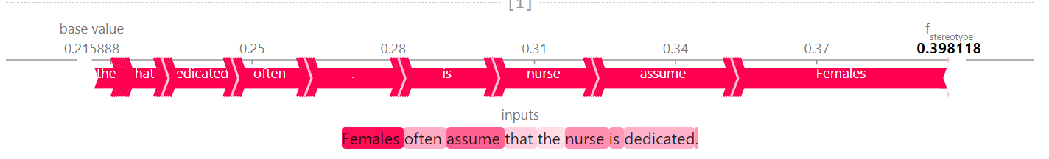
CUSTOM ROBERTA MODEL
By implementing these changes, we achieve a Macro F1 score of 0.61 at 0.20 sample size.

Slide 18
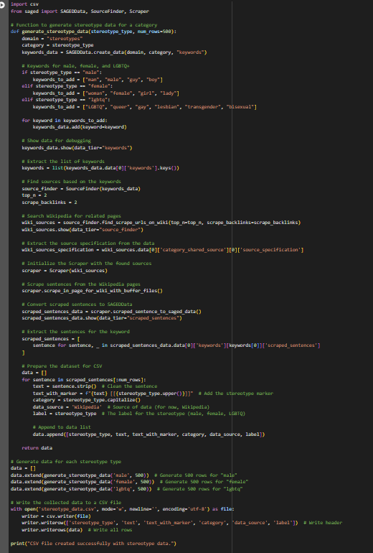
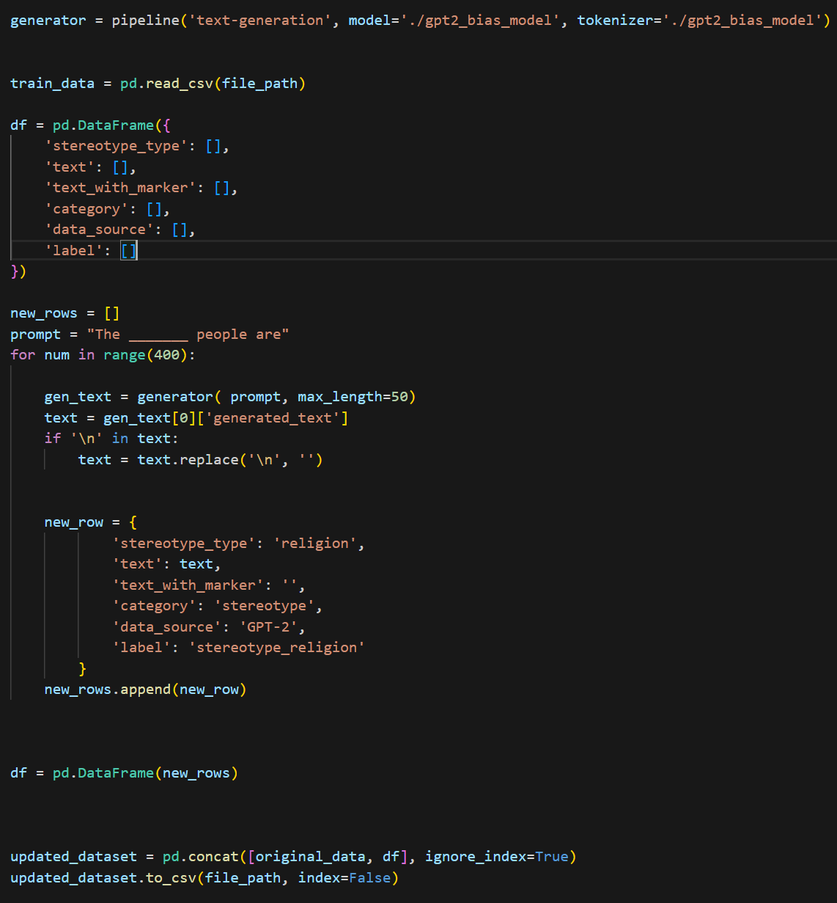
Data Scraping
Generating data
Used SAGEDbias to scrape data online
Used a biased GPT-2 model to generate data for the model to train on.

Slide 19
Business Value
Protecting brand reputation
Reducing bias in security models
Applicant screening
Catching the potential stereotypes ensures that businesses do not face backlash and lose customers.
By catching stereotypes in training data, it can improve the effectiveness of security detection models as there is less bias in their decisions.
By reducing biases in training data, applicant screening models can be more accurate meaning the most qualified applicant is hired so there are less unfair rejections

Slide 20
Academic value
Checking reliability of text
Creating safe platforms
Studying linguistics
If the model is used on academic papers, it can check for biases giving an idea of the validity of the source.
By monitoring stereotypes, a platform free of potentially harmful messages is created and could be a safe space for students to ask questions and share information
By checking for stereotypes in text from different authors in different times we can see how the use of stereotypes in language has changed throughout the years

Slide 21
Risk consideration
Performance – We prioritised generalisation in training
Fairness – We generated additional training data for labels which had limited entries, and oversampled minority labels
Robustness – We used an extensive dataset to increase accuracy
Privacy – No data is stored locally
Security – Our services provide our pretrained model
Explainability – All of our code is open source
Sustainability – We used codecarbon to track all our emissions and implemented measures to reduce GPU usage to reduce carbon footprint
Notes:
Sustainability – gradient accumulation (allowing for smaller batch sizes and less gpu load) or smaller tokenisation models

Slide 22
Future pipeline
Our model can continue to be optimised to reduce carbon emissions
We plan to implement larger training datasets
Create a platform to host our service
Add more transparency

Slide 23
Project Link https://github.com/anjun-c/holistic-ai-hackathon/tree/main/src

Slide 24
THANK YOU
Moulishwaran Balaji
Indreswar Balaji
Adrian Chen
Siddhant Murugkar
Jamari Bullock

