Slide 1
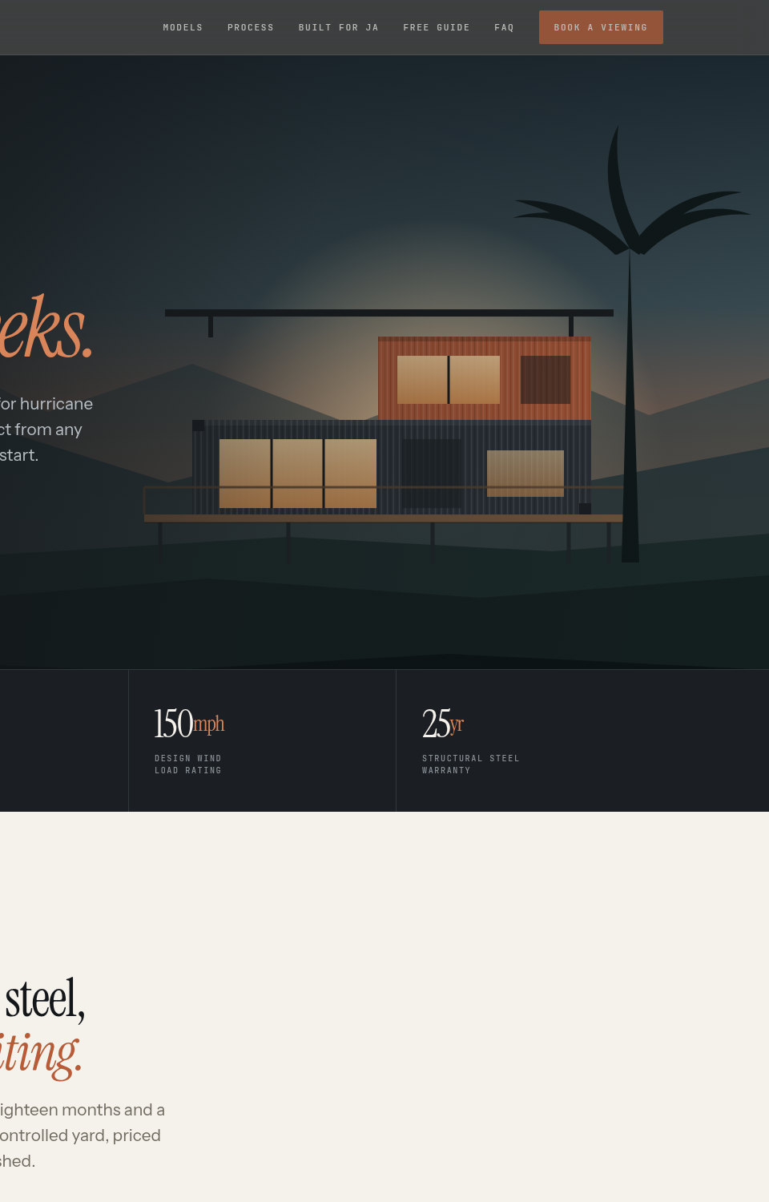
PROPOSAL · 30 AUGUST 2026
A WEBSITE THAT
SELLS CONTAINERS
WHILE YOU SLEEP.
Prepared for Design Container JA — the website, the buyer’s guide that captures leads, and the system that delivers it.
J$100,000 FIXED · 3 WEEKS
Notes:
Open warmly. Thank them for the time. Frame: I did not come to show you a mock-up — I built the thing. Then move straight to slide 2 rather than talking about YardScale.

Slide 2
WHERE YOU ARE NOW
THE PROBLEM IS NOT
DEMAND. IT IS PROOF.
01
Social sells the look. It cannot sell the decision.
A buyer about to spend eight million dollars needs specifications, a price range and proof the structure is engineered. None of that fits in a caption — so the conversation stalls at “DM for price”.
02
Every enquiry arrives cold, into one inbox.
You answer the same six questions by hand, several times a week, to people who may not own land yet. That is expensive in the one resource you cannot buy more of.
03
You do not own the audience.
A follower is rented. If the platform changes what it shows, your pipeline changes with it. An email list of people who raised their hand is an asset you keep.
THE GAP
YARDSCALE DIGITAL
Notes:
Do not rush these. Ask after each one whether that matches their experience. The third point — owning the audience — is the one that usually lands hardest.

Slide 3
WHAT IT COSTS YOU
EVERY WEEK WITHOUT IT,
THE SAME THING HAPPENS.
11pm
6
0
When people actually decide about houses — and there is nowhere to send them
Questions answered by hand, over and over, before anyone is qualified
Records kept of the buyer who was eight months out but real
None of this is a marketing problem. It is a plumbing problem — and plumbing is fixable.
THE STAKE
YARDSCALE DIGITAL
Notes:
Keep this slide short. It is a bridge, not an argument. The line at the bottom is the pivot into the solution.

Slide 4
WHAT WE PROPOSE
A SITE, A GUIDE, AND A
SYSTEM BETWEEN THEM.
01
02
03
The website
The buyer’s guide
The lead system
Answers every question a buyer has before they contact you — models, prices, process, hurricane engineering, financing and approvals. The people who do call are already most of the way to yes.
A 20-page PDF worth having: costs, import duty, parish approvals, financing, and a site checklist. Given away free in exchange for a name and an email.
The guide sends itself. Every enquiry arrives with the parish, the model and the site notes already attached — by email and on WhatsApp, in seconds.
The site and the guide are already built. You can look at both today.
THE PROPOSAL
YARDSCALE DIGITAL
Notes:
This is the moment to slow down and say plainly: this is not a pitch for work I might do. It is done. That is the whole reason they should say yes today.

Slide 5
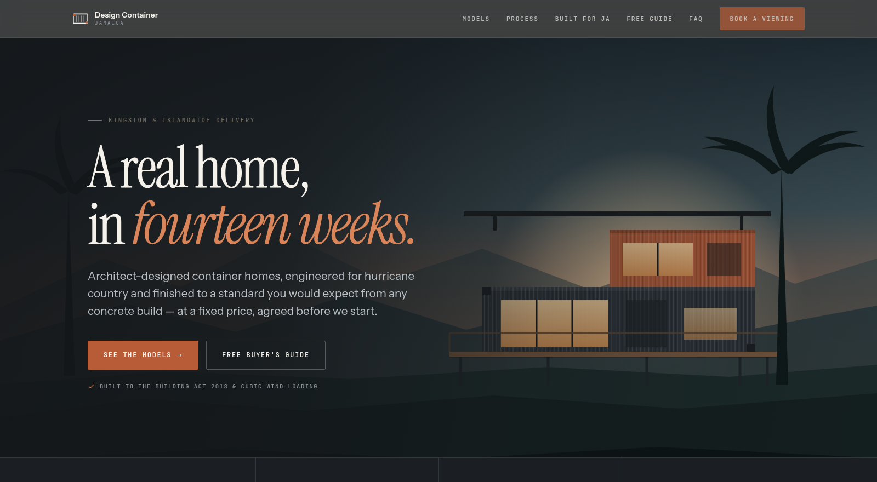
THE SITE — BUILT, NOT SKETCHED
Mobile-first, loads instantly, and every drawing is vector — so it stays sharp on any screen and costs nothing to host.
Notes:
Open the live site on a phone here rather than talking over the screenshot. Let them scroll it themselves — that does more than anything you can say.

Slide 6
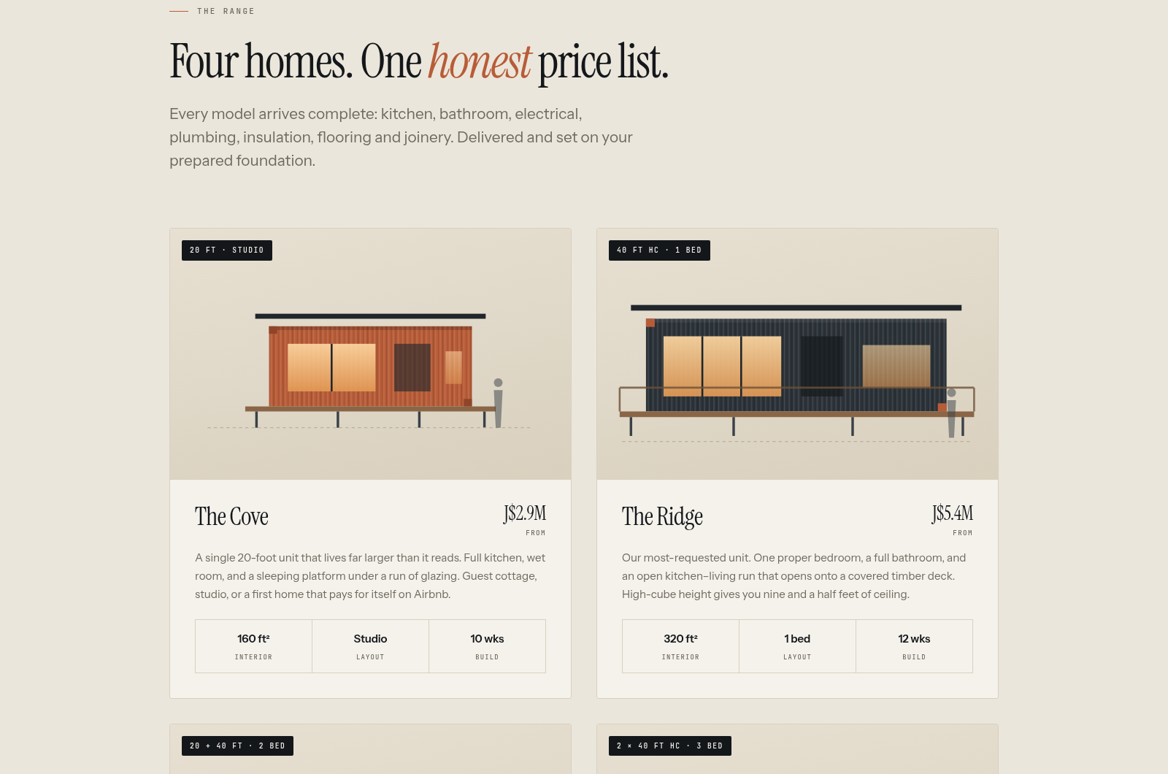
EVERY MODEL, PRICED IN THE OPEN
Prices shown are placeholders benchmarked against the published Jamaican market — we swap in your real numbers in week one. Publishing a range filters out the people who were never going to buy, before they reach your phone.
THE RANGE
YARDSCALE DIGITAL
Notes:
Be explicit that the prices are placeholders and that you need their real ones. This is the single biggest thing you need from them in week one — say so here.

Slide 7
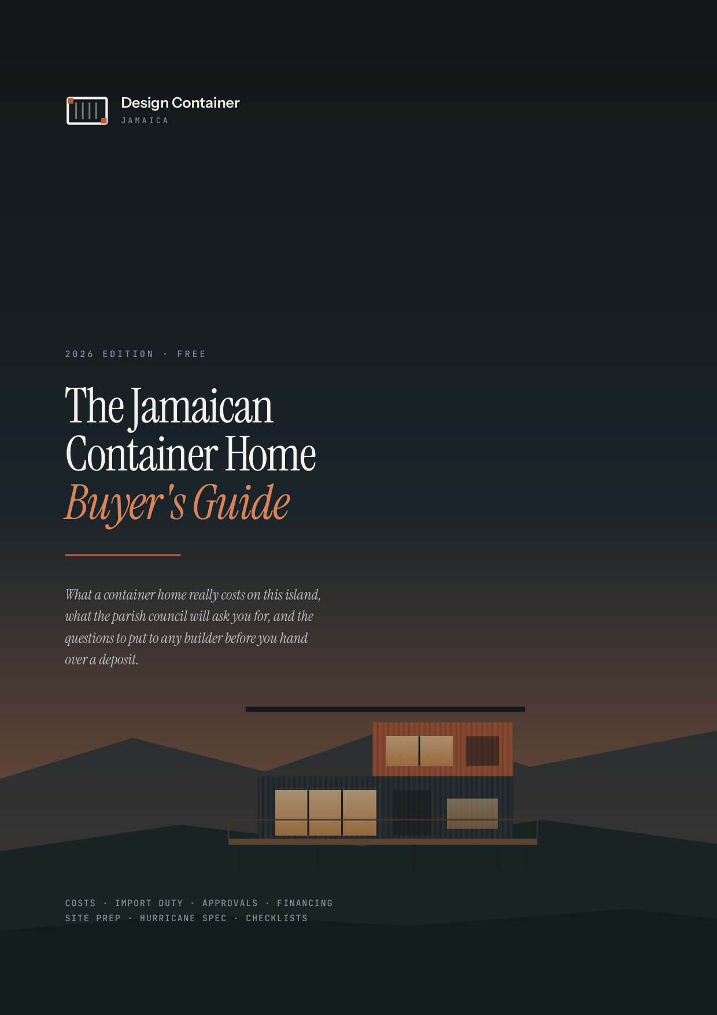
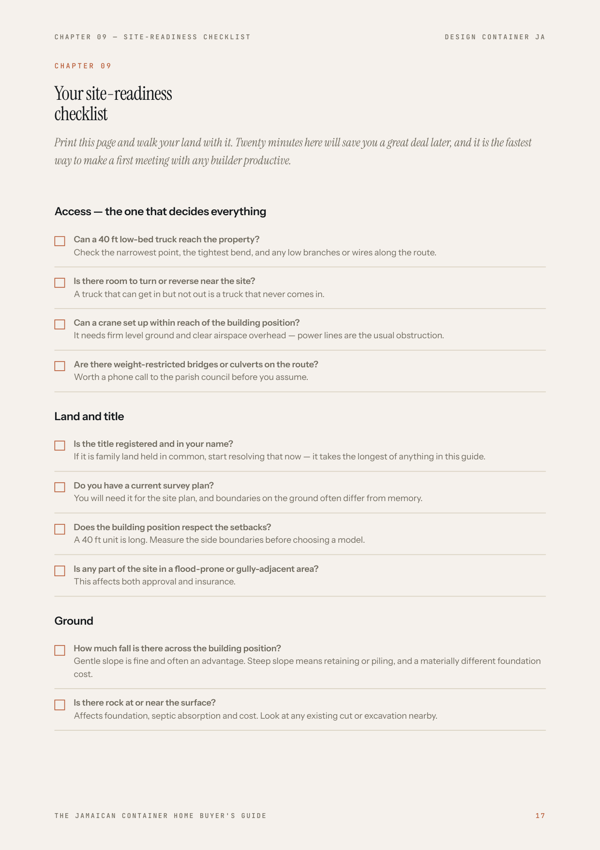
THE LEAD MAGNET
20 PAGES THEY
ACTUALLY WANT.
The true landed cost of an imported unit — duty, GCT and stamp duty, worked through
What parish council asks for, and the four things that stall an approval
Which lenders finance prefab here, and what each needs from the buyer
Seven questions to ask any builder before paying a deposit
A site-readiness checklist they can walk their land with
It also makes you the one who told them the truth — the position you want to hold when they finally choose a builder.
THE GUIDE
YARDSCALE DIGITAL
Notes:
Hand them the printed guide here if you have one. Physical beats a slide. Point out that it is genuinely useful even to someone who never buys from them — that is what makes it work.

Slide 8
HOW IT WORKS
FROM STRANGER TO SITE VISIT.
01
02
03
04
05
Finds you
Reads the site
Takes the guide
Gets nurtured
Books a viewing
Search, a shared link, or your social bio — all now pointing somewhere that sells.
Models, prices, process and engineering. Most objections answered before contact.
Not ready to buy, but happy to swap an email for something genuinely useful.
You now own the relationship, and can stay in touch until they are ready.
Arrives warm, informed, and already comfortable with the price.
The step most builders skip is the third one. It is the only one that turns traffic you already have into a list you own.
THE FUNNEL
YARDSCALE DIGITAL
Notes:
Walk left to right with your hand. Pause on step three. Ask them what happens today to someone who is eight months out — the honest answer is nothing, and they will say so themselves.

Slide 9
TIMELINE
THREE WEEKS, START TO LIVE.
WEEK 1
Content and confirmation
YOUR INPUT
You confirm model names, real prices and specifications. One 45-minute call covers most of it.
WEEK 2
Build and revisions
PREVIEW LINK
Your content goes in, the guide takes your real figures, and you get a private preview link. Two rounds included.
WEEK 3
Launch and handover
LIVE SITE
Domain connected, forms tested with a real submission, walkthrough recorded, accounts put in your name.
AFTER
Two weeks of support
INCLUDED
Anything broken or confusing, we fix it. Not a contract — just making sure what we handed you works.
One thing only would slow this down: waiting on your confirmed prices and specifications.
Notes:
Emphasise that the clock is mostly on them, in a friendly way. Ask directly: can you get me the confirmed prices this week?

Slide 10
INVESTMENT
ONE PRICE. NO SURPRISES.
TOTAL — FIXED
WHAT IS INCLUDED
J$100,000
Website — designed, built, deployed
Buyer’s guide — written, designed, produced
Lead capture and automated delivery
Hosting setup, domain and SSL
Handover, documentation and training
Two weeks of post-launch support
Founding-client rate. In exchange we ask for a short testimonial once the site is live, permission to feature the work, and an introduction to one other business you rate.
J$50,000 on acceptance · J$50,000 on launch
You own everything on final payment — site, guide, domain, files. No lock-in and no monthly fee required to keep it running.
INVESTMENT
YARDSCALE DIGITAL
Notes:
Say the number plainly and then stop talking. Do not justify it. If they ask why it is low, the honest answer is the founding-client trade — testimonial, portfolio, one referral.

Slide 11
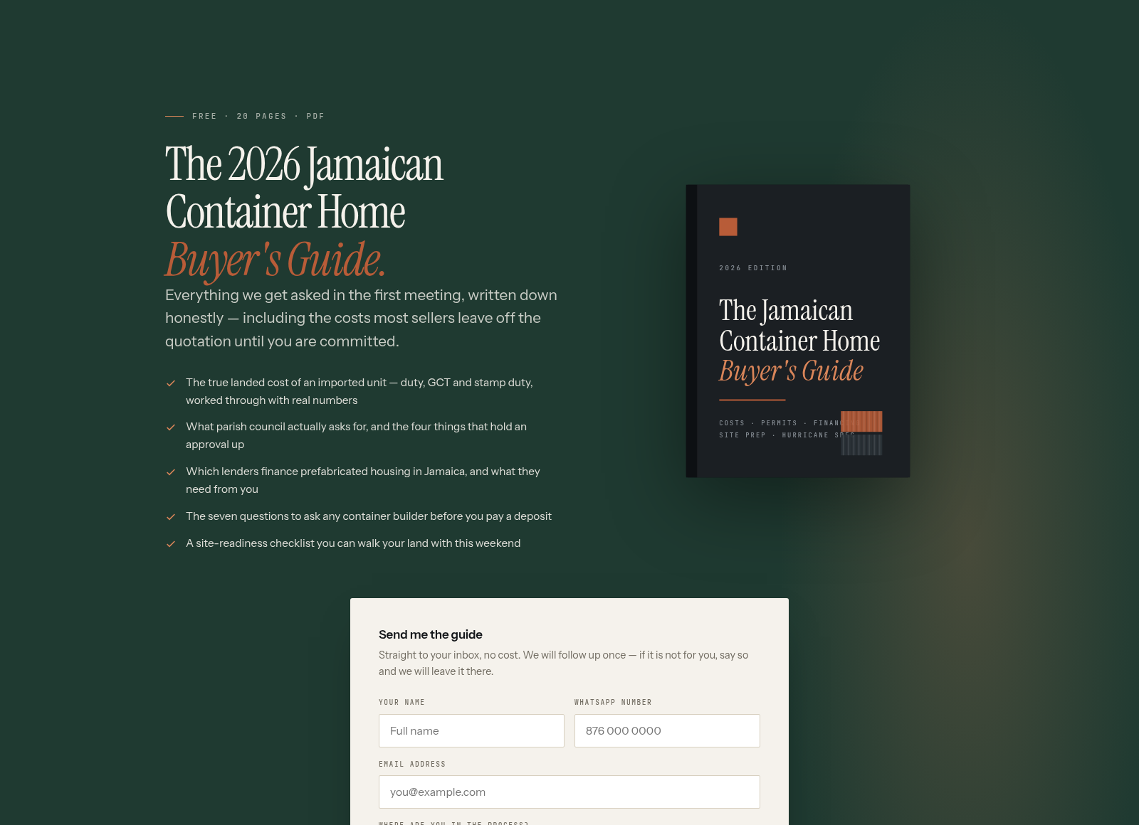
NEXT STEP
LOOK AT IT
BEFORE YOU
DECIDE.
The site and the guide already exist. Open the preview, read the guide the way one of your buyers would, and tell me what is wrong with it. If it is right, say the word and we start on your content this week.
SEE THE LIVE PREVIEW →
yardscaledigital@gmail.com
Notes:
Close by asking for the decision, not for another meeting. If they hesitate, the fallback ask is small: give me your confirmed prices this week and I will put them in, then you decide.

