Slide 1
Influential Actors in Communication Networks Erdős Institute Data Science Boot Camp May-Summer-2024
Adam Perhala, Jungbae An

Slide 2
Overview
Central actors in communication networks
Detecting Framework

Slide 3
Dataset: House Hearing Transcripts
22 committees, 105th-114th Congresses
1,026,677 speeches by 1,045 House members

Slide 4
Methods
Topic Classification
Similarity Networks
Finding Influential Attributes

Slide 5
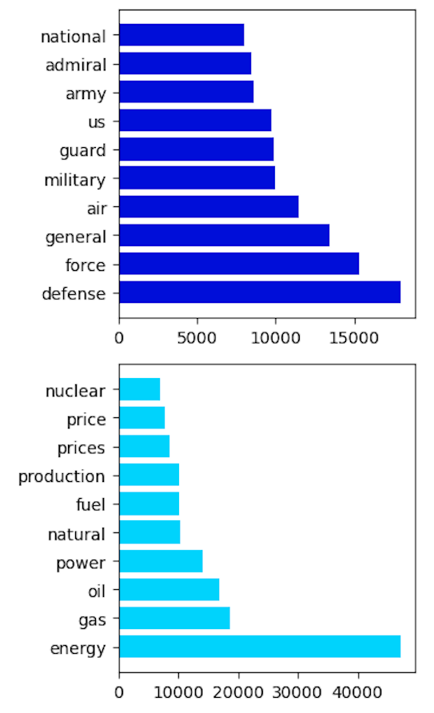
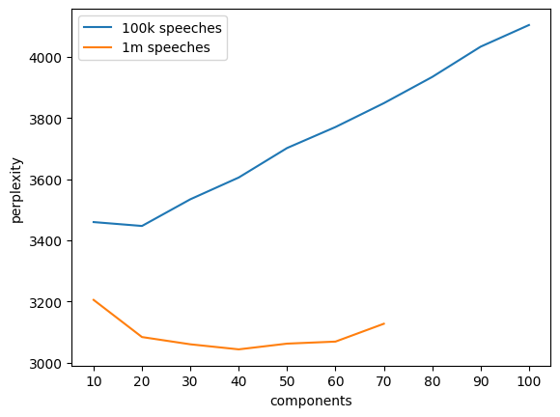
Step 1: Topic Classification
Dimension reduction to low-dimensional policy issues
Using Latent Dirichlet Allocation (LDA)
K = 40 based on perplexity score

Slide 6
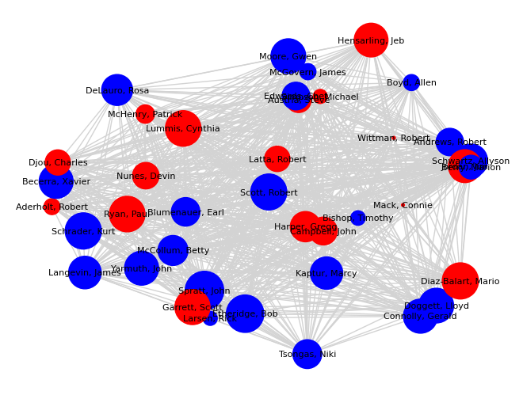
Step 2: Similarity Network
Networks created for each committee by each congress
Edges weighted by topic similarity
Cosine similarity of each pair of members
Network structure analyzed
Edge weights by party affiliation
Centrality score with PageRank
House Budget Committee, 111th Congress.
Edges weighted by topic similarity and node size given by PageRank

Slide 7
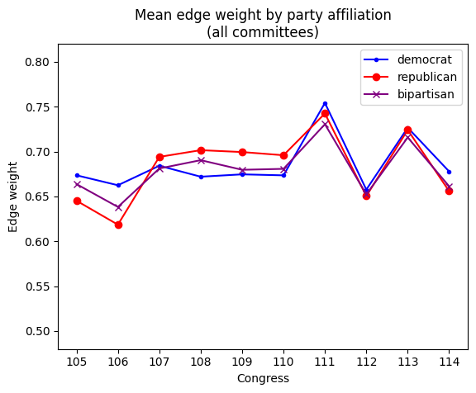
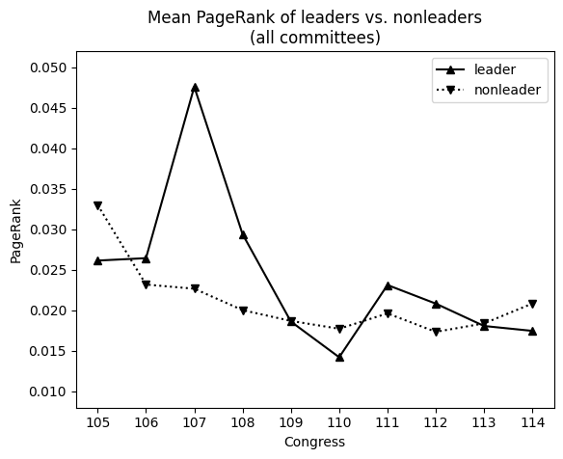
Step 3: Who are Central Actors?
House Budget Committee, 114th Congress.
Mean cosine similarity by edge types

Slide 8
Potential Applications
Our case informs academic and public policy research and provides a framework for future related studies
Additional applications outside of academic interests
Social media trends
Advertising campaigns
Market and consumer research

