Slide 1
Influential Actors in Communication Networks Erdős Institute Data Science Boot Camp May-Summer-2024
Adam Perhala, Jungbae An

Slide 2
Overview
Central actors in communication networks
Detecting Framework

Slide 3
Dataset: House Hearing Transcripts
22 committees, 105th-114th Congresses
1,026,677 speeches by 1,045 House members

Slide 4
Methods
Topic Classification
Similarity Networks
Finding Influential Attributes

Slide 5
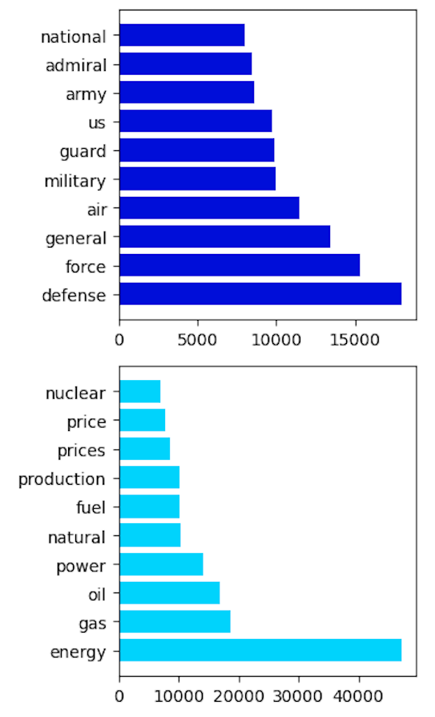
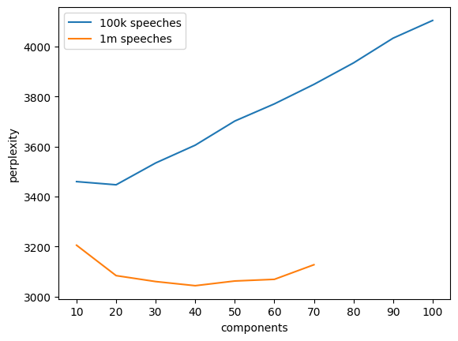
Step 1: Topic Classification
Dimension reduction to low-dimensional policy issues
Using Latent Dirichlet Allocation (LDA)
K = 40 based on perplexity score

Slide 6
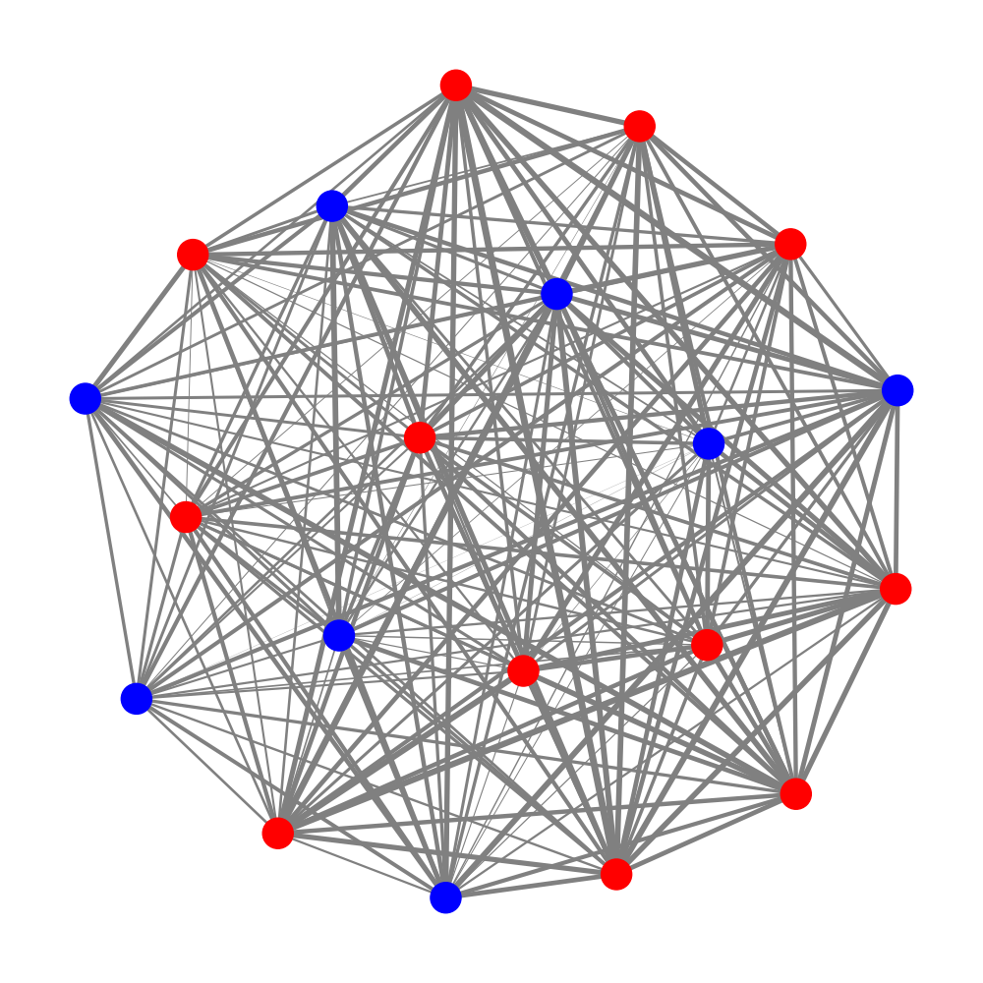
Step 2: Similarity Network
Networks weighted by topic similarity
Cosine similarity of each pair of members in the same committee
House Budget Committee, 114th Congress.
Edges weighted by topic similarity,
standardized within the committee

Slide 7
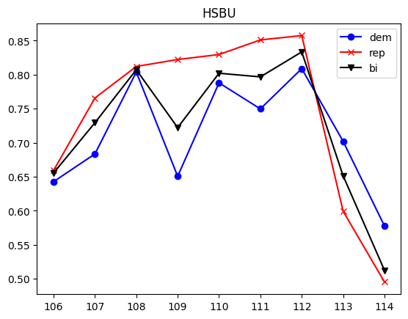
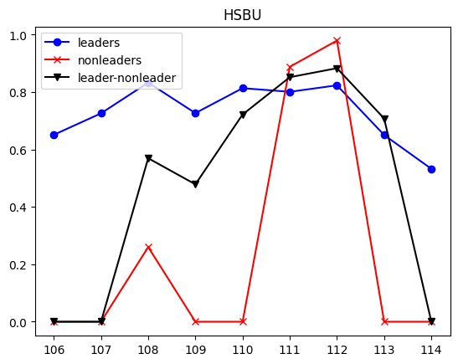
Step 3: Who are Central Actors?
House Budget Committee, 114th Congress.
Mean cosine similarity by edge types

Slide 8
Potential Application
Our case informs academic and public policy research
The framework can inform online consumer research

