Slide 1
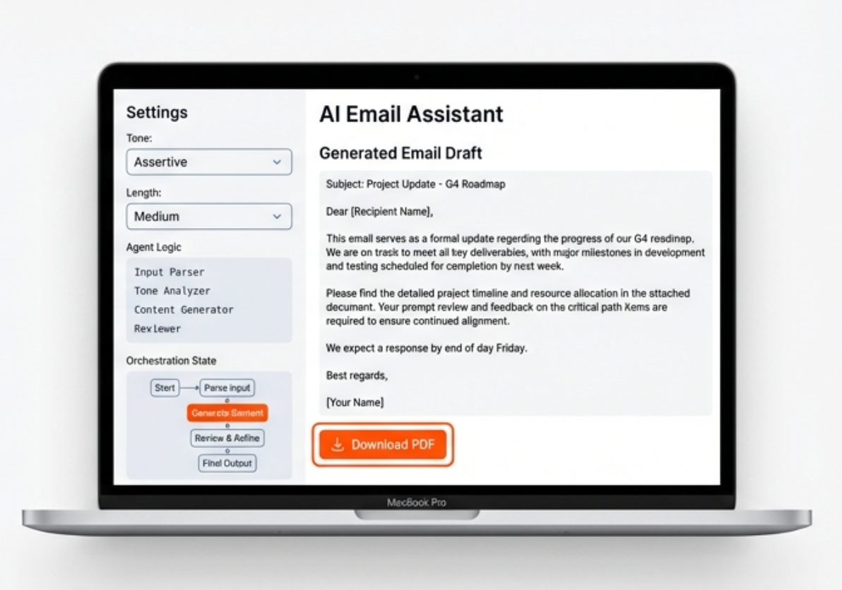
AI-Powered Email Assistant Multi-Agent Orchestration with LangGraph & Streamlit
Anju Susan Raju

Slide 2
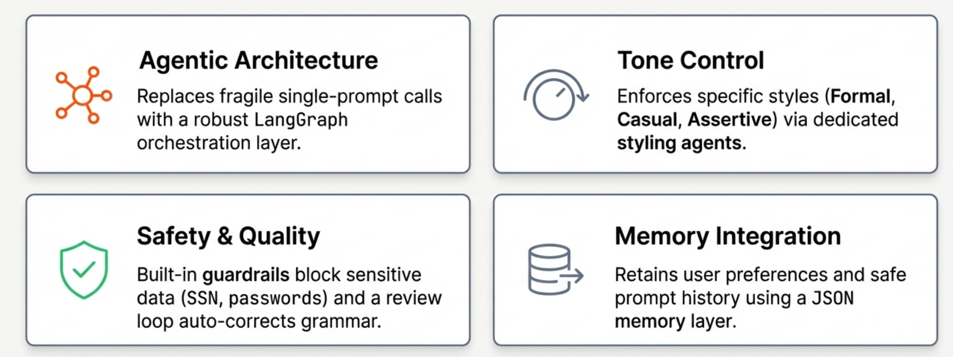
Project Summary
Streamlit-based AI application
Multi-agent orchestration using LangGraph
Context-aware, professional email generation
Memory, guardrails, retry logic

Slide 3
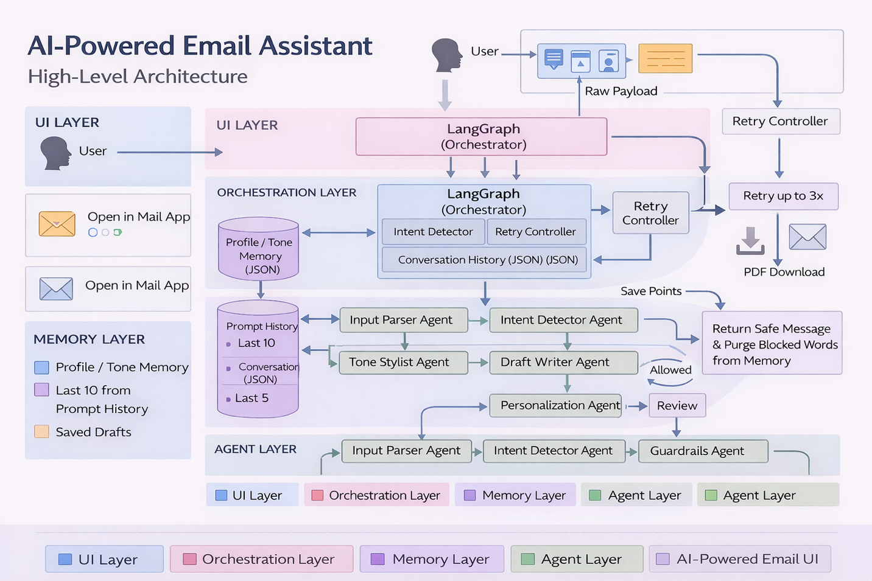
High Level Architecture

Slide 4
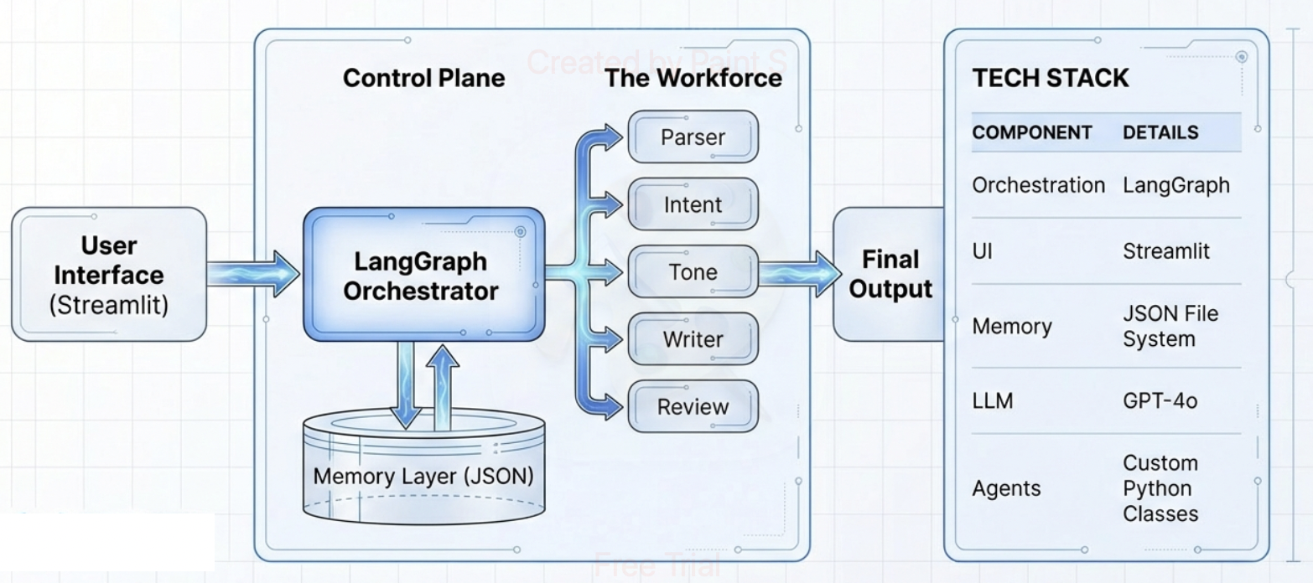
Agentic Orchestration Overview

Slide 5
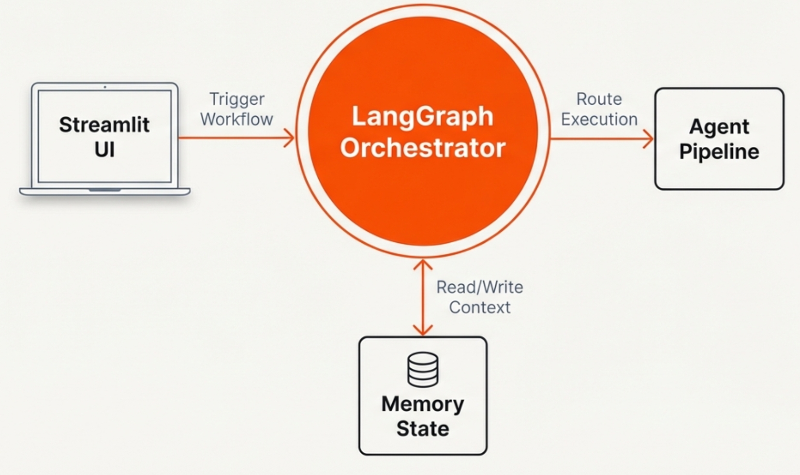
The Orchestrator: LangGraph Control Plane

Slide 6
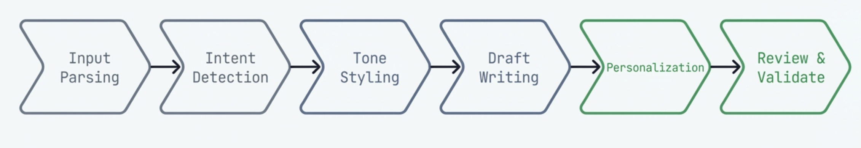
The Workflow: A Journey of Data
Each step represents an independent agent updating the shared state object.

Slide 7
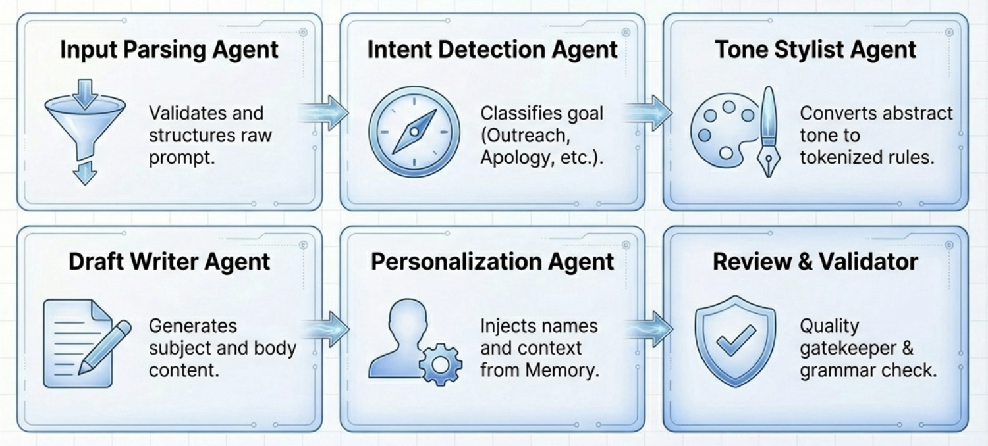
The Specialized Agent Pipeline

Slide 8
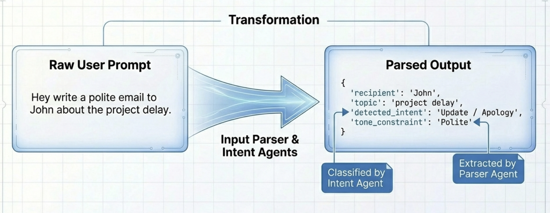
Agent Deep Dive: Understanding the Request

Slide 9
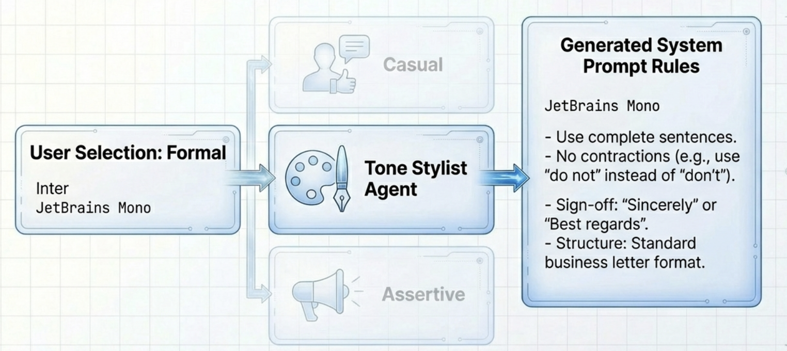
Agent Deep Dive: Setting the Style (Tone Stylist)

Slide 10
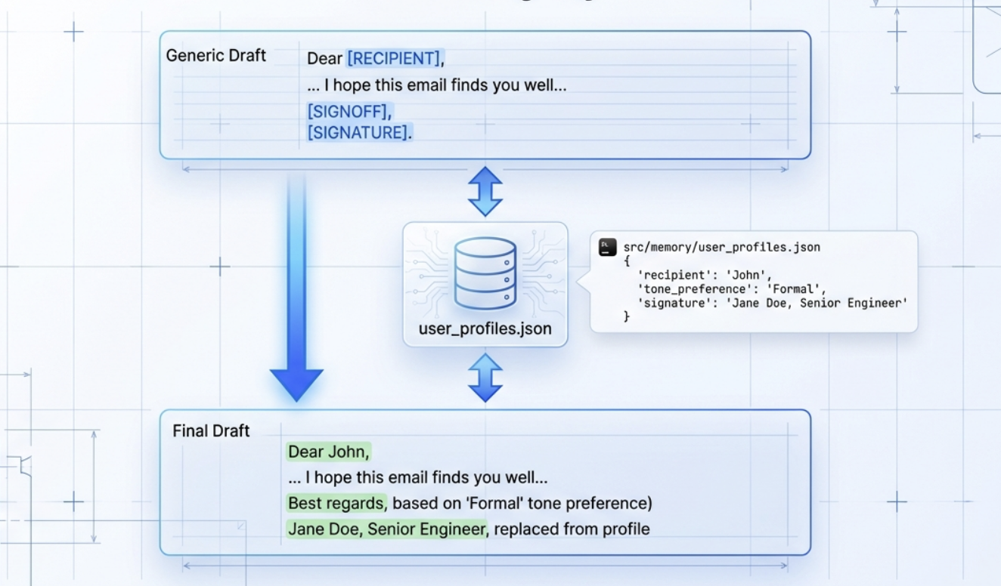
Agent Deep Dive: Personalization & Memory Injection

Slide 11
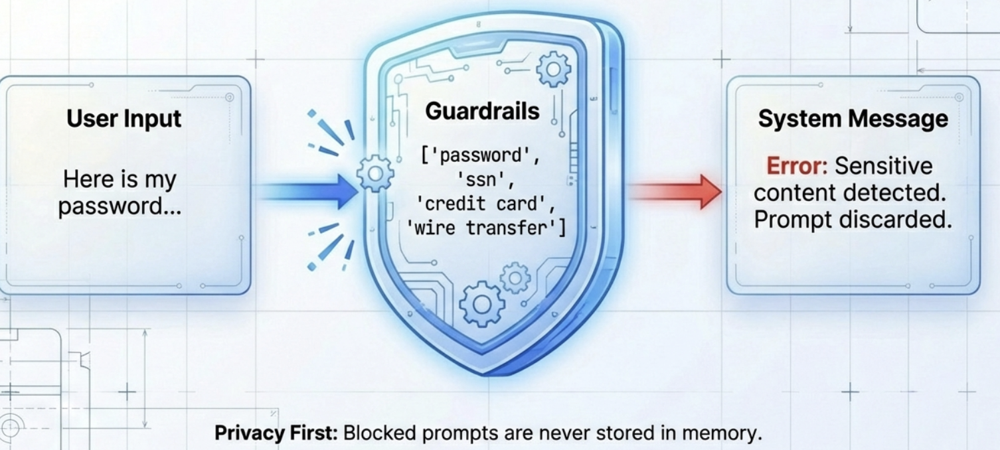
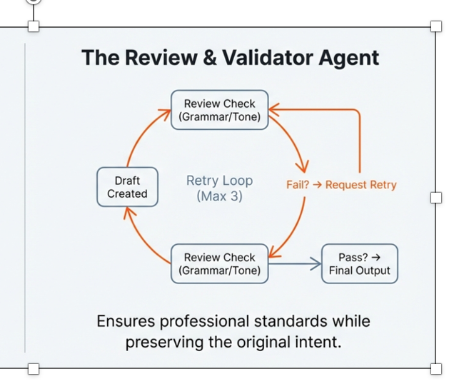
Quality Assurance & Auto-Correction
Enterprise-Grade Guardrails

Slide 12
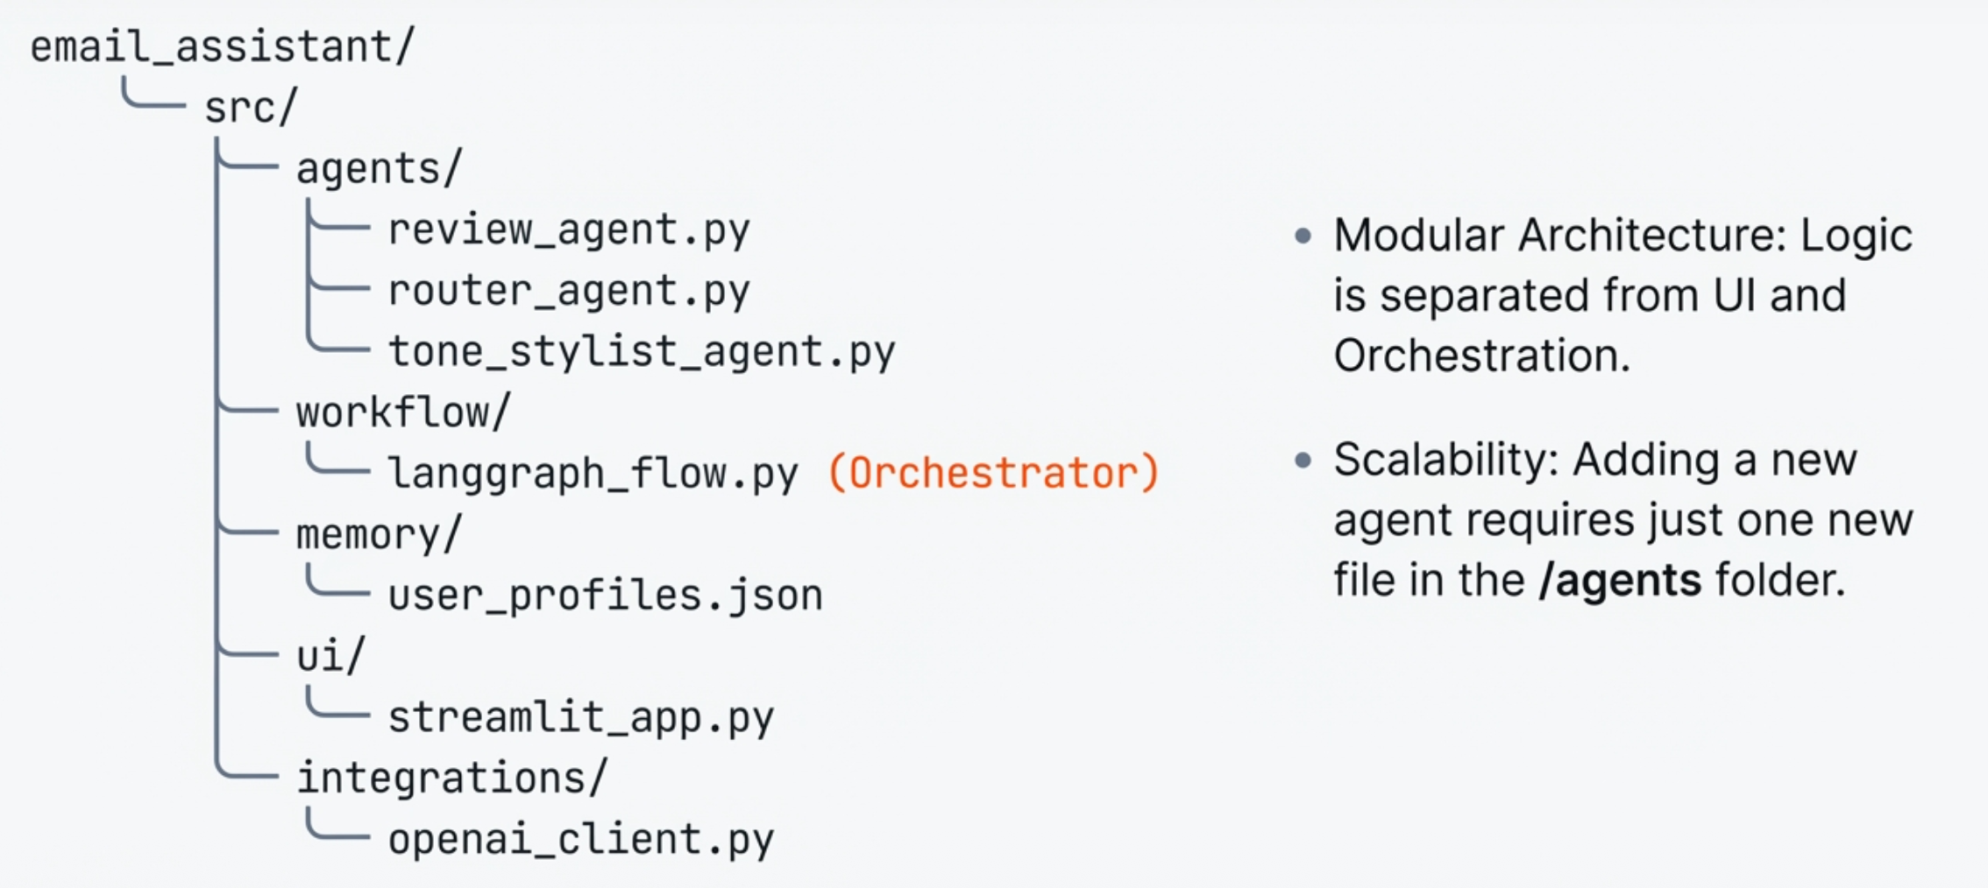
Technical Implementation: Project Structure

Slide 13
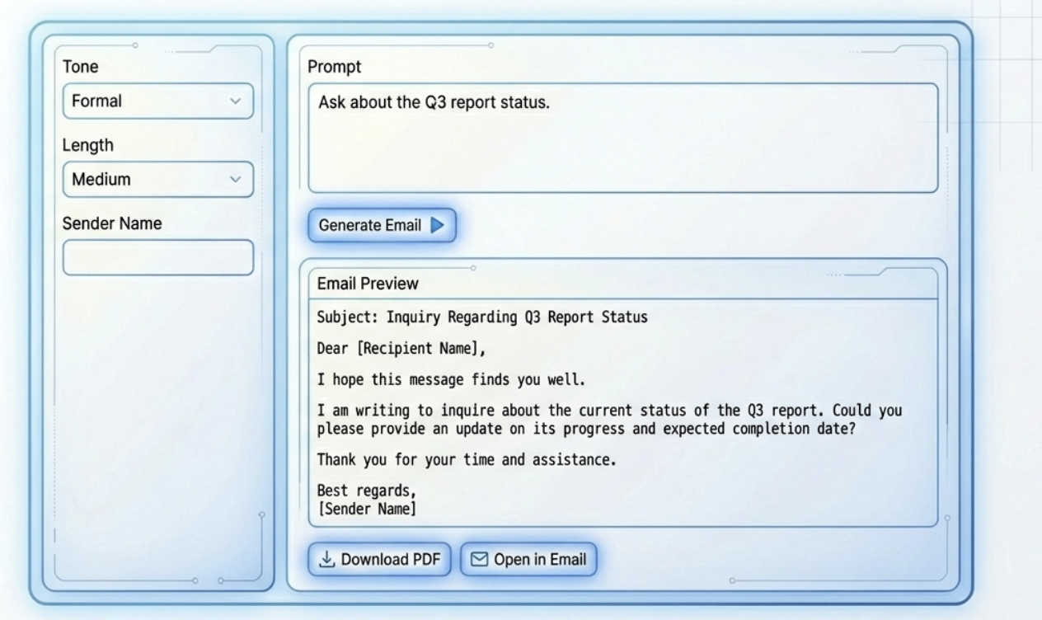
Application Ul & Features

Slide 14
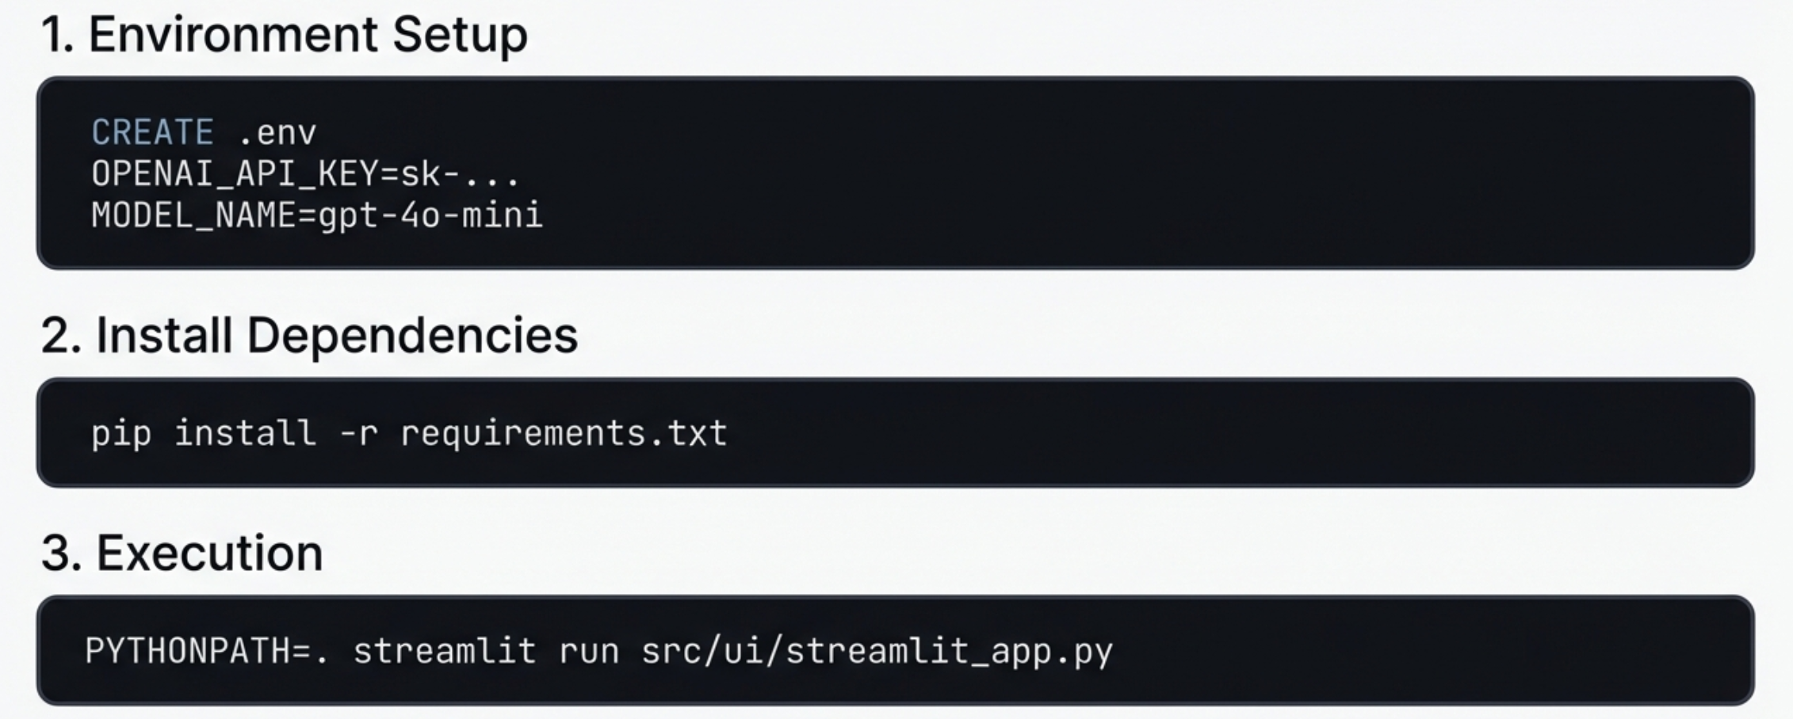
Installation & Deployment

Slide 15
Thank you

