Slide 1
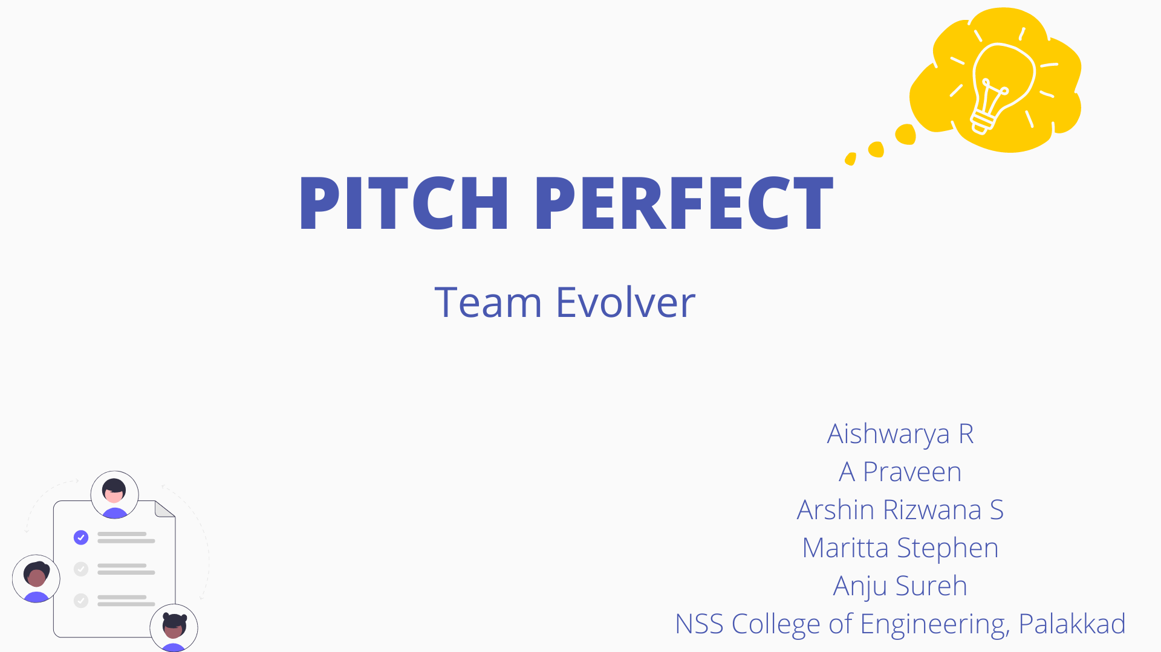

Slide 2

INTRODUCTION
Are you one among them ?
Manager
Consultant
Freelance professional
Student
Entrepreneur

Slide 3
INVENTOR
Platform for Sharing ideas
Find perfect investor
Collaborate with investors across the world

Slide 4
INVESTOR
Find innovate ideas
Building business with creative ideas
Collaborate with multiple investors.

Slide 5
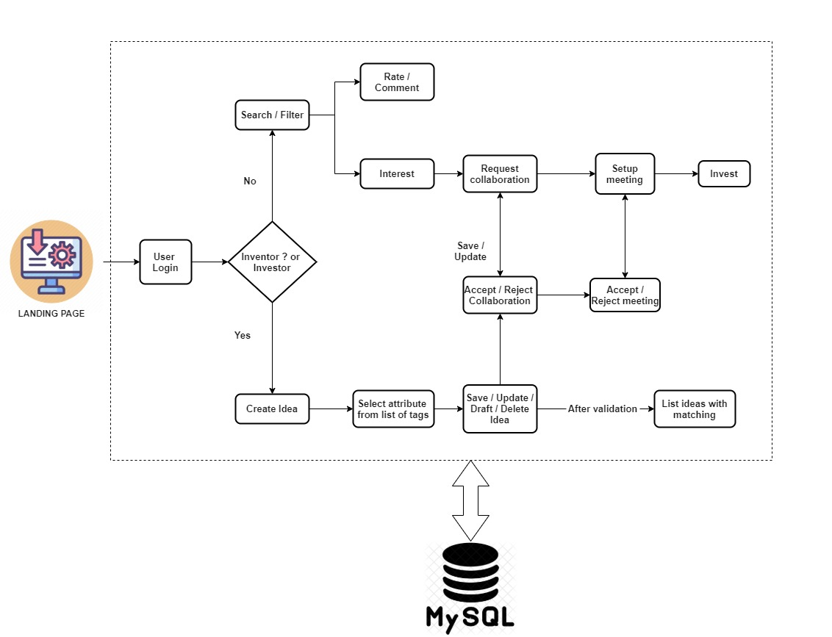
FLOW DIAGRAM

Slide 6
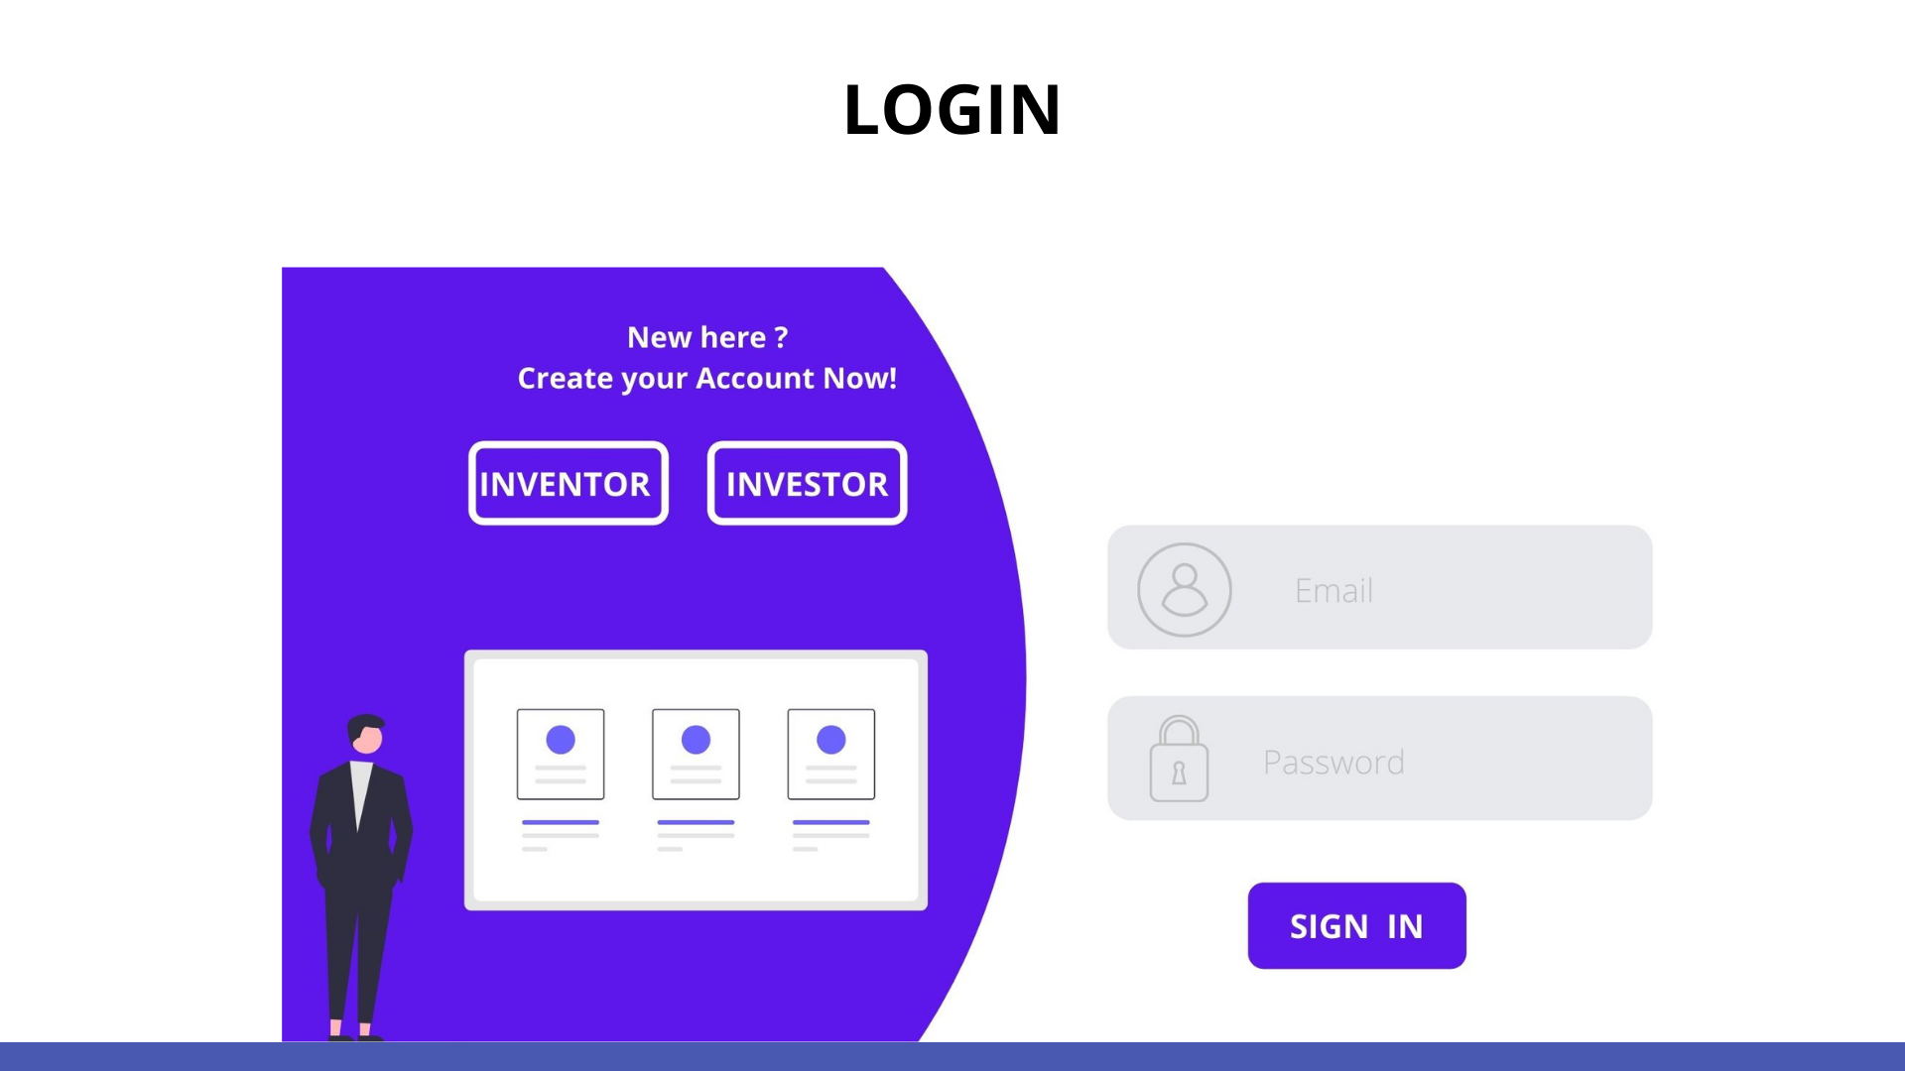

Slide 7




Name
Email
Occupation
Password
SIGN UP

Slide 8





INVESTOR
A
Artificial Intelligence
Agriculture
Voice-based Virtual Assistant for Windows 9.3/10
INTERESTED
Heart disease prediction 9/10
INTERESTED
INTERESTED

Slide 9


INVENTOR
Project Title
IDEAS
Abstract
CREATE IDEA
Documents
COLLABORATION
SUBMIT

Slide 10
