Slide 1

A RAYUDU
BATSMAN
Base Price – 50L
Points - 600

Slide 2

D MILLER
BATSMAN
Base Price – 50L
Points - 590

Slide 3

P SHAW
BATSMAN
Base Price – 50L
Points - 630

Slide 4

D’ARCY SHORT
BATSMAN
Base Price – 50L
Points - 580

Slide 5

M AGARWAL
BATSMAN
Base Price – 30L
Points - 440

Slide 6

S IYER
BATSMAN
Base Price – 30L
Points - 470

Slide 7
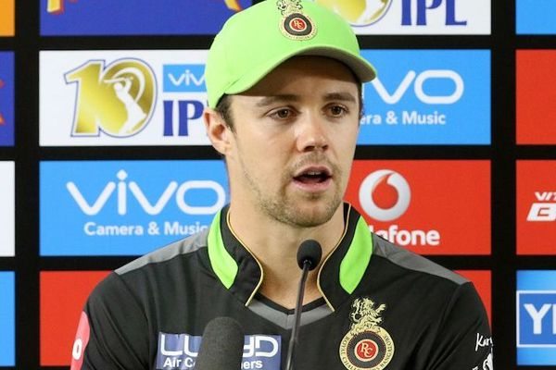
T HEAD
BATSMAN
Base Price – 30L
Points - 420

Slide 8

A HALES
BATSMAN
Base Price – 30L
Points - 450

Slide 9

J ROY
BATSMAN
Base Price – 30L
Points - 460

Slide 10

S GILL
BATSMAN
Base Price – 20L
Points - 360

Slide 11

S HETMYER
BATSMAN
Base Price – 30L
Points - 450

