Slide 1

S DHAWAN
BATSMAN
Base Price – 1.5CR
Points - 1140

Slide 2

D WARNER
BATSMAN
Base Price – 2CR
Points - 1200

Slide 3

K WILLIAMSON
BATSMAN
Base Price – 1.5CR
Points - 970

Slide 4

A RAHANE
BATSMAN
Base Price – 1CR
Points – 810

Slide 5

E LEWIS
BATSMAN
Base Price – 1CR
Points - 900

Slide 6

M GUPTIL
BATSMAN
Base Price – 1CR
Points - 820

Slide 7

M PANDEY
BATSMAN
Base Price – 1CR
Points – 800

Slide 8

C GAYLE
BATSMAN
Base Price – 1CR
Points - 850

Slide 9

S RAINA
BATSMAN
Base Price – 1CR
Points - 870

Slide 10

FAF DU PLESIS
BATSMAN
Base Price – 1CR
Points - 850

Slide 11
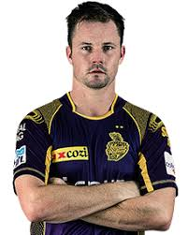
C MUNRO
BATSMAN
Base Price – 1CR
Points - 890

Slide 12

A FINCH
BATSMAN
Base Price – 1CR
Points - 860

Slide 13
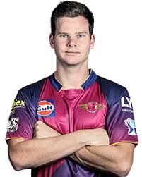
S SMITH
BATSMAN
Base Price – 2CR
Points - 1220

