Slide 1
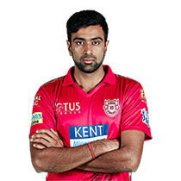
R ASHWIN
ALL-ROUNDER
Base Price – 1.5CR
Points - 1100

Slide 2

A RUSSELL
ALL-ROUNDER
Base Price – 1.5CR
Points - 1160

Slide 3

D BRAVO
ALL-ROUNDER
Base Price – 1.5CR
Points - 1110

Slide 4
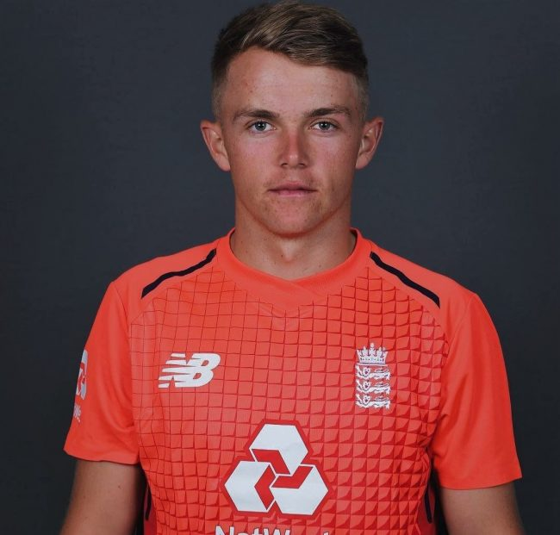
S CURRAN
ALL-ROUNDER
Base Price – 1CR
Points - 860

Slide 5

H PANDYA
ALL-ROUNDER
Base Price – 1.5CR
Points - 1140

Slide 6

S NARINE
ALL-ROUNDER
Base Price – 1.5CR
Points - 1150

Slide 7
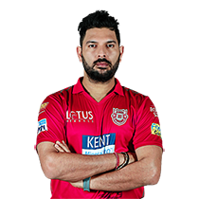
YUVRAJ
ALL-ROUNDER
Base Price – 1CR
Points - 840

Slide 8

G MAXWELL
ALL-ROUNDER
Base Price – 1.5CR
Points - 1020

Slide 9

S AL HASAN
ALL-ROUNDER
Base Price – 75L
Points - 680

Slide 10

K JADHAV
ALL-ROUNDER
Base Price – 50L
Points - 620

Slide 11

K POLLARD
ALL-ROUNDER
Base Price – 75L
Points - 650

