Slide 1

A B DE VILLIERS
MARQUEE PLAYERS
WICKET-KEEPER
Base Price – 2CR
Points - 1390

Slide 2

MS DHONI
MARQUEE PLAYERS
WICKET-KEEPER
Base Price – 2CR
Points - 1350

Slide 3
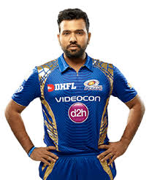
R SHARMA
MARQUEE PLAYERS
BATSMAN
Base Price – 2CR
Points - 1380

Slide 4
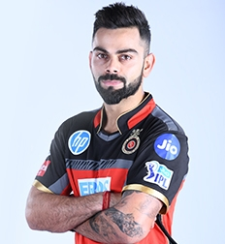
V KOHLI
MARQUEE PLAYERS
BATSMAN
Base Price – 2CR
Points - 1400

Slide 5

J BUMRAH
MARQUEE PLAYERS
PACER
Base Price – 2CR
Points - 1350

Slide 6

M STARC
MARQUEE PLAYERS
PACER
Base Price – 2CR
Points - 1300

Slide 7

B STOKES
MARQUEE PLAYERS
ALL-ROUNDER
Base Price – 2CR
Points - 1280

Slide 8

R KHAN
MARQUEE PLAYERS
SPINNERS
Base Price – 2CR
Points - 1350

Slide 9

C LYNN
MARQUEE PLAYERS
BATSMAN
Base Price – 2CR
Points - 1240

