Slide 1

LAB LINK
HEALTHCARE
The LabLink project aims to improve patient safety and healthcare efficiency by providing real-time information on the maintenance and calibration status of medical equipment through the use of QR codes and a centralized database
2023 April,21 Team Mavericks

Slide 2

PROBLEM STATEMENT
In India, the lack of transparency in the medical scanning procedure has contributed to numerous cases of medical negligence resulting in death.
This lack of transparency can prevent proper diagnosis and can lead to the use of faulty or outdated testing apparatus, producing inaccurate medical reports.
This can cause serious repercussions, as the incorrect diagnosis can lead to incorrect treatment and can even be fatal.
The negligence of medical staff to utilize updated technology and efficient testing procedures can have dire consequences, and it is essential that the medical scanning procedure is made more transparent in order to prevent further cases of medical negligence.

Slide 3

SOLUTION
The solution to the problem of medical negligence due to faulty testing equipment in India is to implement a QR code-based system that provides patients with access to information about the testing machines used in medical facilities.
The QR codes can be placed on each machine and can be scanned by patients to obtain information such as the machine's maintenance history, purchase date, and servicing schedules.
This information can be made available to patients through a website or mobile app, making it easier for them to verify the accuracy of their medical reports and take informed decisions regarding their health.

Slide 4
IMPACT
Improved Patient Safety Increased Transparency
Increased Efficiency and Productivity Enhanced Data Management Increased Accoutability Empowerment of Patients

Slide 5


Timeline
Project Ideation
Gathering Requirement
Research
Analysis
Design Thinking
UI/UX Design
Design Review
Coding
Testing
Edge Case ID
Edge Case Elimination
Deployment
Future Prospects

Slide 6





TECH STACK
FRONT END: HTML CSS REACT JS
BACK END:
FIREBASE
VERSION CONTROL:
GITHUB

Slide 7

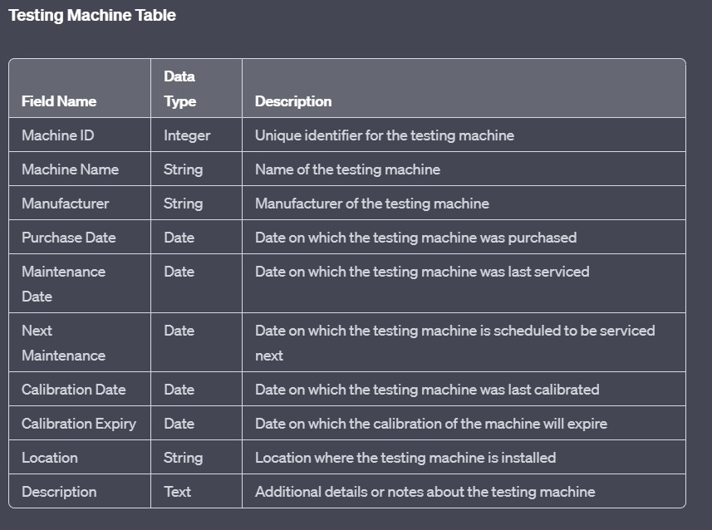
SCHEMA

Slide 8
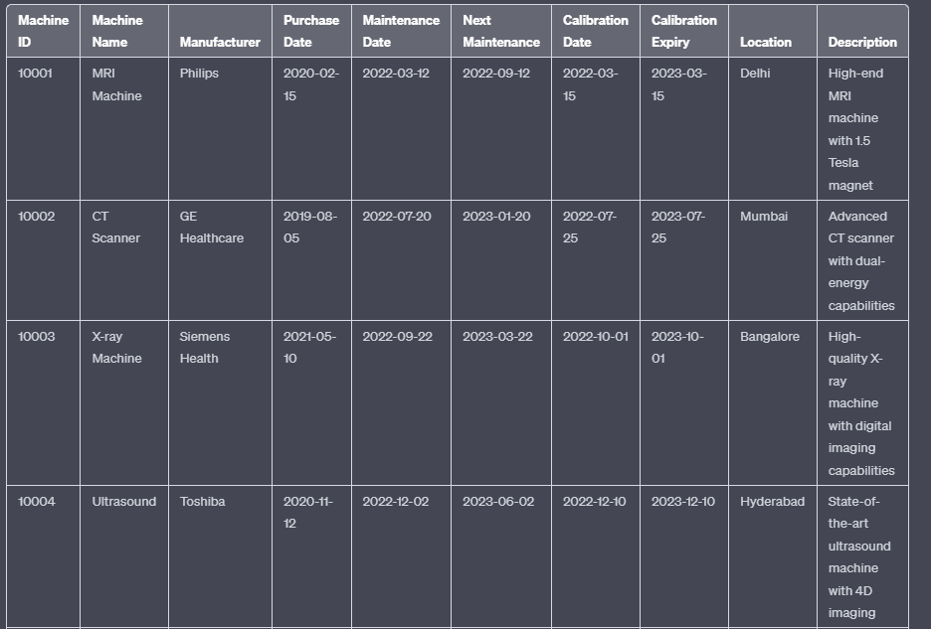
DUMMY DATA

Slide 9
FUTURE PROSPECTS
Collaboration with NABL and Frame Healthcare Policies Collaboration with Equipment Manufacturers
Induce Healthy Competition Between Testing Labs in a Particular Region
Adding Sensors to HeavyWeight Testing transparency.
Specific Components of Machines to further increase

Slide 10



THE TEAM
ANKIT KUMAR
ARNAV JHA
PRABHJOT SINGH
10

