Slide 1
Machine Learning Based Spam Filter
Ayush Kumar

Slide 2
SPAM
Unsolicited bulk e-mail, major issue affecting everyone using an email service.
Provides a huge audience, incurs no expense to the spamming party.
Cost time and money, affects productivity
Initially these were built to filter out text but soon there was a need to filter images

Slide 3
Example of spam
Pump and dump scheme
Spammers sent mail to promote a stock and create artificial inflation of stock price
When price increases, they would sell their stock at profit
Necessary to stop such parties

Slide 4
Spam Filter
Program to detect spam
Require training
Make decision based on the training set
Able to adapt to the new words and act accordingly.
Email
Filter
Spam
Inbox
Junk Folder

Slide 5
DATA SET
The data-set used here, is split into a training set and a test set containing 702 mails and 260 mails respectively, divided equally between spam and ham mails.
The emails in corpus have been already preprocessed in the following ways:
Removal of stop words – Stop words like “and”, “the”, “of”, etc. are very common in all English sentences and are not very meaningful in deciding spam or legitimate status, so these words have been removed from the emails.
Lemmatization – It is the process of grouping together the different inflected forms of a word so they can be analyzed as a single item. For example, “include”, “includes,” and “included” would all be represented as “include”. The context of the sentence is also preserved in lemmatization as opposed to stemming (another buzz word in text mining which does not consider meaning of the sentence).

Slide 6
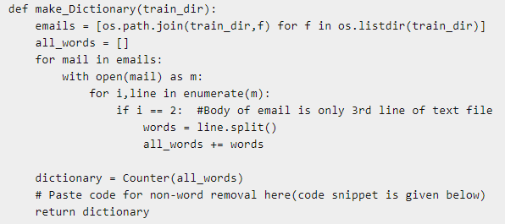
Creating a word dictionary

Slide 7
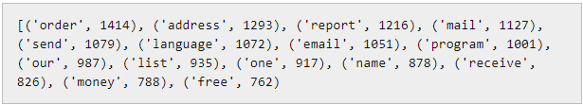
Creating a word dictionary
As a first step, we need to create a dictionary of words and their frequency. For this task, training set of 700 mails is utilized. This python function creates the dictionary for you.
Once the dictionary is created we can add just a few lines of code remove non-words
Dictionary can be seen by the command print dictionary.
Output will be something like this

Slide 8
Extraction Process
Once the dictionary is ready, we can extract word count vector (our feature here) of 3000 dimensions for each email of training set. Each word count vector contains the frequency of 3000 words in the training file.
The python code will generate a feature vector matrix whose rows denote 700 files of training set and columns denote 3000 words of dictionary

Slide 9
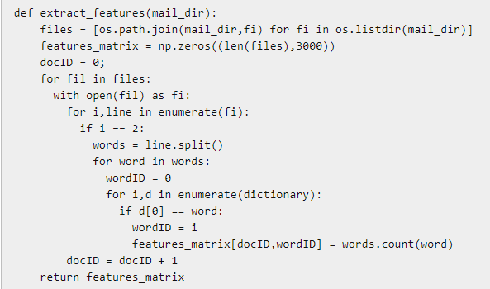
Extraction Process

Slide 10
Training classifier
Here, we will be using scikit-learn ML library for training classifiers.
I have trained two models here namely
Naive Bayes classifier
Support Vector Machines (SVM).
Naive Bayes classifier is a conventional and very popular method for document classification problem. It is a supervised probabilistic classifier based on Bayes theorem assuming independence between every pair of features.
SVMs are supervised binary classifiers which are very effective when you have higher number of features. The goal of SVM is to separate some subset of training data from rest called the support vectors (boundary of separating hyper-plane). The decision function of SVM model that predicts the class of the test data is based on support vectors and makes use of a kernel trick.

Slide 11
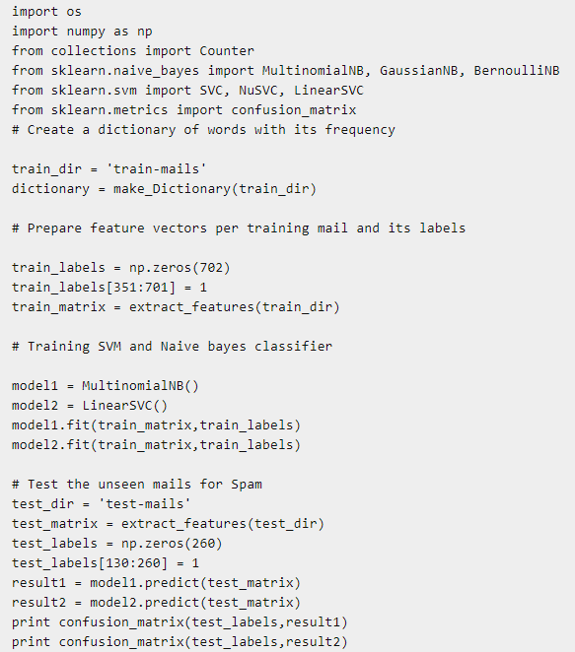
Training classifier Code

Slide 12
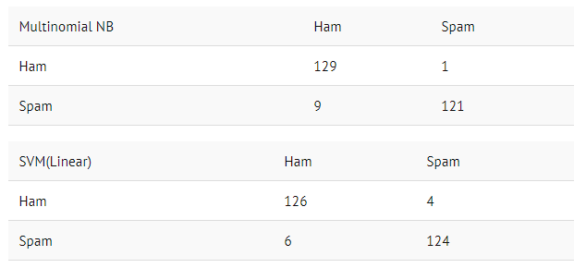
Performance Checking
Test-set contains 130 spam emails and 130 non-spam emails.

