Slide 1
Tiny Pest Intelligence: Multi-Class Detection and Recommendation System
TEAM MEMBERS
K.GOVARDHAN 22HP1A4245
B.ANKAMMA 22HP1A4238
V.PADMAKANTH 22HP1A4253
UNDER THE GUIDANCE OF
Mrs. D.ARCHANA MADAM
Assistant Professor CSE(AI&ML ) Department

Slide 2
PROBLEM STATEMENT
In real-world farming, different crops are attacked by many types of tiny pests right from their early growth stages, making it impossible for a single-species system to protect the farm. Standard detection tools are mostly trained for only one pest, like the Aphid, and fail to identify the diverse range of small insects found in a multi-crop environment. Because these pests are extremely small and vary across different plant varieties, they are often missed or misidentified during the most critical early stages of infestation. This lack of a multi-pest detection system prevents farmers from knowing exactly which pest is attacking, leading to the wrong pesticide use and significant crop loss.

Slide 3
ABSTRACT
The existing system uses Aphid-YOLO, a lightweight YOLOv8-based model designed to detect and count tiny aphids in complex field environments. The system does not address multi-pest detection, which limits its applicability in real agricultural scenarios where multiple pests co-exist. Detecting tiny pests in real-time field conditions is difficult due to noise, occlusion, and low image quality. Balancing high accuracy with lightweight models for real-time use is still a challenge. This project develops an advanced agricultural intelligence system by enhancing the YOLOv11 framework for high-precision Multi-Pest Detection. By integrating a P2 High-Resolution layer and NWD Loss, the model successfully identifies tiny and densely clustered pests from the Pest24 dataset that are often missed by standard systems

Slide 4
Objectives
Multi Tiny Pest Detection: To implement an enhanced YOLOv11-based detection model with a P2 high-resolution feature layer and NWD loss for accurate detection and counting of tiny pests in complex field backgrounds.
Severity Estimation: To design a pest density analysis module that classifies infestation levels into Low, Medium, and High severity based on detected pest count and spatial distribution.
LLM-Based Decision Support: To integrate Large Language Models (LLMs) with the vision system to enable control strategies, and treatment recommendations based on detected severity.
Farmer-Centric Guidance: To provide actionable, real-time intervention suggestions that assist farmers in selecting the most effective pest management measures.

Slide 5
Literature Survey
Author | Model / Methodology | Key Contribution | Limitation | Relevance to Project
Lin et al. (Standard YOLO) | YOLOv5 / YOLOv8 | Real-time object detection using CSPDarknet. | Struggles with "Tiny Objects" as features vanish in deep layers. | Provides the basic framework for real-time detection.
Wang et al. () | Faster R-CNN / SSD | Large-scale multi-target agricultural pest dataset. | computational cost; suitable for real-time mobile use. | Primary data source for training your multi-class model.
Zheng et al. | Aphid-YOLO (A-YOLO) | TPANet tiny pest detection. | Focuses only on counting; no decision-making or mapping. | Core Architecture for your pest detection engine.
Du et al. | Density-based Clustering | Identification of densely clustered pests in the wild. | No GPS integration or field-wide visualization. | Logic used for your Severity Estimation (Density analysis).

Slide 6
REQUIREMENTS
Operating System: Windows / Linux
Programming Language: Python 3.8 or above
Deep Learning Framework: Tensorflow / PyTorch
Object Detection Model: YOLOv11
Computer Vision Library: OpenCV
Data Handling: NumPy, Pandas
LLM Integration: Open-source LLM (recommendations)
Development Environment: Jupyter Notebook / Google Colab

Slide 7
FEASIBILITY STUDY
Technical Feasibility
Android phones works with images from mobile and field cameras.
YOLO models support real-time detection
TensorFlow Lite enables mobile deployment
Economic Feasibility
Uses existing smartphones or cameras.
Built with open-source tools only.
Operational Feasibility
Simple & Easy-to-use interface
Provides automatic severity and control guidance.

Slide 8
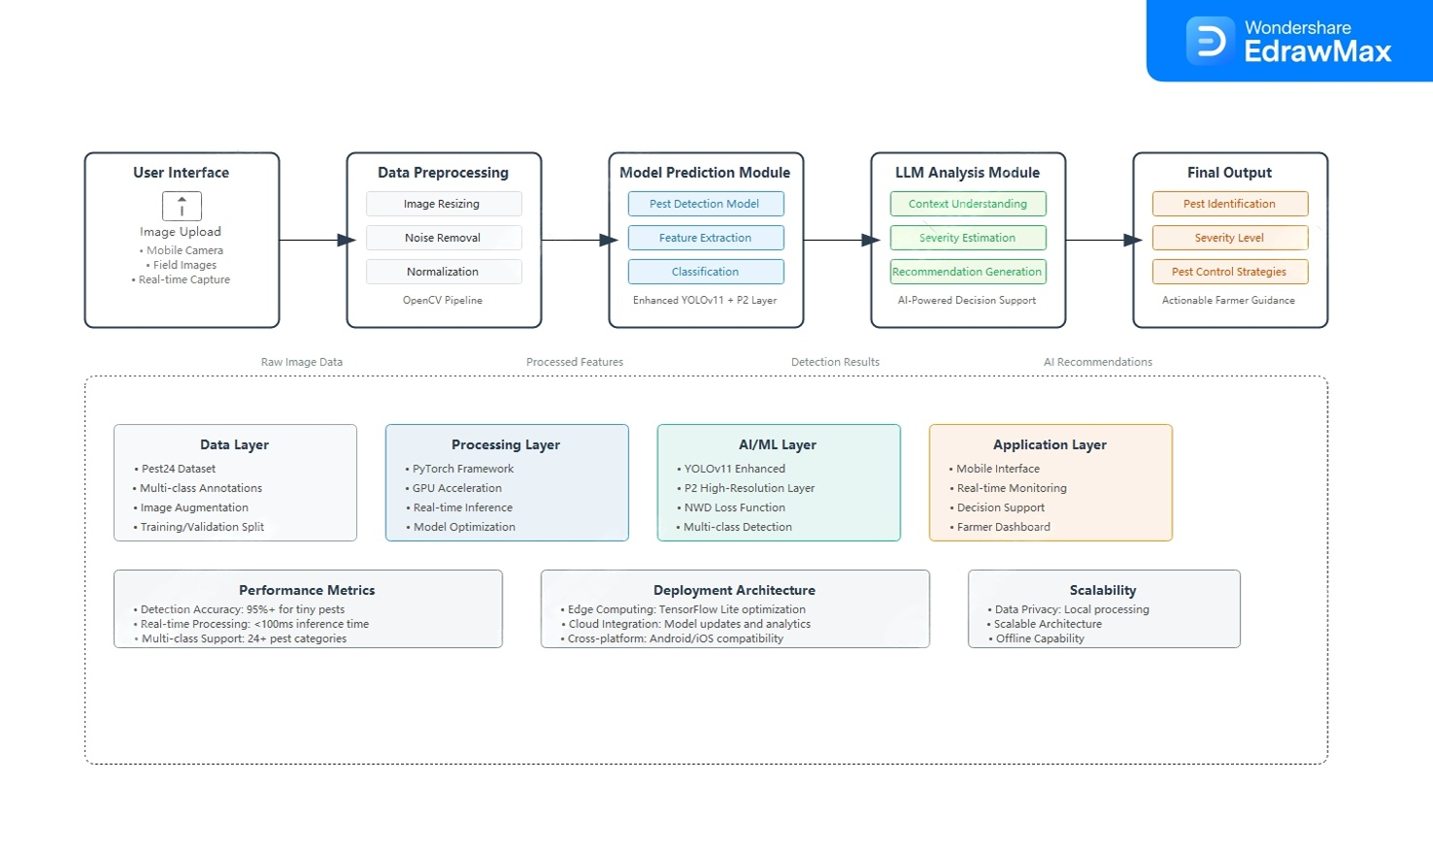
System Architecture

Slide 9
Methodology

Slide 10
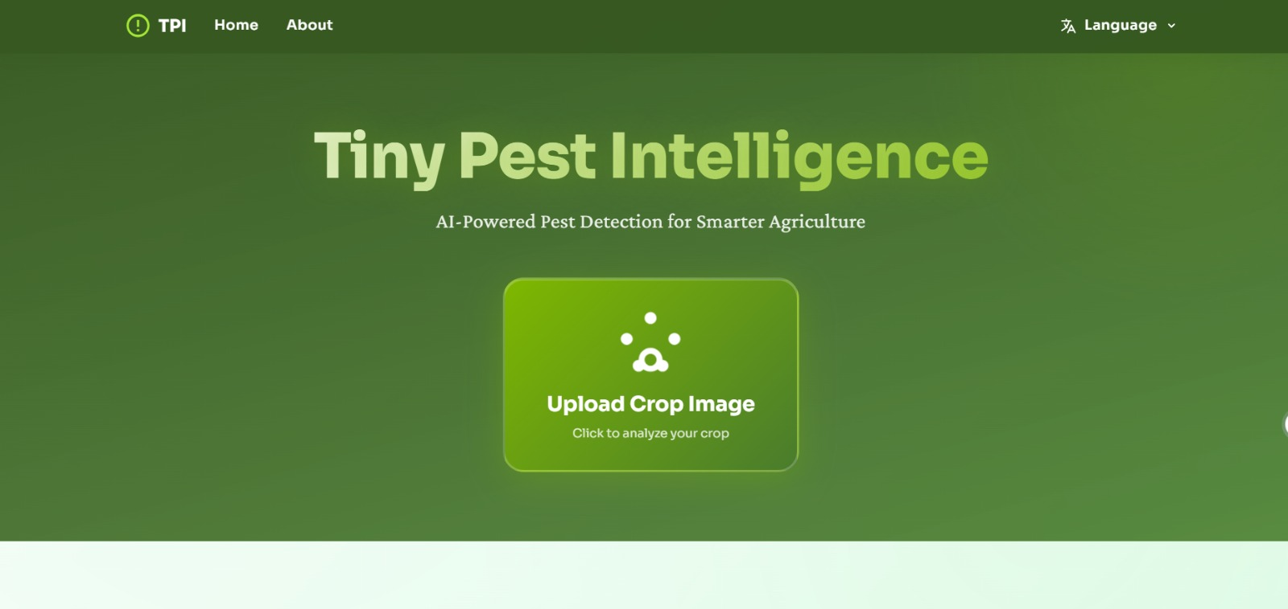
Current Progress
Implementing the user interface
Model as yolo11 and adding p2 resolution layer
working abstraction for submission to conference paper

Slide 11

Publication Details

