Slide 1
FLUX

Slide 2
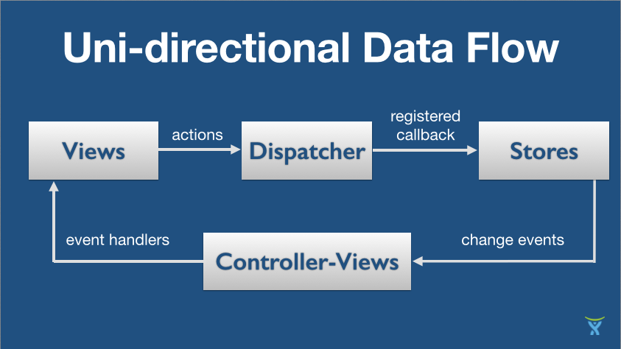
React – State

Slide 3
React – State
Unidirectional Data Flow
In React, application data flows unidirectionally via the state and props objects, as opposed to the two-way binding of libraries like Angular.
In a multi component heirachy, a common parent component should manage the state and pass it down the chain via props.
state should be updated using the setState method to ensure that a UI refresh will occur.
The resulting values should be passed down to child components using attributes that are accessible in said children via this.props.

Slide 4
React – FLUX
Flux is an architecture that Facebook uses internally when working with React.
It is not a framework or a library.
It is a new kind of architecture that complements React and the concept of Unidirectional Data Flow.
, Facebook does provide a repo called a Dispatcher library. The dispatcher is a sort of global pub/sub handler that broadcasts payloads to registered callbacks.
Flux architecture will use Dispatcher library and NodeJS’s EventEmitter module to set up an event system that helps manage an applications state.

Slide 5
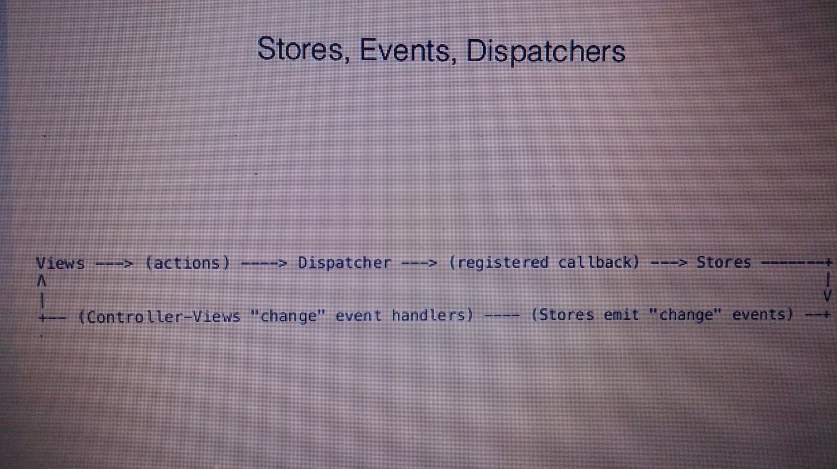
React – FLUX Components

Slide 6
React – FLUX Components
Actions – Helper methods that facilitate passing data to the Dispatcher
Dispatcher – Receives actions and broadcasts payloads to registered callbacks
Stores – Containers for application state & logic that have callbacks registered to the dispatcher.
Controller Views – React Components that grab the state from Stores and pass it down via props to child components.

Slide 7
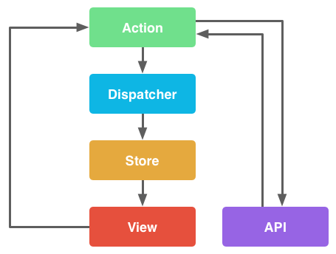
React – FLUX Components

Slide 8
React – FLUX Components
The Dispatcher is the manager which is central hub for application. The dispatcher receives actions and dispatches the actions and data to registered callbacks.
So it’s essentially pub/sub?
Not exactly. The dispatcher broadcasts the payload to ALL of its registered callbacks, and includes functionality that allows to invoke the callbacks in a specific order, even waiting for updates before proceeding.
There is only everone dispatcher, and it acts as the central hub within application.

Slide 9
React – FLUX Components
var AppDispatcher = new Dispatcher();
AppDispatcher.handleViewAction = function(action) { this.dispatch({
source: 'VIEW_ACTION',
action: action
});}
module.exports = AppDispatcher;

Slide 10
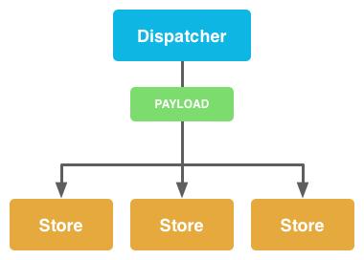
React – FLUX Components

Slide 11
React – FLUX Components
Stores
In Flux, Stores manage application state for a particular domain within application.
From a high level, this basically means that per app section, stores manage the data, data retrieval methods and dispatcher callbacks.

Slide 12
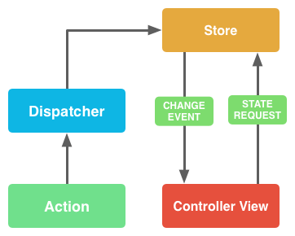
React – FLUX Components

Slide 13
React – FLUX Components
Action Creators & Actions
Action Creators are collections of methods that are called within views to send actions to the Dispatcher.
Actions are the actual payloads that are delivered via the dispatcher.

Slide 14
React – FLUX Components
Controller Views
Controller views are really just React components that listen to change events and retrieve Application state from Stores.
They then pass that data down to their child components via props.

Slide 15
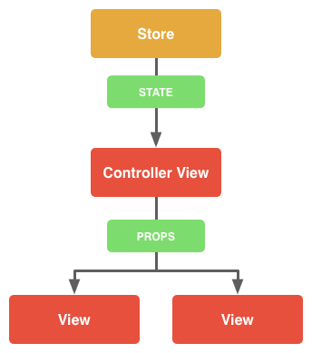
React – FLUX Components

Slide 16
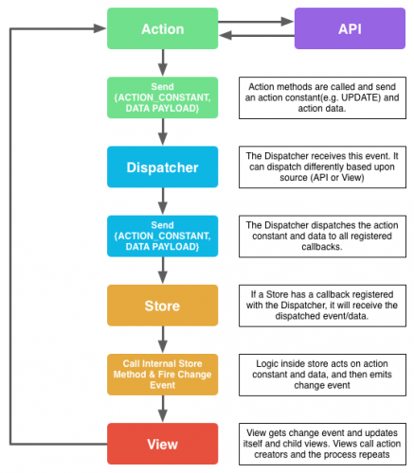
React – FLUX Flow

Slide 17
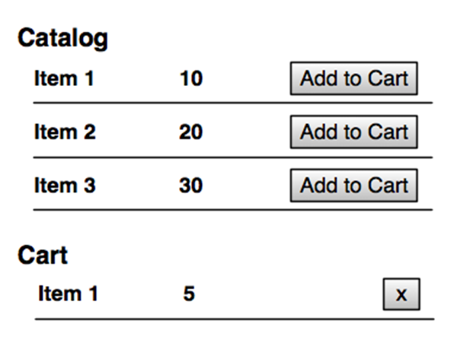
React – Angular with FLUX case study

Slide 18
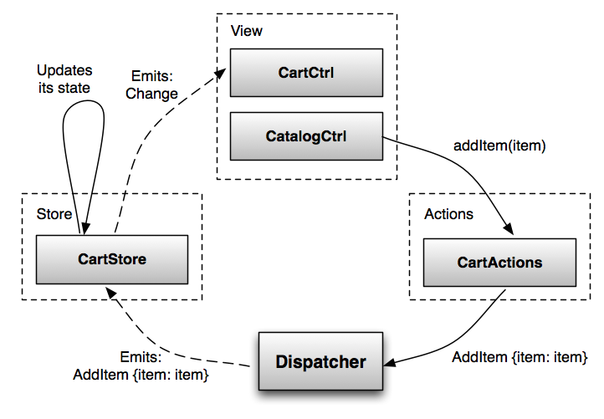
React – Angular with FLUX case study

Slide 19
React – Angular with FLUX case study

Slide 20
React – Angular with FLUX case study

Slide 21
React – Angular with FLUX case study

Slide 22
React – Angular with FLUX case study
DISPATCHER
The dispatcher is a message-bus service that propagates events from views to stores. It has no application logic

Slide 23
React – Angular with FLUX case study
STORE
A store contains application logic and state for a particular domain. It registers itself with the dispatcher to be notified about the events flowing through the system. The store then updates itself based on those events.

Slide 24
React – Angular with FLUX case study

Slide 25
React – Angular with FLUX case study

Slide 26
React – Angular with FLUX case study

Slide 27
React – Angular with FLUX case study

