Slide 1
Latency-Aware Edge Game Server Placement
Measuring how server load breaks the analytical latency model
used in edge placement decisions
Ankam Charan Teja · Aranya Roy · Aadhar · Nikhil · Yash
Notes:
Good [morning/afternoon]. This talk is about a mismatch between how edge placement algorithms choose a server node and what players actually experience when that node gets busy.
Repository: github.com/ankamteja/latency-aware-edge-game-placement.
10-minute slot — one idea per slide.

Slide 2
The Problem: Nearest Is Not Always Fastest
A navigation analogy — routing blind to traffic
🗺 Maps without traffic
▸ Your GPS picks the shortest route by distance
▸ It does not see that the short road is jammed
▸ You arrive later than if you had taken the longer road
🖧 Edge placement without load
▸ The algorithm picks the nearest edge node
▸ It uses only: propagation delay + packet size / bandwidth
▸ It does not see that the node is nearly full
▸ Players on a jammed edge node wait longer than on a distant cloud node
→
Notes:
Think of navigation routing by distance only. The shortest road is not always the fastest — traffic matters.
Edge placement makes the same mistake. The standard formula measures propagation delay and link bandwidth but knows nothing about how many players are already on the node.
Edge nodes are small and capped. Once crowded, queueing inside the game thread exceeds the network advantage. The nearest node becomes the worst choice.

Slide 3
The Load-Blind Formula — and Why Simulators Hide the Error
latency = propagation_delay + data_size / bandwidth
latency = propagation_delay + data_size / bandwidth
What the formula captures
▸ Propagation delay: signal travel time over the physical link
▸ data_size / bandwidth: time to transmit the packet
▸ Both terms are network-only — server is assumed instantaneous
▸ Accurate when the server has spare capacity
What the formula misses
▸ A loaded server queues every game tick — that delay is absent
▸ Simulators that evaluate placement use the same formula
▸ The model omits a term; the evaluator inherits the same gap
▸ Error is invisible until measured on a real workload
Notes:
The formula has two terms: propagation (distance) and transmission (bandwidth). Both are network properties. The server is treated as instantaneous.
At low load that is fine. At high load the game's main tick loop queues work — every player action waits for the previous tick. This queueing delay can be hundreds of milliseconds, dwarfing the 5 ms propagation advantage.
The deeper problem: placement research evaluates algorithms in simulators built on this same formula. The omitted term never appears, so the error is never noticed.

Slide 4
Research Question
How large is the gap between what the analytical formula predicts and what a player actually experiences when an edge node is under load — and can a predictor trained on measured data close it?
Sub-goals
▸ Measure latency at four layers simultaneously on the same loaded node
▸ Quantify model error as a function of player count
▸ Train a data-driven predictor to replace the analytical formula
▸ Show that load-aware placement changes which node wins
Notes:
One sentence: can we measure the error the formula ignores and use that measurement to make better placement decisions?
Four sub-goals drive the experimental design that follows.

Slide 5
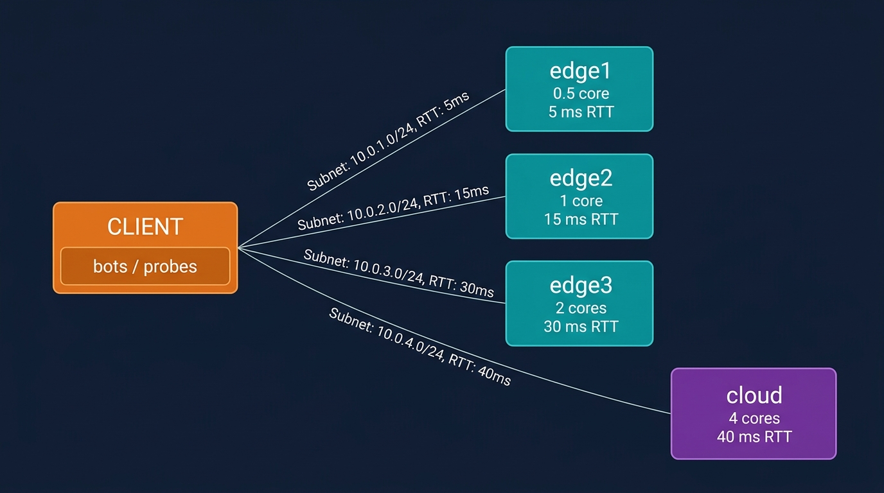
Testbed: Containerlab Edge-Cloud Topology
Client + three edge nodes + cloud — all on one physical host
Node
CPU cap
RTT
edge1
0.5 core
5 ms
edge2
1 core
15 ms
edge3
2 cores
30 ms
cloud
4 cores
40 ms
• Containerlab emulates links with exact RTT budgets
• Minecraft Paper server on each node, CPU-capped via cgroups
• mineflayer bots speak the real game protocol
• All four probes run in parallel — same load, same moment
Notes:
The testbed runs entirely on one physical machine. Containerlab creates virtual network paths with precisely controlled latency.
Each node runs a real Minecraft Paper server, capped to its CPU quota via Linux cgroups. Bots use the mineflayer library — actual game protocol, not HTTP.
This lets us measure game-thread latency, not synthetic web-request latency.

Slide 6
Four-Rung Measurement Ladder
Decomposing where delay lives — network, OS, process, or game thread
1
1 ICMP ping
What the analytical formula predicts.
ICMP flat ⟹ the network is not the cause.
Kernel to kernel — network only
2
2 TCP handshake
Separates link delay from OS accept queue.
Expected to stay nearly flat under load.
Network + server host's TCP accept path
3
3 Status ping
Minecraft server-list ping.
Shows whether server-process load bleeds into responses.
Network + server process answering a request
4
4 In-game RTT
Chat echo via mineflayer.
Every ms above probe 1 is model error — unmeasured queueing.
Network + server's main game thread (tick loop)
Notes:
All four probes run concurrently on the same link under the same load — so delay can be attributed to a layer, not guessed.
Probe 1 is the formula's prediction. Every millisecond between probe 1 and probe 4 is model error.
Measurement result: ICMP barely moved (5.07–5.10 ms at any load). In-game p95 RTT went from 11 ms at 1 player to 6248 ms at 40 players — a 570× increase on the same link, caused entirely by the game thread.

Slide 7
Node Capacity: Flat, Then a Cliff
p95 in-game RTT and tick time (MSPT), mean of two replicates. Tick budget is 50 ms.
Players
edge1 p95
edge1 MSPT
edge2 p95
edge2 MSPT
The flat-then-vertical shape
▸ edge1 (0.5 core) stays within 10 ms of its 5 ms network RTT up to 40 players
▸ Between 40 and 60 players its p95 jumps to 6.7–8.6 s
▸ edge2 (1 core) is flat to 60 players, breaks between 80 and 100
▸ edge3 and cloud never reach a knee within 100 players
▸ ICMP never moved more than 0.3 ms in any cell
1
6 ms
1.0 ms
16 ms
1.6 ms
20
8.5 ms
2.5 ms
17.5 ms
2.5 ms
40
14.5 ms
4.6 ms
21 ms
4.0 ms
60
7.7 s
46 ms
23 ms
6.3 ms
80
—
—
34 ms – 2.7 s
11 ms
The tail breaks first
▸ edge1 at 50 players: MSPT 6.5 ms, 1/8 of the budget
▸ p95 already 47–308 ms
100
—
—
5.3 – 14.4 s
46 ms
Notes:
Two replicates of the grid, time of day frozen, idle host. Each cell is 90 s of steady load. The network round trip is flat everywhere; the latency growth is all inside the server. The point to make: mean tick time looks healthy while the tail is already breaking. At the knee the two replicates disagree a lot (edge2 at 80: 34 ms vs 2.7 s), which is why we quote a range there. Source: docs/08-results.md section 8.2.

Slide 8
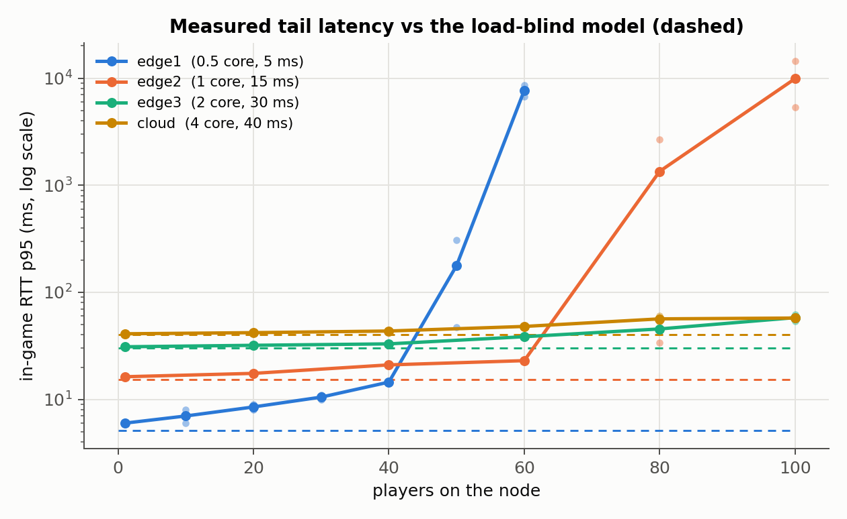
Rank Inversion: One Match, Which Node?
The load-blind model always picks the nearest node. Right to 40 players, wrong at 60.
Players
edge1 p95
edge2 p95
Model picks
Measured best
Key finding
▸ Model ranks by distance alone: edge1 (5 ms) always first
▸ At 60 players edge1 is 330x worse than edge2
▸ Regret on the worst player: 7.66 s
▸ Queueing and learned models switch to edge2 at 60: zero regret
1
6 ms
16 ms
edge1 ✓
edge1
20
8.5 ms
17.5 ms
edge1 ✓
edge1
40
14.5 ms
21 ms
edge1 ✓
edge1
60
7.7 s
23 ms
edge1 ✗
edge2
Notes:
This is the single-match version of the question. Table: measured p95, mean of both replicates. The figure shows every node; the dashed lines are what the load-blind formula predicts, flat at the network RTT. Honest framing: the inversion appears between 40 and 60 players on this testbed because we chose 0.5 core and 5 ms; the claim is that it exists and is large, not the exact player count. Source: 08-results 8.3.

Slide 9
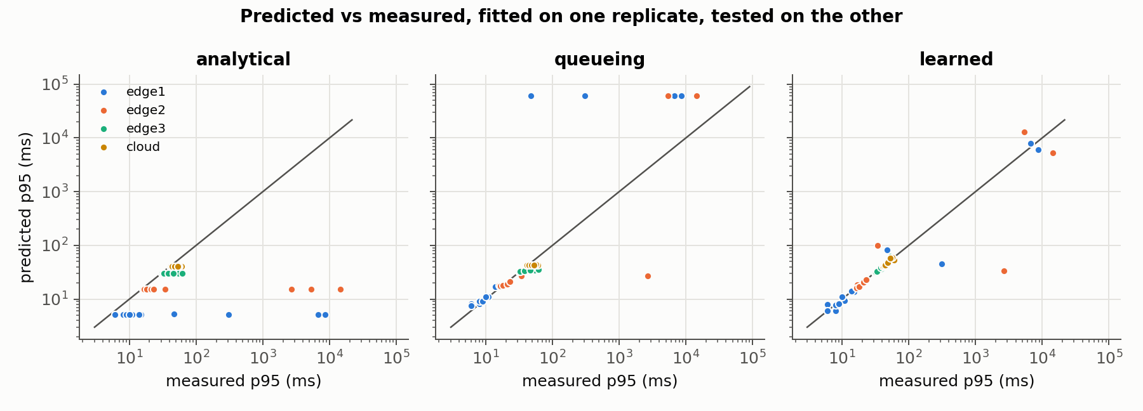
Dataset and the Learned Predictor vs Analytical Formula
Three latency models, fitted on one replicate, tested on the other
Dataset and models
▸ Dataset: 81 cells, 243 rows of 30 s windows (grid1, grid2, deployments)
▸ Analytical: RTT + size/bandwidth, no load term
▸ Queueing (M/M/1): RTT + s/(1−u), s fitted = 2.8 ms
▸ Learned: RTT + gradient-boosted trees on utilization, players, cores
▸ Median abs error: analytical 5.8 ms, queueing 1.8 ms, learned 0.9 ms
▸ Learned transfers best to an unseen node on 3 of 4 nodes
Notes:
The dataset is the artifact: every row is a measured window, not a formula output. Splits are by replicate, never by row. Read the figure: points on the diagonal are correct predictions. Analytical is a flat line per node, it cannot see load. Queueing is good in the flat part but explodes near the knee (the dots at the top). Learned follows the diagonal best. Source: results/model/summary.md, 08-results 8.4.

Slide 10
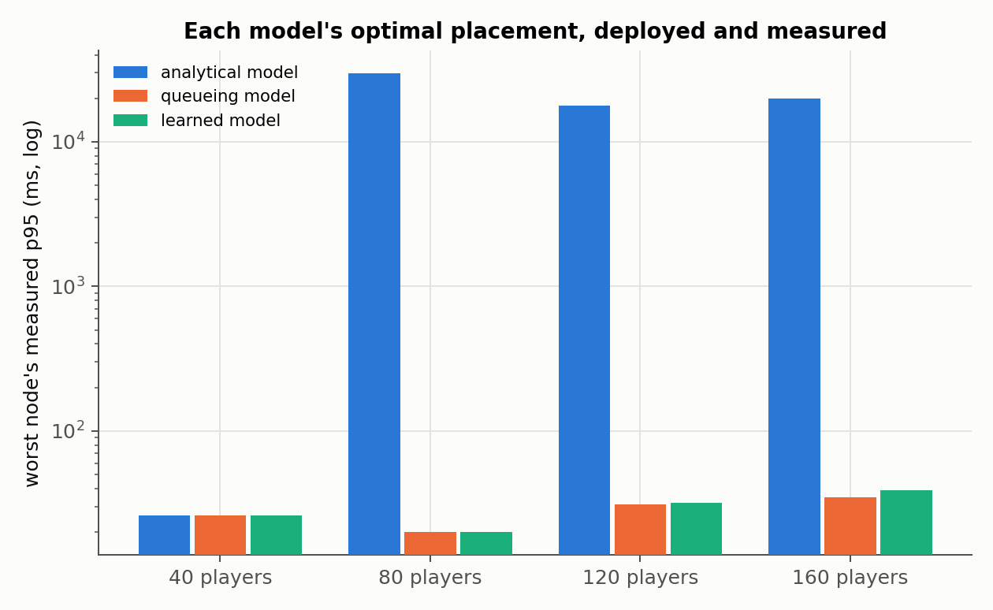
Placement Algorithms Compared on Worst-Player Latency
Each model's optimal placement deployed for real, all nodes loaded at once
Worst player's measured p95
▸ 40 players: analytical 26 ms · queueing 26 · learned 26
▸ 80: analytical 29.9 s · queueing 20 ms · learned 20 ms
▸ 120: analytical 17.8 s · queueing 31 ms · learned 32 ms
▸ 160: analytical 20.0 s · queueing 35 ms · learned 39 ms
▸ Load-blind puts everyone on the nearest node: 570–1500x worse
▸ Both load-aware models keep edge1 at 40 and spread the rest
▸ Learned predicts best, but places the same as fitted M/M/1
Notes:
This is the end-to-end test. For 40 to 160 players in matches of 10, each model's brute-force optimum was computed and then deployed on the testbed with every loaded node running at once. The clock grades the models, not the models themselves. The analytical model predicted 5-15 ms for all of these. Be careful with the last bullet: the learned model does not place better than the queueing model here. Source: results/placement/deployments.csv, 08-results 8.5.

Slide 11
Limitations
Scope
▸ One host, two replicates: a spread, not a confidence interval
▸ Capacities and delays were chosen to create the trade-off
▸ Bots, not humans; hostile mobs disabled
▸ Four nodes, four placement scenarios
Measurement
▸ Knees are unstable: replicates differ 6–80x there
▸ Host processes can share the servers' cores: one contended run was 2.4x the CPU, excluded
▸ edge3 and cloud never pushed past their knee (100-player ceiling)
▸ Bandwidth term negligible: links carry no background traffic
Notes:
Every number on the previous slides comes with these limits. The contended run is the most interesting one: the host itself became the load the model is blind to. Source: 08-results 8.6.

Slide 12
Conclusion and Future Work
What this work shows
▸ The load-blind formula is right only below a node's saturation point
▸ Above it the error is seconds: 18–30 s worst-player latency, deployed
▸ Load-aware placement keeps the same players at 20–39 ms
▸ A learned model predicts latency best; a fitted M/M/1 already places right here
▸ The latency term in placement must see load, and is better measured than assumed
Future work
▸ More replicates on a dedicated host, intervals on the knees
▸ Push larger nodes past their knee; larger placement problems
▸ Jitter, loss and bandwidth caps; mob AI back as a second load source
Notes:
Close on the deployed numbers, they are the strongest evidence. Repo, raw data and dataset: github.com/ankamteja/latency-aware-edge-game-placement.

