Slide 1
Latency-Aware Edge Game Server Placement
Measuring how server load breaks the analytical latency model
used in edge placement decisions
Ankam Charan Teja · Aranya Roy · Nikhil Kumar Reddy · Yashvardhan Deep · Akshit Singh
Notes:
This talk is about a mismatch between how edge placement algorithms choose a server node and what players actually experience when that node gets busy. Repository and a replay of the live dashboard: github.com/ankamteja/latency-aware-edge-game-placement. 10 minutes, one idea per slide.

Slide 2
ABSTRACT
Abstract
Edge placement algorithms choose a node with a latency formula that has no term for server load, and are usually evaluated in simulators built on the same formula. We measure the error on a real testbed: four CPU-capped game servers, protocol-level bots, latency measured at four depths at once, and each model's placement deployed for real and run as a live controller.
Key results
▸ Network delay stays within 0.3 ms at any load; the smallest node's p95 goes from 15 ms to 6.7–8.6 s
▸ Deployed, the load-blind placement leaves the worst players at 18–30 s; load-aware placements 16–55 ms
▸ The learned model predicts best (0.9 ms median error, 1.1 ms held out) but places like a fitted M/M/1
▸ Live, 3 runs each: formula 1.1 s, M/M/1 99 ms, learned 39 ms, learned corrected live 33 ms
Notes:
The whole talk in one slide: the formula placement algorithms use has no load term, so on a busy edge node it is wrong by seconds, and a simulator built on it cannot show that. Every number here is measured, and each comes back with its detail on a later slide.

Slide 3
I · INTRODUCTION
The Problem: Nearest Is Not Always Fastest
A navigation analogy: routing blind to traffic
Maps without traffic
▸ Your GPS picks the shortest route by distance
▸ It does not see that the short road is jammed
▸ You arrive later than if you had taken the longer road
Edge placement without load
▸ The algorithm picks the nearest edge node
▸ It uses only: propagation delay + packet size / bandwidth
▸ It does not see that the node is nearly full
▸ Players on a jammed edge node wait longer than on a distant cloud node
→
Notes:
Think of navigation routing by distance only. The shortest road is not always the fastest; traffic matters.
Edge placement makes the same mistake. The standard formula measures propagation delay and link bandwidth but knows nothing about how many players are already on the node.
Edge nodes are small and capped. Once crowded, queueing inside the game thread exceeds the network advantage. The nearest node becomes the worst choice.

Slide 4
I · INTRODUCTION
The Load-Blind Formula, and Why Simulators Hide the Error
latency = propagation_delay + data_size / bandwidth
latency = propagation_delay + data_size / bandwidth
What the formula captures
▸ Propagation delay: signal travel time over the physical link
▸ data_size / bandwidth: time to transmit the packet
▸ Both terms are network-only: the server is assumed to answer instantly
▸ Accurate when the server has spare capacity
What the formula misses
▸ A busy server makes every action wait for its game tick; the formula has no term for that
▸ Simulators that evaluate placement use the same formula
▸ The model omits a term; the evaluator inherits the same gap
▸ Error is invisible until measured on a real workload
Notes:
The formula has two terms: propagation (distance) and transmission (bandwidth). Both are network properties. The server is treated as instantaneous.
At low load that is fine. At high load the game's main tick loop queues work: every player action waits for the previous tick. This queueing delay can be hundreds of milliseconds, dwarfing the 5 ms propagation advantage.
The deeper problem: placement research evaluates algorithms in simulators built on this same formula. The omitted term never appears, so the error is never noticed.

Slide 5
I · INTRODUCTION
Research Question
How large is the gap between what the analytical formula predicts and what a player actually experiences when an edge node is under load, and can a predictor trained on measured data close it?
Sub-goals
▸ Measure latency at four layers simultaneously on the same loaded node
▸ Quantify model error as a function of player count
▸ Train a data-driven predictor to replace the analytical formula
▸ Show that load-aware placement changes which node wins
Notes:
One sentence: can we measure the error the formula ignores and use that measurement to make better placement decisions?
Four sub-goals drive the experimental design that follows.

Slide 6
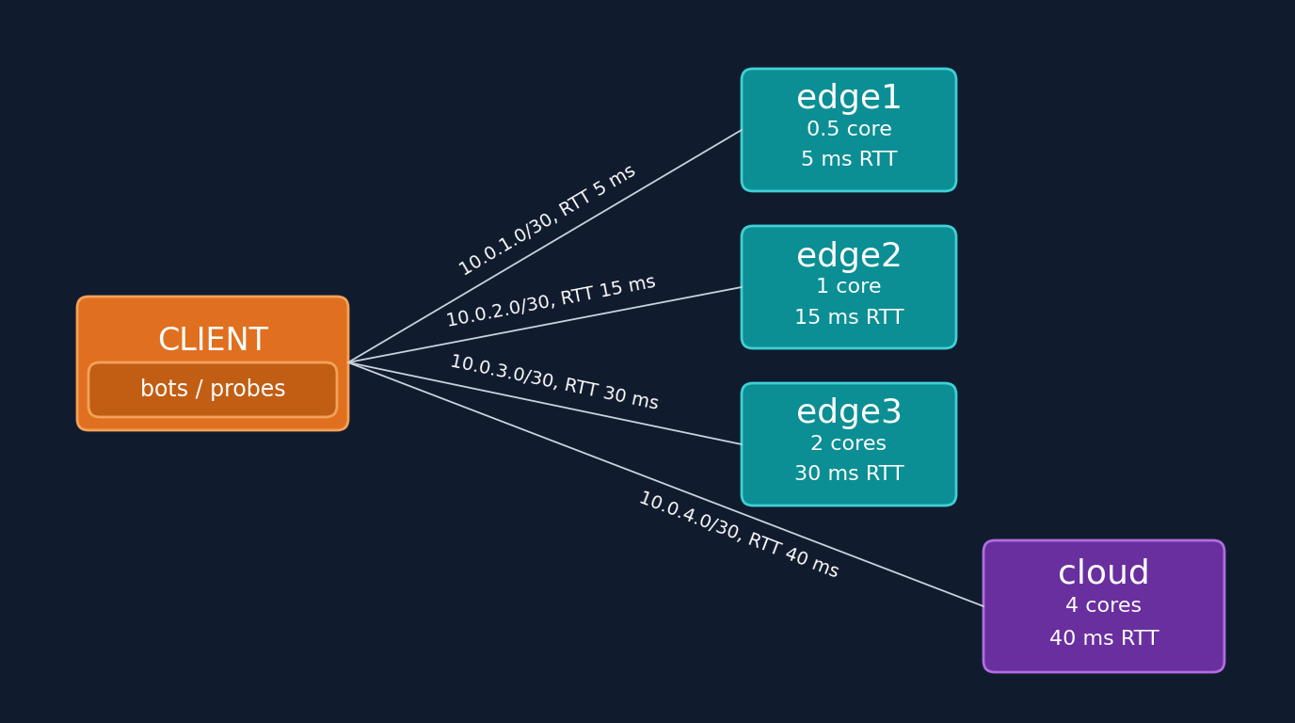

II · METHODOLOGY
Testbed: Containerlab Edge-Cloud Topology
A client, three edge nodes and a cloud node, all on one laptop
Node
CPU cap
RTT
edge1
0.5 core
5 ms
edge2
1 core
15 ms
edge3
2 cores
30 ms
cloud
4 cores
40 ms
• netem adds each link's delay; the RTT is measured with ping
• Minecraft Paper server on each node, CPU-capped via cgroups
• mineflayer bots speak the real game protocol
• All four probes run in parallel: same load, same moment
Notes:
The testbed runs entirely on one physical machine. Containerlab creates virtual network paths with precisely controlled latency.
Each node runs a real Minecraft Paper server, capped to its CPU quota via Linux cgroups. Bots use the mineflayer library, which speaks the real game protocol, not HTTP.
This lets us measure game-thread latency, not synthetic web-request latency.

Slide 7
II · METHODOLOGY
Four-Rung Measurement Ladder
Where the delay comes from: network, OS, server process or game thread
1
1 ICMP ping
What the analytical formula predicts.
If ICMP stays flat, the network is not the cause.
Network only
2
2 TCP handshake
Separates link delay from OS accept queue.
Expected to stay nearly flat under load.
Network + server host's TCP accept path
3
3 Status ping
Minecraft server-list ping.
Shows whether server-process load bleeds into responses.
Network + server process answering a request
4
4 In-game RTT
Chat echo via mineflayer.
Every ms above probe 1 is delay the formula cannot see.
Network + server's main game thread (tick loop)
Notes:
All four probes run at the same time, on the same link, under the same load, so the delay can be traced to a layer instead of guessed. Probe 1 is what the formula predicts; anything above it is delay the formula cannot see. p95 means 95% of messages were faster than this value: it shows what the unluckiest players feel, not the average. Measured on edge1 from 1 to 60 players: ICMP stayed at 5.1 to 5.3 ms, the status ping moved only at 60 players (16 to 32 ms), and the in-game p95 went from 6 ms to 6.7 to 8.6 seconds. Source: docs/08-results.md 8.2.

Slide 8
III · IMPLEMENTATION
Implementation
Testbed and measurement
▸ containerlab topology, tc netem delays, cgroup cpu.max quotas on disjoint cores
▸ Paper 1.21.4 servers; topology/verify.sh checks links, RTT, CPU limits, power mode
▸ bots/bot.js: mineflayer bots, 10 per process; probe.js: TCP and status ping
▸ collect.sh, grid.sh: one cell = settle, baseline, joins, 90 s steady window
Analysis and live system
▸ build_dataset.py: 150 cells, 450 rows of 30 s windows
▸ models.py: three models behind one predict(node, players)
▸ experiment.py: exhaustive placement search; deploy_plan.sh deploys it
▸ live/: 2 s controller loop, browser dashboard, 29 unit tests
▸ rebuild.sh: every table and figure rebuilt from the raw data
Notes:
How it is built. Everything is scripts in the repository: the topology and its checks, the bots and probes, the cell collector, the dataset builder, the three models behind one interface so every algorithm runs with any of them, the placement search and deployer, and the live controller with its dashboard. One command rebuilds every number in the report from the raw measurements. Source: README, report Section III.

Slide 9
IV · RESULTS
Node Capacity: Flat, Then a Cliff
p95 in-game RTT and tick time (MSPT), mean of two replicates. Tick budget is 50 ms.
Players
edge1 p95
edge1 MSPT
edge2 p95
edge2 MSPT
The flat-then-vertical shape
▸ edge1 (0.5 core) stays within 10 ms of its 5 ms network RTT up to 40 players
▸ Between 40 and 60 players its p95 jumps to 6.7–8.6 s
▸ edge2 (1 core) is flat to 60 players; knee at 80, breaks by 100
▸ edge3 and cloud never reach a knee within 100 players
▸ ICMP never moved more than 0.3 ms in any cell
1
6 ms
1.0 ms
16 ms
1.6 ms
20
8.5 ms
2.5 ms
17.5 ms
2.5 ms
40
14.5 ms
4.6 ms
21 ms
4.0 ms
60
7.7 s
46 ms
23 ms
6.3 ms
80
not run
not run
34 ms – 2.7 s
11 ms
The tail breaks first
▸ edge1 at 50 players: MSPT 6.6 ms, 1/8 of the budget
▸ p95 already 47–308 ms
100
not run
not run
5.3 – 14.4 s
46 ms
Notes:
Two replicates of the grid, time of day frozen, idle host. Each cell is 90 s of steady load. The network round trip is flat everywhere; the latency growth is all inside the server. The point to make: mean tick time looks healthy while the tail is already breaking. At the knee the two replicates disagree a lot (edge2 at 80: 34 ms vs 2.7 s), which is why we quote a range there. Source: docs/08-results.md section 8.2.

Slide 10
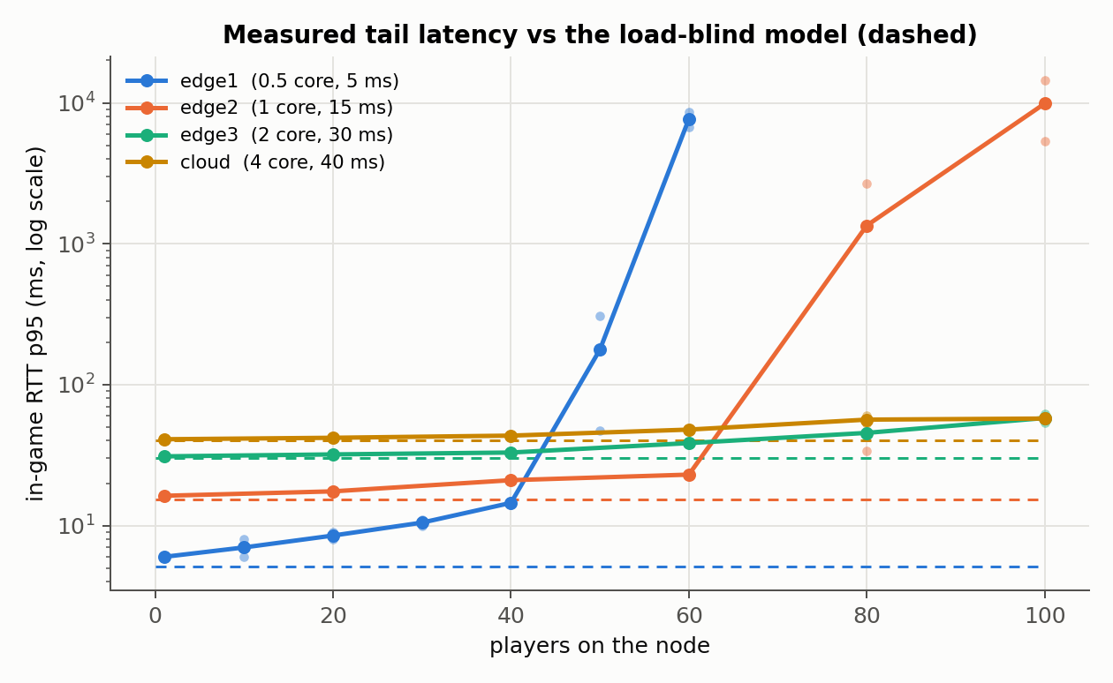
IV · RESULTS
Rank Inversion: One Match, Which Node?
The load-blind model always picks the nearest node. Right to 40 players, wrong at 60.
Players
edge1 p95
edge2 p95
Model picks
Measured best
Key finding
▸ Model ranks by distance alone: edge1 (5 ms) always first
▸ At 60 players edge1 is 330x worse than edge2
▸ Regret on the worst player: 7.66 s
▸ Queueing and learned models switch to edge2 at 60: zero regret
1
6 ms
16 ms
edge1 ✓
edge1
20
8.5 ms
17.5 ms
edge1 ✓
edge1
40
14.5 ms
21 ms
edge1 ✓
edge1
60
7.7 s
23 ms
edge1 ✗
edge2
Notes:
This is the single-match version of the question. Table: measured p95, mean of both replicates. The figure shows every node; the dashed lines are what the load-blind formula predicts, flat at the network RTT. Honest framing: the inversion appears between 40 and 60 players on this testbed because we chose 0.5 core and 5 ms; the claim is that it exists and is large, not the exact player count. Source: 08-results 8.3.

Slide 11
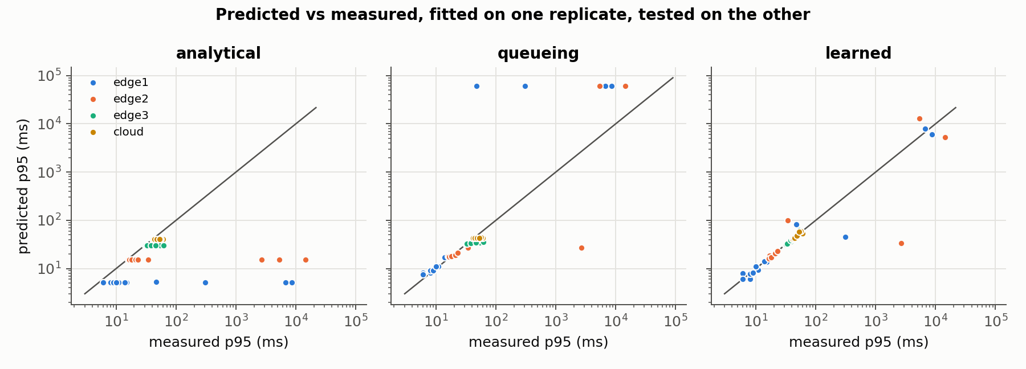
IV · RESULTS
Dataset and the Learned Predictor vs Analytical Formula
Three latency models, each scored on replicates it was not fitted on
Dataset and models
▸ Dataset: 150 cells, 450 rows of 30 s windows (4 grid replicates + 2 deployment rounds)
▸ Analytical: RTT + size/bandwidth, no load term
▸ Queueing (M/M/1): RTT + s/(1−u), s fitted = 2.4 ms
▸ Learned: RTT + gradient-boosted trees on utilization, players, cores
▸ Fit on one replicate, test on the other: median abs error 5.8 / 1.8 / 0.9 ms (analytical / queueing / learned)
▸ Fit on both, test on two held-out replicates: 6.9 / 2.2 / 1.1 ms; F1 at 50 ms 0.00 / 0.60 / 0.86
▸ Held out, learned vs queueing is within noise (95% interval -4.2 to +0.1 ms)
Notes:
The dataset is the artifact: every row is a measured window, not a formula output. The first error line fits on one replicate and tests on the other. The second fits on both and tests on two more replicates measured hours later and never used in a fit. The ranking holds there, but learned vs queueing is not a significant difference on those 50 cells. F1 is for the decision 'will this node break 50 ms at this load': the analytical model never predicts a violation, so its accuracy looks fine and its F1 is zero. Source: 08-results 8.4.

Slide 12
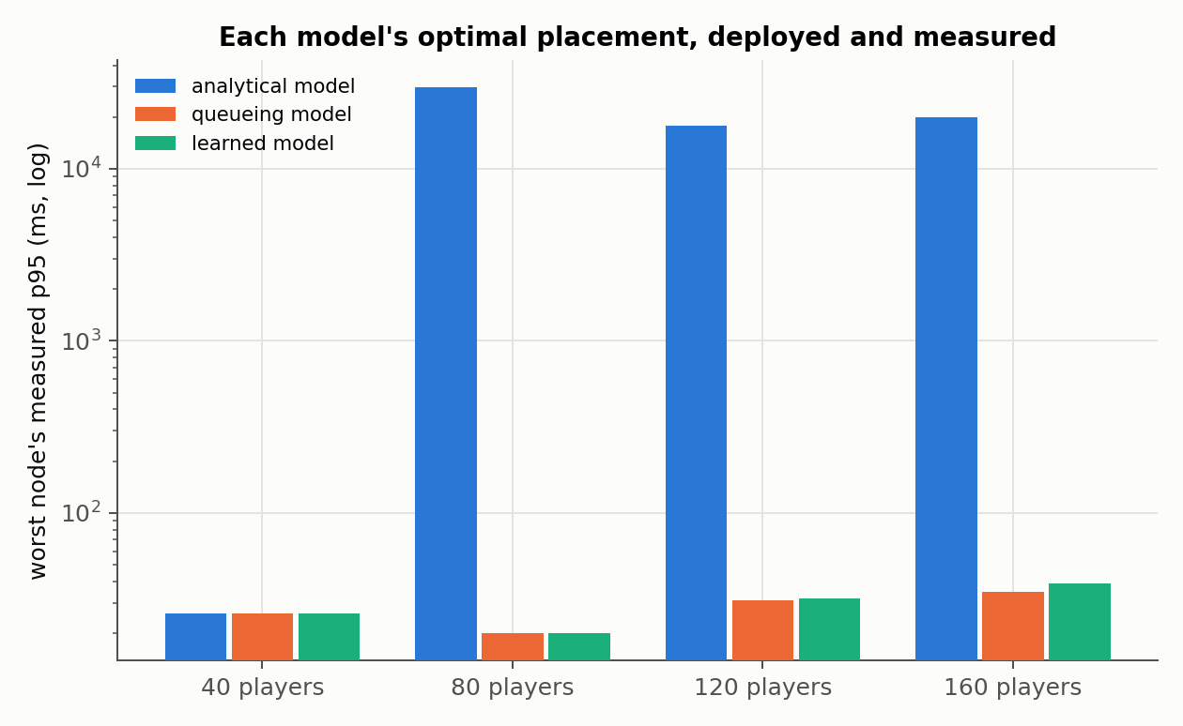
IV · RESULTS
Placement Algorithms Compared on Worst-Player Latency
Each model's optimal placement deployed for real, all nodes loaded at once
Worst player's measured p95, round 1 / round 2
▸ 40 players: all three 26 / 16 ms
▸ 80: analytical 29.9 / 28.2 s · queueing 20 / 20 ms · learned 20 / 20 ms
▸ 120: analytical 17.8 / 18.7 s · queueing 31 / 37 ms · learned 32 / 32 ms
▸ 160: analytical 20.0 / 28.3 s · queueing 35 / 40 ms · learned 39 / 55 ms
▸ Graded by its own formula, as a simulator would, the load-blind placement looks best (5–15 ms)
▸ Deployed: 500–1500x worse; the overloaded edge1 held only 43–71 of its 80–100 players
▸ Learned predicts best, but places almost the same as fitted M/M/1
Notes:
This is the end-to-end test. For 40 to 160 players in matches of 10, each model's brute-force optimum was computed and then deployed on the testbed with every loaded node running at once. The clock grades the models, not the models themselves. The analytical model predicted 5-15 ms for all of these. Be careful with the last bullet: the learned model does not place better than the queueing model here. Source: results/placement/deployments.csv, 08-results 8.5.

Slide 13
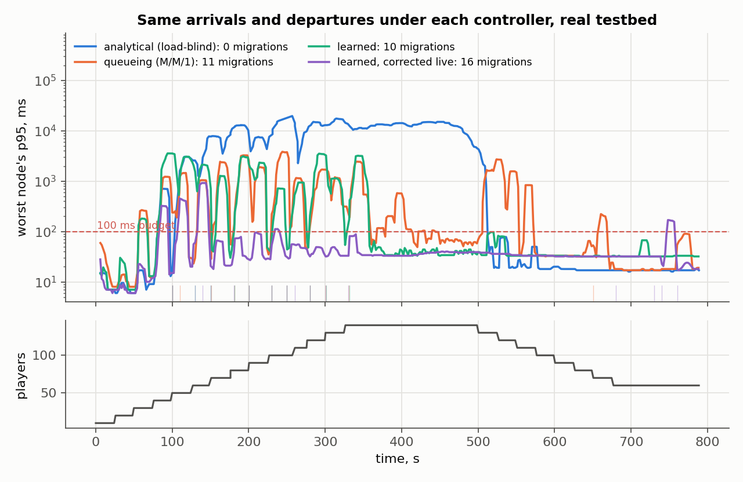
IV · RESULTS
Live Controller on the Real Testbed
Same 13-minute schedule of players under each controller; one match moved at most every 10 s
Worst-off players, median of 3 runs each
▸ Load-blind formula: 1.1 s (76 ms to 4.5 s), over 100 ms 53% of the time, never moves a match
▸ Queueing (M/M/1): 99 ms (72 to 166), 50%: loads edge2 to 80 players, past its knee, in every run
▸ Learned model: 39 ms (33 to 47), 33%: stops edge2 at 70 and uses edge3, in every run
▸ Learned, corrected live: 33 ms (32 to 34), 8%, with 15 moves: more caution, fewer bad moments
▸ 10–16 moves for the load-aware controllers (load-blind: 0), 6 s to reconnect
▸ Learned's remaining time over budget: edge1 at 40 players, just below its knee
Notes:
This is the placement result in closed loop. A controller re-runs placement every 10 s on live measurements and moves whole matches. Each controller ran three times; the chart shows each one's median run. The load-blind range is wide because in one run edge1's players most likely timed out, which lowered the latency of those left. Every run sees exactly the same arrivals and departures; new matches land on the nearest node, as a distance-based matchmaker would do. The formula sees 5 ms on edge1 at any load, so it never acts. Source: docs/09-live.md 9.6, results/live/.

Slide 14
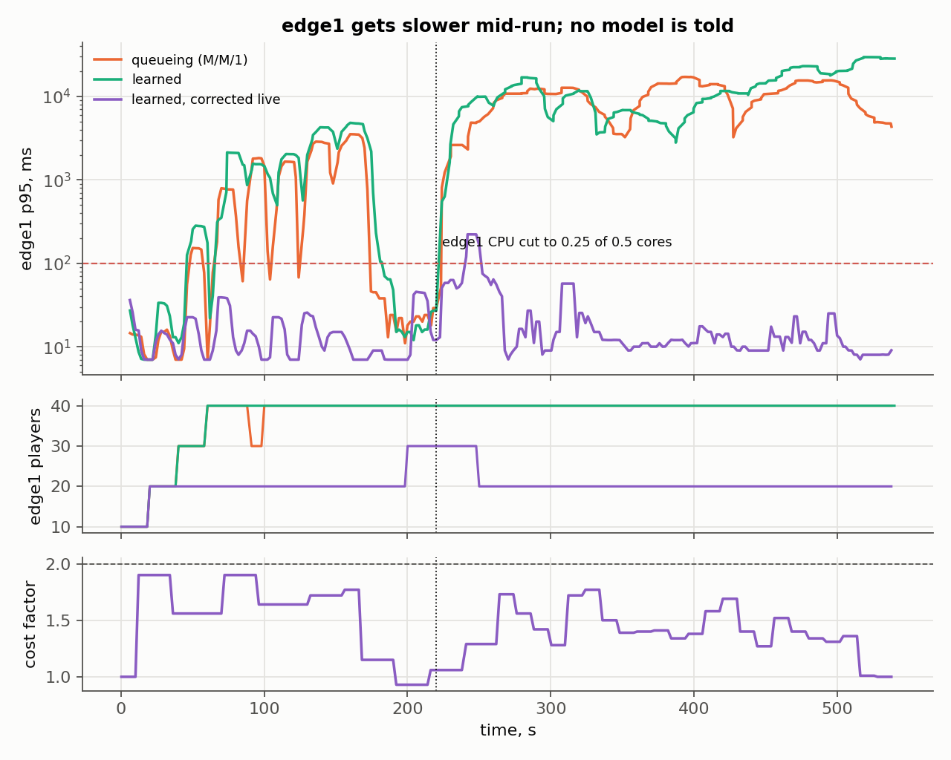
IV · RESULTS
A Node Gets Slower and No Model Is Told
edge1's CPU cut from 0.5 to 0.25 cores at 220 s; the controller only sees measurements
After the cut
▸ Queueing and offline learned keep 40 players on the slowed edge1 (6 runs)
▸ They are over 100 ms 99–100% of the time after the cut
▸ Corrected live, with memory: 6% after the cut (4 to 13%, 3 runs), 8–12 moves
▸ Caveat: it learns from players logging in, so in 2 of 3 runs edge1 was already near empty at the cut
▸ Clean detection: 30 players at the cut, a match moved off 27 s later
Notes:
The node got slower and nothing told the controller: a noisy neighbour, a throttled host, a smaller VM. The offline model keeps using the curve measured at 0.5 cores. The live-corrected model compares every 10 s window with its prediction, estimates how much more each player now costs edge1, and remembers loads it measured over budget for 5 minutes. Be honest if asked: the memory was added after a first run in which the model noticed, then forgot and moved a match back. And the correction also learns from the seconds in which a new match is logging in, so in two of its three runs it already distrusted edge1 and had moved almost everyone off before the cut. Only one run, with 30 players on edge1 at the cut, shows it detecting the change: it moved a match off 27 s later. Source: docs/09-live.md 9.6.

Slide 15
V · CONCLUSION AND FUTURE WORK
Limitations
Scope
▸ One host: bootstrap intervals cover cells, not whole replicates (only four)
▸ Capacities and delays were chosen to create the trade-off
▸ Bots, not humans; hostile mobs disabled
▸ A move is a reconnect (about 6 s), not a state handover
▸ Live: 3 runs per controller, wide ranges; direction, not effect sizes
Measurement
▸ Knees are unstable: replicates differ 6–80x there
▸ Host power mode changes capacity 2–3x: all clean runs in Performance mode
▸ edge3 and cloud never pushed past their knee (100-player ceiling)
▸ Bandwidth term negligible: links carry no background traffic
Notes:
Every number on the previous slides comes with these limits. The power-mode effect is the most interesting one: with nothing else changed, the laptop's Balanced mode made every node 2-3x slower and moved edge1's knee from 50 players to under 20. No latency formula sees that; a measured model does. Source: 08-results 8.6.

Slide 16
V · CONCLUSION AND FUTURE WORK
Conclusion and Future Work
What this work shows
▸ The load-blind formula is right only below a node's saturation point
▸ Above it the error is seconds: 18–30 s worst-player latency, deployed
▸ Load-aware placement keeps the same players at 16–55 ms
▸ Live, 3 runs each: the formula never moves a match; the learned controller's median is 39 ms
▸ Utilization alone is not enough: live, M/M/1 overloaded edge2 in all 3 runs, the learned model in none
Future work
▸ More replicates on a dedicated host, intervals on the knees
▸ State handover instead of reconnect; place new matches with the model
▸ Jitter, loss and bandwidth caps; mob AI back as a second load source
Notes:
Close on the deployed and live numbers, they are the strongest evidence. Repo, raw data, dataset and the live dashboard: github.com/ankamteja/latency-aware-edge-game-placement.

