Slide 1
Final Report
Group Members:
Anupama Kannan,
Brandon Alcaraz,
Miranda Montroy,
Samuel Kim,
Thomas Cho

Slide 2
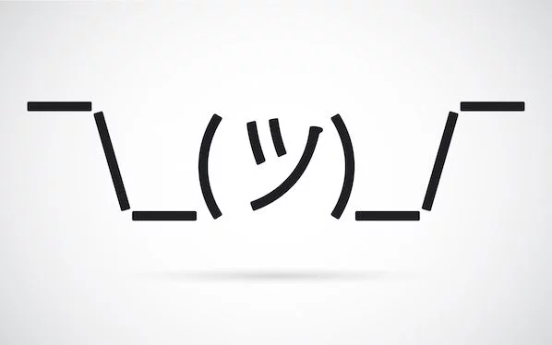
Team Nickname:
Why Not

Slide 3
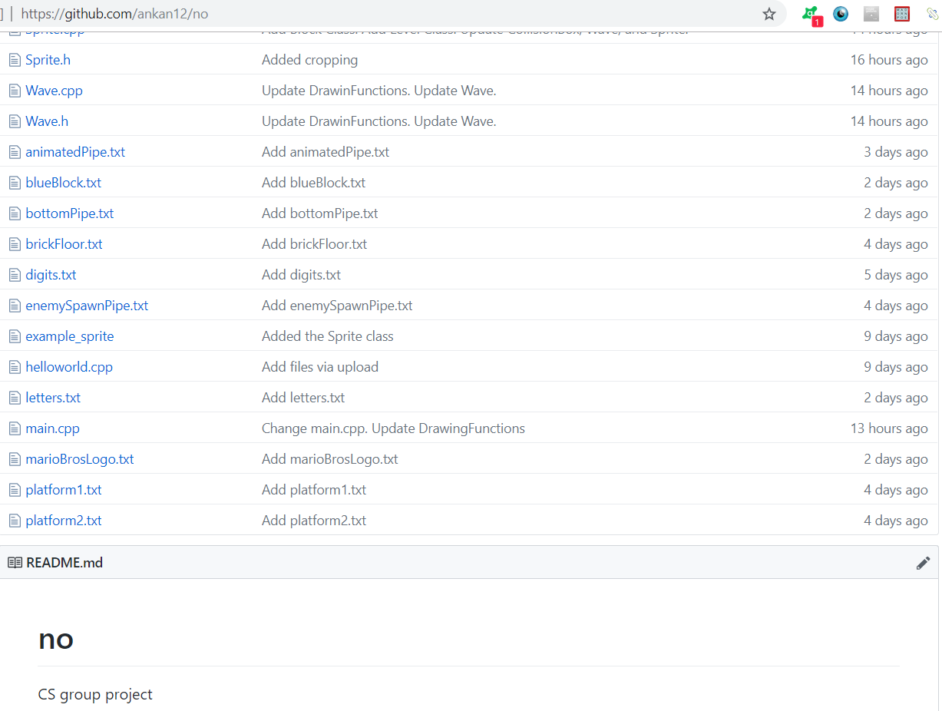
Git Repository:
https://github.com/ankan12/no
“Do you have an idea of what the project
should be named?”
“no.”

Slide 4
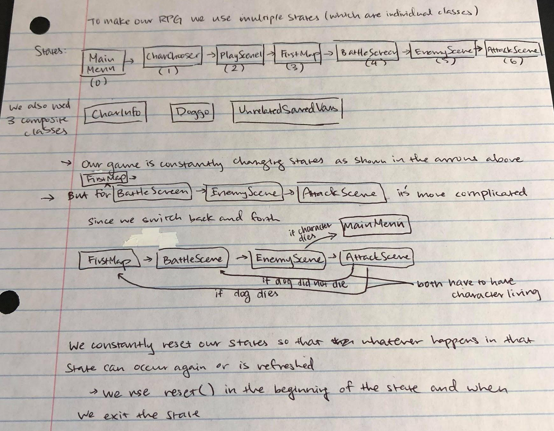
Anupama Kannan
Hometown: Fremont, California
Major and Why: Bioinformatics,
integration of 2 interesting fields
Interesting Fact: I’ve made a game before in AP Computer Science A!

Slide 5
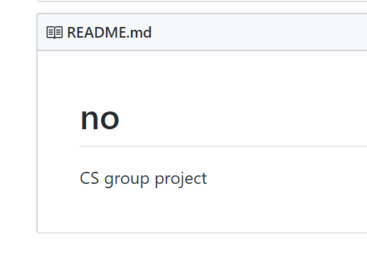
Anupama Kannan Roles
Mario sprite formation
Got images
User’s Manual
Git Repository managing

Slide 6
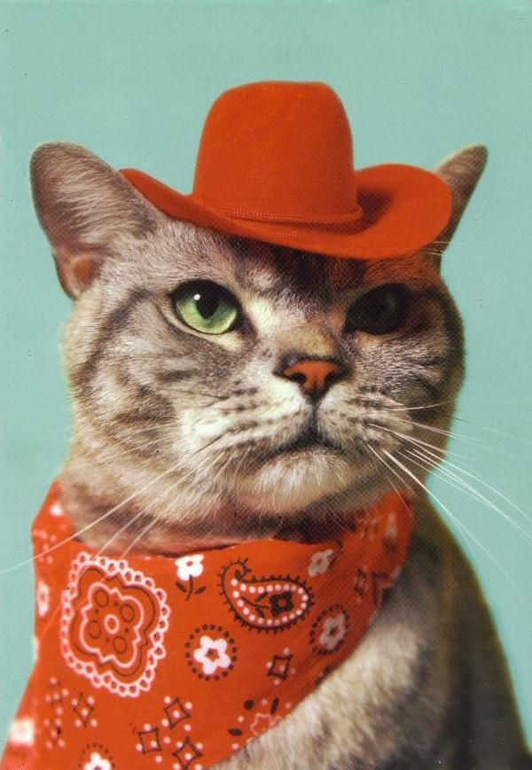
Brandon Alcaraz
Hometown: San Antonio, Texas
Major and Why: Computer Science, because I want to become a video game developer.
Interesting Fact: I play Collegiate Esports.

Slide 7
Brandon Alcaraz Roles
Game movements
Player and non-player
Helped with collision boxes
Debugging
Score storage
Wrote class for score access

Slide 8
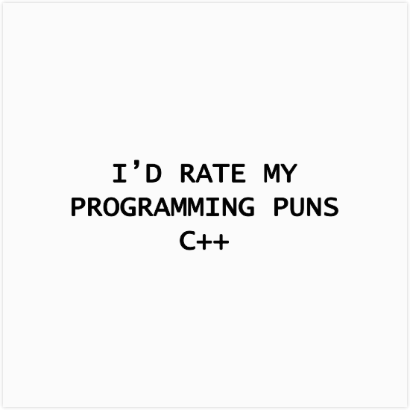
Miranda Montroy
Hometown: Spring, Tx
Major and Why: Computer Science, flexibility and integration of math and creativity
Interesting Fact: I can crochet and knit, and I once made an electronic dragon out out yarn and circuit.

Slide 9
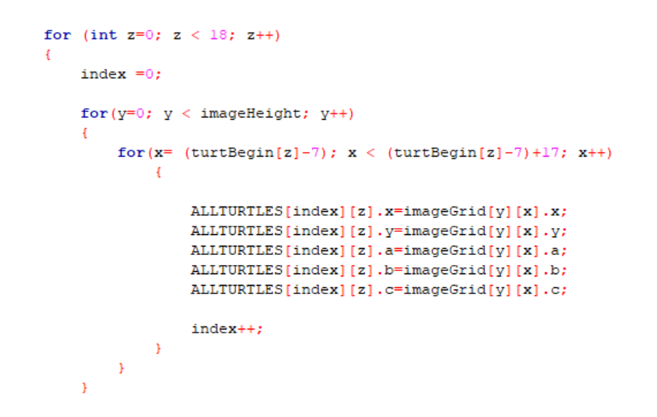
Miranda Montroy Roles
Group Liaison
Enemy sprites
Image collection
Movement
PowerPoint

Slide 10
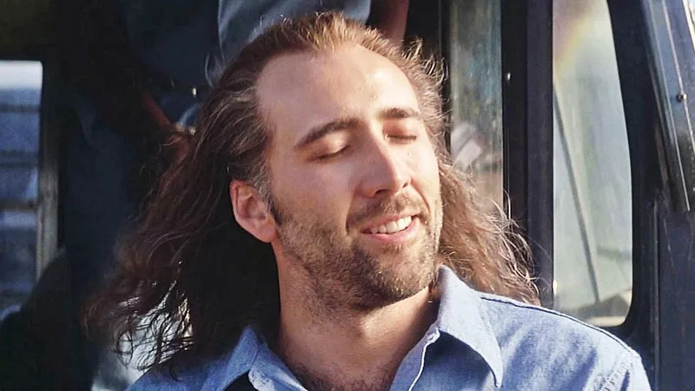
Samuel Kim
Hometown: League City, Texas
Major and Why: Computer Science, because I enjoy programming
Interesting Fact: My birthday, July 14, is the same as Nicholas Cage’s daughter’s birthday in Con Air.

Slide 11
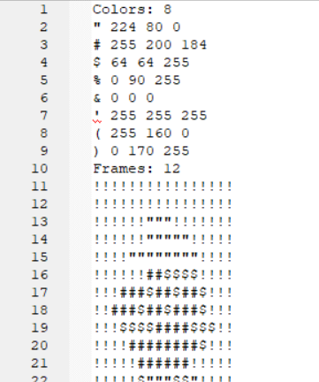
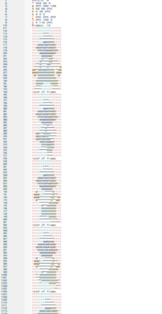

Samuel Kim Roles
Sprite finishing
Compiling images
Made class
Collision boxes
Creation
Image work
Letters and numbers
Freeze animation
Level Design
Wave
Made class for the bump

Slide 12
Thomas Cho
Hometown: Seoul, South Korea
Major and Why: Computer Science, because I love video games
Interesting Fact: I used to be a semi professional King of Glory player

Slide 13
Thomas Cho Roles
Sound
Finding
Linking to movement

Slide 14

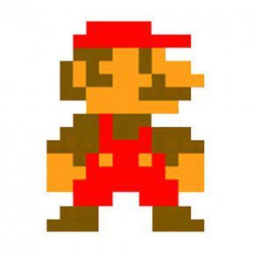

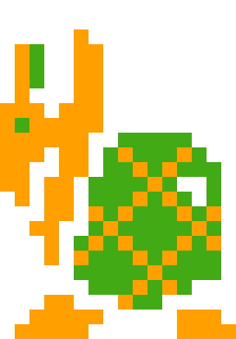
Demonstration

