Slide 1
Progress Report
Group Members:
Anupama Kannan,
Brandon Alcaraz,
Miranda Montroy,
Samuel Kim,
Thomas Cho

Slide 2
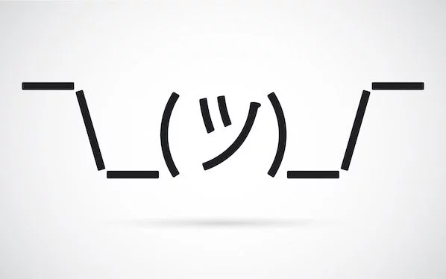
Team Nickname:
Why Not

Slide 3
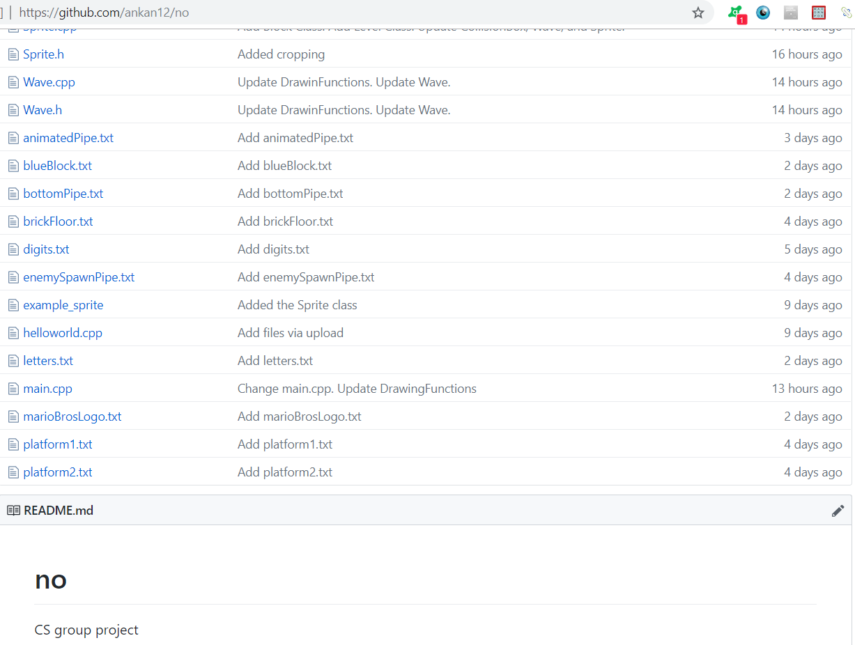
Git Repository:
https://github.com/ankan12/no
“Do you have an idea of what the project
should be named?”
“no.”

Slide 4
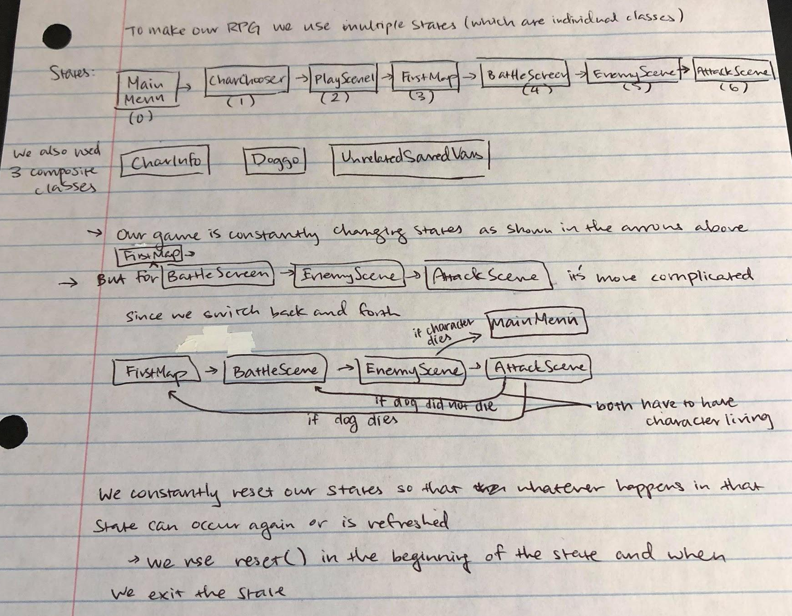
Anupama Kannan
Hometown: Fremont, California
Major and Why: Bioinformatics,
integration of 2 interesting fields
Primary Responsibility: SDL Drawing, Player Sprite
Interesting Fact: I’ve made a game before in AP Computer Science A!

Slide 5
Brandon Alcaraz
Hometown: San Antonio, Texas
Major and Why: Computer Science, because I want to become a video game developer.
Primary Responsibility: Game Physics/Mechanics
Interesting Fact: I play Collegiate Esports.

Slide 6
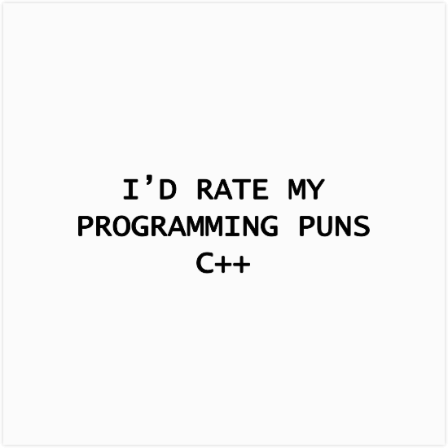
Miranda Montroy
Hometown: Spring, Tx
Major and Why: Computer Science, flexibility and integration of math and creativity
Primary Responsibility: Group liaison, SDL drawing, enemy sprite
Interesting Fact: I can crochet and knit, and I once made an electronic dragon out out yarn and circuit.

Slide 7
Samuel Kim
Hometown: League City, Texas
Major and Why: Computer Science, because I enjoy programming
Primary Responsibility: SDL Drawing
Interesting Fact: My birthday, July 14, is the same as Nicholas Cage’s daughter’s birthday in Con Air.

Slide 8
Thomas Cho
Hometown: Seoul, South Korea
Major and Why: Computer Science, because I love video games
Primary Responsibility: Game Sound Effects
Interesting Fact: I used to be a semi professional King of Glory player

Slide 9
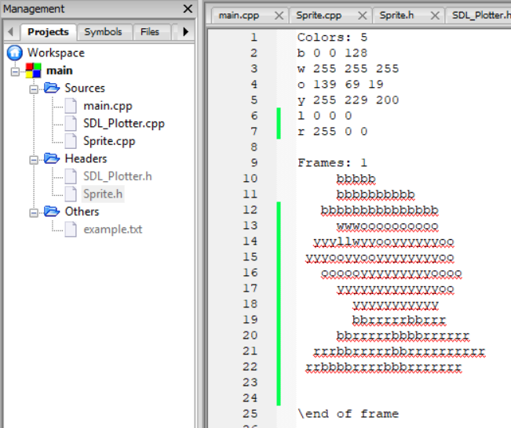
Progress:
Basic Collision Boxes
Drawing Functions
Number Drawing
Sprite Class for Drawing Characters
High Scores Class
Mario Sprite
Turtle Sprite
Background Sprite

Slide 10
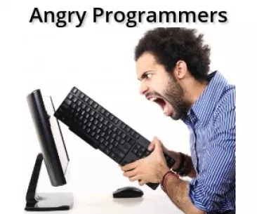
Areas of Concern:
Movements of Characters
Functioning SDL
Git
Animation

