Slide 1

Healthcare Analytics for Doctor Visits
Student Name: Ankana Paul
University: Techno International Batanagar

Slide 2

PROBLEM STATEMENT
Healthcare data contains information about health conditions, healthcare support, and doctor visits.
Problem: Identify patterns associated with doctor visits and understand how factors such as illness, reduced activity, health status, age, income, gender, and chronic conditions relate to visit frequency.

Slide 3
Project Description
This project performs exploratory healthcare analytics on a dataset of 5,190 records. It examines doctor-visit frequency using descriptive statistics, visualizations, group comparisons, correlation analysis, and an exploratory Random Forest regression baseline.
The analysis is intended for educational understanding of patterns in the supplied dataset, not for clinical diagnosis or decision-making.

Slide 4

WHO ARE THE END USERS?
Students learning healthcare analytics and data analysis
Data analysts exploring healthcare utilization patterns
Academic instructors demonstrating exploratory data analysis
Researchers using the dataset for educational pattern analysis
Primary end user for this DIY project: students/instructors in an academic setting.

Slide 5

Technology Used
  Python 3
  pandas – data loading, cleaning and aggregation
  NumPy – numerical analysis
  Matplotlib – visualizations
  scikit-learn – exploratory Random Forest regression
  Jupyter Notebook – reproducible analysis
  python-docx / python-pptx – project documentation

Slide 6
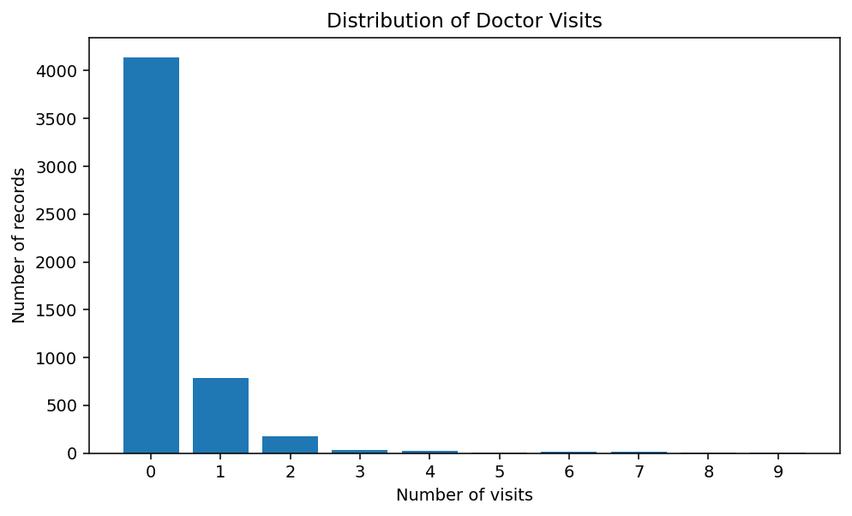
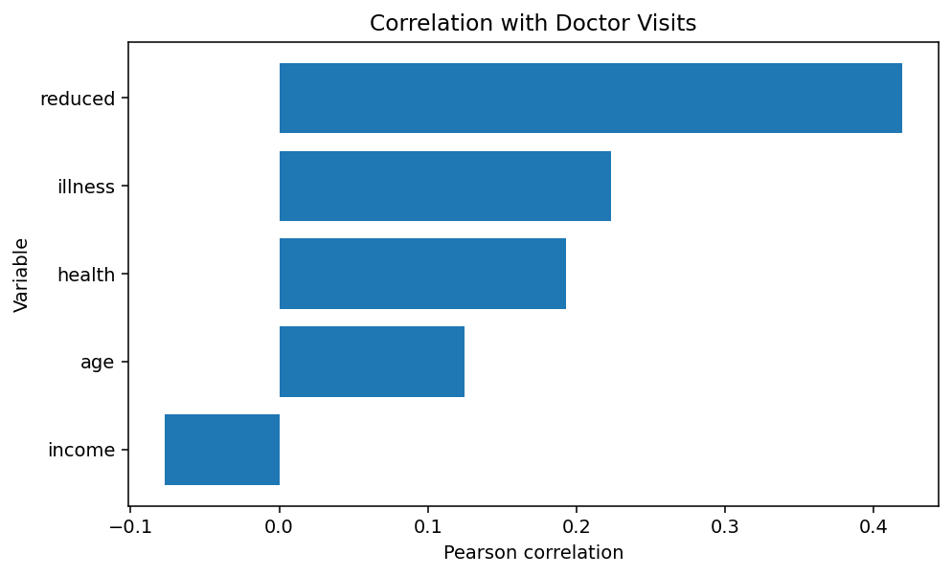
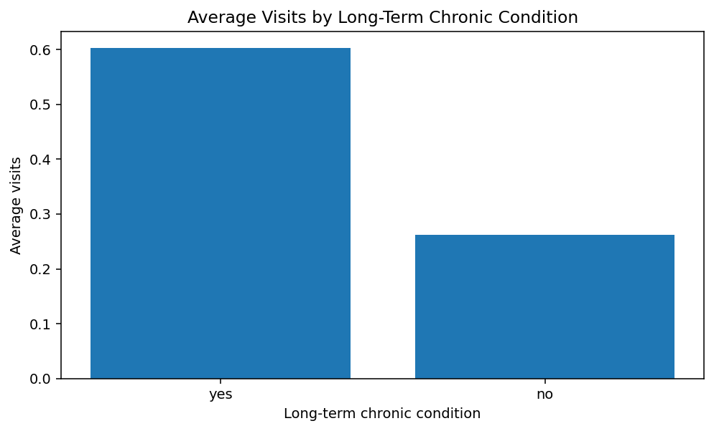
RESULTS
Key results: 79.8% of records have zero visits;
`reduced` has the strongest positive main numerical correlation (0.419);
long-term chronic = yes has 0.603 average visits vs 0.262 for no.
GitHub Repository: https://github.com/ankana-paul/Healthcare_Analytics_Doctor_Visits

Slide 7
Thank you

