Slide 1
Paravirtualization under Xen
  Anshuman Kanetkar

Slide 2
Contents
Objectives
Xen Overview
Xen Architecture
Guest OS requirements
The Target Guest Kernel
Implementation Constraints
Development Environment/Setup
Guest Kernel Modifications
Conclusions

Slide 3
Objectives
Study Xen architecture and hypercall interface
Study Guest Os requirements for paravirtualization under Xen
Port an OS kernel from scratch to run as a Domain U Guest under Xen

Slide 4
Paravirtualization Overview
Different from ‘full virtualization’
  Guest OS’s are aware of the hypervisor,
  use a system call interface to communicate with it
Performance benefits
  ‘Fast path’ to I/O devices through the hypervisor’s virtual bus
  Fast inter-domain communication

Slide 5
Xen Overview
Xen is a hypervisor for Intel x86 and other platforms
  Supports paravirtualized guest OS’
  On x86 platform, runs unmodified Guest OS’ using Intel VT extensions
  Large address space support
    Intel ‘PAE’ -- Physical Address Extensions -- compatibility
  Remote Monitoring API for Guest OS’

Slide 6
Xen Architecture
Xen Hypervisor kernel executes in privileged mode
  Ring 0 on Intel x86 platform
Hypervisor provides secure partitioning of system resources (memory, cpu, I/O)‏
Guest OS’ request privileged operations using ‘hypercall’ interface
  Guest kernel in Ring 1, user-mode processes in Ring 3
Requires a ‘privileged’ OS kernel to provide device driver support + administration console
  Domain 0
Unprivileged Guests have to use Xen abstractions
  Domain U

Slide 7
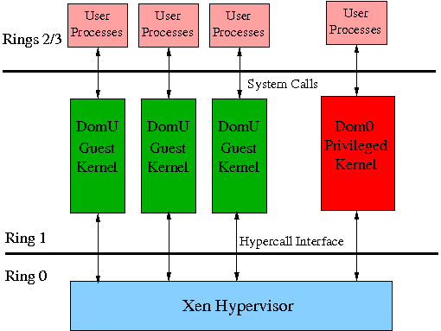
Xen Architectural Diagram

Slide 8
Xen Hypercall Interface
Guest OS’ use hypercalls for privileged operations
  A hypercall is a Software interrupt from Ring1->Ring0
Hypercall Categories
  CPU Operations
    Hypervisor scheduler interface
    CPU state information
    Timer
  Memory
    Paging (directories/tables)‏
    Cache/TLB Flush
    Segmentation (GDT/LDT/descriptors)‏
  I/O
    Physical/Virtual Interrupts
    'Event Channel’ abstraction for I/O channels

Slide 9
Xen Memory Virtualization
Page frame allocation performed by Xen kernel
Each Guest Domain allocated Physical Page frames
  'Real' page frame addresses are called 'Machine Addresses'
  No. frames alloc'ed == Phys. Mem size of guest domain
  Xen provides mach->phys and phys->mach translation tables
Guest provided 'illusion' of contiguous physical page frames
  This contiguous range of addresses are called 'Pseudo-Physical Addresses'
  Guest performs translation between machine and pseudo-physical addresses
  Guest Page Tables contain mapping from virtual addresses to machine-addresses

Slide 10
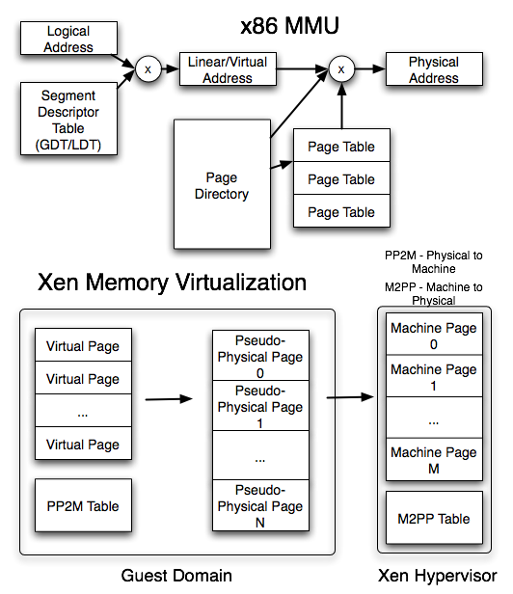
Xen Memory Virtualization (Diagram)‏

Slide 11
Xen Memory Virtualization (cont'd)‏
Guest is started with Paging Enabled
  Initial page-directory maps lower 4MB of phys.memory
  start_info points to mach<-->phys translation tables
Xen supplies an initial GDT
  Default flat 4GB kernel/user segments
Xen Kernel mapped into top 64MB area of domain's virtual memory map

Slide 12
Xen Memory Models
Xen supports three models
  Read-only page tables
    All Guest Page tables are always read-only
    Any Page Table/Directory updates have to be validated by the hypervisor
    User/Supervisor mode distinction handled transparently by Xen kernel
  Writable page-tables
    Process allowed to write to page-tables
    Xen automatically updates page-map
    Requires fewer updates to OS code

Slide 13
Xen Memory Models (cont'd)‏
  Shadow Page-tables
    Guest Kernel maintains its own set of writable page-tables.
    Xen has own copy
    Periodic sync between two copies
Design Choice: Read-only page table mode
  Safer choice for prototype implementation
  Can be made efficient by batching MMU updates

Slide 14
Starting a Guest Domain under Xen
Domain configuration file
  Contains resource specifications, kernel image etc.
Domain creation/statusdestruction
  sudo xm create <domain_config>
  sudo xm list
  sudo xm destroy
Xen ‘Domain Builder’ -- specialized loader for domains
  Builds initial domain memory map
  Transfers control to guest kernel as a Ring-1 process

Slide 15
Criteria for Kernel Paravirtualization
One Guest OS runs in privileged mode (Domain 0)‏
  Privileged access to physical hardware
Other Guest OS’s run in ‘Domain U’
  Use hypercall interface and Xen abstractions for privileged operations
Guest can run with or without PAE support
  PAE supports > 4GB physical memory
Modifications restricted to architecture-dependent parts of the kernel
  Arch-dependent code should be modular

Slide 16
The ‘Pebbles’ Guest Kernel
Small-footprint monolithic kernel
  Supports multi-tasking, paging, console I/O
Derived from CMU CS410 ‘Pebbles’ kernel
Unmodified Operation
  Kernel runs in Ring0
  Processes in Ring3
  Direct Access to
    System Page tables
    I/O Ports
    Interrupt Vector Table

Slide 17
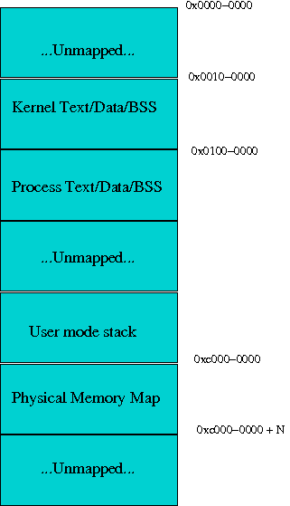
Pebbles Unmodified Memory
Map (Diagram)‏

Slide 18
Modifications required for Paravirtualization
Boot-up
  Kernel binary should contain an ELF header, containing parameters for Xen
  Initial stack set up
  Memory allocator set up
Exception Handling
  Set up virtual trap table for exception/system call handlers
Memory
  Page table controls
  Task virtual memory setup
  Xen-aware Task switching
I/O
  Console I/O Ring buffer/event channel
Timer
  Bind to virtual timer IRQ

Slide 19
Project Constraints
The implementation will have the following constraints:
  Non-PAE mode
    Guest Kernel is non-PAE
    Xen version 3.1.4 (supports non-PAE)‏
  No framebuffer support
    Only serial console will be supported
  Read-only page tables
    Xen supports a more efficient 'writable page table' mechanism

Slide 20
Development Environment/Setup
Xen version 3.1.4
Domain 0 – Linux kernel 2.4.18
Debugging
  gdbserver/gdb stub provided with Xen tools
  Guest Kernel modified to allow debugger to 'hook' into kernel at boot time
Xen Daemon/Tools
  Xend – Xen Daemon
  Xm – xen control interface

Slide 21
Modifications to Boot-up sequence
Unmodified Operation
    Boot-up code supported Multiboot spec
Xen Boot Sequence
    Add an ELF Header, with key-value pairs for Xen 'Domain Builder'
    Setup initial stack, 'start_info' struct passed by Xen
    Setup low-mem memory allocator, parse command line
    Call kernel start routine 'kernel_main'

Slide 22
Modifications to Exception Handling code
Unmodified Operation
  Direct Access to IVT (Interrupt Vector Table)‏
Xen port
  Use set_trap_table hypercall to set up virtual IVT entries
  Exception handlers do not require any changes to entry/exit code

Slide 23
Modifications to memory manager
Changes to Kernel Page directory set up
  At boot time, only lower 4MB of phys. Memory is mapped
  Initial Memory Map:
    kernel image, data, BSS
    Xen Hypercall page
      Stubs for hypercall interrupt calls
    Xen data structures
      'start_info’ (Static, boot-time information)‏
        Physical to Machine Address map
        Initial Page directory
        ‘shared_info’
      ‘shared_info’ (Dynamic, run-time information)‏
        CPU state (timer/interrupts)‏
        Event Channel state
    Boot stack

Slide 24
Modifications to Memory Manager (cont'd)‏
Guest Kernel has to map all of physical memory into highmem
  Kernel Virtual Base: 0xC0000000 (i.e. @ 3GB)‏
Paging setup sequence
  Map phys. memory at virtual address 0xC0000000
  Page-tables allocated, zeroed, and marked read-only
  Page Directory Entry updated with new page table

Slide 25
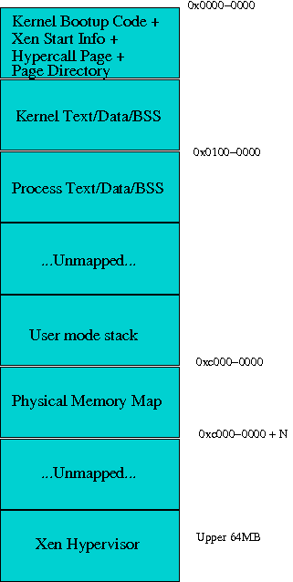
Pebbles Memory Map Under Xen (Diagram)‏

Slide 26
Modifications to Memory Manager (cont'd)‏
  All Page Map changes use hypercall 'mmu_update’
    Arguments to mmu_update
      Machine Address of target page’s Page-table or page-directory entry
      New value of PTE/PDE (has to contain a machine address)‏
    Features
      Can Batch multiple requests for efficiency
  MMU Request Buffering
    A 2K request buffer was implemented for batching requests
      Queue is flushed ‘automatically’ when full
      Page map code also forces queue flush at appropriate times

Slide 27
Modifications to Memory Manager (cont'd)‏
Task Setup
    Task Page directory setup
      New page directory base installed using mmuext_op hypercall
    Page Mapping Operation changes
        All physical addresses are translated to machine addresses for updates
        The mmu_update queue is used to batch updates
        Page Table read operations translate machine addresses to physical/virtual addresses
    Task Switch
      The stack_switch hypercall is used to update the Xen kernel's virtual TSS

Slide 28
Modifications to Kernel Timer Handler
Xen provides a virtual Timer IRQ
Guest OS registers an ‘Event-Channel’ port with the virtual timer IRQ
Xen Delivers timer notifications via ‘hypervisor_callback’
Event Demultiplexing mechanism in ‘hypervisor_callback’ to dispatch the interrupt
Xen maintains clock time, and 'real-time' i.e. time elapsed since boot
  Guest OS can read values from shared Xen data structures

Slide 29
Console I/O Modifications
Xen provides a Console 'Event-Channel' abstraction
  Keyboard handler can be bound to a virtuall interrupt
  Characters read off ring-buffer stored in Xen shared area
  Console output uses a 2K ring buffer for serial output
Only Serial output supported
  No direct framebuffer manipulations

Slide 30
Conclusion
Studied Xen Architecture and paravirtualization mechanisms
Modified an existing OS kernel to use Xen paravirtualization interface
Was able to boot the modified OS kernel under a Xen environment
  Kernel was able to set up its exception handlers – page fault and GPF handlers were tested
  Kernel was able to set up its data structures and virtual memory map
  User-mode processes were created, and system calls such as fork/exec etc. were tested
  Timer handler was modified to support Xen timer notifications
  Console driver was modified to support Xen serial Console

Slide 31
References
Xen and the Art of Virtualization
  www.cl.cam.ac.uk/research/srg/netos/papers/2003-xensosp.pdf
Xen Architecture Reference
  http://wiki.xensource.com/xenwiki/XenArchitecture?action=AttachFile&do=get&target=Xen+Architecture_Q1+2008.pdf
Xen Users Manual
  http://www.xen.org/files/xen_user_manual.pdf
Xen Developers Manual
  http://www.xen.org/files/xen_interface.pdf
Porting Minix to Xen
  http://www.google.com/url?sa=t&source=web&ct=res&cd=1&url=http%3A%2F%2Fchoices.cs.uiuc.edu%2Fcache%2FReport.pdf&ei=Os6ASfaxC9CCtweoiKXwCw&usg=AFQjCNFZAnQcOiUGPKSIFJwSD0t2_G-ldA&sig2=-8fLD_k6WmbTOZrLN701cA

