Slide 1
HR Analytics Project
End-to-end dashboarding using SQL, Tableau, Power BI
Presented by : Ankan Das
Social Links : LinkedIn, Project Portfolio

Slide 2
Project Overview
Objective: Provide HR leaders with interactive dashboards
Goal: Visualize key HR metrics like headcount, salary, tenure, demographics
Outcome: Data-driven decision-making through clear insights

Slide 3
Data Description & SQL Processing
Raw HR data cleaned and transformed using SQL
Aggregations (e.g. headcount by year) and summaries computed USING GROUP BY & WINDOW FUNCTIONS IN SQL.
Clean data serves as input to Tableau and Power BI

Slide 4
Key Metrics & KPIs
People Count: 161
Average Salary: $54.23K
Avg. Leave Balance: 16.42 days
Employees with Leave > 20 days: 41

Slide 5
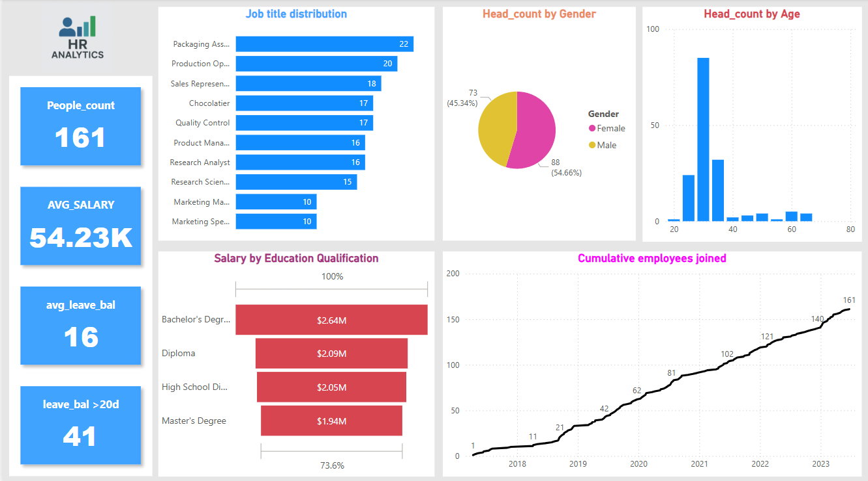
Dashboard 1: Power BI Overview

Slide 6
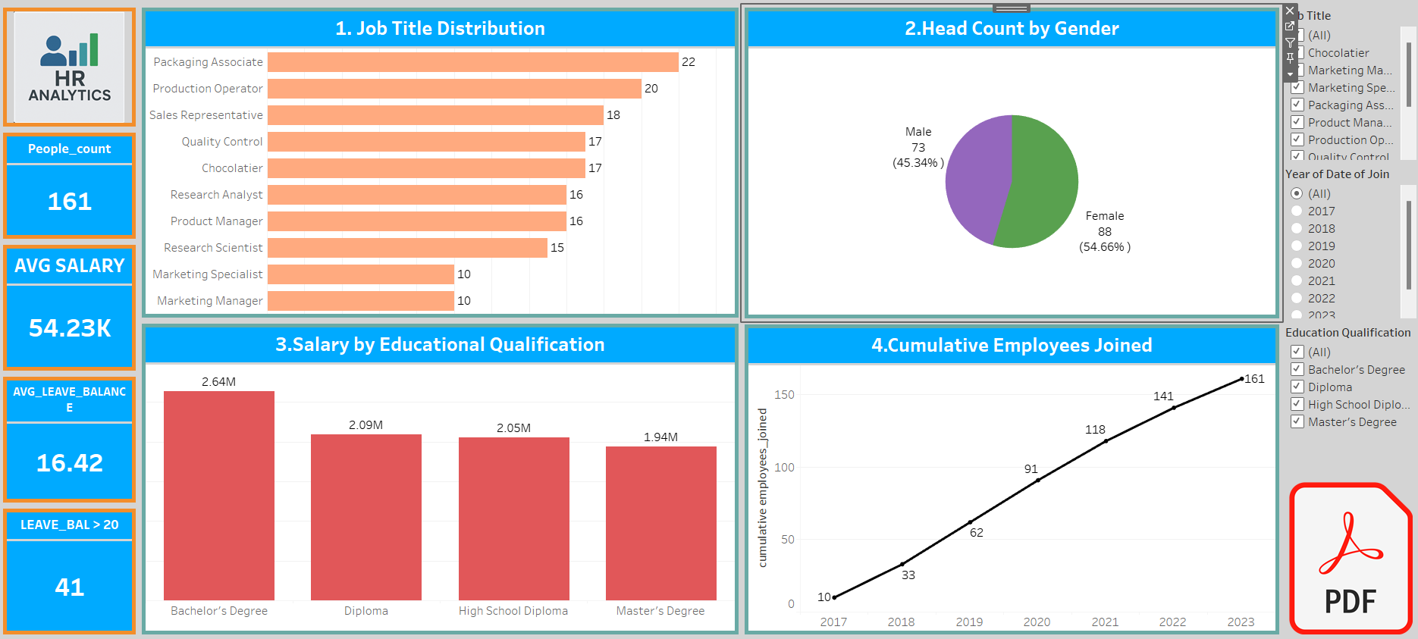
Dashboard 2: Tableau Overview

Slide 7
Job Title Distribution
Top roles: Packaging Associate (22), Production Operator (20), Sales Rep (18)
Packaging Associate alone ~13.7% of workforce

Slide 8
Gender & Age Distribution
Gender: Female 54.66%, Male 45.34%
Age: Majority 25–35 years; young workforce

Slide 9
Salary by Education
Bachelor's Degree: $2.64M
Diploma: $2.09M
High School: $2.05M
Master’s Degree: $1.94M

Slide 10
Employee Growth Trend
2017: 10 → 2023: 161 employees
Steady hiring growth post-2018

Slide 11
Dashboard Tools Comparison
Tableau: rich custom visuals, great interactivity
Power BI: fast, Microsoft integration, bold KPIs
Both tools turn raw data into insights

Slide 12
Insights & Recommendations
Retain critical roles (e.g. Packaging Associate)
Develop young workforce with training
Promote inclusive culture via gender balance
Scale planning with steady growth

Slide 13
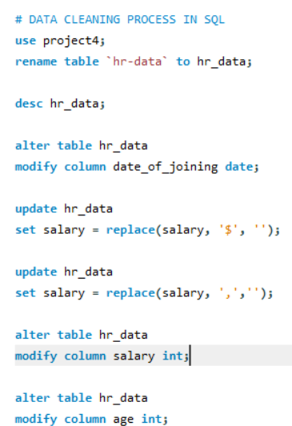
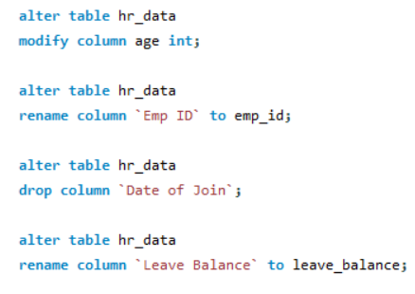
SQL DATA CLEANING QUERIES

Slide 14
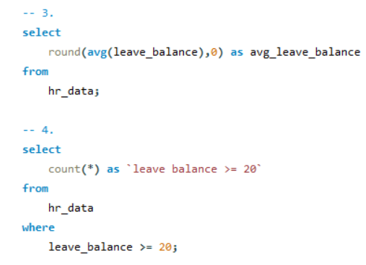
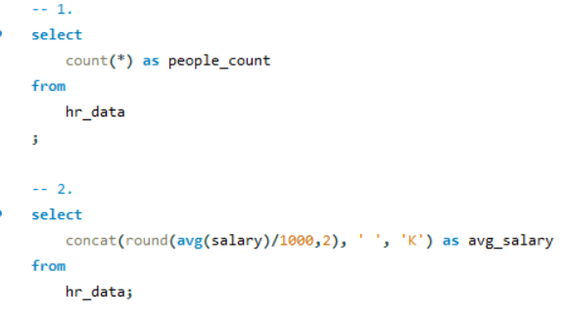
SQL KPI VISUAL QUERIES

Slide 15
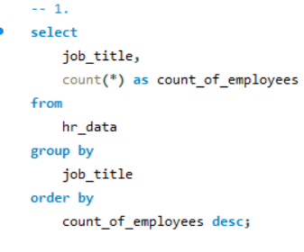
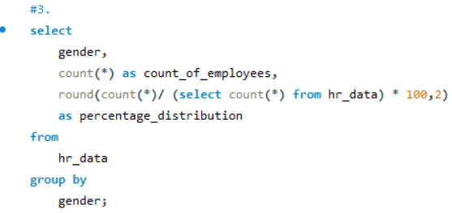
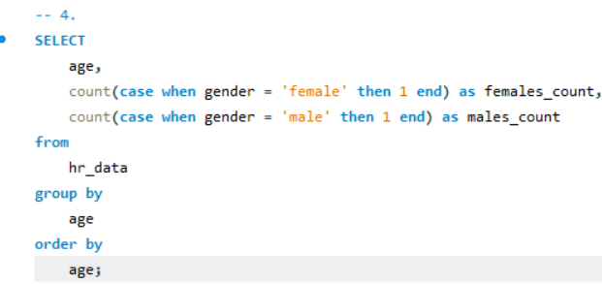
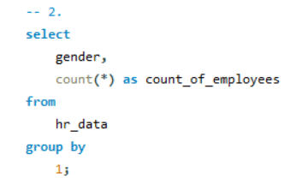
SQL DASHBOARD VISUALS

Slide 16
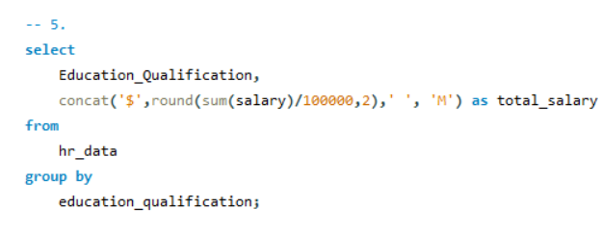
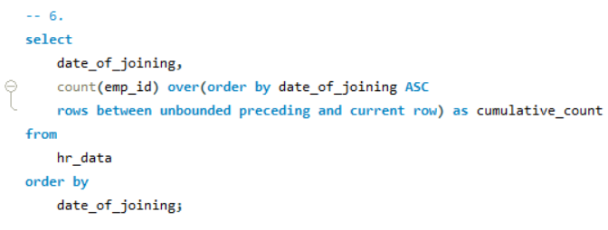
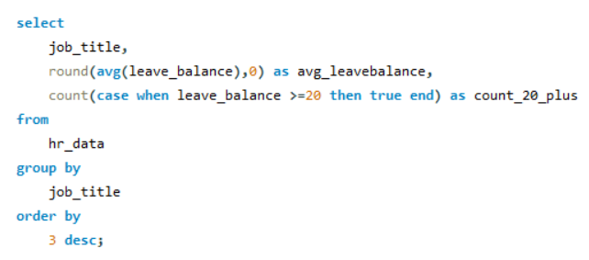

Slide 17
Conclusion
SQL + Tableau + Power BI → insights
HR leaders get fast, data-backed decisions
Project shows power of data-driven HR

